Slide 1

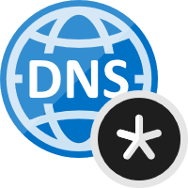
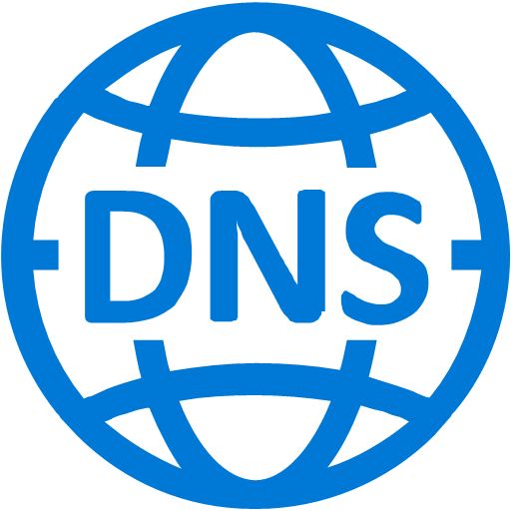











Network Design – Private Endpoint with On-Prem workload using DNS forwarder
Azure Private DNS Zone for Key Vault:
privatelink.vaultcore.azure.net
A record for kv1 added manually
Received Query:
kv1.privatelink.vaultcore.azure.net
Response: 10.2.0.4
Authoritative DNS
Received Query: kv1.vault.azure.net
Response:(CNAME)
kv1.privatelink.vaultcore.azure.net
VNet link:
Allows to query the private IP from private DNS zone
5
4
Spoke VNet – 10.2.0.0/16
Azure Provided DNS
168.63.129.16
Hub VNet – 10.0.0.0/16
6
vn-hub-gwyexprt
vn-spoke-pep
On-Premise
vn-spoke-app 10.1.0.0/16
sn-app – 10.1.0.0/24
Subnet – 10.0.0.0/24
Subnet – 10.2.0.0/24
sn-pep
DNS Query: kv1.vault.azure.net
Private connection to kv1.vault.azure.net - 10.2.0.4
NIC with Private IP from the Subnet is created & assigned to Key Vault
1
Private Peering
VNet Peering
kv1.vault.azure.net
NIC
VM
Private Endpoint NIC
10.1.0.4
8
ExpressRoute
7
Response: (CNAME)
kv1.privatelink.vaultcore.azure.net
Address: 10.2.0.4
Virtual Network Gateway
10.2.0.4
10.1.1.4
DNS Forwarder
10.0.1.4
10.0.1.5
NIC
Legend
2
3
Conditional Forwarder for vault.azure.net to 10.0.1.4/5
Server level forwarder to 168.63.129.16 Azure provided DNS
DNS traffic
Private connection

Slide 2

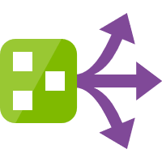


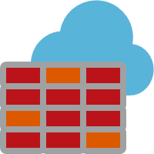



Network Design – Azure Firewall with Service Endpoint
Spoke VNet – 10.3.0.0/16
Hub VNet – 10.0.0.0/16
vn-spoke-sep
vn-hub-firewall
Route Filters
Subnet – 10.3.0.0/24 (Application)
Ext traffic routed to Azure Firewall
Subnet – 10.0.0.0/24
AzureFirewallSubnet
10.0.0.4 → 0.0.0.0/0
Route Table
Deny all traffic by default
VNet Peering
No access from internet
Traffic filtering rules allow outbound access to key vault
Internet
VM
AAD Service Endpoint
Azure Firewall
Key Vault
NIC
10.3.0.4
Integrated with Azure Monitor for logging & analyzing traffic
10.0.0.4
20.38.149.196
1. Outbound key vault allowed
2. Outbound Azure AD allowed
3. Outbound internet denied
Traffic goes through Microsoft backbone
network
NSG
KV Service Endpoint
Log analytics workspace
Comments:
Route with address prefix 0.0.0.0/0 & next hop type as NVA is associated with the Application subnet in the spoke VNet.
Key Vault Service Endpoint enabled only for AzureFirewallSubnet in the Hub VNet. It is disabled in the Spoke VNet. The Service Endpoint for Azure AD must be enabled on the Spoke VNet. Also, any other Azure service which has to be accessed, Service Endpoint must be enabled on the spoke VNet for them.
Service endpoint enabled for other Azure services on the Spoke VNet, will not route traffic through the next hop type in a route with the 0.0.0.0/0 address prefix.
Legend
Operations team route
Application route

