Slide 1
Azure Key Vault
Network Design

Slide 2
Network options
Network Firewall
Only allow specific Public IPs
Service Endpoint
Leverages Azure backbone network
Allows on-prem connectivity over ExpressRoute Public peering
Private Endpoint
Leverages private link
Assigns Private IP to PaaS resource
Allows on-prem connectivity over ExpressRoute Private peering

Slide 3
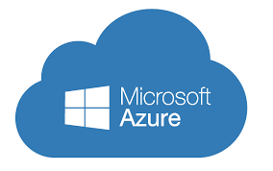

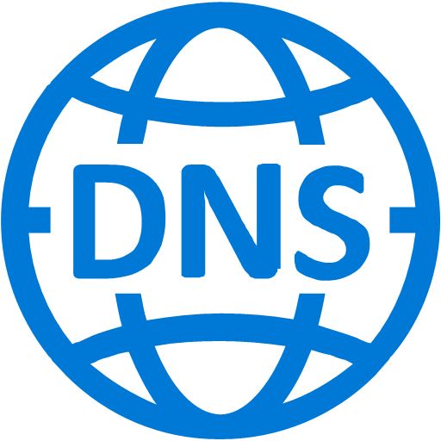




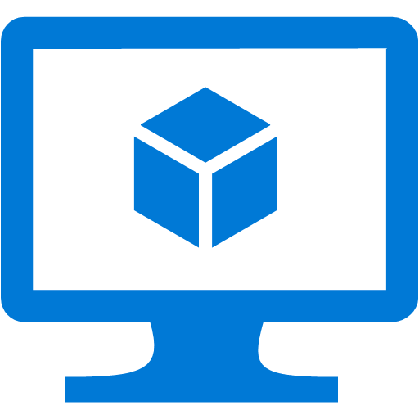



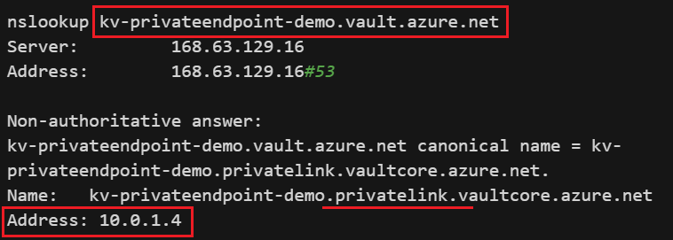

Azure Key Vault – Network Design - Private Endpoint
How teams/applications connect to Azure Key Vault from on-premise?
VNet1 – 10.0.0.0/16
Azure DNS private zone
Subnet1 - 10.0.1.0/24
No access from internet
ExpressRoute Private peering
App Hosting Environment
Private Link
Internet
Additional notes:
Private Endpoint can be on the same subnet as VM or in a different subnet within the VNet
NSG if enabled for the Private Endpoint subnet, will be disabled for that subnet.
Integration with private DNS zone is optional (recommended)
PEP requires VNet in same subscription & location
The Key Vault configured using private endpoint can be reached from the same VNet, regionally or globally peered VNets & on-premise using VPN or ExpressRoute.
Microsoft backbone
network
Private Endpoint
Key Vault
IaaS
Private IP
10.0.1.5
Private IP from the subnet assigned dynamically to NIC
Private IP
10.0.1.4
NIC1
NIC2
NSG
1. Outbound internet denied
Private peering
Express Route
On-Premise

Slide 4
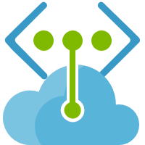

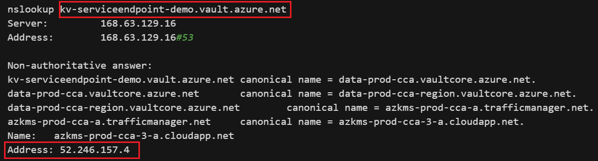
Azure Key Vault – Network Design - Service Endpoint
VNet1 – 10.0.0.0/16
Subnet1 - 10.0.2.0/24
How applications connect to Azure Key Vault from on-premise?
App Hosting Environment
No access from internet
ExpressRoute Microsoft peering or Public peering
IaaS
Internet
How teams connect to Azure Key Vault from on-premise?
Private IP
10.0.2.4
Service Endpoint
Key Vault
NIC1
Provision a VM on Azure VNet which has ExpressRoute Private peering with On-Prem. Enable Service Endpoint on the Subnet for Azure Key Vault. Access Key Vault from that VM.
Public IP
52.246.157.4
1. Outbound key vault allowed
2. Outbound internet denied
NSG
VNet2 – 10.1.0.0/16
Option 1 – Microsoft peering
Subnet2 - 10.1.2.0/24
CKI/PAM Operation server
Express Route
Option 2 – Private peering
On-Premise
Service Endpoint
IaaS
NIC2
Private IP
10.1.2.4
1. Outbound key vault allowed
2. Outbound internet denied
NSG

Slide 5
Private Endpoint vs Service Endpoint: Comparison
Feature | Private Endpoint | Service Endpoint
Routing through Azure backbone network | Yes | Yes
Service instance | Enabled for one instance of PaaS resource type | Enabled for all instances of PaaS resource type
Security / Data exfiltration | In-built | Enabled using Endpoint policies
Access from On-Premise | ExpressRoute private peering | ExpressRoute Microsoft peering or public peering
IP addressing | PaaS resource gets a Private IP | PaaS resource has Public IP
NSG | Outbound internet is not required | If outbound connectivity to internet is denied from the VNet, it requires connectivity to PaaS resources to be enabled
Performance | Traffic goes through the backbone network & the network hops are reduced. | Traffic goes through the backbone network & the network hops are reduced.
Service Availability | Available for all the services or any service which is fronted by a load balancer | Only selected Azure services can be accessed
Pricing | Charged hourly and also by the amount of inbound and outbound data processed | Free. It is enabled on the VNet

Slide 6
Features | Private Endpoint | Service Endpoint
 | Differences
Service instance | Enables for one instance of a Resource type | Enables for all instances of a Resource type
IP addressing | Private IP is assigned from the subnet (source) to the service instance (destination). Both source & destination uses private IP for communication. | Source IP address switches from using public IP address to using its private IP address when communicating with the service (destination) from the subnet. Destination service still uses its public IP.
Security/Data Exfiltration | Azure Private Link maps a specific PaaS resource to private IP address. This means that any malicious intent to exfiltrate the data to a different account using the same private endpoint will fail, thus providing built-in data exfiltration protection. | Service endpoint policies allows to filter egress virtual network traffic to Azure Storage accounts over service endpoint, and allow data exfiltration to only specific Azure Storage accounts. Endpoint policies provide granular access control for virtual network traffic to Azure Storage when connecting over service endpoint.
Access from On-Premise | A Private Endpoint in the VNet can be mapped to an instance of a PaaS Service (e.g. Key Vault). These resources are then accessible over a private IP address in the VNet, enabling connectivity from on-premises through Azure ExpressRoute private peering and/or VPN gateway and keep the network configuration simple by not opening it up to public IP addresses. | In Service Endpoint, a PaaS resource (e.g. Key Vault) is locked down to just the VNet. However, the PaaS endpoint is still served over a public IP address and therefore not reachable from on-premises through Azure ExpressRoute private peering or VPN gateway. Azure public peering has been deprecated and is not available for new ExpressRoute circuits.
Service connectivity from VNet & network routing | Connect your virtual network to services in Azure without a public IP address at the source or destination. Service providers can render their services in their own virtual network and consumers can access those services in their local virtual network. The Private Link platform will handle the connectivity between the consumer and services over the Azure backbone network. Outbound connectivity to internet from the VNet is not required. | Service endpoints provide the ability to secure Azure service resources to your virtual network by extending VNet identity to the service. Once you enable service endpoints in your virtual network, you can add a virtual network rule to secure the Azure service resources to your virtual network. The rule addition provides improved security by fully removing public internet access to resources and allowing traffic only from your virtual network. If outbound connectivity to internet is denied from the VNet, it requires connectivity to Key Vault resources to be enabled via NSG. Service endpoints add a system route which takes precedence over any BGP or UDR routes and provide optimum routing for the service endpoint traffic.
Services availability | It is available for all the services or any service which is fronted by a load balancer. Limitation is 1. Only IPv4 and TCP traffic is supported 2. Supported only on Standard Load Balancer See the list: https://docs.microsoft.com/en-us/azure/private-link/private-link-overview#availability | With service endpoints only selected Azure services can be accessed privately. See the list: https://docs.microsoft.com/en-us/azure/virtual-network/virtual-network-service-endpoints-overview
Pricing | Private endpoints is charged hourly and also by the amount of inbound and outbound data processed. | Free. It is enabled as part of the VNet.
Performance | Traffic goes through the backbone network & the network hops are reduced. | Traffic goes through the backbone network & the network hops are reduced.

