Slide 1



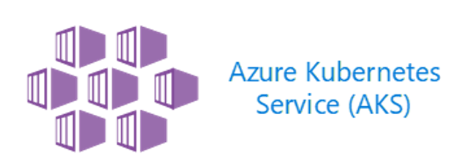





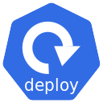
Azure
https/6380
Local dev box running spring boot app
Azure Cache for Redis
Azure
Public IP for K8s Service
http/80
http/80
User
AKS
Load Balancer
Spring Boot App
https/6380
Azure Cache for Redis

