Slide 1

Hybrid Quantum Neural Networks for Remote Sensing Imagery Classification
Abhinandan Yadav & Srikanth Gunturu
Under the guidance of
Prof. Abhishek Dixit
Assoc Professor - Dept of Electrical Engineering
IIT Delhi
QCML Batch 2024

Slide 2
Objective
Explore the usage of Quantum Neural networks in tandem with classic Convolutional Neural Networks (CNN) for Remote sensing imagery classification, resulting in Hybrid Quantum Neural Network. *
* Based on the literature - https://ieeexplore.ieee.org/document/9647979

Slide 3
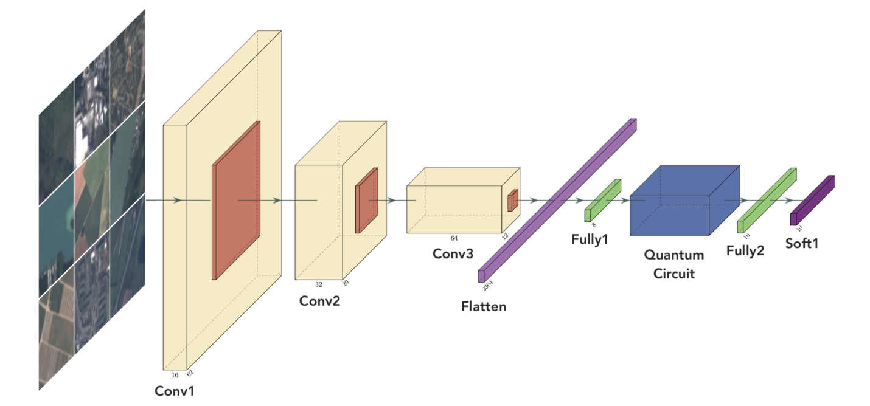
Architecture
* Based on the literature - https://ieeexplore.ieee.org/document/9647979

Slide 4
Methodology
Dataset preparation - EuroSAT dataset
Classic Neural Network implementation - for baseline performance using CNN
Quantum circuit design - including
No entanglement circuit
Bellman circuit
Real amplitudes circuit
Integrate Quantum circuit with CNN as a hybrid layer
Training and validation

Slide 5
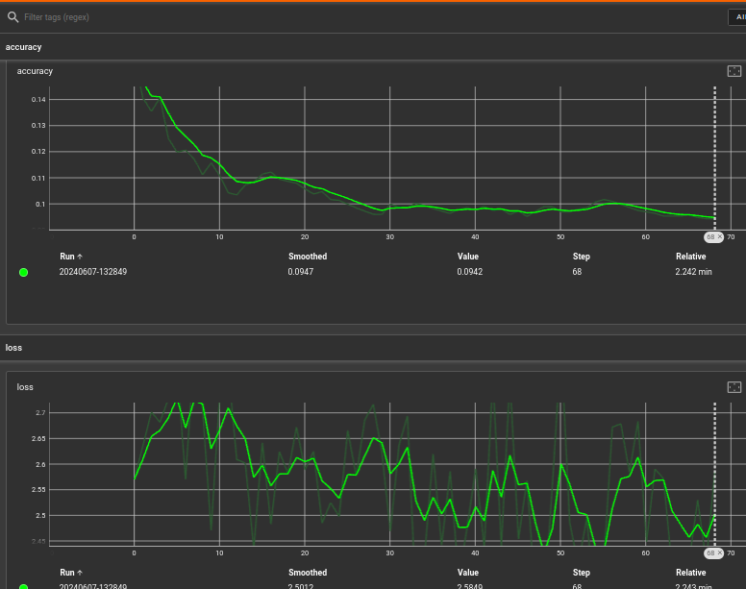
Results
a) On Classical Systems
b) On Hybrid Quantum Systems
i) Training Results
i) Training Results
Epoch 1 Step 300 Loss 2.3077473640441895 Accuracy 0.11503322422504425
**Training accuracy over epoch 1: 0.11074074357748032**
ii) Test Results
169/169 [==============================] - 65s 381ms/step - loss: 2.2502 - accuracy: 0.1667
>>> # Print the validation loss and accuracy
>>> print("Validation Loss:", val_loss)
Validation Loss: 2.250182867050171
>>> print("Validation Accuracy:", val_accuracy)
Validation Accuracy: 0.1666666716337204

Slide 6
Conclusion & Next steps
In this study, we applied a neural network model to the task of remote sensing imagery classification and achieved a validation loss of 2.2502 and a validation accuracy of approximately 16.67%. These results indicate that the model's performance is currently suboptimal and that it struggles to accurately classify remote sensing imagery.
When we implemented code on Quantum machine we were able to get validation loss of 2.30 and a validation accuracy of approximately 11% which substantially a great point to accomplish in quantum niche and to dwell on.
Future research could explore alternative model architectures, incorporate additional data sources, or investigate the use of transfer learning or ensemble methods to further enhance the classification accuracy.

Slide 7
References
Original Literature - https://ieeexplore.ieee.org/document/9647979
Github code repo - https://github.com/abhinandan0y/QCML

