Slide 1
INVESTMENT ASSIGNMENT SUBMISSION
Name: Abhinandan Baheti

Slide 2
Problem Statement
Objectives
Identify the best sectors, countries, and a suitable investment type for making investments
Constraints
To invest between 5 to 15 million USD per round of investment
to invest only in English-speaking countries because of the ease of communication
Data Analysis Goals
Investment type analysis – Analyze Investments in the venture, seed, angel, private equity categories
Country Analysis – Identity countries having most investments in the past
Sector Analysis - Understand the distribution of investments across the eight main sectors
Approach
Data cleaning / Imputation, Funding Type Analysis, Country Analysis, Sector Analysis, Generate Plots
Deliverables
Jupyter Notebook with python code
PPT
Investments Checkpoints Excel Sheet

Slide 3
Flow Chart
Load
Clean/Impute
Operations
Analysis
Build Plots
Companies, rounds2, mapping files into dataframes + Identify the gaps in csv’s
Identify Unique values + clean the data with nan values and drop columns which doesn’t add values such as founded_at, homepage_url etc
Apply various operations with pandas and numpy library to evaluate the given checkpoints such as
Top 3 English speaking countries for venture type having avg investment between $5-15MUSD
Analyse Data for Investment , Country and Sector Analysis
Build graphs for decision making as per checklist 6 and provide conclusion for inferences

Slide 4
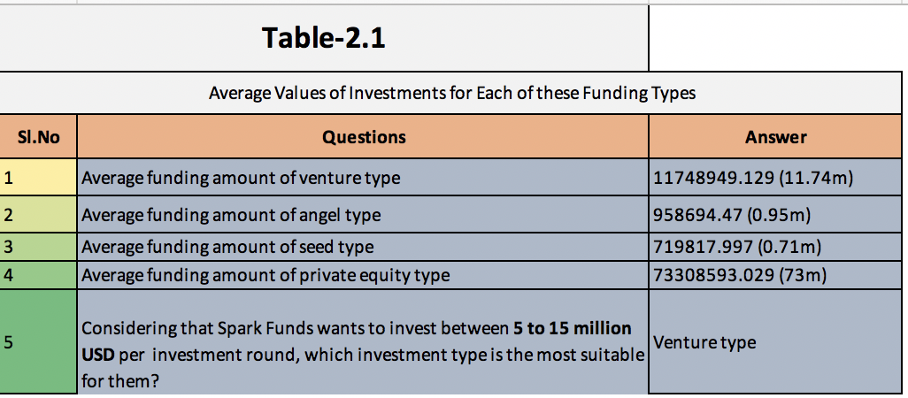
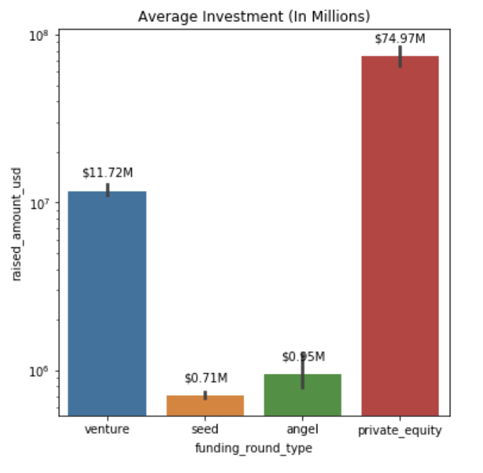
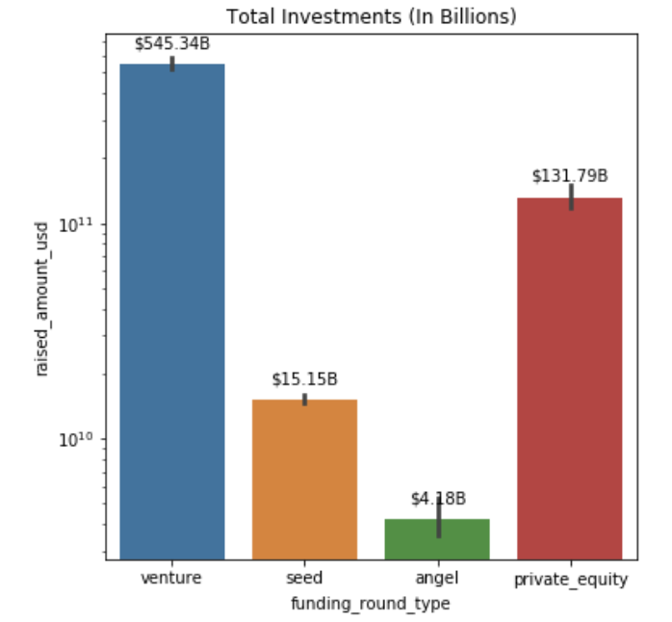
Investment Analysis
Average Investments –
Venture – $11.73M
Seed – $0.71M
Angel – $0.95M
Private Equity – $74.97M
Venture type falls under our constraint of $5-15M USD with Total investment as $545B USD

Slide 5
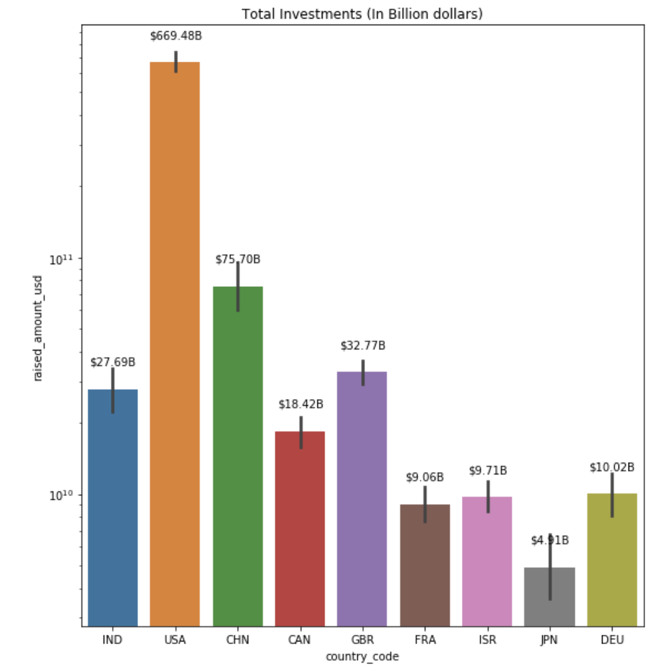
Country Analysis
Highest Total Investment is in USA - $669.48 B USD

Slide 6
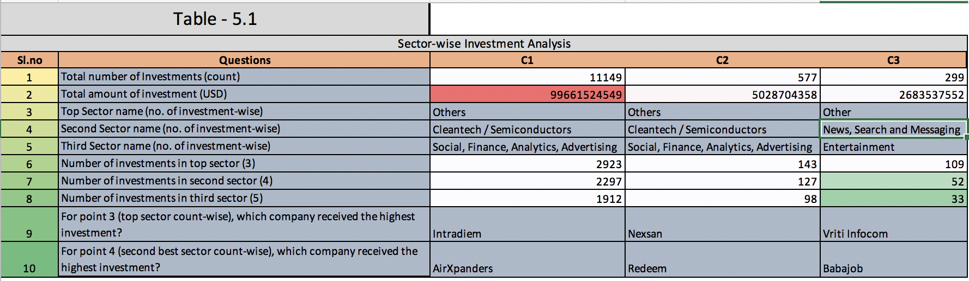
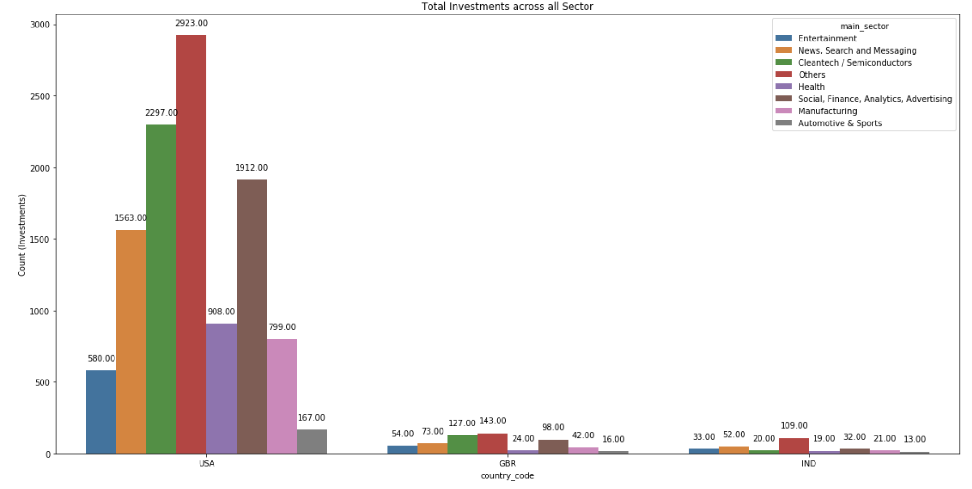
Sector wise Analysis across top 3 countries / sectors
Capturing Count of Total Investments across 8 Sectors for the selected top 3 English speaking countries USA, GBR, IND

Slide 7
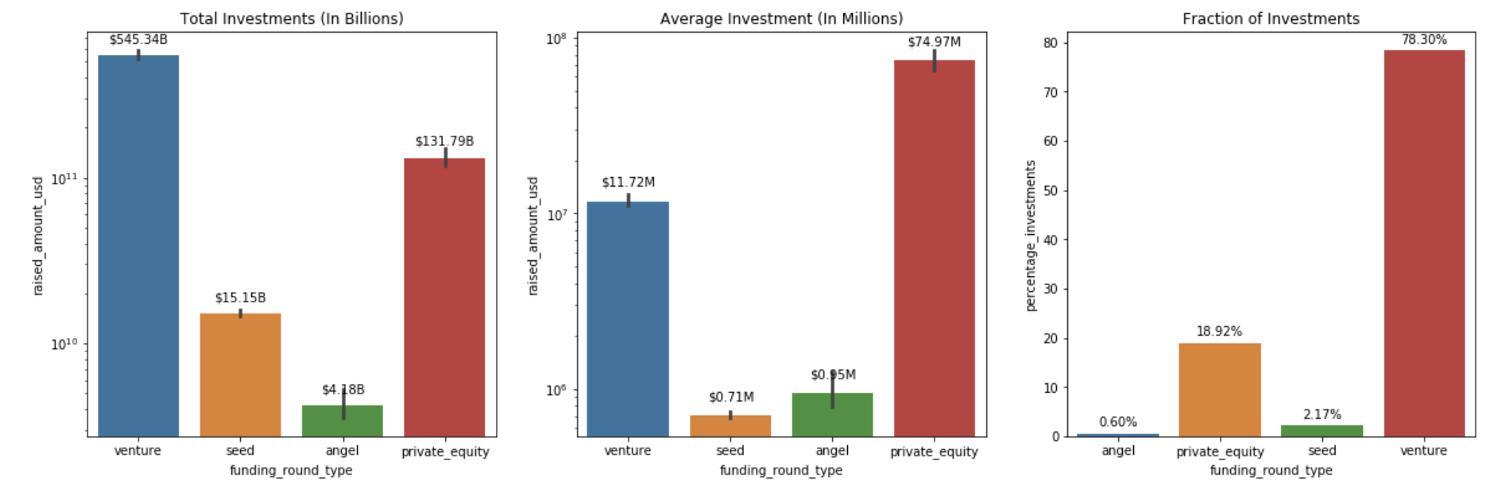
PLOT 1 - showing the fraction of total investments (globally) in venture, seed, and private equity, and the average amount of investment in each funding type

Slide 8
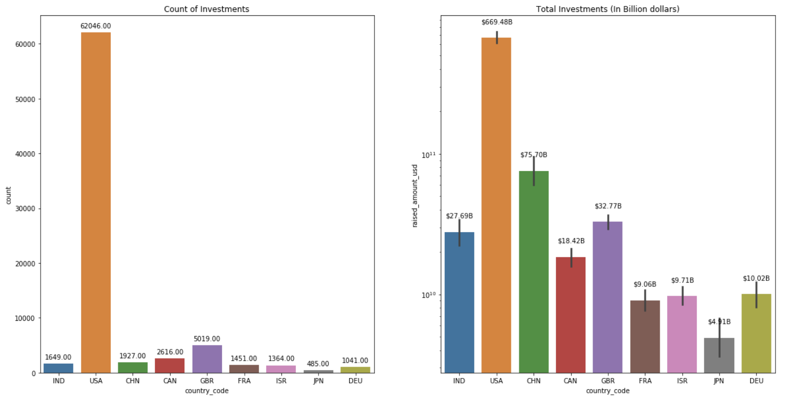
PLOT 2 - Top 9 countries against the total amount of investments of funding type Venture

Slide 9
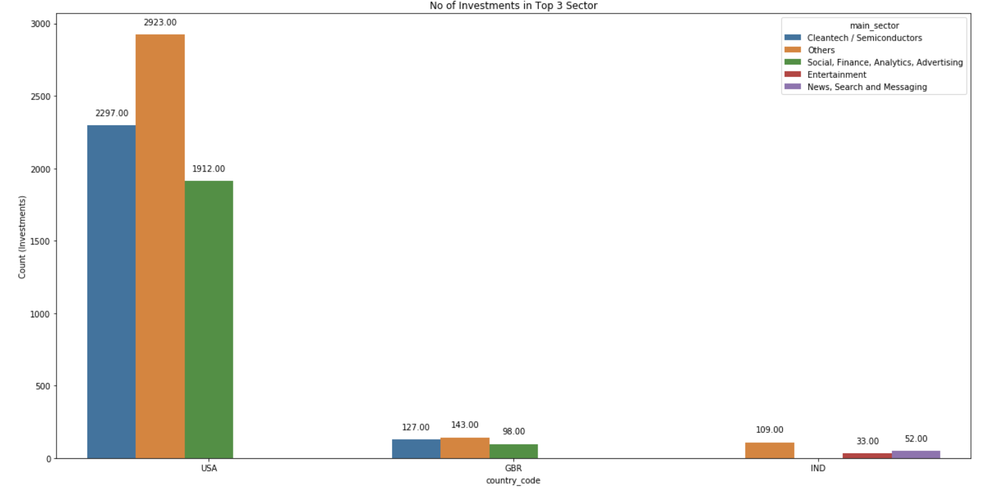
PLOT 3 - Number of investments in the top 3 sectors of the top 3 countries (USA, GBR, IND) for Funding Type Venture

Slide 10
Conclusions
Top English Speaking Countries to Invest in are
USA
GBR
IND
Top Sectors to Invest in are
USA and GBR – Others, Cleantech / Semiconductors, Social Finance Analytics and Advertising
IND – Others, Entertainment, News Search and Messaging

