Slide 1
AquaGuard
Water Quality Monitoring & Complaint Management
A database-driven platform connecting water-quality readings, citizen complaints, alerts and administrative action.
Mohammed Faizan — 24BCE2617
Ashad Rizwan — 24BCE0431
Abhinandan Nakhate Jain — 24BCE2872
Team AquaDB

Slide 2
1. Problem Statement
Water-quality problems can affect citizens before authorities have a complete picture of the situation.
Citizen complaints and technical water readings are often handled as separate information streams.
Authorities need a central system to track complaints, assign responsibility, monitor status and respond to unsafe readings.
AquaGuard brings these workflows together in one database-backed platform.
2

Slide 3
2. Proposed Solution
💧 Water Monitoring
📢 Citizen Complaints
🚨 Alerts
Stores pH, turbidity, TDS and temperature readings and classifies risk.
Citizens submit water-related complaints with category, location, description and priority.
Critical water readings create alerts that administrators can review and resolve.
👨‍💼 Admin Control
📊 Tracking
Admins view complaints, assign officers and update complaint status.
Dashboards provide counts, recent complaints, water-quality status and alert status.
3

Slide 4
3. System Architecture
Citizen / Admin
Web Browser
Application Layer
PHP + HTML + CSS
Database Layer
MySQL / XAMPP
4

Slide 5
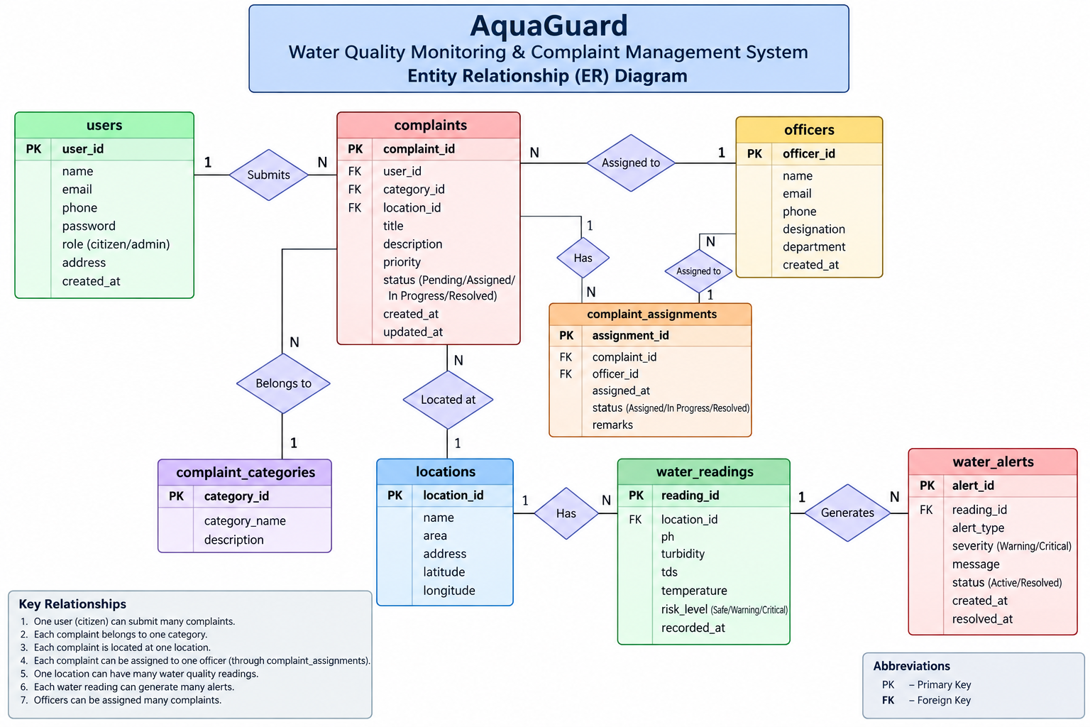
4. Database Design — ER Diagram
5

Slide 6
5. End-to-End Workflow
1. Citizen logs in
2. Submits complaint
3. Complaint stored in MySQL
4. Admin reviews complaint
5. Officer is assigned
6. Status → IN PROGRESS
7. Status → RESOLVED
6

Slide 7
6. Water Quality Monitoring & Alerts
Water readings are stored with location, pH, turbidity, TDS and temperature.
Each reading has a risk level such as SAFE, WARNING or CRITICAL.
A critical reading can be represented through the water-alert workflow.
Administrators can review active alerts and mark them as resolved.
This connects database data directly to an operational response.
7

Slide 8
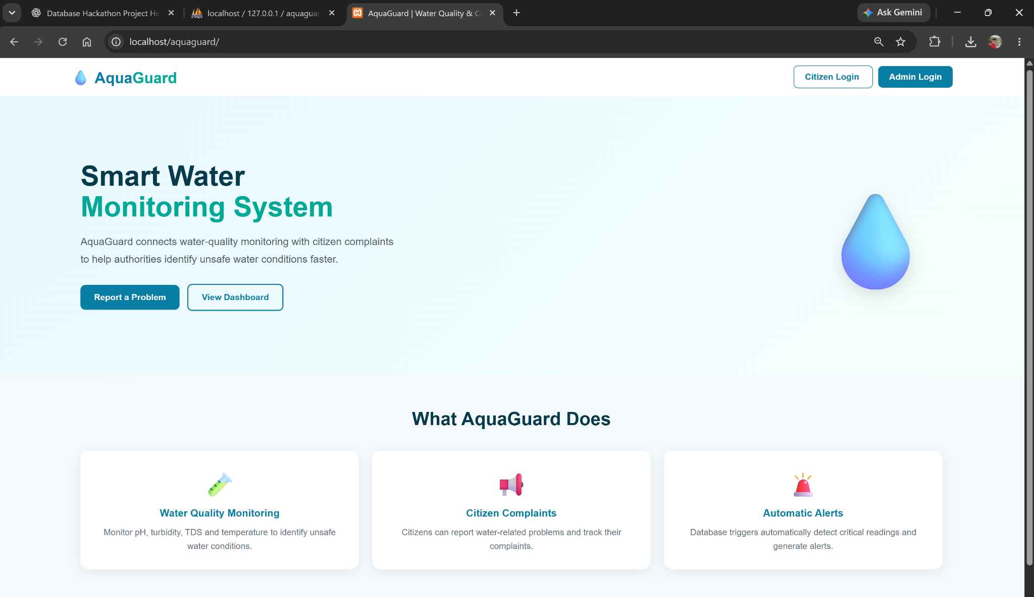
7. Working Prototype — Homepage
8

Slide 9
8. Live Demo Plan
Citizen Login → Submit a water complaint.
Admin Login → View the new complaint.
Assign an officer → change status to IN PROGRESS.
Resolve the complaint → verify the citizen dashboard updates.
Open Water Quality → show SAFE / WARNING / CRITICAL readings.
Open Alerts → show the critical alert and resolve it.
Return to Admin Dashboard → show updated counts.
9

Slide 10
9. Technology Stack
Frontend
Backend
Database
HTML
CSS
Responsive dashboard-style UI
PHP
Server-side form handling
MySQL queries
MySQL
Relational tables
Joins, updates and status tracking
Environment
Core Focus
XAMPP
Apache
phpMyAdmin
Database-driven complaint management
Water-quality monitoring
Alert management
10

Slide 11
10. Team Roles
Mohammed Faizan
24BCE2617
Ashad Rizwan
24BCE0431
Abhinandan Nakhate Jain
24BCE2872
Schema design
Tables & relationships
SQL queries
Data validation
Backup & recovery
PHP logic
Authentication
Complaint workflow
Officer assignment
Status updates
UI pages
Dashboards
Water-quality view
Alerts page
Presentation & live demo
Database & System Design
Schema & relationships
SQL queries
Data validation
Backup & recovery
Backend Development
PHP logic
Authentication
Complaint workflow
Officer assignment & status
Frontend & Demo
UI pages & dashboards
Water-quality view
Alerts page
Presentation & live demo
Team AquaDB
11

Slide 12
11. Future Scope
IoT sensors for automatic real-time water-quality readings.
SMS / email / mobile notifications for critical alerts.
Map-based visualization of affected locations.
Analytics for recurring complaint hotspots and water-quality trends.
Role-based access for multiple departments and field officers.
Cloud deployment for centralized access across regions.
12

Slide 13
AquaGuard
From water-quality data to citizen action — one connected database-driven workflow.
Thank You • Questions?
13

