Slide 1


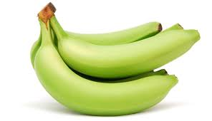



BananaGPT – Image Classification using multi-modal semantic search
BananaGPT App
Google Cloud Function
Twilio Cloud Function
Jarvis
Capture Image input
Call Google Cloud Function
Send Image payload
Label + Image Embedding
Calculate Cosine Similarity,
Assign highest ranked label
Generate Caption, Store Img
Receive event
Show message to the user with image of the banana
Show classification description
Future Use Cases
Highly visual product search. E.g., barbie style dress with golden beads and a brown belt
Text Embedding Model
Image Embedding Model
Image Text Model (VQA, Captions)
Cheaper Object classification on commodity hardware
Product recommendations, context ranking, and much more.

