Slide 1

Insurance Premium Prediction
Data Analysis Processes
Data Preparation
Model Training and Evaluation
Exploratory Data Analysis (EDA)
Visualization (using Python)

Slide 2
Problem Statement
We aim to predict individual medical insurance charges using demographic and health-related features. This study evaluates the performance of Linear Regression and Random Forest models in predicting insurance costs. Additionally, we explore data distribution and key factors affecting charges through various visualizations.

Slide 3
Data Overview:
Age: Age of the primary beneficiary
Sex: Gender of the insurance contractor (female, male)
BMI: Body Mass Index
Children: Number of dependents covered
Smoker: Smoking status (yes, no)
Region: Residential area (northeast, southeast, southwest, northwest)
Charges: Medical costs billed by insurance

Slide 4
Steps followed
1. Getting the Data Ready:
Cleaning Up: We cleaned the data to make sure it’s in a usable format.
Preparing Features: We adjusted the numerical data (like age and BMI) and converted categorical data (like gender and smoking status) into a format that the models can understand.
2. Splitting the Data:
Training Set: We used 80% of the data to teach the models how to make predictions.
Testing Set: We used the remaining 20% to check how well the models predict insurance charges.
3. Models We Tested:
Linear Regression: A simple model that tries to find the best straight line to predict insurance charges based on the features.
Random Forest: A more advanced model that uses multiple decision trees to make predictions and combines their results.

Slide 5

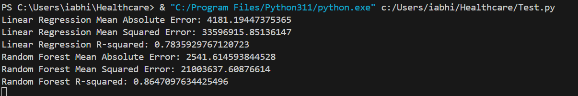
Evaluating Model Performance
Mean Absolute Error (MAE): Random Forest predicts charges more accurately with lower average error ($2,541.61) than Linear Regression ($4,181.19).
Mean Squared Error (MSE): Random Forest also makes fewer large errors compared to Linear Regression.
R-squared: Random Forest explains more of the variation in insurance charges (0.86) than Linear Regression (0.78).
Conclusion: Random Forest provides more precise and reliable predictions for insurance charges compared to Linear Regression.

Slide 6
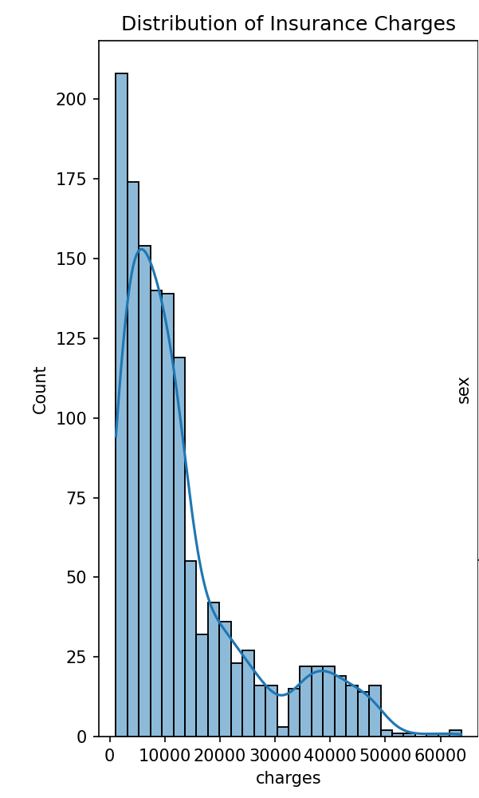
Exploratory Data Analysis (EDA)
Distribution of Insurance Charges:
The histogram shows a right-skewed distribution of insurance charges, with most individuals having lower to moderate charges.
A long tail on the right indicates that a small number of people face significantly higher insurance costs.
This skewness likely reflects a few individuals with severe health issues who incur very high insurance charges.

Slide 7
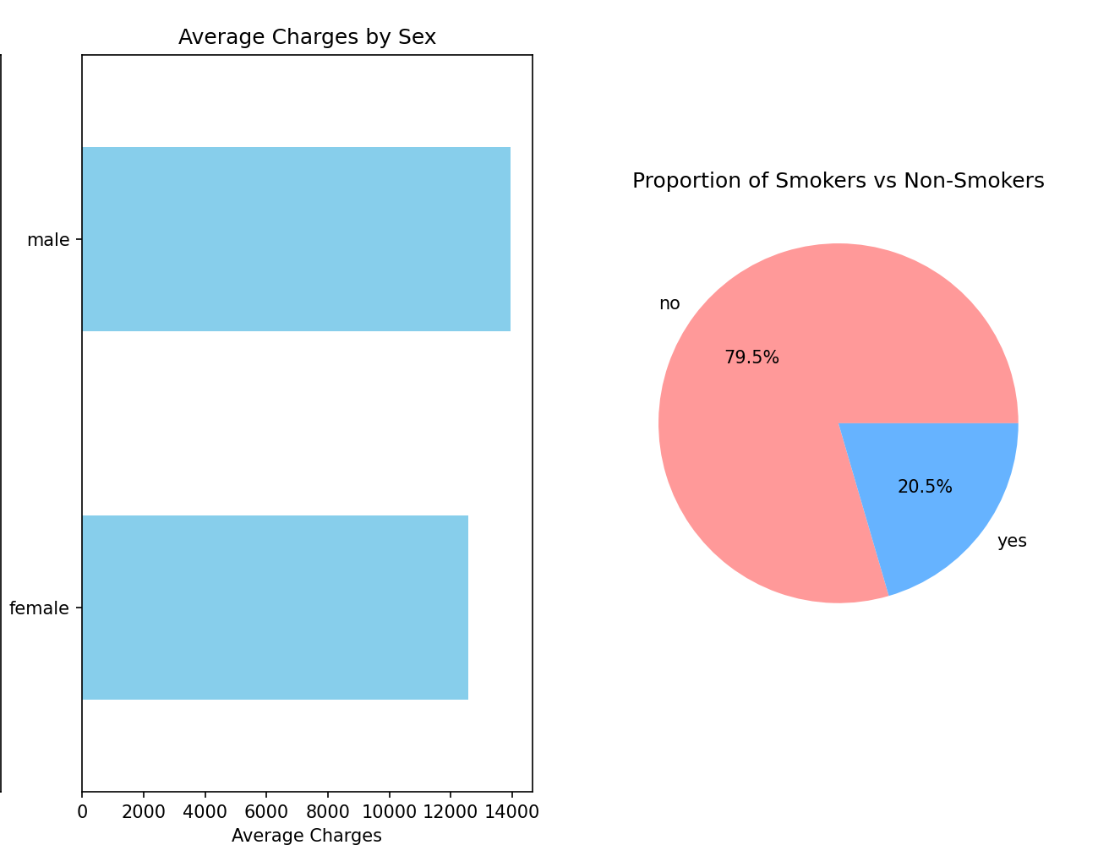
Exploratory Data Analysis (EDA)
Gender pays a vital role in determining the charges
Smoking status appears to be a significant factor in insurance costs, with smokers potentially facing higher premiums due to the associated health risks. The higher percentage of non-smokers could imply a healthier insured population or reflect lower insurance costs for this group.

Slide 8
Key Findings:
Random Forest showed better accuracy than Linear Regression, with lower errors and a higher R-squared value.
Influential Factors:
Smoking Status: Smokers incur higher insurance charges.
Gender: Men have higher average insurance charges than women.
BMI: Higher BMI is linked to higher insurance costs.
Visualization Insights:
Charge Distribution: Most charges are lower, with a few very high ones (right-skewed distribution).
Average Charges by Gender: Men have higher average charges.
Smoking Status: 75% are non-smokers, indicating smoking is a key factor in insurance costs.

