Slide 1
KMRL HACKATHON
Kochi Metro
Unified Ticketing
METRO
+
LAST MILE
One metro ticket. One guided last-mile journey.
A smart platform that connects passenger bookings, destination-aware clusters, and last-mile drivers through one live system.
Passenger Portal • Driver Portal • Flask API

Slide 2
PROBLEM IDENTIFIED
The metro journey breaks at the last mile.
Passengers leave the station without a clear, affordable, or coordinated way to reach their actual destination.
01
02
03
Fragmented experience
Low ride efficiency
Limited visibility
Metro, cab, payment, and pickup guidance are separate decisions.
Drivers receive individual trips instead of ready passenger groups.
KMRL cannot easily coordinate the last-mile handoff through one flow.
KMRL UNIFIED TICKETING / 02

Slide 3
SOLUTION
Unified Booking turns a ticket into a complete journey.
The passenger books for the real final destination. The platform coordinates the rest.
1
2
3
4
Book
Map
Group
Ride
Metro station + final destination
Nearest handoff station + pickup zone
Compatible passengers form a cluster
Driver assignment and trip completion
KMRL UNIFIED TICKETING / 03

Slide 4
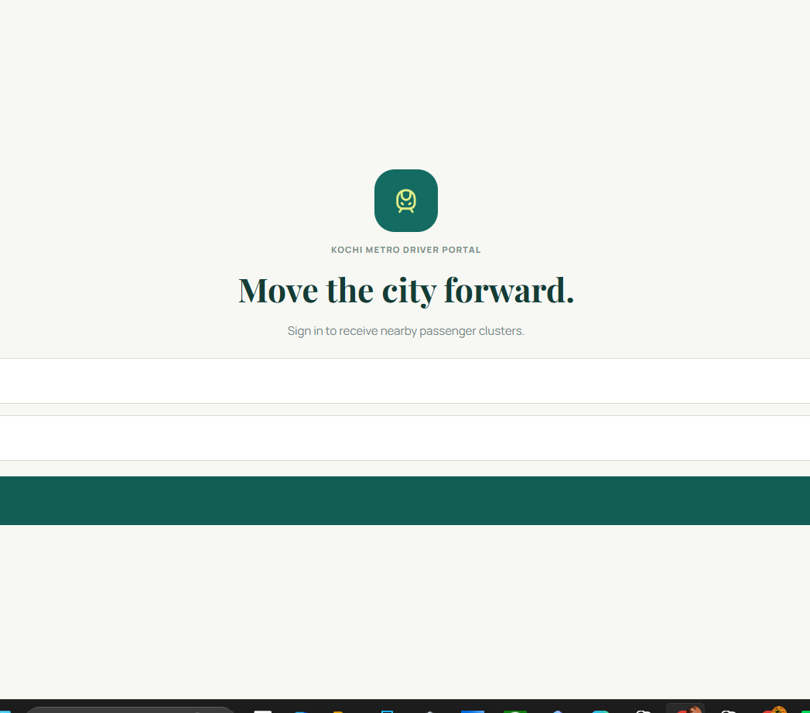
LIVE WORKFLOW
A live booking becomes a live driver cluster.
The two portals are separate React applications, but both see the same booking state through the Flask API.
What the passenger sees
• Cluster created
• Assigned pickup zone
• Driver accepted your trip
• Trip completed
Driver Portal — real-time cluster operations
KMRL UNIFIED TICKETING / 04

Slide 5
ARCHITECTURE
Two React portals connect through one Flask REST API.
Passenger and driver portals never communicate directly. The API owns booking, cluster, and trip status.
Passenger Portal
Flask API
Driver Portal
React + Vite
Booking and journey status
Bookings
Clusters
Driver assignment
Trip completion
React + Vite
Live cluster operations
AWS EC2 • Gunicorn • Nginx • SQLite
KMRL UNIFIED TICKETING / 05

Slide 6
IMPACT & REVENUE MODEL
One connected journey creates value for every participant.
Passengers
Drivers
KMRL
Premium, guided journey
Ready passenger clusters
Proposed last-mile revenue
One booking, one payment, pickup-zone and driver guidance.
Exact names, destinations, zones, fare, and a simple accept-to-complete flow.
15% partner-driver commission. 100% feeder fare retention for KMRL-operated feeder buses.
Prototype proposal: listed routes, fares, zones, and revenue assumptions are demo data and require operational validation before production use.
KMRL UNIFIED TICKETING / 06

Slide 7
THE OPPORTUNITY
Kochi Metro can own
the complete journey.
Not just a metro ticket — a reliable connection from station to destination.
Passenger confidence
Driver efficiency
KMRL visibility
One ticket. One journey. One connected mobility system.
Live demo: Passenger Portal → Flask API → Driver Portal

