Slide 1

To Do
Y O U R U L T I M A T E T A S K M A N A G E R
B Y : A B H I N A N D N M

Slide 2


Welcome to "TO DO," a web-based task management tool designed to streamline your productivity. In our busy lives, staying organized and on top of tasks can be challenging. "TO DO" simplifies task management, helping you prioritize and complete your to-dos efficiently.

Slide 3

Beneﬁts of "TO DO"
Enhanced Productivity
Improved Organization Time Management User-Friendly Experience Visual Appeal
Motivation and Satisfaction

Slide 4

FEATURES
Add Tasks: Quickly add new tasks with ease.
Edit & Delete Tasks: Easily update or remove tasks
Mark Tasks as Complete
Real Time Progress Update.

Slide 5
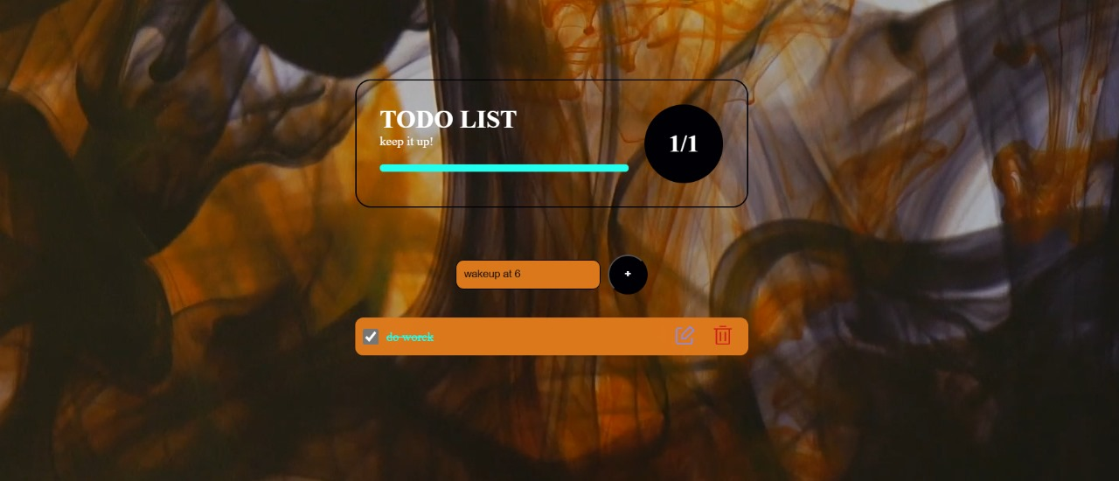
Preview

Slide 6

Technologies Used
HTML CSS
JavaScript

Slide 7
Thanks!

