Slide 1
Uber Sentiment Analysis
Data Mining Project,
Dr. MD KARIM, KEITH MAULL
ABHINAND SHARMA YAMAVARAM (0592)
AJAY GADDAM (0513)
KIRAN KUMAR ADEPU (0458)

Slide 2
Sentiment Analysis:
Sentiment analysis in other words defined as opinion mining.
In essence, it is the process of determining the emotional tone behind a series of words, used to gain an understanding of the attitudes, opinions and emotions expressed within an online mention.

Slide 3
DATASET:
UBER sentiment analysis requires some data or reviews for the customers which contains both positive and negative reviews.
For Data sets:
We used Twitter and Facebook API, but TWITTER and FACEBOOK were restricted from using the API and scrape the reviews.
So we took the OUTWIT software in order to scrape the reviews from Twitter and Facebook.

Slide 4


Example Data sets:
Gud app Recent update made this app bad..always no cars available n surging in uberx option.. POSITIVE
Very poor service- I have coupons but after completing my ride Uber has charged cash, executives told that my coupon deemed invalid. Poor service, bad drivers. Total disgusting. NEGATIVE
Good service. Good app-I like the app and love the service. The app should really add a tipping function though POSITIVE
Love Uber- Love uber every driver I've rode with is so professional and fun to chat with, I never have a problem keep up the good work! POSITIVE

Slide 5
Research Questions:
How to avoid the words that is most used, that is stop words?
What are the overall features of the customers on UBER service?
How this prediction process runs on different keywords?
How this training works based on the data we give as input?
What will be the different predictions of positive and negative keywords based on the code?

Slide 6
CODE and application
We used java to develop the clustering process in order to predict positive and negative reviews of UBER analysis.
We scraped around 1000+ comments in that only 100 reviews were useful for the prediction process.

Slide 7
Project management:
Abhinand Sharma Yamavaram(0592):
Worked more on development of the code in java which involves TFIDF frequency calculations.
Ajay Gaddam(0513):
Worked on development of API and scraping of reviews using OUTWIT.
Kiran Kumar(0458):
He will be working on testing the pulled comments and final resting and reporting of the entire documentation.

Slide 8
Sample code:
Map<String,Double> map = new HashMap<String,Double>();
map.put("happy", 1.04);
map.put("reliable", 1.04);
map.put("fair", 1.04);
map.put("good", 0.54);
map.put("experience", 1.04);
map.put("wise", 1.04);
map.put("price", 1.04);
map.put("perfect", 1.04);
map.put("love", 0.77);
map.put("services", 0.54);

Slide 9
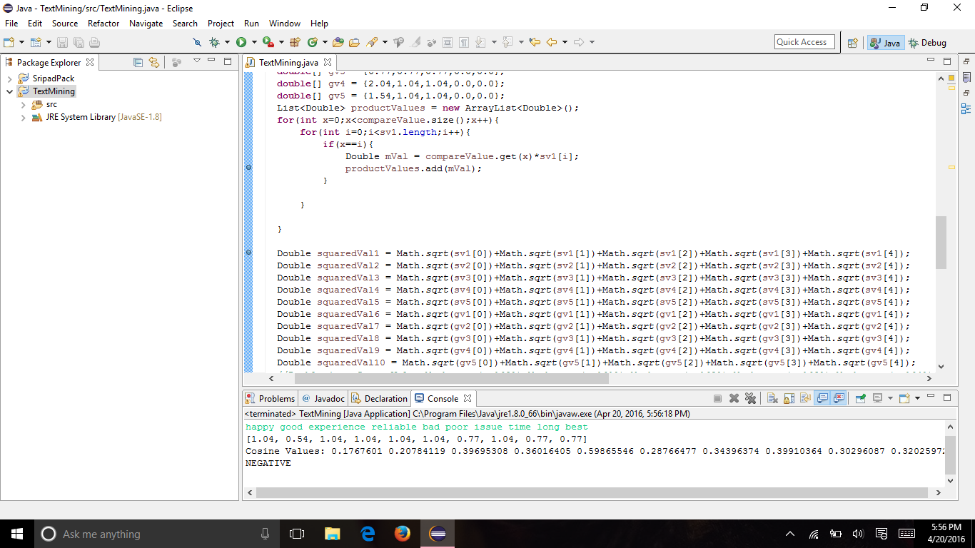
Output:

Slide 10
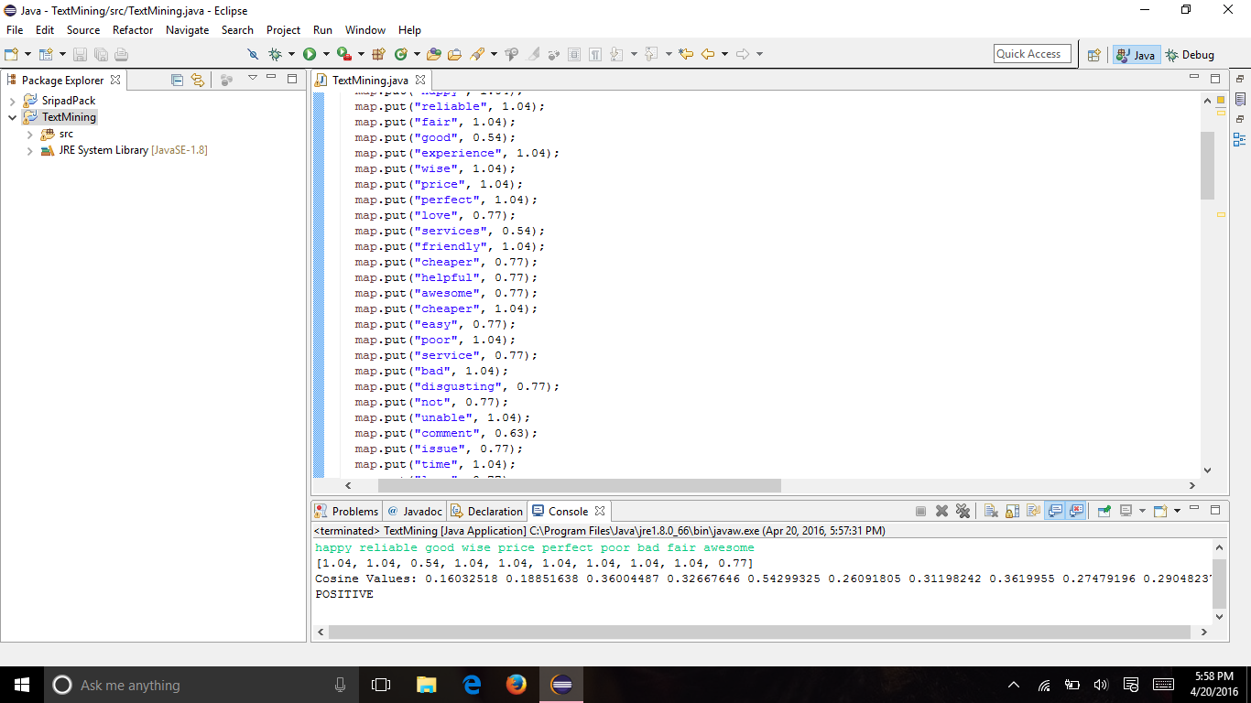

Slide 11
Project References:
Combining Knowledge and Data Mining to Understand Sentiment - A Practical Assessment of Approaches
http://www.sas.com/en_us/offers/sem/combining-knowledge-data-mining-to-understand-sentiment-105008.html?keyword=sentiment+analysis&matchtype=e&publisher=google&gclid=CjwKEAjw0pa5BRCLmoKIx_HTh1wSJABk5F_4XhiJyhNbHyrZtZG7XfeZJDyndxPBIw03zD3iyXejShoCUEDw_wcB
Social Media Sentiment Analysis
http://go.alchemyapi.com/sentiment-analysis?gclid=CjwKEAjw0pa5BRCLmoKIx_HTh1wSJABk5F_4qiHq0Nc3tDOp_bh6bstDQhivG7ORjbCuR_XtCy8ftRoCgXbw_wcB#utm_source=google&utm_medium=cpc&utm_term=sentiment%20analysis&utm_content=social&utm_campaign=sentiment-analysis

Slide 12
Sentiment Analysis
http://nlp.stanford.edu/sentiment/
Sentiment Analysis API
http://www.alchemyapi.com/products/alchemylanguage/sentiment-analysis
Sentiment analysis using product review data
http://journalofbigdata.springeropen.com/articles/10.1186/s40537-015-0015-2
Sentiment Analysis
https://www.lexalytics.com/technology/sentiment

Slide 13
Thank You..

