Slide 1


NEXT GEN EMPLOYABILITY PROGRAM
CREATING A FUTURE-READY WORKFORCE

Slide 2
Student Name : S. ABHINAV GOURAV
Student ID : STU60542e84c78711616129668
College Name : MARRI LAXMAN REDDY INSTITUTE OF TECHNOLOGY AND MANGEMENT

Slide 3
CAPSTONE PROJECT SHOWCASE
Project Title : Implementation of Star Schema Based Sales Analysis
Abstract | Problem Statement | Project Overview | Proposed Solution | Technology Used | Modelling & Results | Conclusion | Q&A

Slide 4
Abstract
This project implements a Sales Analysis system using Microsoft Power BI, a robust business intelligence platform. Leveraging star schemas, the optimized structure enhances data analysis capabilities, enabling users to connect seamlessly to diverse data sources. The initiative aims to empower users with an intuitive interface and rich visualizations, facilitating informed decision-making and driving improved business outcomes.

Slide 5
Problem Statement
Organizations grapple with inefficient data analysis in their sales systems, lacking an integrated solution that combines Microsoft Power BI with optimized star schemas. This gap impedes informed decision-making, impacting overall business outcomes. This project aims to address this challenge by seamlessly integrating Power BI with star schemas in a Sales Analysis system, providing a comprehensive solution for enhanced data analytics and improved decision support.

Slide 6
Project Overview
The project centers on developing a Sales Analysis system to address challenges faced by organizations in extracting actionable insights from their sales data. Leveraging Microsoft Power BI and optimized star schemas, the system aims to seamlessly integrate an intuitive interface with enhanced data structuring. This integration will empower users to conduct efficient data analysis, enabling informed decision-making and contributing to improved business outcomes. The project's scope encompasses the implementation of this integrated solution, emphasizing a comprehensive approach to sales data analytics for organizational benefit.

Slide 7
Proposed Solution
Our solution transforms Sales Analysis by combining Microsoft Power BI with thoughtfully structured star schemas. This straightforward approach simplifies data analysis, allowing organizations to uncover key patterns in their sales data. With Power BI's user-friendly features, users can make informed decisions, leading to improved business outcomes. This uncomplicated solution provides a clear and strategic insight into organizational performance, offering a significant step forward in sales data analytics without unnecessary complexity.

Slide 8
Technology Used
Power BI:
It refers to a business intelligence (BI) platform developed by Microsoft. It allows users to connect to various data sources, analyze it, create interactive visualizations, and share their findings with others. Power BI offers both a desktop application for detailed analysis and a cloud-based service for sharing and collaboration.
Power BI and star schemas are a powerful combination for data analysis. The optimized structure, intuitive interface, and rich visual capabilities empower users to gain deeper insights from their data, driving better decision-making and improved business outcomes.

Slide 9
Modelling & Results

Slide 10
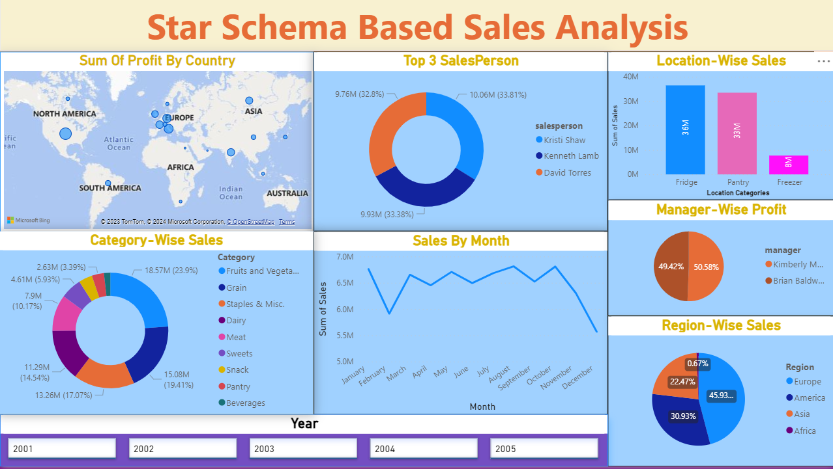

Slide 11
Top 3 SalesPerson:
﻿Kristi Shaw had the highest Sum of Sales at 1,00,62,974.19, followed by Kenneth Lamb at 99,34,575.88 and David Torres at 97,62,317.99.﻿﻿
﻿﻿Kristi Shaw accounted for 33.81% of Sum of Sales.﻿﻿
﻿
Sales by Region:
﻿Europe had the highest Sum of Sales at 3,56,75,825.02, followed by America, Asia, and Africa.﻿﻿﻿﻿Europe accounted for 45.93% of Sum of Sales.﻿﻿
﻿
Sales by Category:
Fruits and Vegetables is the top-selling category, generating $18.57M in sales.
Sales by Location:
At 3,64,69,996.36, Fridge had the highest Sum of Sales and was 372.53% higher than Freezer, which had the lowest Sum of Sales at 77,18,048.90.

Slide 12
Manager-Wise Profit:
﻿Sum of Profit for Kimberly Mack (4826398.69) was higher than Brian Baldwin (4715447.22).﻿﻿
﻿﻿Kimberly Mack accounted for 50.58% of Sum of Profit.﻿﻿

Slide 13
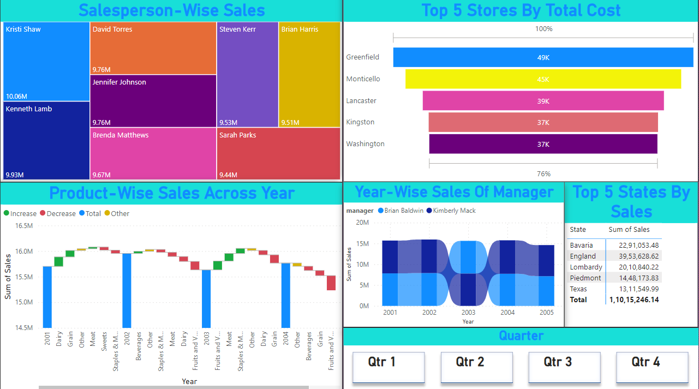

Slide 14
Top 5 Stores:
Greenfield is the top-performing region, generating $49K in sales.
Monticello and Lancaster are the next highest-selling regions, at $45K and $39K, respectively.
Year-Wise Sales of Manager:
Brian Baldwin has the highest sales in 2005, at $20M.
Kimberly Mack has the highest sales in 2003, at $15M.
Top 5 States by Sales:
Bavaria is the top state, with sales of $22,91,053.48.
England and Lombardy are the next highest-selling states, at $39,53,628.62 and $20,10,840.22, respectively

Slide 15
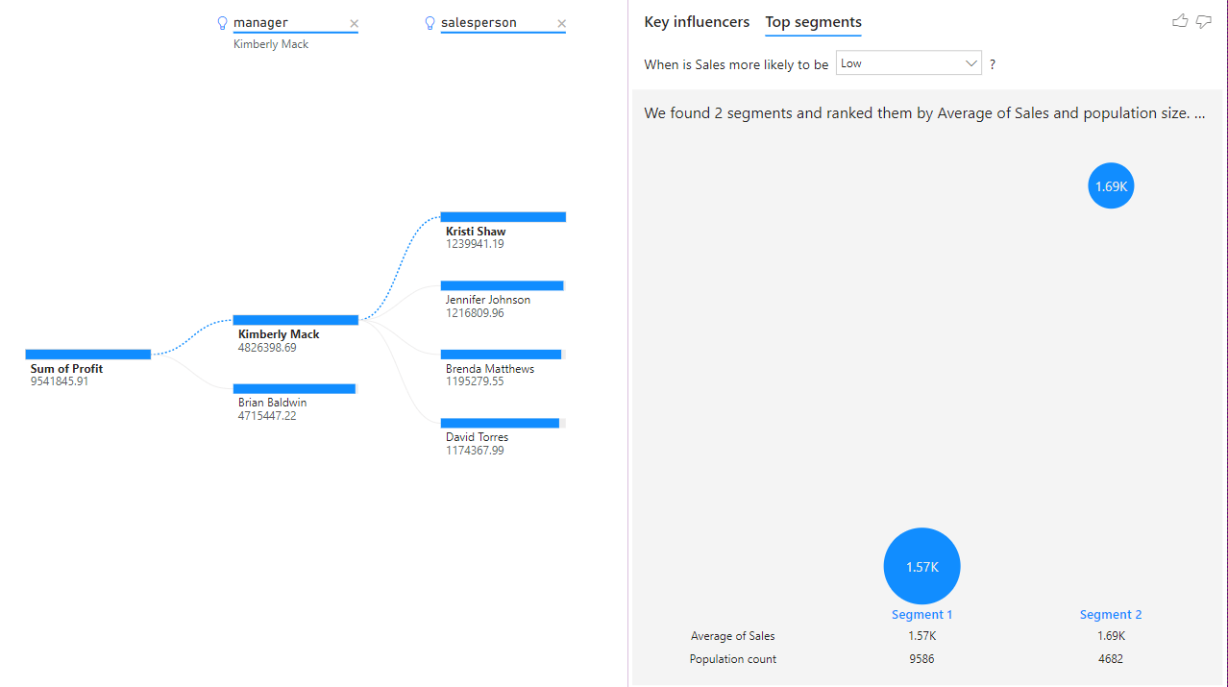

Slide 16
Key Influences and Segments:
﻿Sales Decreased the most (by 750.69) when Category was Beverages. 2 other factors also caused Sales to Decrease, explore them in the key influencers visual.﻿﻿
﻿﻿﻿Sales Increased the most (by 547.79) when Category was Snack. 2 other factors also caused Sales to Increase, explore them in the key influencers visual.﻿﻿

Slide 17
Conclusion
Key Influences:
Highest Sales Decrease: Beverages category ($750.69).
Highest Sales Increase: Snack category ($547.79).
Top Performers:
Top Store: Greenfield ($49K).
Top Manager: Kimberly Mack.
Top State: Bavaria ($22.91M).
Top Salesperson: Kristi Shaw ($100.63M).
Top Region: Europe ($356.76M).
Profit Insights:
Kimberly Mack's profit exceeds Brian Baldwin's ($4.83M vs. $4.72M).
Kimberly Mack accounts for 50.58% of total profit.
Sales Breakdown:
Fruits and Vegetables lead in category sales ($18.57M).
Fridge category dominates in location sales ($364.70M).

Slide 18
Thank You!
Notes:
Thank You !!

