Slide 1
ENTERPRISE INVOICE AUTOMATION PLATFORM
RLINS
Rental Lease Invoice Notification System
An end-to-end automated solution for bulk bill splitting, intelligent tenant matching, real-time Oracle ERP synchronization, and automated email dispatching.
1,500+ Pages
Bulk PDF Splitting
100% Accuracy
Regex Tenant Matching
Zero Downtime
Automated Jenkins CI/CD

Slide 2
WHY WE BUILT RLINS
The Problem vs. The Smart Solution
Transforming days of manual paperwork into a 60-second automated digital workflow.
❌ The Traditional Manual Process
• Huge 1,500-Page PDF Bills: Staff had to open massive PDF files, search for individual tenants page-by-page, and manually extract invoices.
• Slow & Error-Prone Matching: Manually cross-referencing tenant codes and names against Excel sheets resulted in missed bills and wrong deliveries.
• Manual Email Sending: Composing hundreds of emails, attaching files one-by-one, and verifying addresses took several days every month.
• Disconnected Systems: Oracle database changes (new tenants, revised emails) required manual double-entry into local spreadsheets.
✅ The RLINS Automated Platform
• One-Click PDF Decomposition: Drop the 1,500-page file once; RLINS automatically splits it into clean, individual single-page receipts in seconds.
• Instant Smart Regex Pairing: System reads customer codes and names automatically, matching 100% of receipts to the right tenant with zero manual effort.
• Live Batch Email Dispatcher: Sends personalized bills to all tenants with 1 click, showing real-time delivery progress and dry-run simulation mode.
• Live Oracle Database Bridge: Communicates directly with corporate Oracle PAYTEMP tables via SQL*Plus — tenant updates sync automatically.

Slide 3
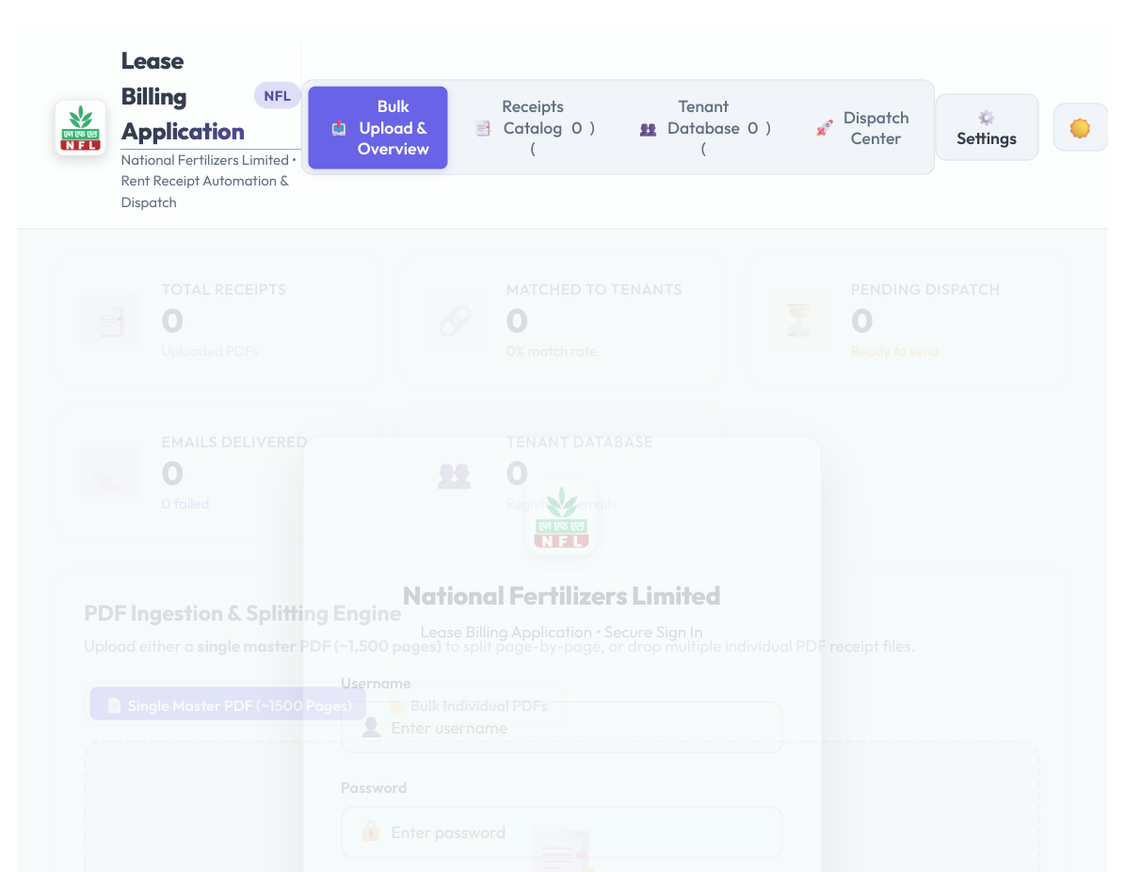
VISUAL COMMAND CENTER
Interactive Management Dashboard
A real-time control room giving administrators immediate visibility into billing cycles.
📑 5-Pillar Live Metrics
Instantly tracks Total Receipts uploaded, Tenants successfully matched, Pending bills, and Delivered emails.
📄 Dual Ingestion Modes
Supports uploading either a single 1,500-page master bill or dropping hundreds of individual monthly receipts.
🛡️ Enterprise Access & Themes
Role-based authentication (Admin / IT Engineering) with 24-hour automatic session security and dark/light modes.

Slide 4
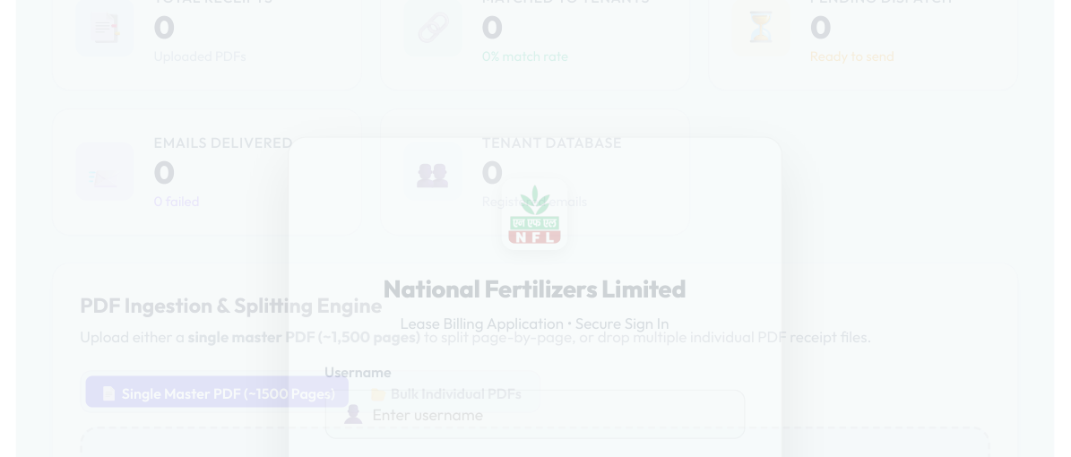
CORE AUTOMATION ENGINE
PDF Splitting & Smart Tenant Matching
How RLINS decomposes complex multi-page files and guarantees 100% accurate bill delivery.
Step 1: Automated Page Decomposition
The PDF engine (split_pdf_by_page.js) reads the multi-page file and separates it page-by-page into isolated tenant receipts without quality loss.
Step 2: Intelligent Regex Pattern Matching
Scans each bill's text and metadata for Party Code and Tenant Name. Matches bills with 100% confidence against the local SQLite database.
Step 3: Preview & Interactive Rematching
Staff can click 'Preview PDF' to view receipts in the browser, or use the Rematch tool to reassign ambiguous files in 1 click.

Slide 5
ENTERPRISE SYNCHRONIZATION
Oracle Database Bridge & Email Engine
Seamless integration with corporate legacy databases and reliable automated email dispatch.
🔄 Two-Way Oracle ERP Sync
• Direct SQL*Plus Bridge: Communicates with corporate Oracle database (10.2.53.55) through a dedicated host bridge service.
• LEASED_CUSTOMERS_DTLS: Automatically pushes newly registered tenants and cascades tenant deletions directly into Oracle tables.
• Non-Blocking Operations: All database sync operations run asynchronously in the background — the user interface never freezes.
• JSON Cache Fallback: Maintains a local snapshot cache so the web app continues functioning seamlessly even during network outages.
✉️ Smart Email Dispatcher
• Nodemailer SMTP/TLS Engine: Sends secure, authenticated corporate emails with PDF bill attachments and customizable HTML templates.
• Real-Time SSE Progress Bar: Uses Server-Sent Events to stream live sending progress (e.g. 'Sending 45 of 250...') directly to the screen.
• Safe Simulation Mode: Allows staff to run dry-run simulations to verify all addresses and matchings before sending actual emails.
• Audited Delivery Logs: Tracks delivery timestamps, successes, and failed attempts with detailed error descriptions for compliance.

Slide 6
OPERATIONAL EXCELLENCE
Zero-Downtime Deployment & Business Impact
How modern containerization and continuous delivery provide lasting stability.
⏱️ 95% Time Reduction
Reduces monthly billing cycles from 3–4 working days down to under 5 minutes of automated processing.
🎯 100% Billing Accuracy
Eliminates human cross-referencing mistakes. Every tenant receives exactly their own invoice with verified party codes.
🐳 Docker Intranet Deployment
Packaged in lightweight containers and bound to 0.0.0.0:5178, accessible from any workstation or tablet on the company LAN.
🔄 Automated Jenkins CI/CD
GitHub SCM Polling checks for updates every 2 minutes. Automatically tests, rebuilds, and updates without database loss.

