Slide 1
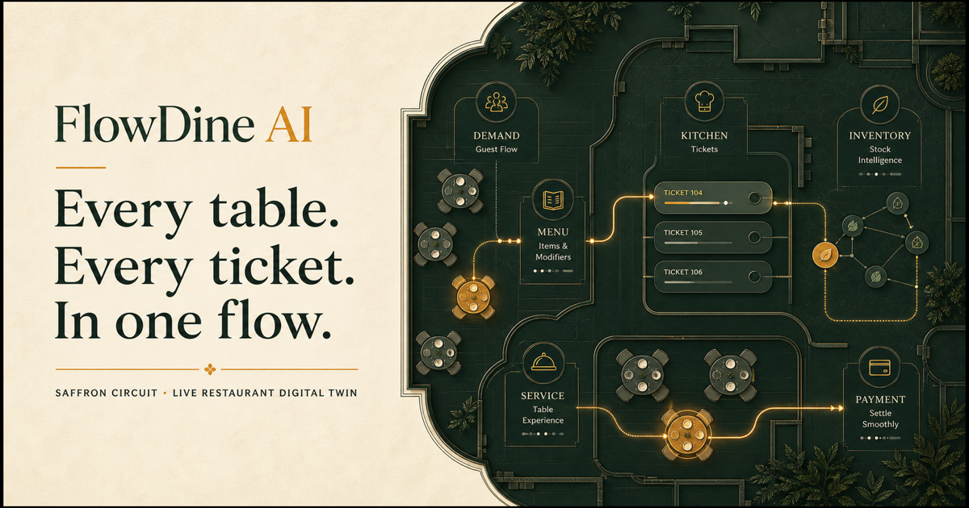
Live Restaurant Digital Twin
for faster, smarter dining
VIBEATHON 6.0 / SMART RESTAURANT MANAGEMENT
TEAM NAME: ____________________
Notes:
FlowDine AI is not another food delivery app. It is a live operating layer for the restaurant itself. Our core idea is simple: every table, ticket, ingredient, and staff action should run from the same shared truth. In the next few minutes, we will show how that digital twin removes unavailable-order frustration, helps teams act sooner, and gives managers a real-time view of the dining room.
[Sources]
- FlowDine AI live project and generated social card: public/og.png
- VibeAthon 6.0 problem statement: Vibeathon_6.0_PS.pdf, pages 1-4

Slide 2
THE OPERATING PROBLEM
Restaurants are serving guests with fragmented truth.
01
Dish availability
Guests discover stockouts after choosing.
One service. Five blind spots.
02
Waiting time
Tables and orders move without a shared promise.
03
Communication
Kitchen, floor, and guest updates arrive late.
04
Manual operations
Orders, billing, and stock are reconciled by hand.
05
Manager visibility
The cost is not only time. It is broken trust at the table.
Bottlenecks appear only after service suffers.
FLOWDINE AI / VIBEATHON 6.0
02
Notes:
The brief identifies the same pattern restaurants face every day: guests do not know what is available, queues and orders feel unpredictable, staff communication is delayed, and managers cannot see the operation as it changes. These are not separate inconveniences. They all come from fragmented systems and manual handoffs. When the menu, kitchen, floor, and inventory disagree, the guest experiences the failure first.
[Sources]
- VibeAthon 6.0 problem statement: Vibeathon_6.0_PS.pdf, page 1

Slide 3
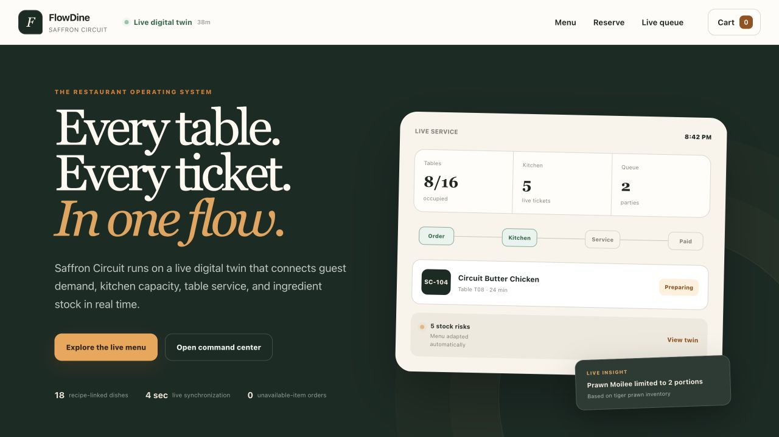
THE PRODUCT INSIGHT
The missing product is not another ordering app.
It is one live operating layer that makes every role act from the same restaurant state.
MENU ≠ STOCK
KITCHEN ≠ FLOOR
MANAGER ≠ LIVE STATE
FlowDine replaces those gaps with one continuously synchronized truth.
REAL PRODUCT / LIVE DEPLOYMENT
FLOWDINE AI / VIBEATHON 6.0
03
Notes:
Most restaurant products optimize one isolated touchpoint: ordering, billing, or inventory. Our insight was that local optimization still leaves the dining room disconnected. FlowDine models the restaurant as one living system. The guest sees availability from stock, the kitchen sees the accepted ticket, the waiter sees service priorities, and the manager sees the resulting risk and revenue signals. The value comes from the connection, not from any single screen.
[Sources]
- FlowDine AI live deployment: https://flowdine-ai.abhinavchaudhary484.chatgpt.site
- Product positioning and architecture: README.md

Slide 4
THE SOLUTION
One digital twin. Four focused experiences. One inventory truth.
Every action updates the shared operating state used by the next role.
Customer
Waiter
Discover • order • track
LIVE RESTAURANT
Serve • resolve • turn tables
Digital Twin
orders • tables • stock • demand
Kitchen
Manager
Prioritize • prepare • pass
Monitor • decide • improve
Inventory
Recipe-linked availability
FLOWDINE AI / VIBEATHON 6.0
04
Notes:
FlowDine gives each role a focused workspace while keeping the underlying truth shared. Customers get confidence before ordering. Kitchen staff get prioritized tickets with notes and allergens. Waiters get the next service action and a live table map. Managers get revenue, demand, stock, and bottleneck signals. Inventory is not a separate afterthought; it participates in every accepted order and continuously reshapes what the menu can promise.
[Sources]
- FlowDine AI product surfaces and shared-state architecture: README.md and docs/ARCHITECTURE.md

Slide 5
THE END-TO-END PROOF
One order moves the entire restaurant forward.
No re-entry. No manual stock toggle. No invisible handoff.
01
02
03
04
05
06
07
Scan / browse
Place order
Kitchen accepts
Stock reserved
Waiter serves
Bill closes
Manager sees
Live menu
Notes + table
Ticket created
Portions recalc
Table advances
Totals verified
Metrics update
1 accepted order
updates 4 role views + the inventory ledger + the audit trail
FLOWDINE AI / VIBEATHON 6.0
05
Notes:
This is the workflow judges can experience in the live product. A guest places a table order with notes. The server checks permissions and inventory, reserves the recipe ingredients, and creates the kitchen ticket. Kitchen and waiter roles advance the same order state. Billing uses paise-safe totals, and the manager view reacts to the same event. The important proof is that each step changes what the next role sees.
[Sources]
- FlowDine AI order lifecycle: README.md
- Server-authoritative domain transitions: lib/domain.ts

Slide 6
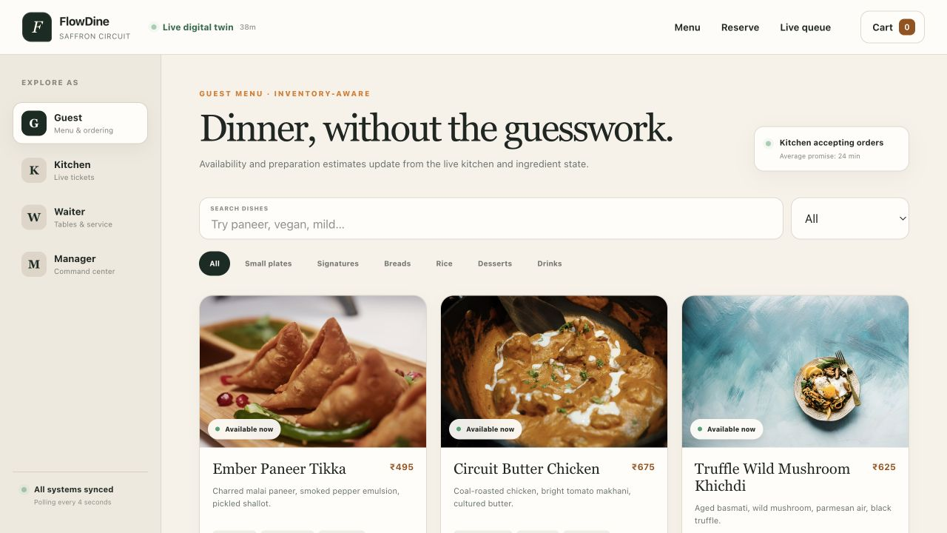
SIGNATURE INNOVATION
Availability is calculated - never manually guessed.
The limiting recipe ingredient becomes the truthful menu promise.
LIVE MENU
Illustrative low-stock case
Ember Paneer Tikka
Paneer
720g ÷ 180g
4 portions
Greek yogurt
245ml ÷ 35ml
7 portions
MIN(4, 7)
ONLY 4 LEFT
At zero, ordering is blocked automatically.
FLOWDINE AI / VIBEATHON 6.0
06
Notes:
This is our signature innovation. A dish is not marked available because someone remembered to toggle it. FlowDine divides usable ingredient stock by each recipe requirement and takes the minimum. In this low-stock example, paneer supports four portions while yogurt supports seven, so the menu can truthfully promise only four. When an order is accepted, inventory is reserved immediately. When the limiting ingredient reaches zero, the dish becomes unavailable automatically.
[Sources]
- Recipe-linked availability implementation: lib/domain.ts and lib/seed.ts
- Real guest-menu screenshot captured from https://flowdine-ai.abhinavchaudhary484.chatgpt.site/menu

Slide 7
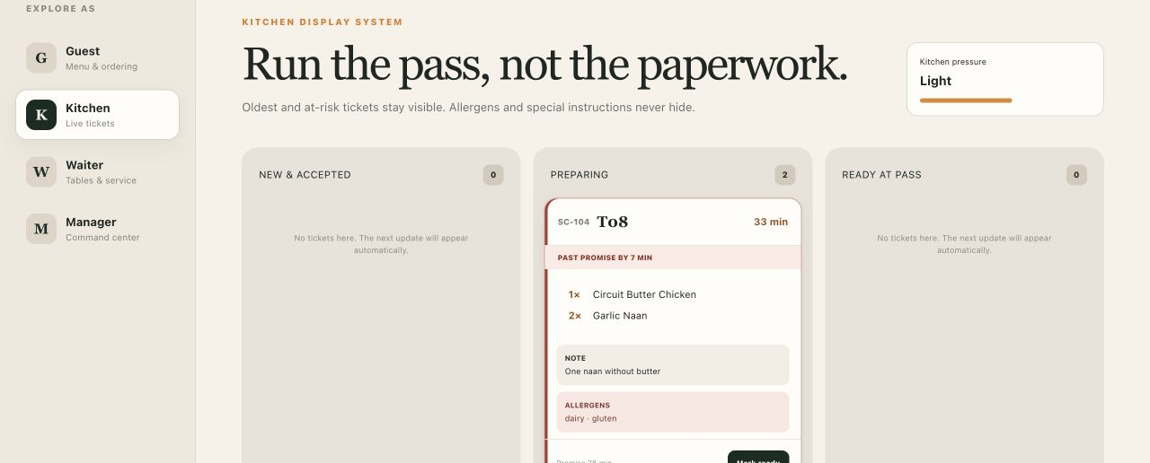
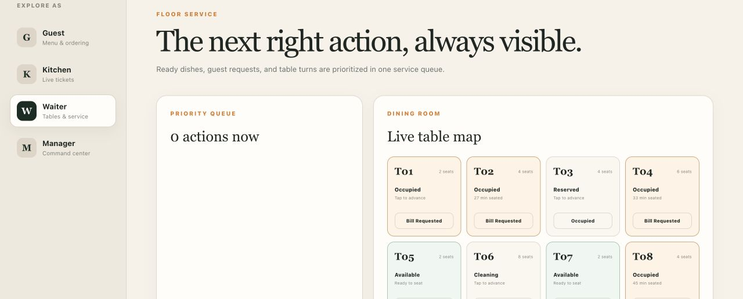
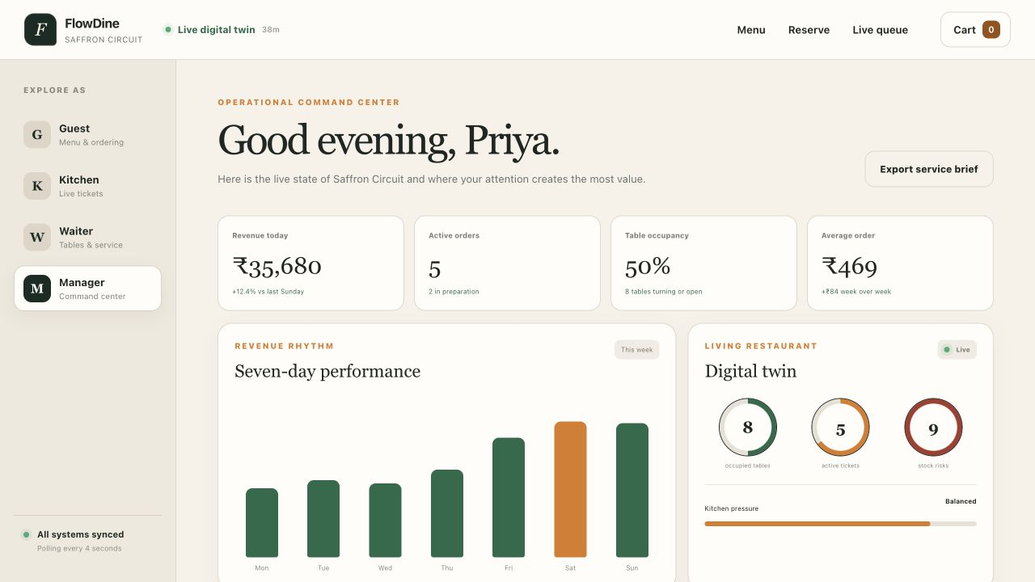
ROLE-BASED EXPERIENCE
The same truth, designed for the next decision.
CUSTOMER
KITCHEN
Live menu + ordering
Prioritized ticket flow
WAITER
MANAGER
Tasks + table service
Command center
FLOWDINE AI / VIBEATHON 6.0
07
Notes:
The interface changes with the role, but the operating state does not. Guests browse live availability and order with confidence. Kitchen staff see ticket age, promise risk, notes, and allergens. Waiters see ready dishes, guest requests, and table turns. Managers see revenue, demand, inventory, and bottlenecks. This focus keeps each screen calm and actionable while preserving one end-to-end workflow behind the scenes.
[Sources]
- Real role screenshots captured from https://flowdine-ai.abhinavchaudhary484.chatgpt.site/menu, /kitchen, /staff, and /dashboard
- FlowDine role permission matrix: lib/domain.ts and docs/ARCHITECTURE.md

Slide 8
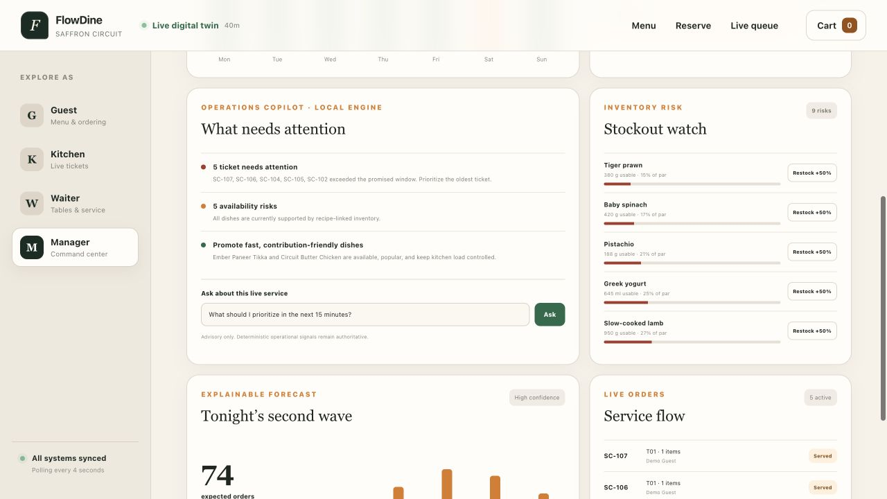
INTELLIGENT OPERATIONS
AI advises. Deterministic signals stay in control.
The manager gets prioritized action, not another dashboard to interpret.
PREDICT
Demand forecast
Weighted recent service history
PROTECT
Stockout watch
Recipe-aware inventory risk
PRIORITIZE
Bottleneck detection
Late tickets and service pressure
RECOMMEND
Smart suggestions
Available, popular, load-safe dishes
Gemini when configured • evidence-based fallback without a key
FLOWDINE AI / VIBEATHON 6.0
08
Notes:
FlowDine turns operational data into the next best action. It forecasts demand, surfaces stock risks, detects late tickets, and recommends dishes that are actually available and manageable for the kitchen. The AI copilot can use Gemini when configured, but it is deliberately advisory. Inventory, billing, permissions, and forecast calculations remain deterministic. If the AI key is missing or the call fails, managers still receive evidence-based local guidance.
[Sources]
- Intelligence and safety design: README.md, docs/ARCHITECTURE.md, and app/api/copilot/route.ts
- Real manager intelligence screenshot captured from https://flowdine-ai.abhinavchaudhary484.chatgpt.site/dashboard

Slide 9
MANAGEMENT COMMAND CENTER
A manager can read the whole service in seconds.
₹35,680
5
REVENUE TODAY
ACTIVE ORDERS
50%
5
TABLE OCCUPANCY
DELAYED TICKETS
9
₹469
LOW-STOCK INGREDIENTS
AVERAGE ORDER
LIVE SERVICE MIX
Current seeded tickets • item quantities
FLOWDINE AI / VIBEATHON 6.0
09
Notes:
The command center is designed for a five-second scan. Revenue, active orders, occupancy, average order value, delayed tickets, and stock risk appear together because they influence one another. The revenue rhythm shows the service pattern, while the digital twin shows table, ticket, and inventory pressure. The service-mix chart uses quantities in the seeded live tickets, so the demo remains explainable rather than presenting invented historical sales.
[Sources]
- Real manager dashboard captured from https://flowdine-ai.abhinavchaudhary484.chatgpt.site/dashboard
- Seeded service metrics and ticket items: lib/seed.ts

Slide 10
TECHNOLOGY ARCHITECTURE
Production-shaped today. Production-hardened by design.
LIVE JUDGE DEPLOYMENT
Next.js 16 + React 19
Route handlers
TypeScript domain engine
Cloudflare D1
Guest and staff surfaces
Validated API actions
Inventory, billing, permissions
Shared state + audit log
Optional Gemini REST • deterministic fallback
PRODUCTION SAAS HARDENING PATH
Supabase Auth
PostgreSQL + RLS
Realtime events
Provider integrations
Email verification + Google OAuth
Tenant-isolated restaurant data
Push updates instead of polling
Payments + notifications
LIVE: ChatGPT Sites / Cloudflare • 4-second shared-state sync • strict TypeScript • tested domain logic
FLOWDINE AI / VIBEATHON 6.0
10
Notes:
The live judge build uses Next.js and React, server route handlers, a pure TypeScript domain engine, and Cloudflare D1 with optimistic versioned writes and an audit log. Gemini is optional and safely falls back to local evidence-based guidance. For production SaaS, the repository includes a normalized Supabase and PostgreSQL migration path. Real identity, membership-backed row security, realtime events, and provider integrations are the next hardening layer, not features we falsely claim as live.
[Sources]
- Current architecture and deployment: README.md and docs/ARCHITECTURE.md
- Supabase production reference migration: supabase/migrations/202607260001_flowdine.sql

Slide 11
HACKATHON LEVEL MAP
The full operating vision is live - with one honest identity gap.
Bronze
Modern role-based product experience
COMPLETE
Responsive guest, kitchen, waiter, and manager interfaces
Silver
Digital restaurant workflows + authentication
PARTIAL
Workflows complete; email/Google authentication is not runtime-connected
Gold
Management dashboard and daily operations
COMPLETE
Orders, tables, inventory, revenue, service flow, and analytics
Platinum
Intelligent operational decision support
COMPLETE
Forecasting, recommendations, stock risk, insights, and copilot
Bonus
Live restaurant digital twin
COMPLETE
Recipe-linked availability, shared state, audit trail, and bill splitting
Submission truth: demo role switching proves workflows; Supabase Auth is the remaining Silver requirement.
FLOWDINE AI / VIBEATHON 6.0
11
Notes:
Against the official levels, FlowDine completes the modern UX, digital workflows, management dashboard, intelligent operations, and bonus innovation. The only requirement we should not overstate is identity authentication. The public demo has a visible role switcher and the API applies a permission matrix, but email verification and Google OAuth are not connected to runtime identities. We present that gap honestly while demonstrating that the broader operating system is already functional and deployed.
[Sources]
- VibeAthon 6.0 ranking and user stories: Vibeathon_6.0_PS.pdf, pages 2-4
- Current authentication boundary and feature checklist: README.md and docs/FEATURE_CHECKLIST.md

Slide 12
FLOWDINE AI
Let the restaurant
think as one.
FlowDine AI reduces waiting, prevents unavailable-order frustration, improves staff coordination, and gives managers real-time control.
PROMISE
COORDINATE
PREDICT
CONTROL
Only what stock can fulfill
One state across every role
Demand and stock risk sooner
Act before service breaks
OPEN THE LIVE RESTAURANT →
flowdine-ai.abhinavchaudhary484.chatgpt.site
FLOWDINE AI / VIBEATHON 6.0
12
Notes:
FlowDine AI turns the restaurant from a collection of disconnected tools into one coordinated operating system. Guests receive promises the kitchen and inventory can actually keep. Staff see the next right action. Managers see risk early enough to change the outcome. Our invitation is simple: open the live demo, place an order, and watch that single event move through inventory, kitchen, service, and management. That connected proof is the product.
[Sources]
- Live public demo: https://flowdine-ai.abhinavchaudhary484.chatgpt.site
- FlowDine AI end-to-end product summary: README.md

