Slide 1
📷
Smart Parking System
Using ANPR — Automatic Number Plate Recognition
Final Review Presentation
Midhunmadhav A R | Nimal Krishna M | Abhinave P B
Govt. Engineering College, Thrissur — March 2026

Slide 2
Introduction
Kanakakunnu Palace in Thiruvananthapuram is one of Kerala’s most visited tourist destinations receiving thousands of visitors on a daily basis.
The existing parking infrastructure at this location relies entirely on manual processes – vehicles arrive at the gate,
Staff physically record vehicle details, collect payments, and manually assign parking slots

Slide 3
Problem Statement
Why does Kanakakunnu Palace need this system?
🚗
💵
📋
Long Queues
Payment Process Delay
Manual Records
Every vehicle stops at the gate for manual entry — creating severe bottlenecks during peak hours
Entry gate payment option. All payments collected manually at the gate by staff
Vehicle details are recorded manually, leading to errors and inefficiency
Result: Poor visitor experience, high staff workload, and manual parking management.

Slide 4
Objectives
To develop a web-based vehicle registration system that allows users to register and pay for parking in advance.
To implement an Automatic Number Plate Recognition (ANPR) system for real-time vehicle identification,Verification and automated entry.
To build an admin dashboard for monitoring parking slots, tracking vehicle entry/exit, and managing operations efficiently.
To enable secure authentication and digital payments, reducing manual work and improving user convenience.

Slide 5
Existing Solutions
Manual Parking System
Parking is managed manually by staff, where vehicle details are recorded and payments are collected at the entry gate,
leading to long queues and delays.
Barrier-Based Ticketing System Vehicles receive a ticket at entry and pay at exit, but still need to stop at gates, causing congestion and inefficiency.
RFID-Based Parking System Systems enable automatic entry but require prior registration and tag configuration before arriving, making it less suitable for tourist venues with large numbers of first-time and walk-in visitors..
ANPR-Based Systems Uses number plate recognition for automated access, but often lacks integration with pre-registration and payment systems.
Online Parking Booking Systems Allows advance booking and payment, but still requires manual verification at entry, reducing efficiency

Slide 6
Proposed Solution
A dual-lane Smart Parking System combining online pre-registration with ANPR camera entry:
📝
📷
✅
Pre-register
→
Camera Reads
→
Auto Verify
Visitor register vehicle & pays digitally via web portal before arriving
ANPR camera reads number plate at entry — no stopping, no manual check
System checks database and opens gate automatically for registered vehicles
🚗 ANPR Lane → Pre-registered visitors enter automatically | 🧑 Manual Lane → Walk-in visitors handled by staff as before
Walk-in visitors are not excluded — the manual lane continues to operate alongside the ANPR lane.

Slide 7
System Architecture
📱
📷
🗄️
🚧
📊
→
→
→
→
Web Portal
ANPR Camera
Database
Gate Entry
Admin Dashboard
Registration
& Payment
Plate
Detection
Verify &
Match
Open /
Deny
Logs &
Monitoring
Entry Flow
Exit Flow
Vehicle arrives → Camera reads plate
Vehicle exits → Camera reads plate
↕
Database verifies registration & payment
Exit timestamp logged in database
Slot availability checked → Gate opens → Allocate slot
Parking slot marked as available

Slide 8
ANPR Module — How It Works
1
📸
Image Capture
Camera captures frame of incoming vehicle at entry/exit point
2
🔍
Plate Detection
YOLOv8 model locates the number plate region in the image
3
🔤
OCR / Text Read
PaddleOCR extracts alphanumeric text from the cropped plate image
4
📊
Confidence Check
Score ≥ 75% → proceed. Below threshold → flag for manual review
5
🗄️
Database Match
Plate compared with registered vehicles. Grant access or deny entry

Slide 9
Implementation
Technology Stack
Web Portal — 5 Pages
Component | Technology
Frontend | React 18 + Vite + Tailwind CSS
ANPR Detection | YOLOv8
OCR | PaddleOCR
Database | Supabase (PostgreSQL)
Authentication | Google Auth (Supabase Auth)
Version Control | Git + GitHub
🔐
Login / Landing
User & Admin toggle, Google - Login
📝
Signup (3-Step)
Continue with Google → Name and Phone no
🚗
Vehicle Register
Details → payment → Confirm
🔑
Authentication
Payment Authentication flow
📊
Admin Dashboard
Live stats, logs, controls, CSV export

Slide 10
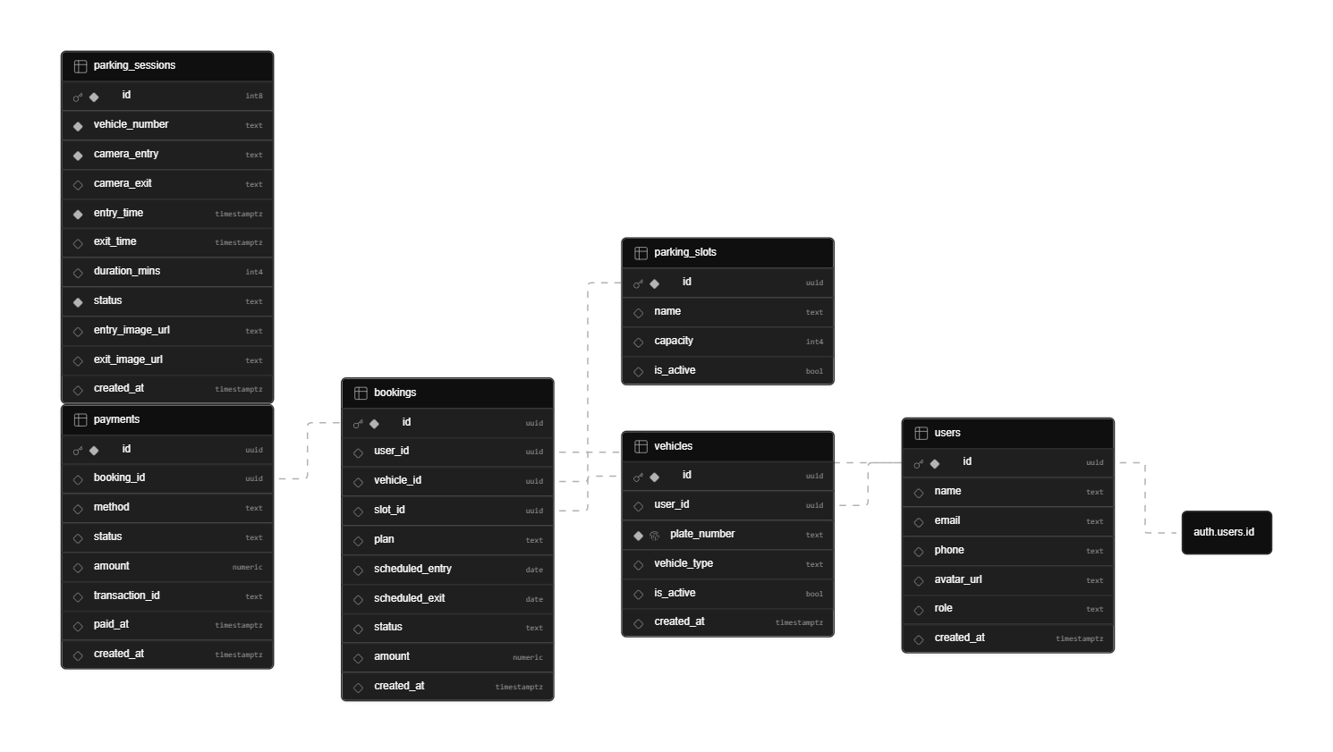
Database

Slide 11
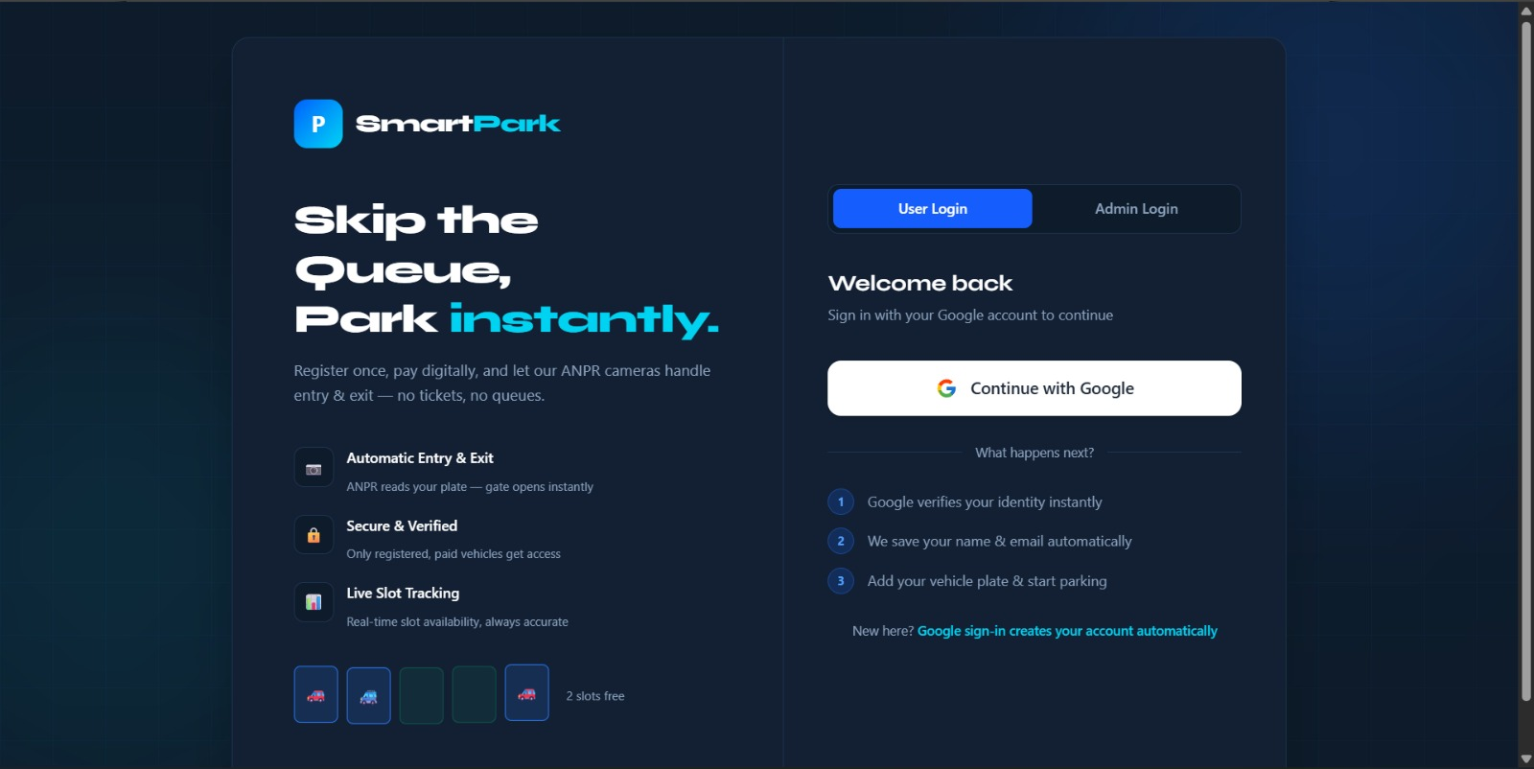

Slide 12
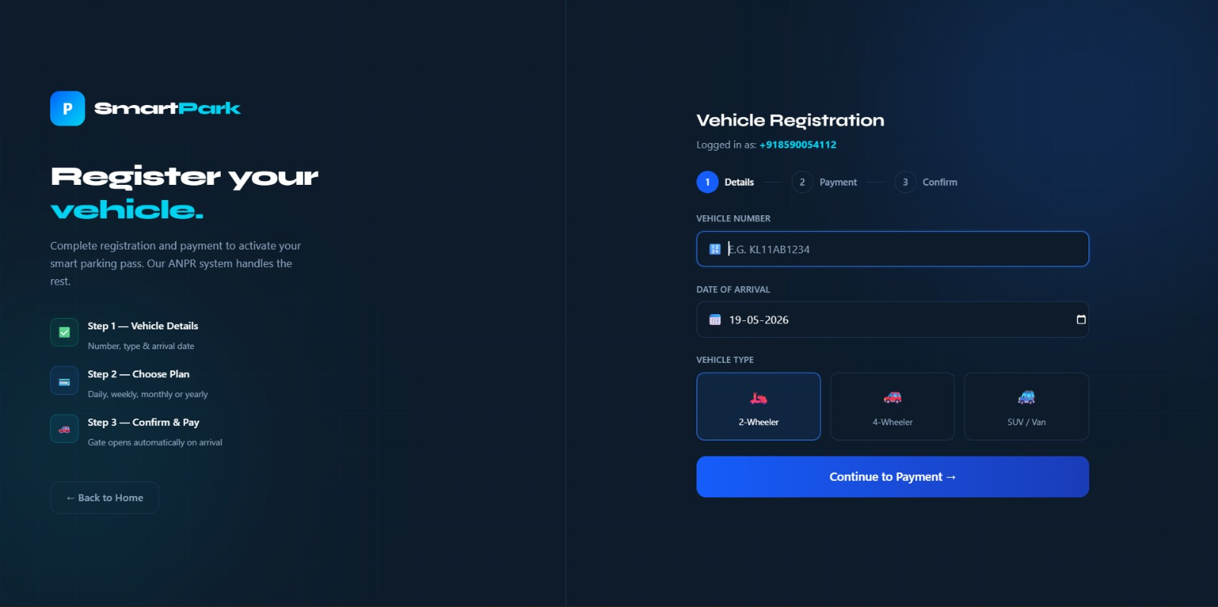

Slide 13
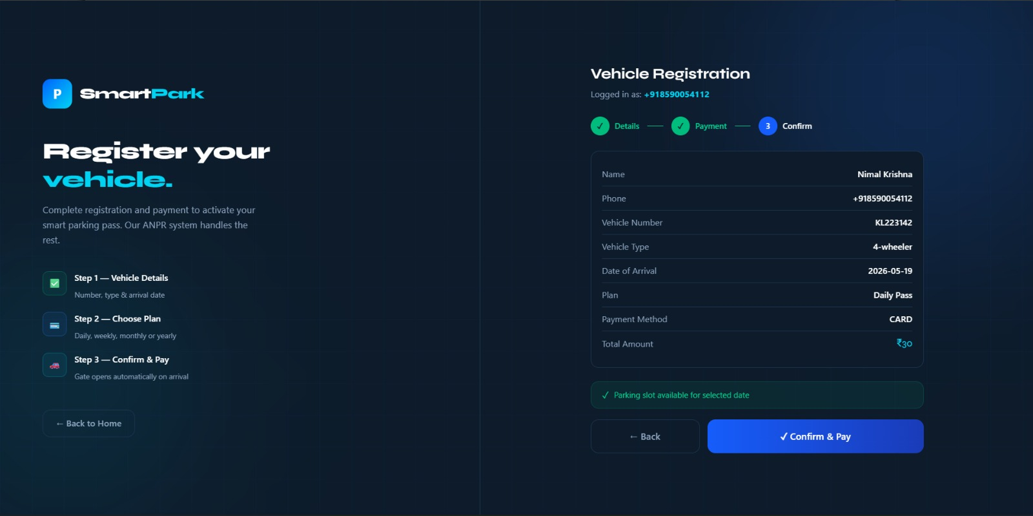

Slide 14
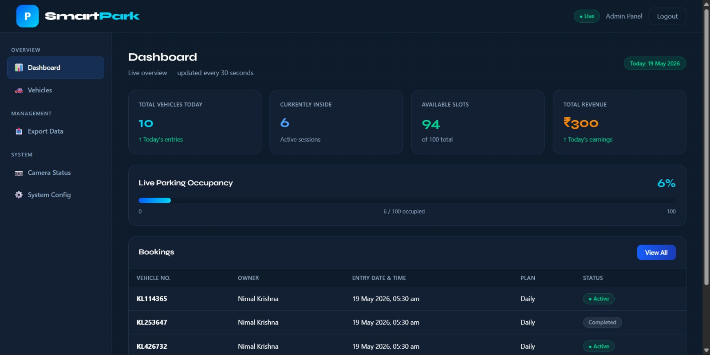

Slide 15
Admin Dashboard
7 sections accessible via sidebar — provides complete control and visibility over the parking system:
📊
Dashboard
📥
Export Data
Live stats — vehicles today, currently inside, available slots, today's revenue. Slot booked Vehicle details
Download entry/exit logs as CSV for reporting, analysis, or audit purposes.
🚗
Vehicles
⚙️
System Config
List of vehicles inside the Parking area, vehicle type, and force-exit control.
Configure total parking slots, ANPR confidence threshold, and operating hours.
📋
Event Log
Every ANPR detection event with plate number, confidence score, timestamp, and access decision.
🎮
Manual Controls
Staff can manually grant entry or force exit for any vehicle — handles edge cases and walk-ins.

Slide 16
Results
Vehicle number plate detection works reliably ANPR pipeline is successfully detecting and reading plates from test images or video frames.
User sign‑up and sign‑in functionality works New users can register, and existing users can log in without errors.
Vehicle registration and slot booking flow works Users can register their vehicle details and successfully book a parking spot when capacity allows.
Demo or simulated payment works The payment step completes as intended, marking the booking as confirmed in the system.
Admin can view complete vehicle and booking details
The administrator can access and monitor complete information about registered users and vehicles

Slide 17
Future Scope
1
Individual Slot Monitoring — Individual slot identifiers (A1, A2, B1...) will enable precise slot allocation and real-time per-slot occupancy tracking on the admin dashboard.
2
Visitor Mobile App — App for visitors to register, pay, check slot availability, and get entry confirmation on their phone
3
Multi-Venue Deployment across Kerala — Extend system to other tourist destinations with per-venue slot count, pricing, and operating hours
4
Subscription-Based Parking Plans — Introduce monthly and yearly parking plans that allow users to access parking with a one-time payment, reducing repeated booking and improving convenience.

Slide 18
Conclusion
✓ System is fully built and ready to deploy — web portal, ANPR module, admin dashboard, and database are all functional
✓ Payment flow is demo-ready — only needs integration with a real gateway (Razorpay / PayU) to go fully live
✓ ANPR achieves accuracy overall— tested and evaluate accuracy overall
✓ Dual-lane design works for everyone — ANPR fast lane for registered visitors, manual lane for walk-ins; no one is left out
✓ Solves a real problem at a real location — purpose-built for Kanakakunnu Palace and scalable to any parking facility in Kerala
Government Engineering College, Thrissur — March 2026

Slide 19
Thank You
Midhunmadhav A R | Nimal Krishna M | Abhinave P B
Guide: Mr. Joby N J, Asst. Professor — GEC Thrissur

