Slide 1
NEXORA AI
One intelligent workspace. Infinite business possibilities.
Executive product review — V1 build
AI business operations & workflow intelligence SaaS · independent product · Nov 2026

Slide 2
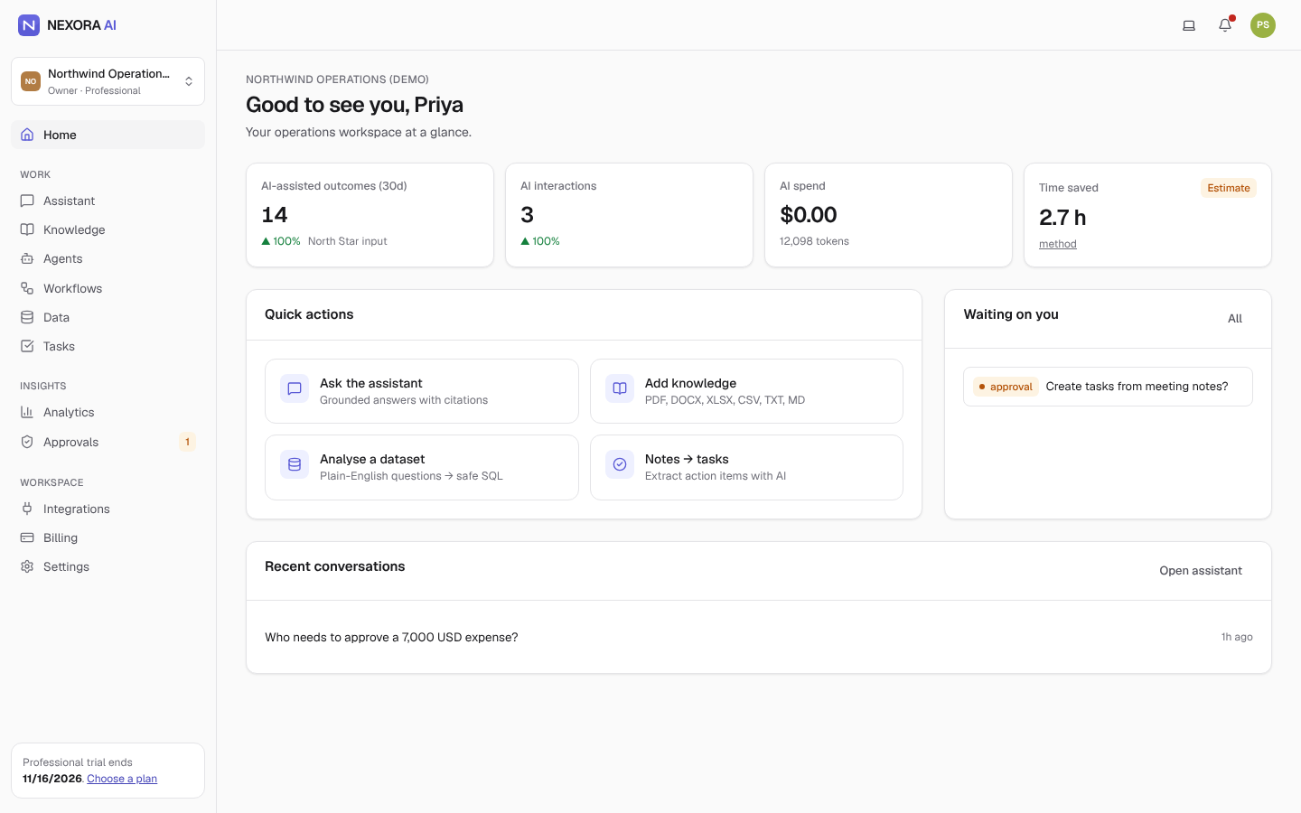
WHERE WE ARE
Executive summary
• Problem: ops-heavy 10–200 person teams lose hours to repeated questions, lost follow-ups and manual reporting; generic AI is ungrounded and ungoverned.
• Product: cited answers from company documents, notes→owned tasks, approval-gated agents & workflows, safe NL→SQL, outcome & cost analytics.
• Status: V1 feature-complete and verified (90 backend tests, 8 E2E journeys incl. Docker prod stack, AI eval harness). Not yet launched.
• Key decision: model shows Pro margin falls from 63% → 11% at full usage → cap included usage + credit packs before launch.
• Ask: 5 design partners with real documents; LLM budget for real-provider evals; ~$0.9M to reach ~break-even (Base case).
NEXORA AI · Executive product review · pre-launch prototype — figures are hypotheses unless marked measured

Slide 3
WHY NOW
Problem & opportunity
Job to be done | Today
Give the right, current answer without pinging the ops lead | Slack DMs, stale wiki
Turn meetings into owned follow-ups | Manual retyping, lost items
Answer a numbers question now | Wait for analyst
Automate hand-offs, approve risky steps | Brittle zaps, no audit
Show what AI saves and costs | Anecdotes
Signal | Data
Orgs using AI (McKinsey 2025) | 88%, few at scale
India Udyam-registered MSMEs (Dec 2025) | ~7.3 crore
TAM / SAM (assumption) | ~$21.6B / ~$2.2B
Base SOM @36 mo (model) | ~$1.3M ARR
Sources and assumptions: MARKET_RESEARCH.md. No interviews conducted yet — validation plan defined.
NEXORA AI · Executive product review · pre-launch prototype — figures are hypotheses unless marked measured

Slide 4
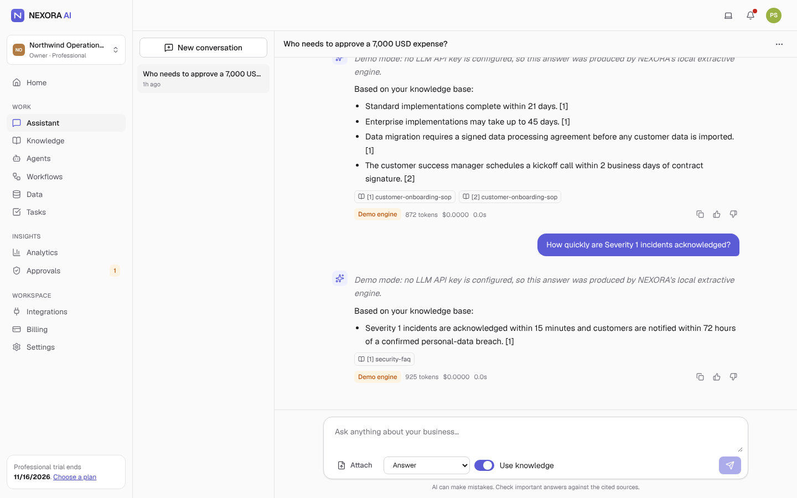
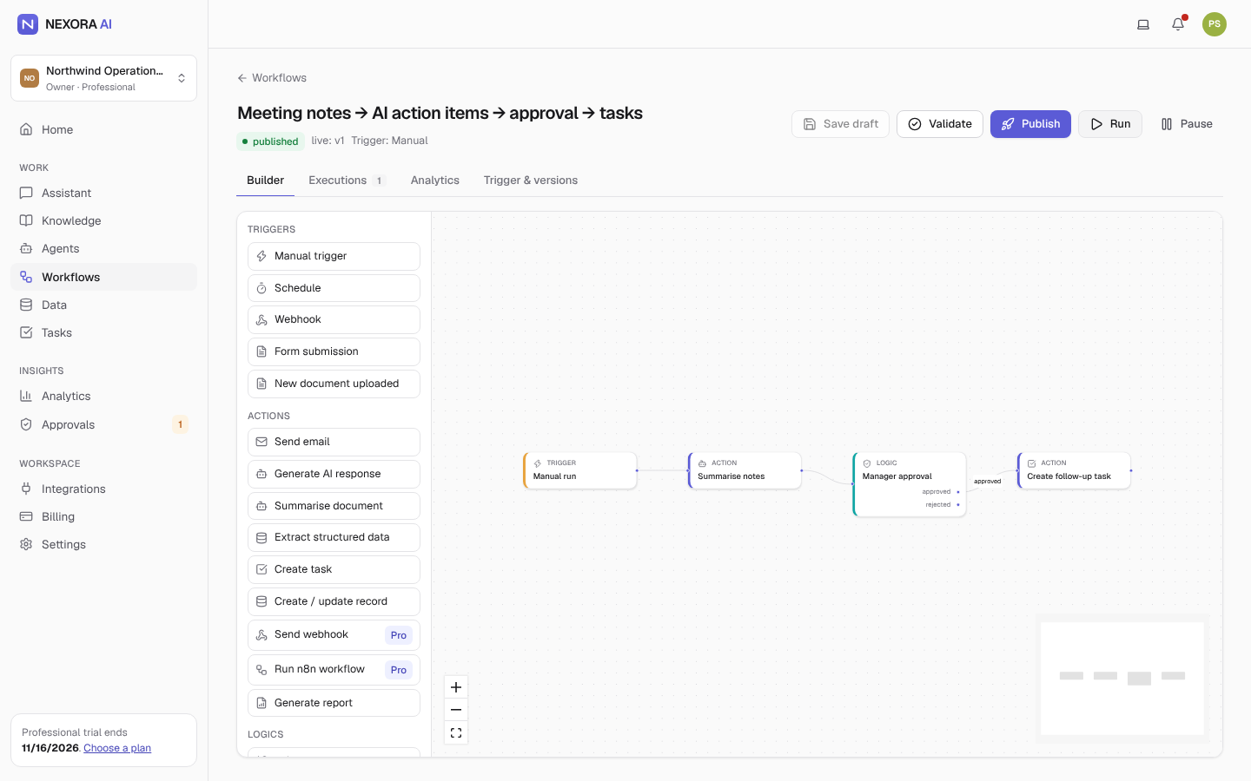
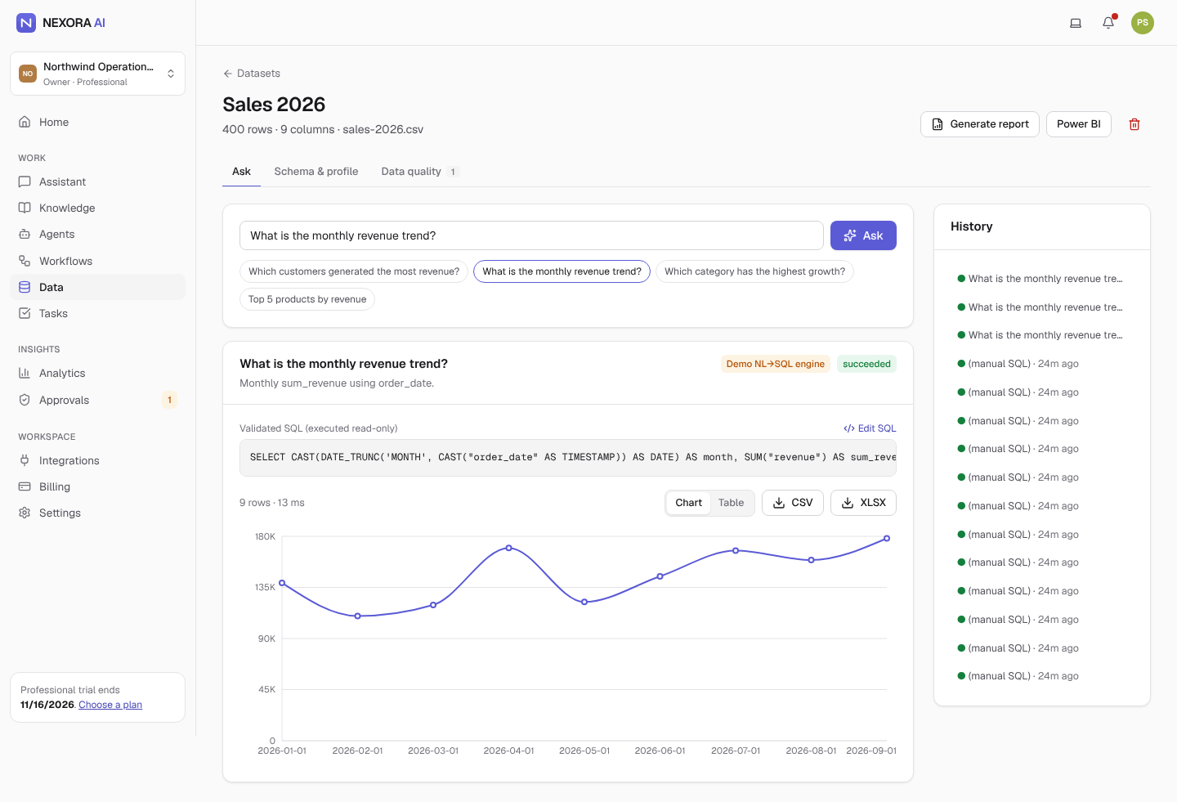
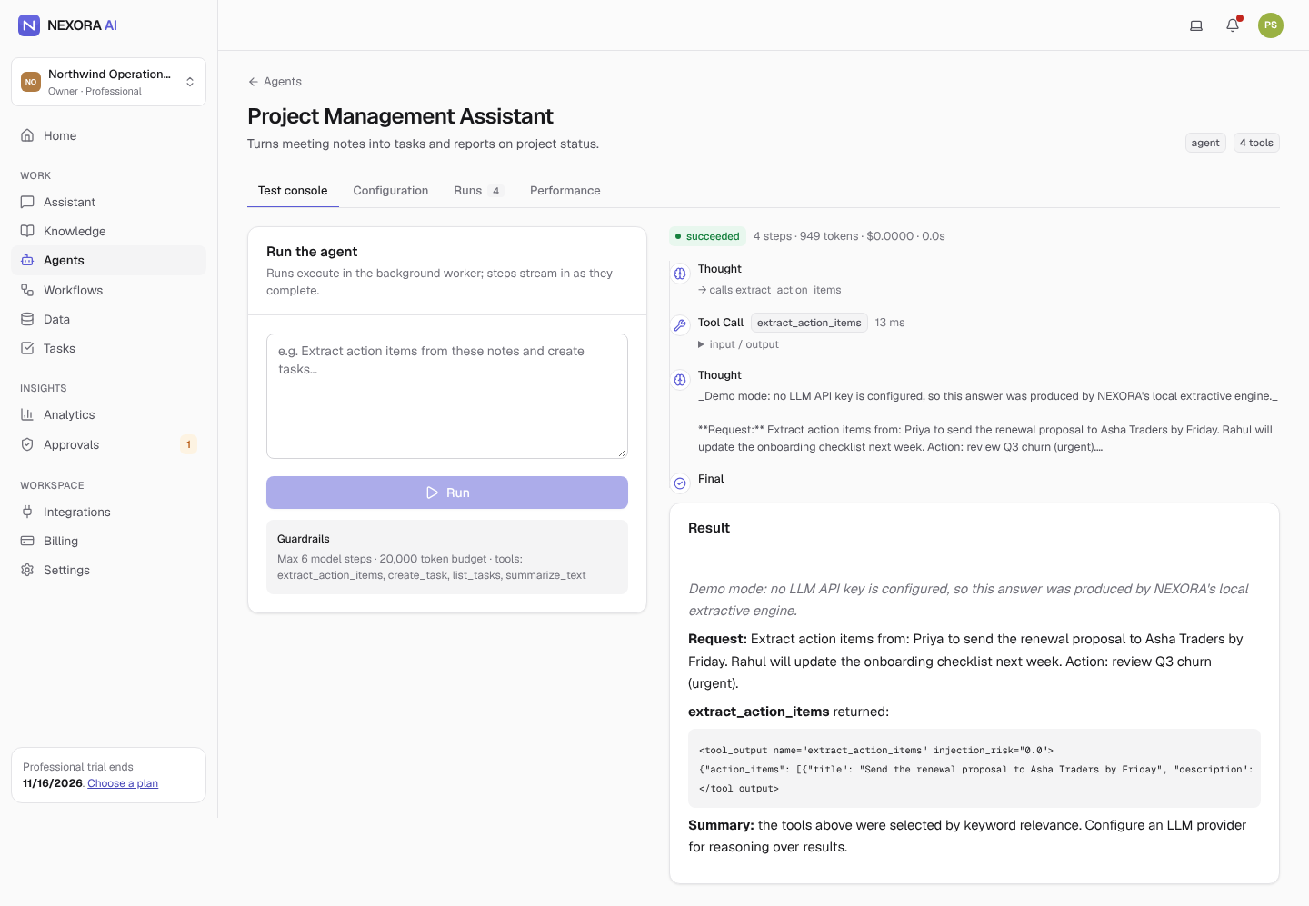
WHAT WE BUILT
Product overview
• Assistant with verified citations
• Knowledge base: 6 formats, hybrid RAG, role-based access, injection defence
• Agent Studio: 8 templates, tool allow-lists, approvals
• Workflows: 20 nodes, versions, HMAC webhooks, forms, schedules
• Data: NL→SQL with AST guard, charts, exports
• Tasks, analytics, billing, integrations, admin console
NEXORA AI · Executive product review · pre-launch prototype — figures are hypotheses unless marked measured

Slide 5
TRADE-OFFS WE MADE
Key product decisions
Decision | Instead of | Why
Per-org seat bands, hard limits, no overage | Per-seat AI pricing | Cheaper than ~$20/seat suites for 5–20 person teams; predictable bills
Provider-neutral AI gateway with task routing | Single model everywhere | Cost: cheap models for simple tasks; resilience via fallback
Hybrid RAG in Postgres with SQL-level permissions | Separate vector DB | Permission filter in the same query; one fewer system
Single persisted agent + human approvals | Multi-agent framework | Reliability, auditability, pauses across processes
Own workflow engine; n8n as a node | Embed n8n | We own permissions, approvals, outcomes; n8n gives connectors
North Star = weekly AI-assisted outcomes | AI messages / WAU | Counts completed value, resists vanity metrics
NEXORA AI · Executive product review · pre-launch prototype — figures are hypotheses unless marked measured

Slide 6
RICE · ICE · MOSCOW
Feature prioritisation
Top MVP stories | RICE
Signup + password policy | 3000
Role-aware retrieval | 2700
Verified citations | 2430
AI notes → tasks | 1920
Approvals for sensitive tools | 1620
RBAC · chat · plans/limits | 1500
Next (V1) | Why
Monitoring & tracing | Before real data
Streaming responses | Real-LLM latency
Postgres RLS | Defence in depth
Razorpay (INR, GST) | India-first dependency
AI credit packs | Margin protection
Excluded deliberately: multi-agent orchestration, 100+ connectors (n8n covers), real-time co-editing, native mobile, fine-tuning.
NEXORA AI · Executive product review · pre-launch prototype — figures are hypotheses unless marked measured

Slide 7
GOVERNED BY DESIGN
AI architecture
Task | Primary model | Why
Classify / summarise | Claude Haiku 5.5 | Cheap, fast, sufficient
Chat / RAG / agents / extract | Claude Sonnet 5.5 | Balanced quality & cost
Analysis / reports | Claude Opus 5.5 | Hard reasoning, low volume
Fallbacks | OpenAI GPT routes → demo engine | Resilience
• Every call metered: tokens, cache, cost, latency, fallback
• Prompt + response caching; token budgets; per-org rate limits
• PII redaction before provider; secret stripping on output
• Injection: detect → neutralise → frame as data → down-rank
• Agents: allow-listed tools, role re-check, approval for side-effects
• NL→SQL: AST allow-list, read-only txn, timeout, row cap
NEXORA AI · Executive product review · pre-launch prototype — figures are hypotheses unless marked measured

Slide 8
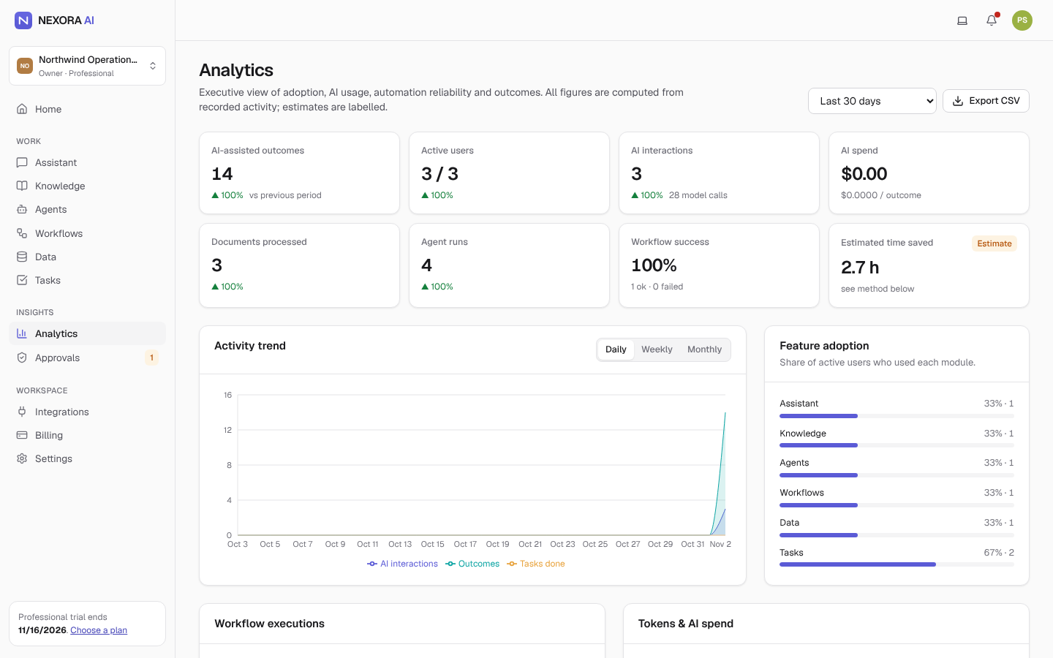
NORTH STAR & GUARDRAILS
Product metrics
• North Star: weekly successful AI-assisted outcomes — only completed, accepted actions count
• Activation: time to first cited answer < 10 min; week-1 outcome rate
• Quality guardrails: correctness ≥ 85%, hallucination ≤ 5%, workflow success ≥ 97%
• Cost guardrail: AI cost per outcome (customer-visible)
• Time saved shown only as a labelled estimate with published assumptions
• Mixpanel taxonomy + Power BI-ready SQL views
NEXORA AI · Executive product review · pre-launch prototype — figures are hypotheses unless marked measured

Slide 9
SCENARIOS
Business case (hypothetical 36-month model)
 | Conservative | Base | Optimistic
Paying orgs (M36) | 147 | 691 | 3,488
ARR (M36) | $0.23M | $1.31M | $9.35M
Blended gross margin (M36) | 37% | 68% | 82%
Break-even | > 36 mo | just > 36 mo | Month 9
Total capital need | ~$1.55M | ~$0.92M | ~$0.25M
Base assumptions: 120 signups in M1, 10% MoM growth decaying, 6% trial→paid, 65/32/3 plan mix, $550 self-serve CAC, $0.009 AI cost/message.
Unit economics (Base): Pro LTV/CAC 9.1× (4.4-mo payback) · Starter 1.5× → Starter acquired organically only.
NEXORA AI · Executive product review · pre-launch prototype — figures are hypotheses unless marked measured

Slide 10
SENSITIVITY
Profitability is most sensitive to heavy usage × model cost
• At Base cost, Pro margin is 63% at typical usage but 11% at full usage
• Plan limits are a promise of maximum cost
• Recommendation: include 5,000 messages + $50 credit packs (≈55% margin)
• Keep routing cheap models and caching; watch cost per outcome weekly
Professional plan gross margin % (y) vs utilisation of the 10,000-message allowance (x)
NEXORA AI · Executive product review · pre-launch prototype — figures are hypotheses unless marked measured

Slide 11
PLAN, NOT COMMITMENT
Roadmap
M0
M1–M3
M4–M8
M9+
MVP — built
V1 — design partners & India
V2 — connected ops
Future
• Cited assistant & KB
• Agents + approvals
• Workflows
• Data NL→SQL
• Billing & admin
• Monitoring, streaming
• RLS, MFA
• Razorpay INR
• Credit packs
• Private evals, Drive
• Jira/Confluence/HubSpot
• Scheduled agents
• Multi-table data
• SSO/SCIM
• ROI report
• Operations radar
• AI-suggested workflows
• Vertical packs
• India data residency
NEXORA AI · Executive product review · pre-launch prototype — figures are hypotheses unless marked measured

Slide 12
RISK MANAGEMENT
Top risks & mitigations
Risk | Prob. | Impact | Mitigation
Wrong answers on customer docs | Med | High | Citations, 'not found', private evals, feedback loop
Cross-tenant leakage | Low | Critical | Org-scoped queries + tests; RLS in V1; pen-test
Margin erosion from heavy users | Med | High | Routing, caching, caps, credit packs, cost alerts
Suites bundle similar features | High | High | Governance + outcomes + India focus; integrate with suites
Provider outage | Med | Med | Multi-provider fallback; graceful demo degrade
DPDP compliance gaps | Med | High | Privacy review, consent records, breach runbook
NEXORA AI · Executive product review · pre-launch prototype — figures are hypotheses unless marked measured

Slide 13
ENGINEERING EXECUTION
Quality evidence (measured)
Check | Result
Backend tests (pytest) | 90 passed · 78% coverage
E2E journeys (Playwright) | 8/8 dev + Docker prod stack
API suite (Newman) | 21 requests, 0 failures
AI eval (demo engine) | 28/29 cases
Load (20 concurrent) | 0% errors · RAG p95 243 ms
Dependency audits | 0 known vulnerabilities
UI console errors (27 screens) | 0
• 12 defects found & fixed in testing (e.g. migration dropping vector indexes, stale AI cache, unlabeled form fields)
• Eval measures the pipeline on a synthetic corpus — real-provider and customer-corpus evals are next
• Not yet tested: live LLMs, Stripe live, OAuth round-trips, load > 20 users
NEXORA AI · Executive product review · pre-launch prototype — figures are hypotheses unless marked measured

Slide 14
DECISIONS REQUESTED
Strategic recommendations
• Approve pricing change before launch: Pro 5,000 included messages + credit packs; Starter acquired organically only
• Recruit 5 design partners (India, 20–100 staff, ops-heavy) under DPA; build private eval sets with them
• Fund real-provider evaluation (~40 calls/run nightly) and observability before handling customer data
• Sequence V1: monitoring → streaming → RLS/MFA → Razorpay → credit packs → Drive/Slack
• Gate expansion bets (AI-suggested workflows, vertical packs) on experiment results, not intuition
• Success by M3: ≥40% week-1 outcome rate, ≥6% trial→paid, ≥65% gross margin, zero isolation incidents
NEXORA AI · Executive product review · pre-launch prototype — figures are hypotheses unless marked measured

