Slide 1
Discord 2.0
Using:
- HTML
- CSS
- JavaScript
Abhinav Gupta​

Slide 2
AGENDA
Draw.io and UI Pages demo:
Login Page
Signup page
User homepage​
​Areas of growth:
Dynamic group name.
Dynamic chat loading based on group selected.
Integration of new functionality (upload files, emoji’s etc.)
What have I earned ?
Creating HTML pages by splitting the pages in row and column.
Hands on experience on using flex and grid in both the direction.
Creating dynamic pages, section, nested section using JavaScript.
Event handler in JavaScript.
​

Slide 3
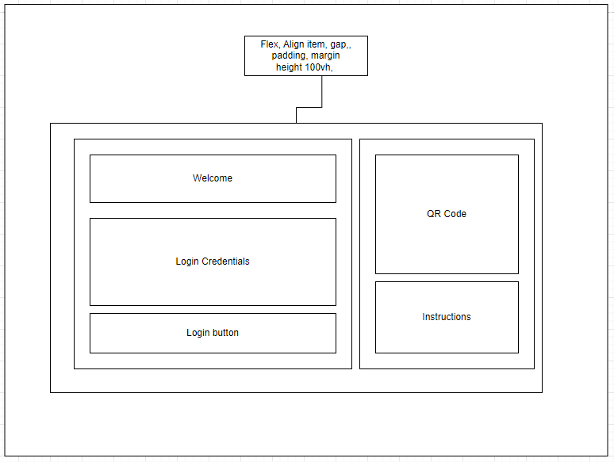
Draw.IO
1. Login Page:

Slide 4
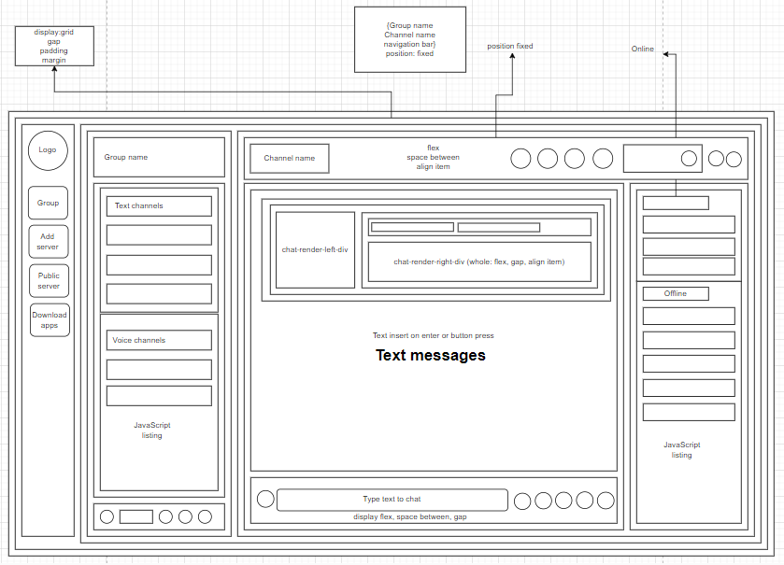
2. User Home Page

Slide 5
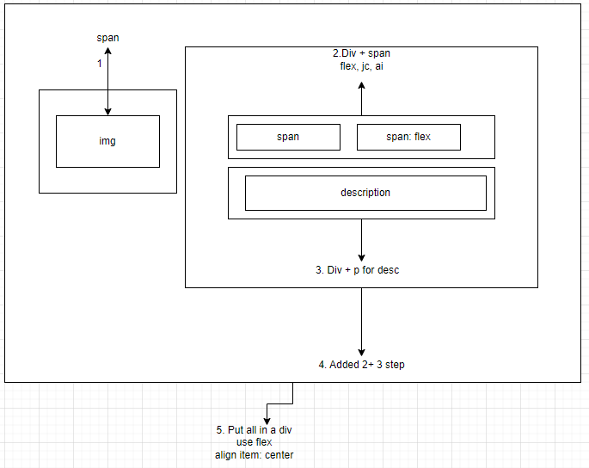

Slide 6
THANK YOU
Abhinav Gupta
Discord 2.0 | Git

