Slide 1
GYM chatbot
CAPSTONE PROJECT
Presented By: Abhinav .
College- University of Petroleum and Energy Studies,Dehradun
Department- B.Tech CSE

Slide 2
OUTLINE
Problem Statement
Proposed System/Solution
System Development Approach
Result
Conclusion
Future Scope
References

Slide 3
Problem Statement
Create a gyms and fitness chatbot to enhance member experience through technology. One effective solution is the implementation of a gym chatbot that can provide instant responses and assistance to members and potential clients. This chatbot will address common queries and facilitate various processes, such as understanding fee structures, getting diet and workout plans, hiring personal trainers, and applying to become a personal trainer

Slide 4
Proposed Solution
User Interaction: The chatbot engages users in natural language conversations, using prompts and responses to guide them through various processes related to the gym, such as membership registration, workout planning, and personal training services.
Information Collection: It prompts users to input their name, mobile number, fitness goals, preferred workout times, and any specific dietary requirements, storing this information securely.
Query Handling: The chatbot responds to inquiries about membership fee structures, workout plans, diet recommendations, personal training options, and general gym information with accurate and helpful responses.
User Guidance: It provides step-by-step guidance, directing users on how to proceed with membership registration, booking personal training sessions, following workout routines, and adhering to dietary plans, including any deadlines and necessary documentation.
Feedback Mechanism: The chatbot incorporates a feedback mechanism to improve its responses and user experience over time, ensuring continuous optimization and better service delivery.

Slide 5
System Approach
The "System Approach" section outlines the overall strategy and methodology for developing and implementing the gym chatbot.
Here's a suggested structure for this section:
System requirements: Windows 11 operating system , 8GB RAM, i5 Processor
Library required to build the model: IBM Watsonx assistant

Slide 6
Result
A gym and fitness chatbot is designed to simplify the membership process and improve the experience for both existing members and clients. Users can interact with the bot to get information about membership options, class schedules, workouts, diet and general gym details. The bot securely collects essential details such as name, mobile number, fitness goals, preferred workout times, and membership preferences. It addresses common questions and facilitates processes like understanding fee structures, getting personalized diet and workout plans, hiring personal trainers, and applying to become a personal trainer. The chatbot effectively manages inquiries, provides accurate responses, and includes a feedback mechanism for ongoing improvement.

Slide 7
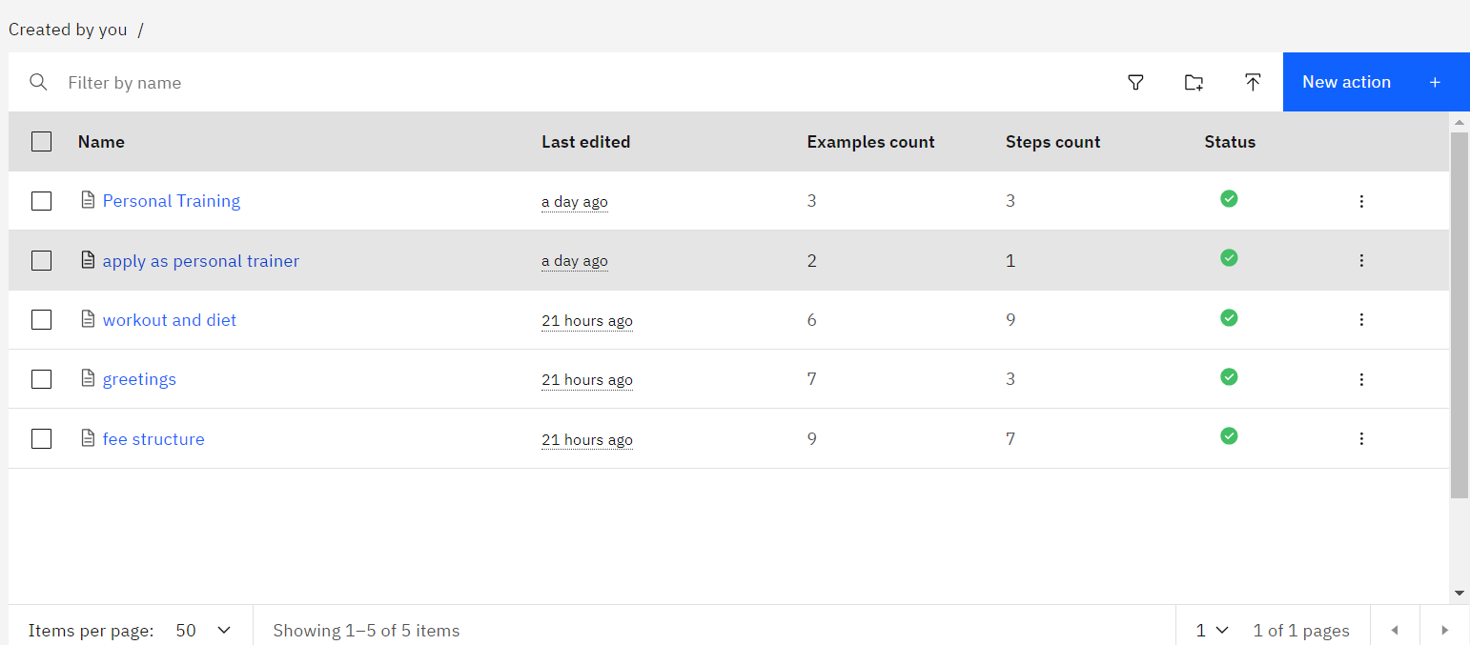
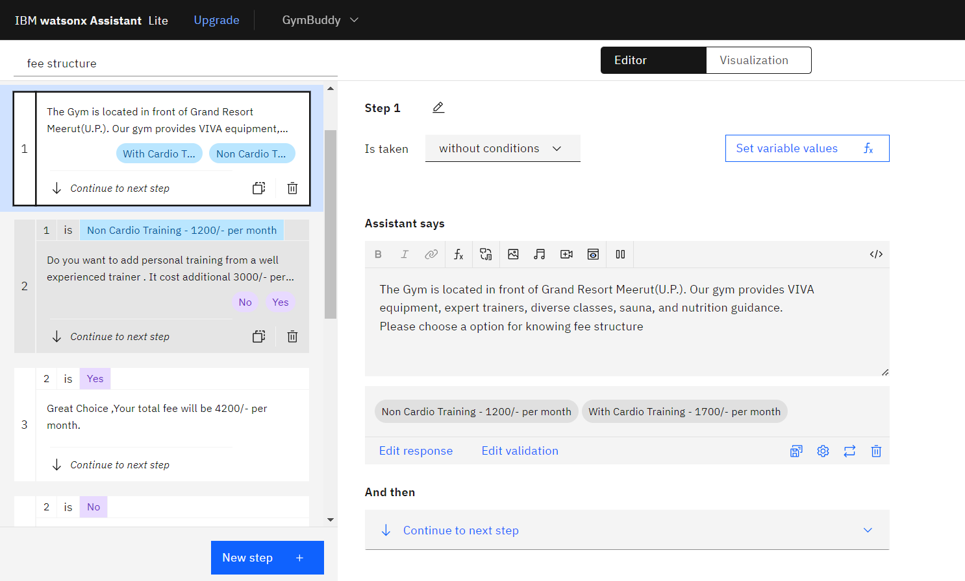
Result

Slide 8
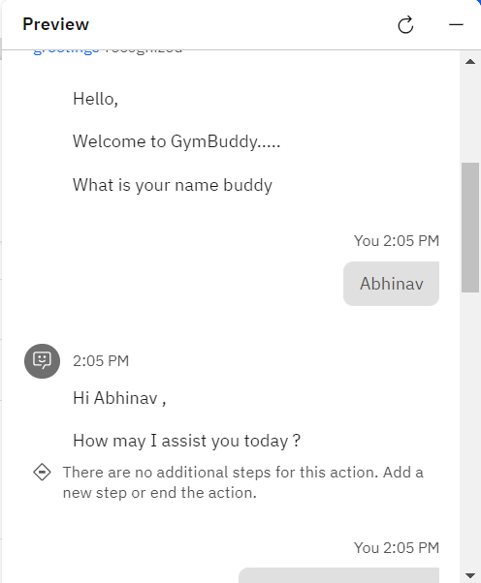
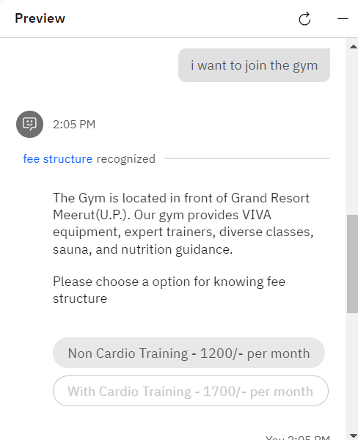
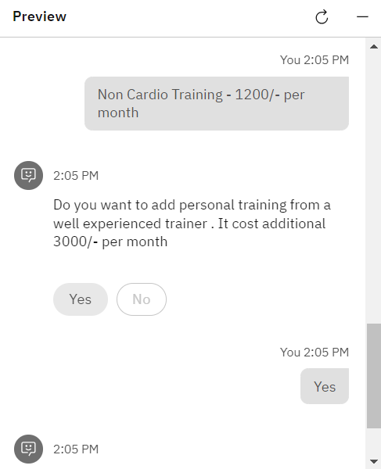
Result

Slide 9
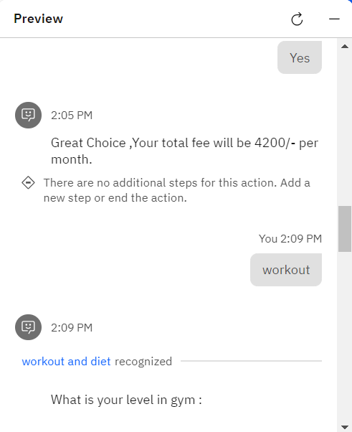
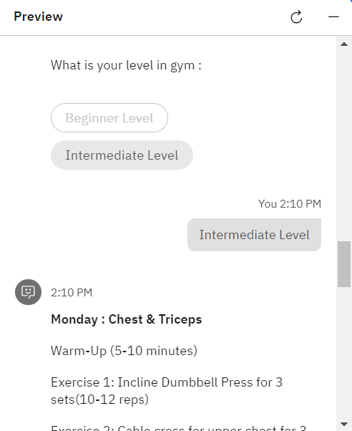
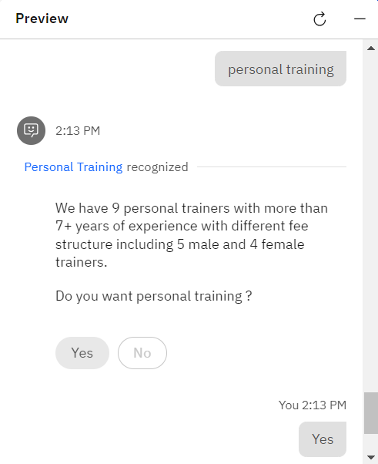
Result

Slide 10
Project Link(GitHub, Google drive link)
https://web-chat.global.assistant.watson.appdomain.cloud/preview.html?backgroundImageURL=https%3A%2F%2Fau-syd.assistant.watson.cloud.ibm.com%2Fpublic%2Fimages%2Fupx-b0125abb-df59-4ef2-b8f2-2407ac81c212%3A%3A145f31b3-46a4-4dd5-b610-befe3e981443&integrationID=1e91c128-3ef8-4043-8c03-0e25c74e9ab8&region=au-syd&serviceInstanceID=b0125abb-df59-4ef2-b8f2-2407ac81c212

Slide 11
Conclusion
In conclusion, creating a gym and fitness chatbot provides an effective solution to enhance the experience for current members and potential clients. By utilizing natural language processing and secure data collection, the chatbot guides users through various gym-related processes and delivers timely, accurate information. Its user-friendly interface and feedback mechanism ensure continuous improvement and optimization, leading to a seamless and efficient experience for both gym members and the administration.

Slide 12
Future scope
Personalized Fitness Recommendations: Tailored exercise and diet plans based on user data and progress.
Integration with Wearable Devices: Real-time health data monitoring for more accurate and personalized advice.
Virtual Training Sessions: Live guidance and virtual classes through video calls or augmented reality.
Community Engagement and Social Features: Building a community of members through shared progress, fitness challenges, and discussion forums.

Slide 13
References
IBM watsonx Assistant Documentation
IBM Developer Resources

Slide 14
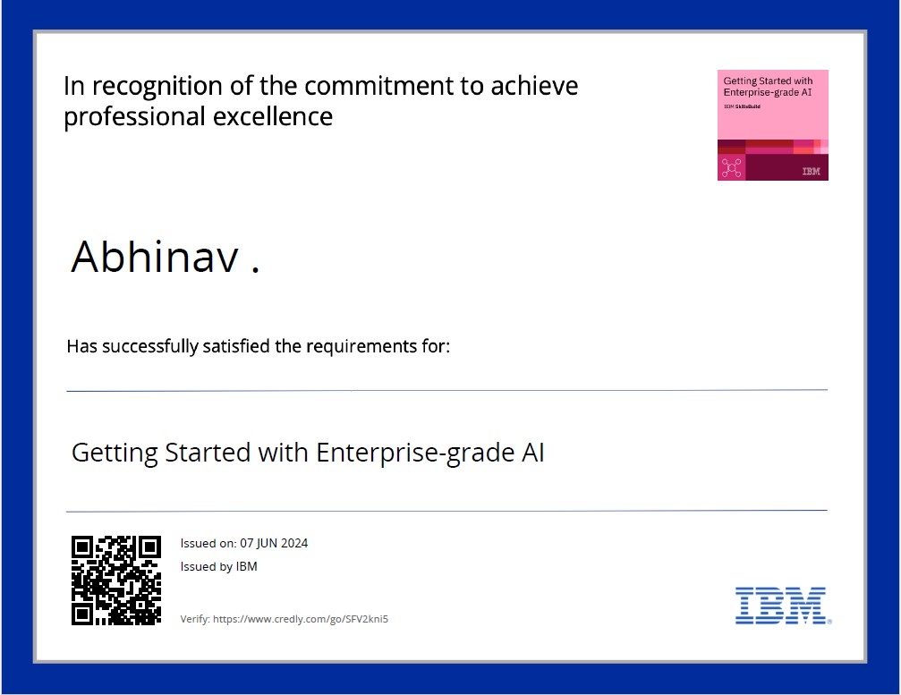
course certificate 1

Slide 15
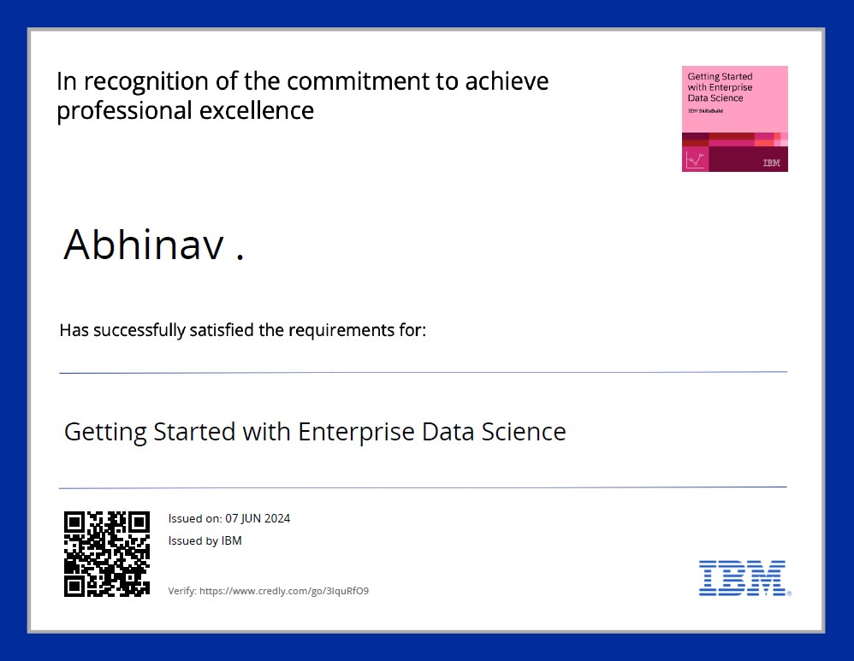
course certificate 2

Slide 16
THANK YOU

