Slide 1

Project Udyam Digital
Making small businesses go digital in one sitting: advise, quote, KYC and track on a phone, in 10 languages
YTL Hackathon 2026 · Enterprise Track A · Business case
Notes:
Project Udyam Digital: a digital-first acquisition and onboarding journey for Accel Business's SMB customers. Working prototype: advisor, quote, smart KYC, tracker and a back-office for sales and partners.

Slide 2

Only 7% of leads go live; the quote is the biggest leak
17.6 days
3
lead to activation
status-chase calls per customer
₹15,053
9.6% vs 2.0%
acquisition cost per activated SMB
activation with vs without GSTIN
60% of 4,632 drops are digitally fixable: unreachable (805), no time for a visit (531), quote slow or confusing (385), paperwork and documents (220+)
Leads reaching each stage, Apr-Jun 2026 (red = 44% conversion, the steepest drop)
Notes:
5,000 leads in Apr-Jun 2026 produced 368 activations. The steepest drop is needs-assessed to quote-accepted (44%). 60% of drop reasons are things a self-serve journey removes: unreachable owners, no time for a visit, slow or complex quotes, paperwork.

Slide 3
Who first: offices and chains; micro shops via partners
WAVE 1 · SELF-SERVE
WAVE 1 · ASSISTED
Professional offices
₹6,815/mo
Small multi-site
₹34,215/mo
Clinics, CA & law firms, coaching
12 months · setup ₹1,500 · live in 5 days
Restaurant, pharmacy & retail chains
24 months · ≈ ₹6.8k per site · one bill
25% of base · 11.1% activation · 13.8% churn · CAC ₹10.7k
15% of base · 11.0% activation · median ₹28k · 10.8% churn
Smart Office: Fibre 300 · 2 business lines · email + endpoint security for 10 · 1 TB backup · 4G failover
One-Bill Chain (5 sites): Fibre 300 + failover per site · POS & CCTV at each store · SD-WAN for central control
WAVE 2 · VIA PARTNERS
FIELD-LED
Micro retail & services
₹2,197/mo
Small manufacturers
₹16,280/mo
Kirana, salon, pharmacy
12 months · budget-trimmed automatically
Auto-parts, textile, packaging units
24 months · site survey by field team
55% of base · 4.1% activation · 22.7% churn · CAC ₹20k
5% of base · 12.8% activation · 8.1% churn (lowest)
Dukaan Starter: Fibre 100 · business SIM · cloud POS with UPI/card; WhatsApp API +₹1,249 with GSTIN
Factory Connect: Leased line 20 Mbps · 3 lines · endpoint + managed firewall · 10 machine IoT sensors
Notes:
Bundles are produced by the prototype's rules engine from the catalogue, at 12/24-month prices excluding GST. Professional offices: 25% of base, 11.1% activation, lowest CAC per activation. Multi-site: highest value (median Rs 28k) and low churn. Micro: huge base but 4.1% activation and 23% churn - a low-cost starter bundle sold and installed by local partners.

Slide 4
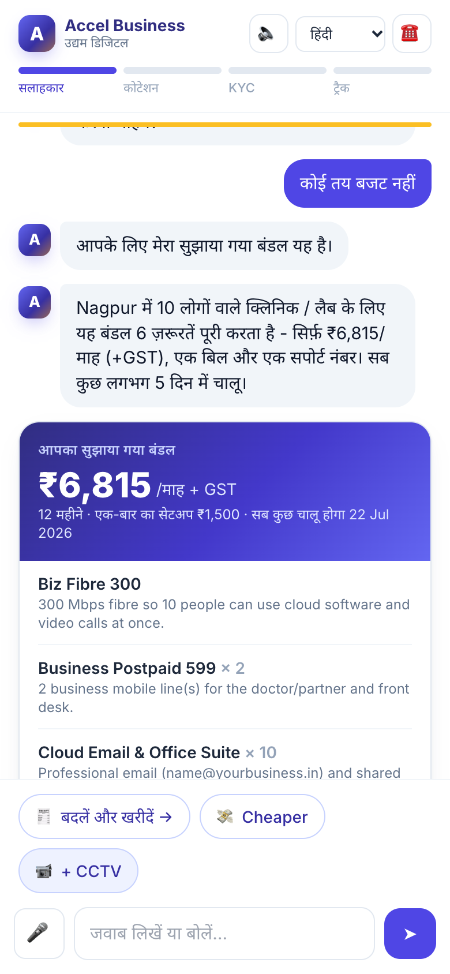
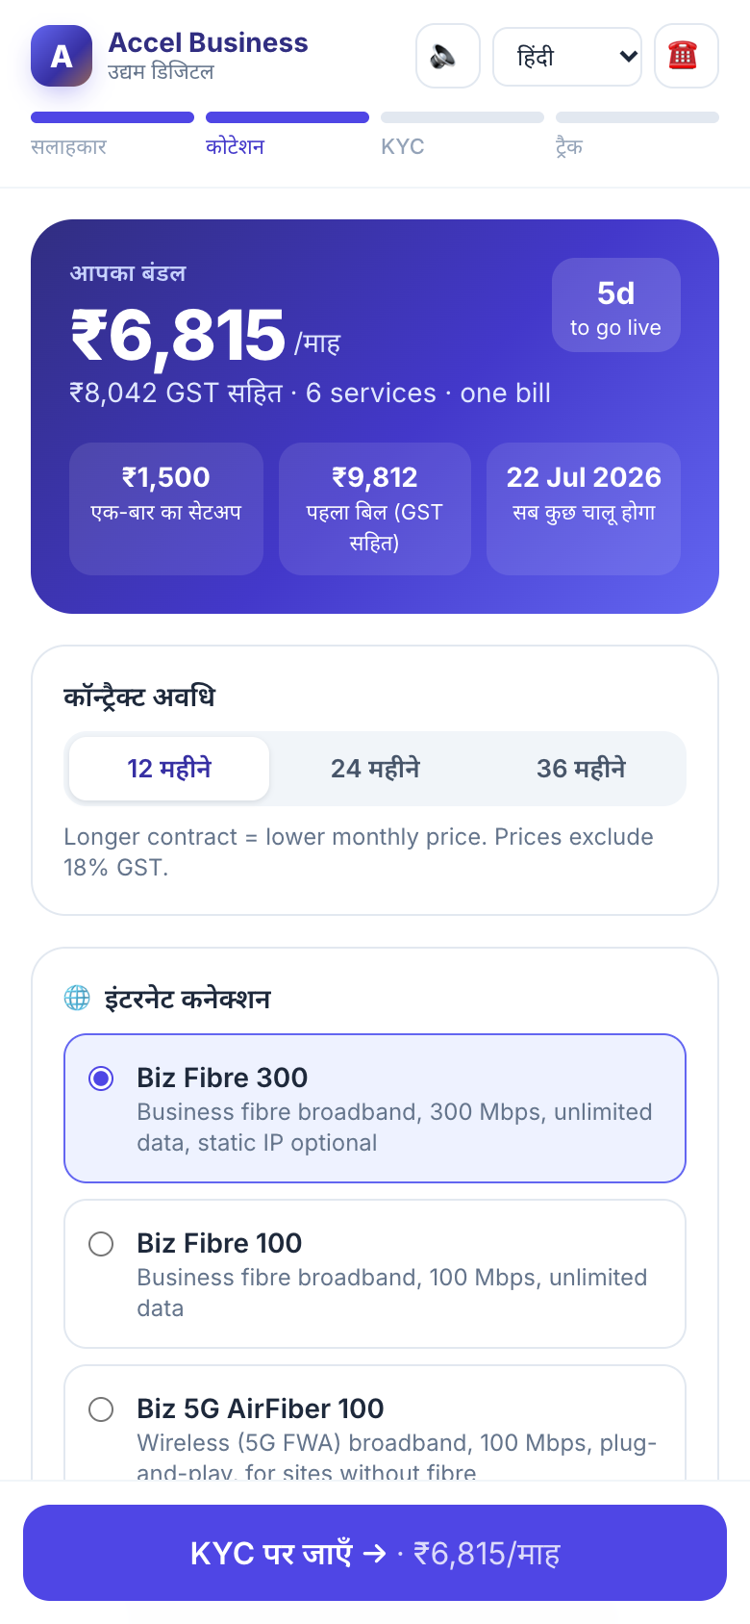
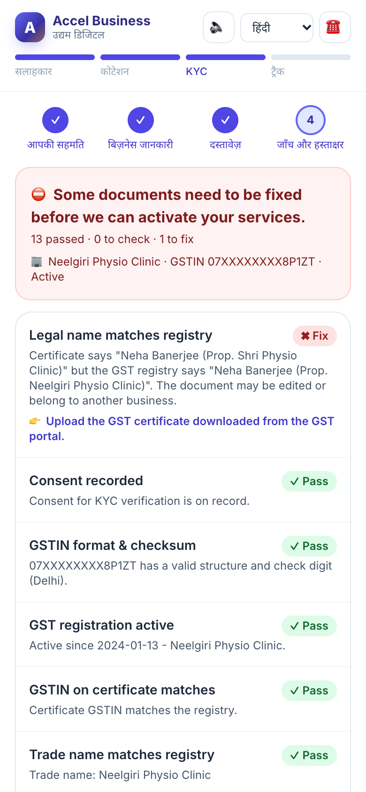
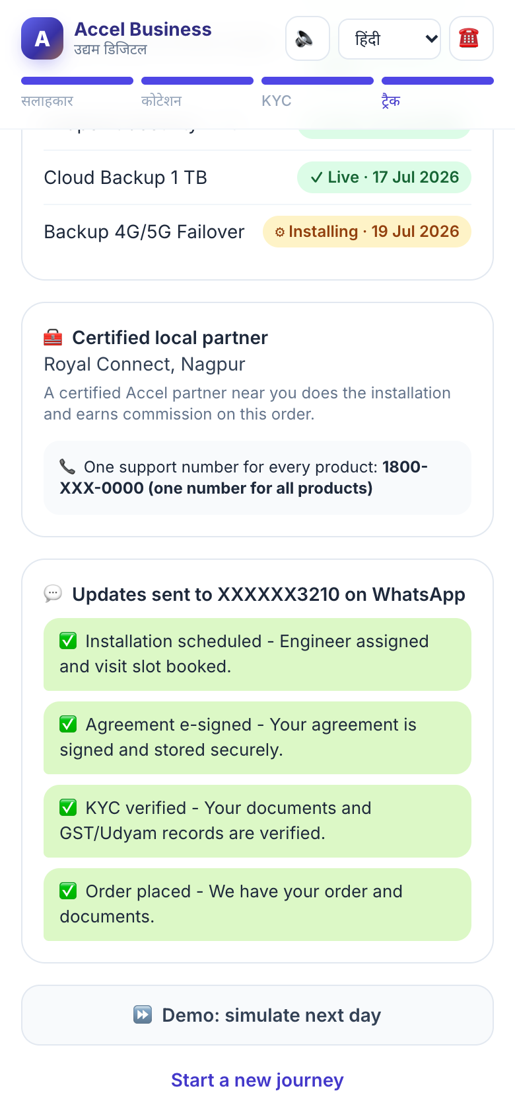
One sitting on a phone: advise, quote, verify, track
1
2
3
4
1 · Advisor
2 · Quote & checkout
3 · Smart KYC
4 · Tracker
Chat, tap or speak in 10 languages; GSTIN auto-fills the profile
One monthly price, add-on toggles, 12/24/36-month pricing
Consent first; OCR + registry checks say exactly what to fix
Live timeline, installer, one support number, WhatsApp updates
Notes:
Live prototype screens. Advisor in Hindi recommends a catalogue-valid bundle with a plain-language reason. Quote shows one monthly price with toggles and contract length. Smart KYC catches an edited GST certificate (applicant K07). Tracker replaces status-chase calls with a timeline, installer details and WhatsApp updates.

Slide 5
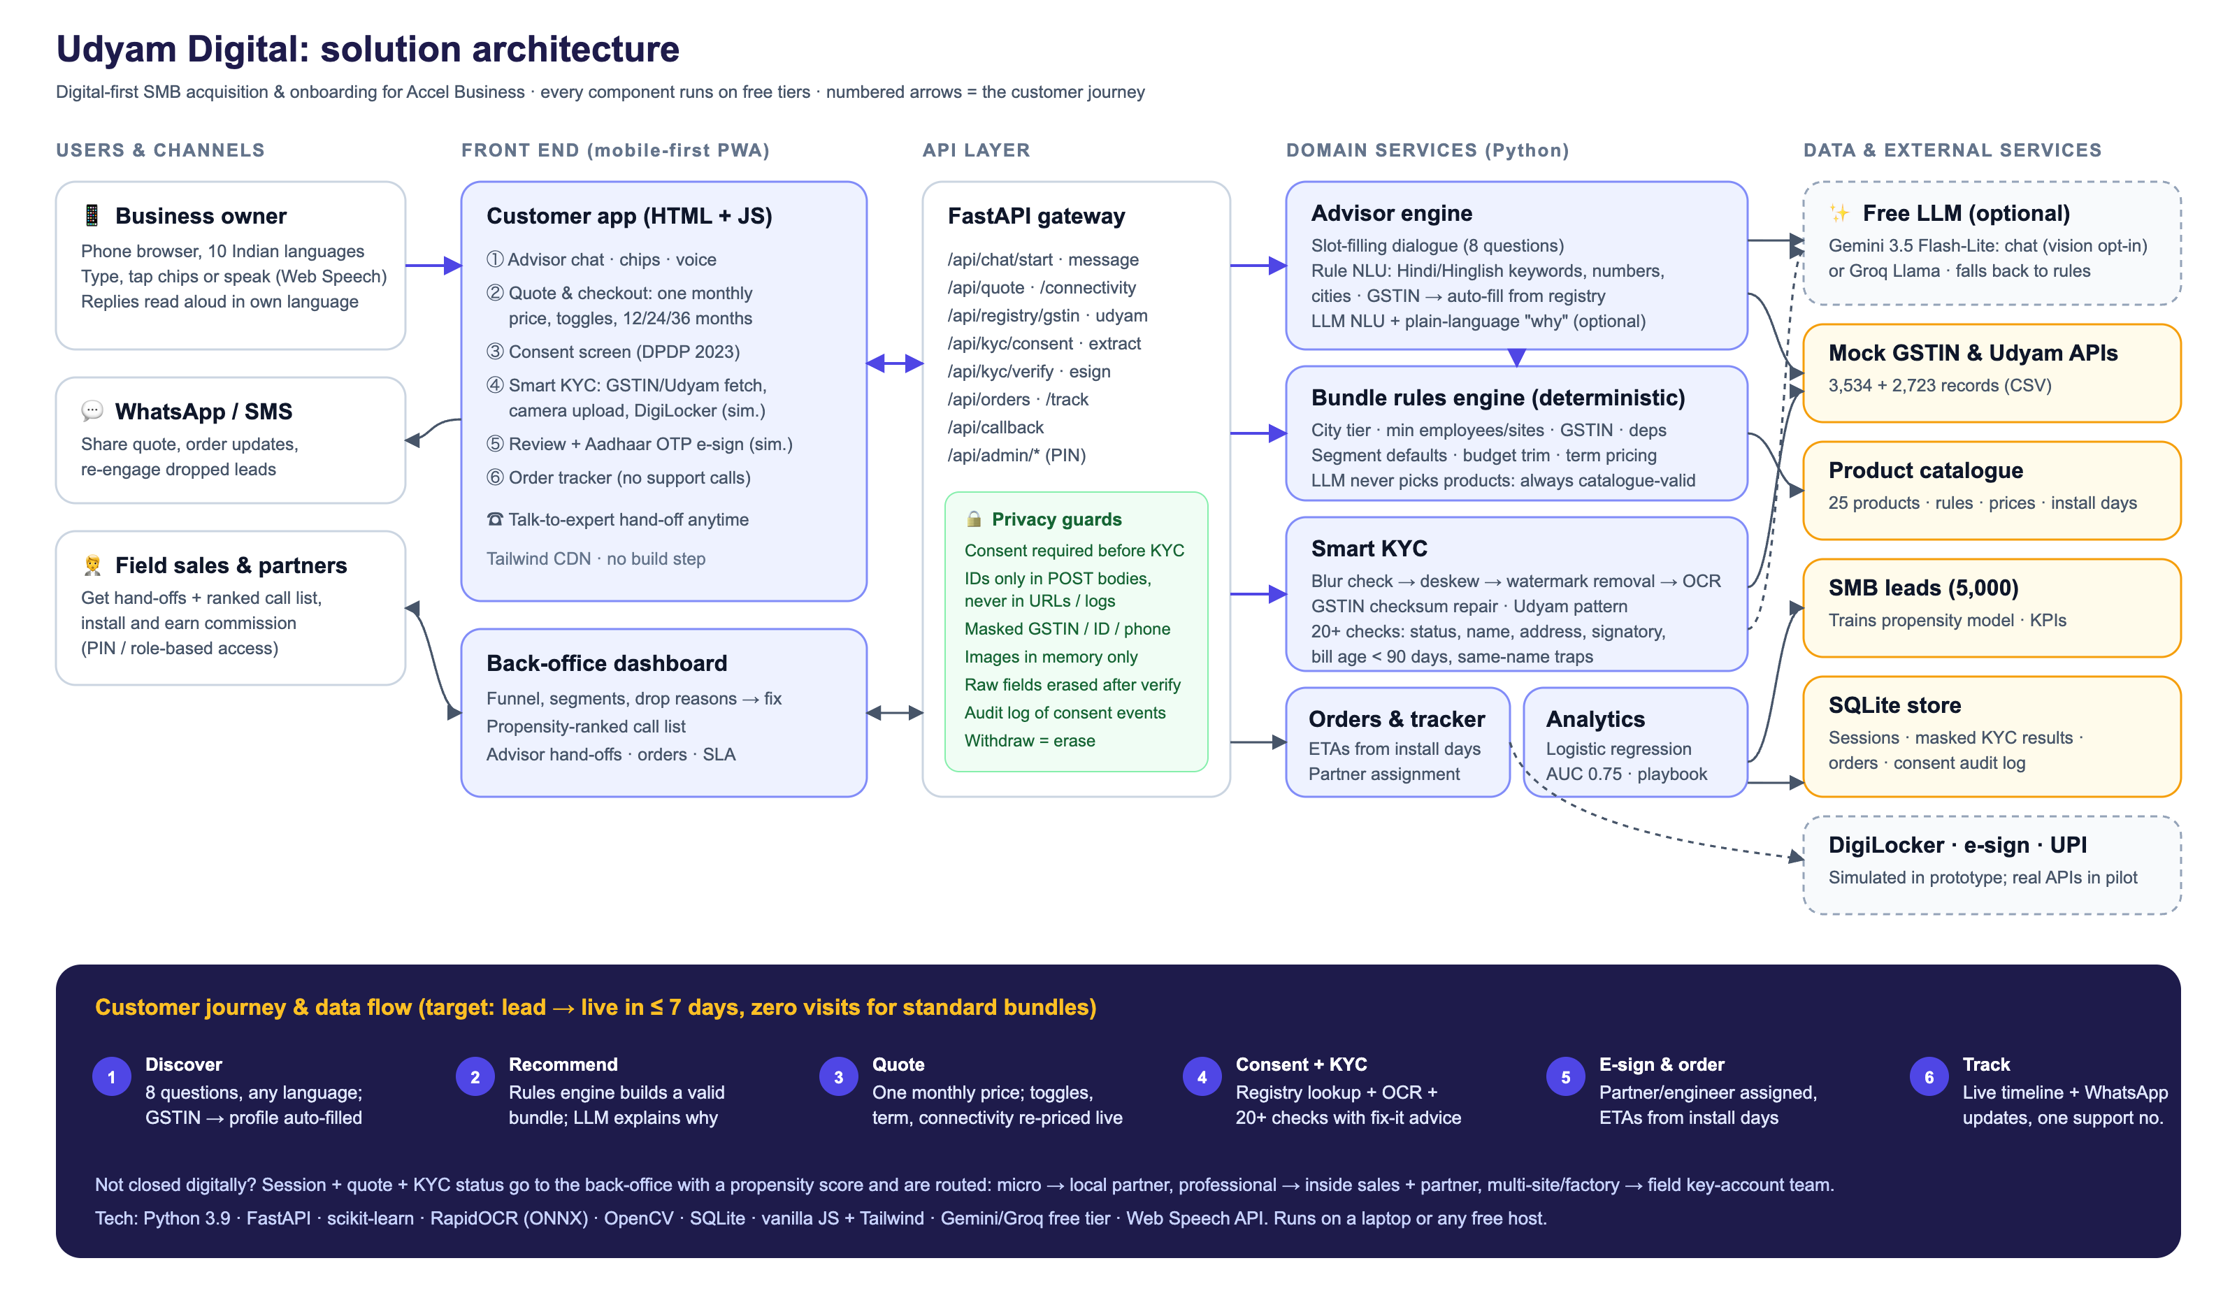
Under the hood: AI talks, rules decide, all on free tiers
Catalogue-safe AI
LLM extracts the profile and writes the 'why'; a rules engine applies tier, size, GSTIN and dependency rules and prices the bundle.
Works with zero keys
Rule-based Hindi/Hinglish NLU + RapidOCR on the laptop; Gemini 3.5 Flash-Lite adds open chat in any language when a free key is set; documents stay on the server.
Data you can trace
Every price, ETA and score comes from the provided CSVs; propensity model AUC 0.745 on held-out leads.
Notes:
FastAPI backend, vanilla JS front end. The LLM (Gemini free tier, or Groq) only understands free text and explains; a deterministic rules engine enforces every catalogue rule so judges' scenarios can never produce an invalid bundle. With no API key the app still works end to end using keyword NLU and on-device OCR.

Slide 6
Smart KYC flagged all 7 planted problems in 12 files
# | Business | Result | What the app found
K01 | Vindhya Tours & Travels | Fix | GSTIN cancelled in registry; Udyam number blank
K02 | Harmony Dental Care | Pass | Tilted photo auto-straightened (7°), all checks pass
K03 | Ganesh Woodcraft | Pass | Not confused with same-name firm in Bengaluru
K04 | Saffron Dental Care LLP | Fix | GST certificate too blurry: re-upload requested
K05 | Balaji Realty LLP | Fix | Udyam certificate missing
K06 | Saffron Unisex Salon | Fix | GSTIN on certificate fails checksum; registry match suggested
K07 | Neelgiri Physio Clinic | Fix | Legal name on certificate differs from registry (edited)
K08 | Green Leaf Legal Associates | Pass | All checks pass
K09 | Kaveri Insurance Advisors | Pass | All checks pass
K10 | Kaveri Stays LLP | Pass | All checks pass
K11 | Trinity Bake House Pvt Ltd | Fix | Electricity bill 257 days old (limit 90)
K12 | Star Electronics | Pass | Not confused with same-name firms in 3 other cities
Privacy by design (DPDP 2023)
• Itemised consent before any upload; marketing off by default
• Document images processed in memory, never stored
• Raw fields erased after verification; only masked IDs kept
• GSTIN, ID, phone masked in UI, logs and back-office
• One-tap withdraw = erase, with audit trail
Notes:
Results from the prototype with no LLM key (local OCR). Pipeline: blur check, deskew, watermark removal, OCR, GSTIN checksum, registry cross-checks for status, names, address, Udyam link, signatory authority and bill age (90 days from 15 Jul 2026). Same-name businesses in other cities (K03, K12) are matched by GSTIN + city, not name.

Slide 7
Digital handles the routine; people close the complex
Cost per activation by lead source
Self-serve
Assisted hand-off
Field key accounts
Micro & professional offices, standard bundles
Leads the advisor could not close
Multi-site chains & manufacturers
• Advisor → quote → KYC → e-sign on the phone
• No visit; install by nearest partner
• WhatsApp nudges recover abandoned quotes
• Back-office ranks them by propensity (AUC 0.745)
• Routed: micro → partner, offices → inside sales
• Rep sees full chat + quote, so no repeat questions
• Site survey, SD-WAN, leased lines, IoT
• Digital KYC + tracker still used
• Reps measured on value, not visits
Visit-led channels cost 4-6× more per activation
Notes:
The journey adds to the channel. Standard bundles close self-serve; anything the advisor cannot close is handed off with the chat, quote, KYC status and a propensity score. Partners install and earn commission on digital orders in their area. Field sales time goes to multi-site and factory accounts, where value justifies a Rs 24k cost per activation.

Slide 8
Doubling conversion halves the cost to acquire an SMB
Per quarter of 5,000 leads
+₹3.2 Cr ARR
Lead → activation
7.4%
→
15%
today
target
per quarterly cohort: +382 activations × ₹6,900 median bundle = +₹26.4 lakh MRR, with no increase in acquisition spend
Days to go live
17.6
→
≤ 7
today
target
₹15,053
→
₹7,386
What the owner gets
Cost per activation
today
target
• Quote in 5 minutes, not 3-5 days
• One bill and one support number for 6+ services
• Plain-language price; no product codes
• KYC from the shop counter, no office visit
Status-chase calls
3
→
< 1
today
target
Notes:
Assumes the same 5,000 leads and the same Rs 55.4 lakh quarterly acquisition spend. At 15% conversion (professional offices and multi-site already convert at 11%), activations rise from 368 to 750 and cost per activation falls to about Rs 7,400. 382 extra customers at the Rs 6,900 median bundle add Rs 26.4 lakh MRR per quarterly cohort, about Rs 3.2 crore ARR.

Slide 9
Five metrics to hold us to, and a 12-month rollout
Metric | Today | Month 6 | Month 12
Lead → activation | 7.4% | 11% | 15%
Days, lead to live | 17.6 | 10 | ≤ 7
Cost per activation | ₹15,053 | ₹10,000 | ≤ ₹8,000
6-month churn | 15.2% | 12% | ≤ 10%
Status-chase calls / customer | 3.0 | 1.0 | < 0.5
M0-2
Pune + Nagpur · professional offices · Hindi, Marathi, English · live GST/Udyam APIs, DigiLocker, e-sign
Pilot
M3-6
8 cities · multi-site chains · WhatsApp front end · partner app with commission tracking
Scale
M7-12
All 22 cities · micro via partners · voice in 10 languages · propensity-driven outreach
Guardrails: NPS ≥ 7 for digital customers; KYC false-reject rate < 2% (manual review queue); partner share of installs ≥ 60%.
National
Notes:
Baselines come from smb_leads.csv. Pilot in Pune (tier 1) and Nagpur (tier 2) for professional offices with Hindi, Marathi and English; then multi-site and WhatsApp; then national with partners for micro retail.

Slide 10
Risks we planned for, and the ask
AI recommends a wrong product
Edited or fake documents
The ask
Rules engine decides; LLM only talks. Every bundle is checked against the catalogue.
Checksum, registry cross-checks, blur detection, manual queue for edge cases.
8-week pilot in Pune and Nagpur for professional offices
Access to live GSTIN, Udyam, DigiLocker and e-sign APIs
20 partners enrolled on digital-order commission
Go / no-go on the five metrics at week 8
DPDP non-compliance
Channel conflict
Itemised consent, minimisation, masking, in-memory images, timed deletion.
Partners install and earn commission on digital orders; reps get ranked hand-offs.
Low digital comfort
Installation delays
Voice, quick-reply chips, 10 languages, one-tap callback to a human.
5G AirFiber fallback (2-day install), partner SLAs, live tracker.
Notes:
Close with the ask: an 8-week pilot in two cities with live GSTIN/Udyam and DigiLocker integrations, measured on the five metrics.

