Slide 1

Who’s That Pokemon
Team Treehouse:
Ken Ho, Abhinav Selvaraj, Breanna Chi, Prabhleen Bagri

Slide 2


Accomplishments
Hosted Backend in EC2 instance. Constantly running.
Implemented responsive loading screen with hints
Populated database with 1000+ pokemon from 150
MVP Singleplayer completed
Styling improvements

Slide 3
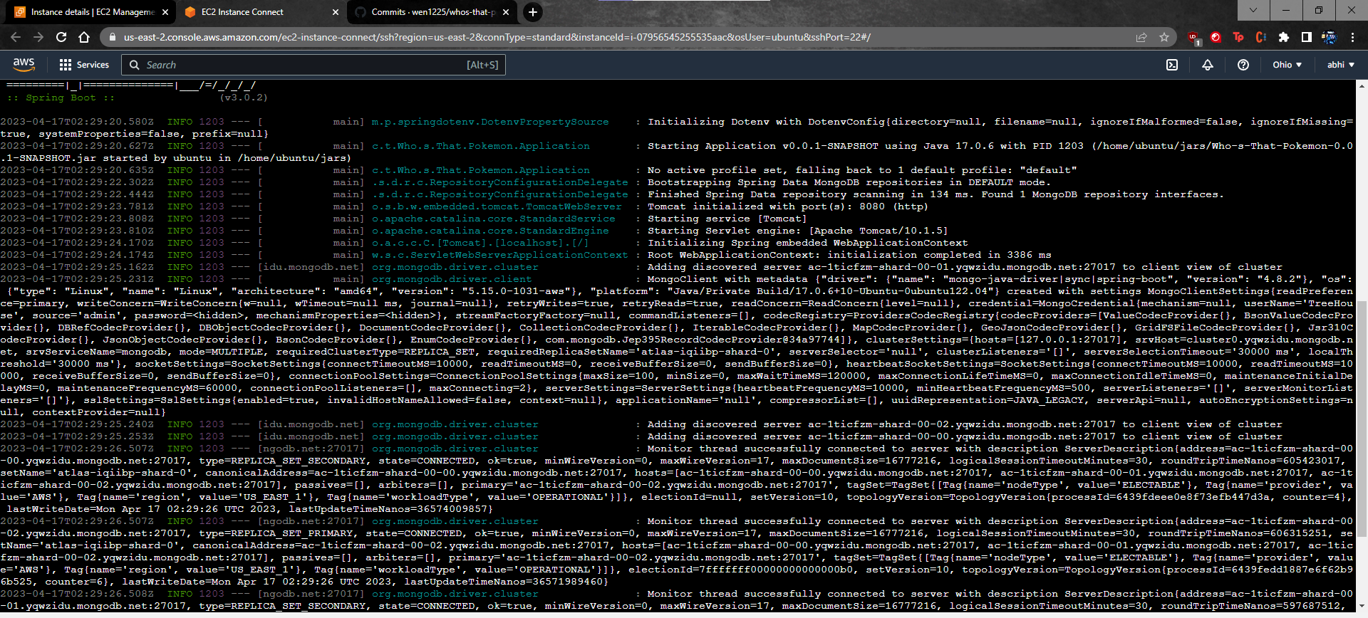

Slide 4
Demo

Slide 5
Milestones (updated)
Milestone 2, 2/26 (completed): Complete basic CRUD database operations, Home page UI, and begin single player functionality
Milestone 3, 3/12 (completed): Continue working on single player functionality, and finalize frontend design.
Milestone 4, 4/16 (In Progress): Finish single player and host backend, Begin multiplayer functionality
Milestone 6, 4/23 (Tentative): Optimize singleplayer, improve documentation instructions and continue multiplayer development
Milestone 7, 5/7 (Tentative): Full deployment(including multiplayer functionality)

Slide 6

Current Assignments
Abhinav: Continue multiplayer functionality
Breanna: Continue on reset round in singleplayer
Ken: Continue responsive styling improvements and development of point system and leaderboard
Prabhleen: Continue point system logic

Slide 7

Blockers
Recreating issues faced by other team during setup (unclear setup instructions)
Hint cards wouldn’t resize properly
Integrating point system
Figuring out libraries needed for multiplayer

Slide 8
Feedback from AudioVision
Setup feedback
Game feedback
- Documentation was good
weird react dependencies errors
Have some null images in the database
Does the sound still play for those pokemon?
Clicking Pokedex Entry enlarges the boxes
Maybe counter should say Round and start at 1
<insert feedback here>
<insert feedback here>

Slide 9

Our Response
Hosted our backend online, so hopefully that resolves backend running issues
Will consider and incorporate the other feedback and suggestions

