Slide 1

Who’s That Pokemon
Team Treehouse:
Ken Ho, Abhinav Selvaraj, Breanna Chi (lead), Prabhleen Bagri

Slide 2


Accomplishments
All Pokemon are now guaranteed to be unique
Home Page now stays the same relative to screen size
Added routing from home page to game page
End page more or less finished as well
Hints now reset after each round

Slide 3
Accomplishments(Cont)
Added slight audio delay after Pokemon are shown
Hosted backend successfully on an AWS EC2 instance
Created a Rules page that explains the rules of the game

Slide 4
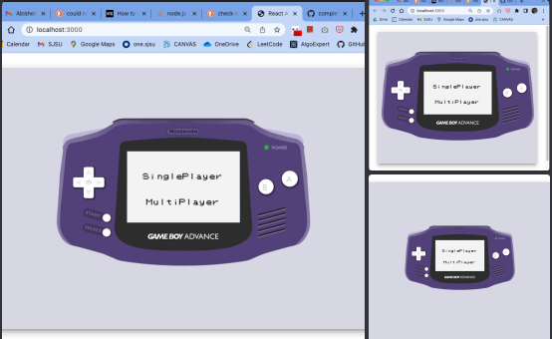

Slide 5
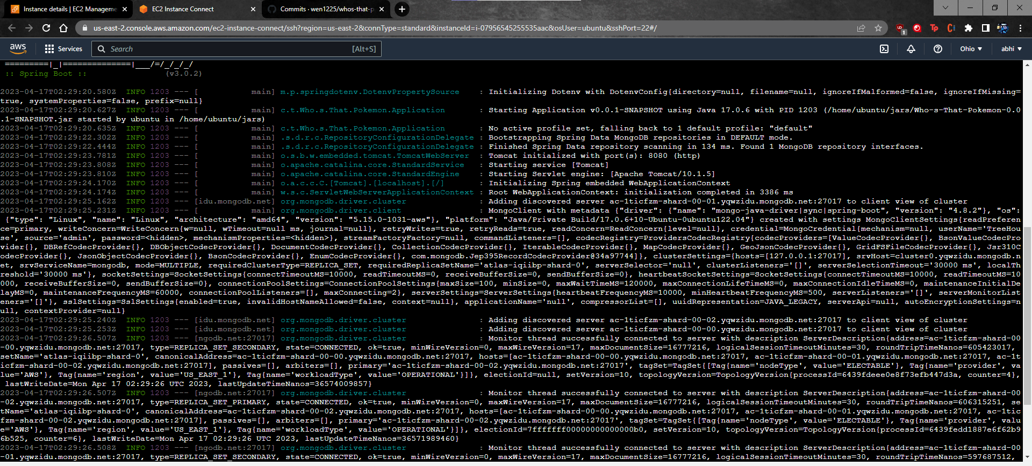

Slide 6
Demo

Slide 7

Milestones (updated)
Milestone 2, 2/26 (completed): Complete basic CRUD database operations, Home page UI, and begin single player functionality
Milestone 3, 3/12 (completed): Continue working on single player functionality, and finalize frontend design.
Milestone 4, 4/16 (In Progress): Finish single player and host backend, Begin multiplayer functionality
Milestone 6, 4/23 (Tentative): Completed working prototype
Milestone 7, 5/7 (Tentative): Full deployment(including multiplayer functionality)

Slide 8

Job assignments
Current Job Assignments (4/2-4/16)
Abhinav: Hosted Backend and added audio delay, added more Pokemon to the DB
Breanna: Working on reset round on Pokemon selection
Ken: Create rule page, Routing for home page, improving CSS styling
Prabhleen: Finish routing point system

Slide 9
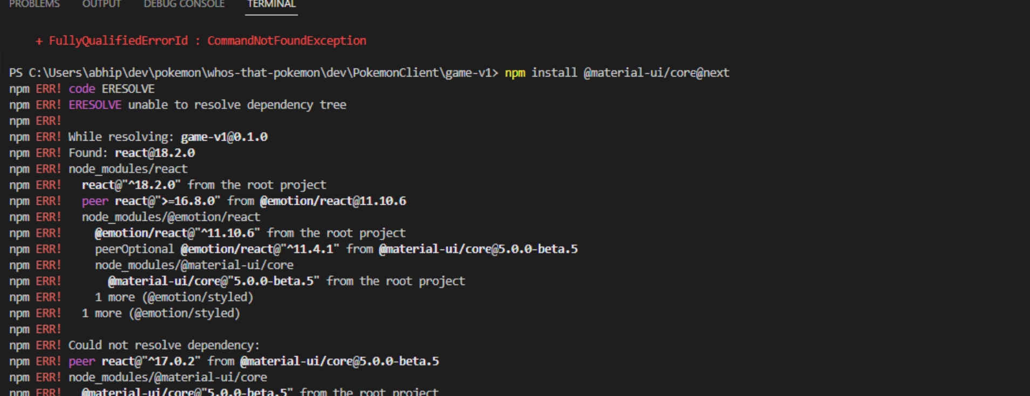

Blockers
Issue with react dependencies
Fitting all components properly within the “box”

Slide 10

Feedback from Luna R.
Clean and simple user interface, like the real game handle.
Keep up the good work.
Some suggestions: Maybe the whole interface can be enlarged a little bit to cover more portion of the screen.
Expert user experience on building/testing the product:
We were able to run the frontend. However, we weren’t able to run the backend
Setup instructions could be more clear and detailed.

Slide 11

Our Response
Hosted our backend online, so hopefully that resolves backend running issues
Will consider and incorporate the other feedback

