Slide 1

Who’s That Pokemon
Team Treehouse:
Ken Ho(Lead), Abhinav Selvaraj, Breanna Chi, Prabhleen Bagri

Slide 2

Project Description
Project is a single or multi player sound based game that is on a website
Players can join a “room” via a link or code
Players will be given a sound that a Pokemon makes, and must correctly identify the Pokemon
First person to guess correctly scores a point
Continue to next question when a player answers correctly
A player can ask for hints if they are stuck
Types
Region
Pokedex entry
Silhouette

Slide 3

Technology Tools
Front End:
HTML, CSS, JS, Framework(if needed)
Back End:
SQL(MySQL), Java, JDBC
Version Control:
Git/GitHub
Environments:
VS Code/Eclipse

Slide 4
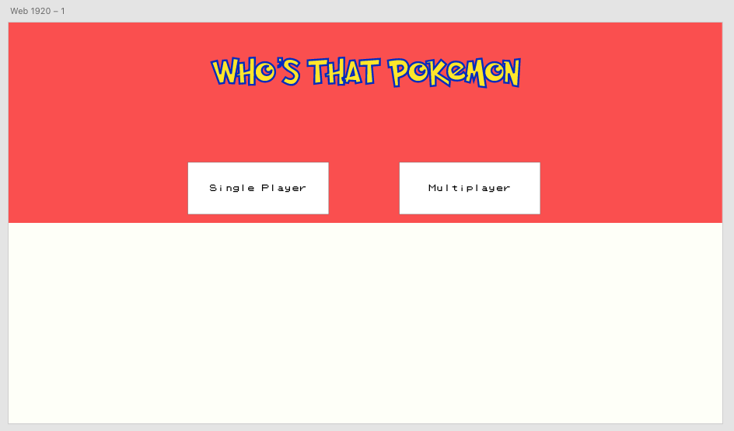

Slide 5

Job Assignments/Milestones
Job Assignments: Backend focused in the beginning
Milestones (TBD):
Milestone 1: Finishing POC and setting up work environment
Milestone 2: Populating database and running test queries, and connecting using JDBC
Milestone 3: Start implementing basic functionality for one player and start working on front ned
Milestone 4: Finish implementing single player functionality and start multiplayer functionality
Milestone 5: Finish frontend
Milestone 6: Finish testing and try to host publicly available website
Milestone 7: Add animations, make the game more interactive, add background music

Slide 6
What are we looking forward to this Semester?
Goals:
Reinforce version control best practices since it will be vital when working in the industry.
Adopt AGILE workflow methodologies.
Learn in-demand programming languages such as JS, React, and Python.
Produce projects that are marketable and sufficiently complex to be included in Resume.
Learn and gain inspiration from other talented groups.

