Slide 1

Who’s That Pokemon
Team Treehouse:
Ken Ho, Abhinav Selvaraj(lead), Breanna Chi, Prabhleen Bagri

Slide 2


Accomplishments
Created Front-end
Connect Front-end to Back-end
Ability to display random Pokemon on website
Fixed Github repo issues

Slide 3
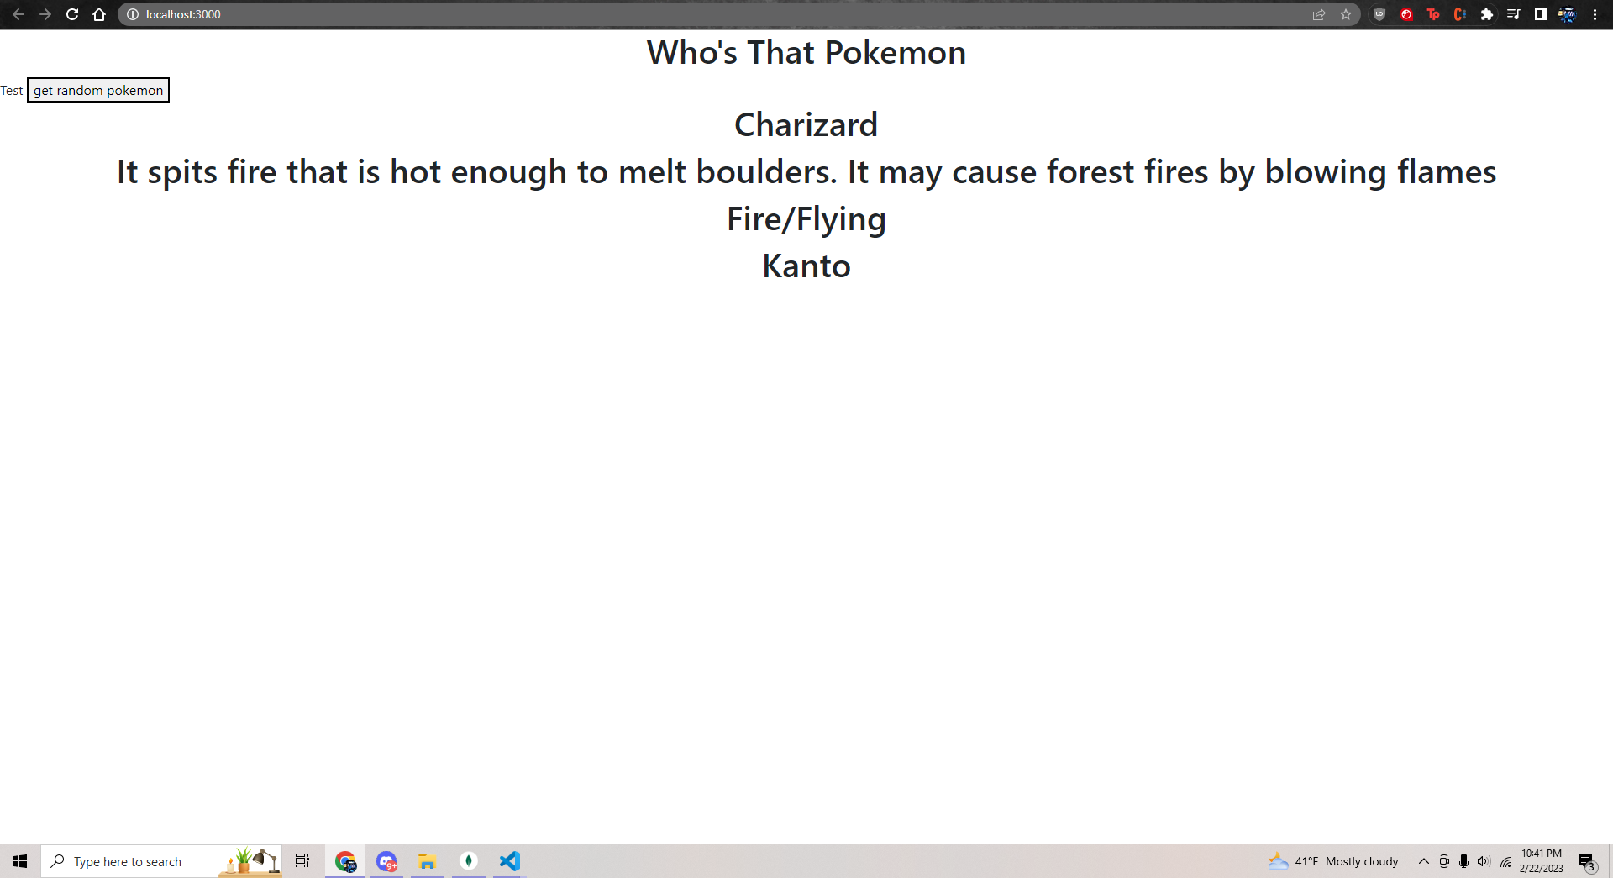

Slide 4


Documentation for Application Users
Single player game or Multiplayer game room with other players
Player(s) will have to guess Pokemon from a Pokemon cry
Get 60 seconds
Longer it takes or more hints given, will deduct points from score
Single: End game will show standing of player
Multiplayer: the standings of those who earned most points in order

Slide 5

Documentation for Expert Users
Pull code from GitHub Repo
Under dev, there will be two folders:
Who’s that pokemon = backend
PokemonClient/Game-v1 = frontend
Launch application.java for backend
For frontend, make sure npm is installed
Under the directory game-v1, call npm start in terminal
Will only work correctly if backend is running simultaneously
In VsCode, need to create two windows and have two terminals running
Must have CORS extension for now

Slide 6

Milestones (updated)
Milestone 2, 2/26 (In Progress): Complete basic CRUD database operations, Home page UI, and begin single player functionality
Milestone 3, 3/12 (Tentative): Continue working on single player functionality, and finalize frontend design.
Milestone 4, 3/26 (Tentative): Finish single player functionality, start multiplayer functionality
Milestone 5, 4/9 (Tentative): Continue working on multiplayer functionality and continue developing frontend
Milestone 6, 4/23 (Tentative): Completed working prototype
Milestone 7, 5/7 (Tentative): Full deployment(including multiplayer functionality)

Slide 7

Job assignments
Current Job Assignments (2/22 - 3/2)
Abhinav: Continue population database and working on Front-end
Breanna: Working on Front-end
Ken: Continue working on UI/UX and gameplay loop, start working on Front-end
Prabhleen: Working on Front-end

Slide 8

Blockers
Still figuring out how to store audio files
React
Chrome’s network protocol and access control issues such as:
Access to XMLHttpRequest at 'http://localhost:8080/api/v1/pokemon/random' from origin 'http://localhost:3000' has been blocked by CORS policy: No 'Access-Control-Allow-Origin' header is present on the requested resource.

Slide 9


Feedback from AudioVision
User Experience
Simple test button for front-back connection
Project simple to set up

Slide 10

Our Response
Appreciate the input and look forward to collaborating in the future
Glad that our project seemed simple to setup
Looking forward to share ways to store audio files

