Slide 1

Who’s That Pokemon
Team Treehouse:
Ken Ho, Abhinav Selvaraj(lead), Breanna Chi, Prabhleen Bagri

Slide 2


Accomplishments
Resolved Audio Issue
Populated Database with 100+ Pokemon
Created/Updated all relevant documents

Slide 3
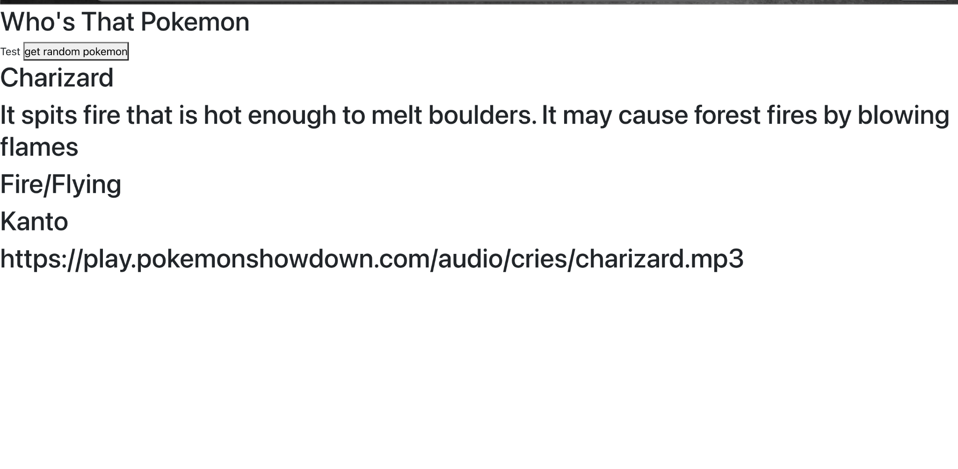
npm install react-scripts

Slide 4

Milestones (updated)
Milestone 2, 2/26 (In Progress): Complete basic CRUD database operations, Home page UI, and begin single player functionality
Milestone 3, 3/12 (Tentative): Continue working on single player functionality, and finalize frontend design.
Milestone 4, 3/26 (Tentative): Finish single player functionality, start multiplayer functionality
Milestone 5, 4/9 (Tentative): Continue working on multiplayer functionality and continue developing frontend
Milestone 6, 4/23 (Tentative): Completed working prototype
Milestone 7, 5/7 (Tentative): Full deployment(including multiplayer functionality)

Slide 5

Job assignments
Current Job Assignments (3/2-3/9)
Abhinav: Continue population database and working on Front-end
Breanna: Working on game over screen
Ken: Working on gameplay loop
Prabhleen: Working on Start game screen

Slide 6

Blockers
React
Trouble setting up project on our local machines:
Manually updating database

Slide 7

Feedback from FoodReal
Expert Documentation
Include Specific Java version
Include link to repo
Clarify Application.java
CORS link not working
Issues with running npm start

Slide 8

Our Response
Will incorporate their recommendations in our expert documentation
Will include link to repo
Look into the issues they were having and help resolve them, and will subsequently update our expert documentation

