Slide 1
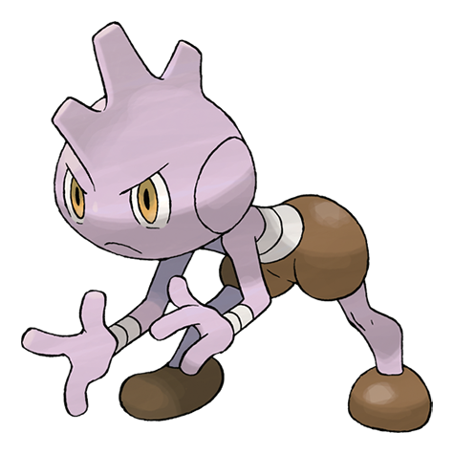
Who’s That Pokemon
Team Treehouse:
Ken Ho, Abhinav Selvaraj(lead), Breanna Chi, Prabhleen Bagri

Slide 2


Accomplishments
Added images for Pokemon
Able to differentiate between right and wrong Pokemon
Created document to list relevant MongoDB queries
Timer function via React

Slide 3
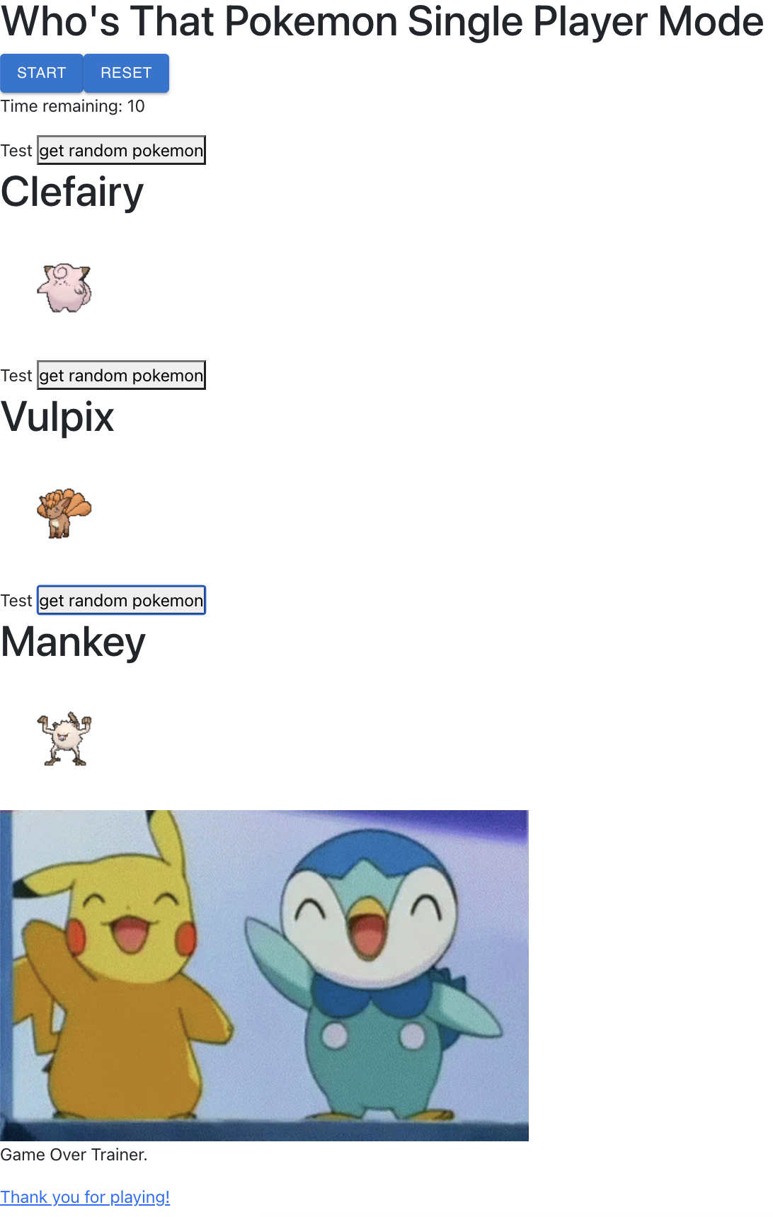

Slide 4

Milestones (updated)
Milestone 2, 2/26 (In Progress): Complete basic CRUD database operations, Home page UI, and begin single player functionality
Milestone 3, 3/12 (Tentative): Continue working on single player functionality, and finalize frontend design.
Milestone 4, 3/26 (Tentative): Finish single player functionality, start multiplayer functionality
Milestone 5, 4/9 (Tentative): Continue working on multiplayer functionality and continue developing frontend
Milestone 6, 4/23 (Tentative): Completed working prototype
Milestone 7, 5/7 (Tentative): Full deployment(including multiplayer functionality)

Slide 5

Job assignments
Current Job Assignments (3/2-3/9)
Abhinav: Adding sprites to database and working on Front-end
Breanna: Working on game over screen
Ken: Working on page routing and game logic
Prabhleen: Working on Start game screen

Slide 6

Blockers
Figuring out the MongoDB crud operations
Manually updating database (working on creating a python script for web scraping)

Slide 7

A Feature Wanted: System Administrator (tentative)
Moderate amount of time/effort
Will need to create a users database and add functionality such as adding and deleting a user
Should not have capabilities of regular user in our instance
Will be able to remove/modify passwords
It is a plus to the product on the developer side, users won't experience benefit as much

Slide 8

Feedback from Gladiators
Give exact path for Application.java
Frontend runs smoothly, instructions clear
Error running Application.java (unclear if local issue)
Overall documentation clear and well done

Slide 9

Our Response
Will make suggested modifications to instructions on expert documentation
Will discuss directly regarding issue, likely a step/instruction missed

