Slide 1

Who’s That Pokemon
Team Treehouse:
Ken Ho, Abhinav Selvaraj, Breanna Chi, Prabhleen Bagri

Slide 2
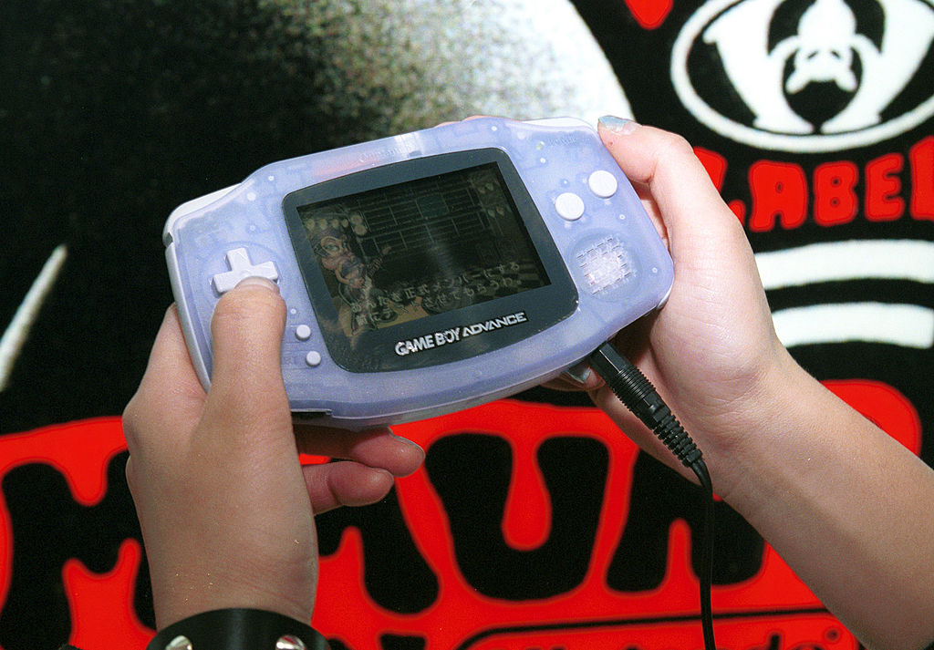
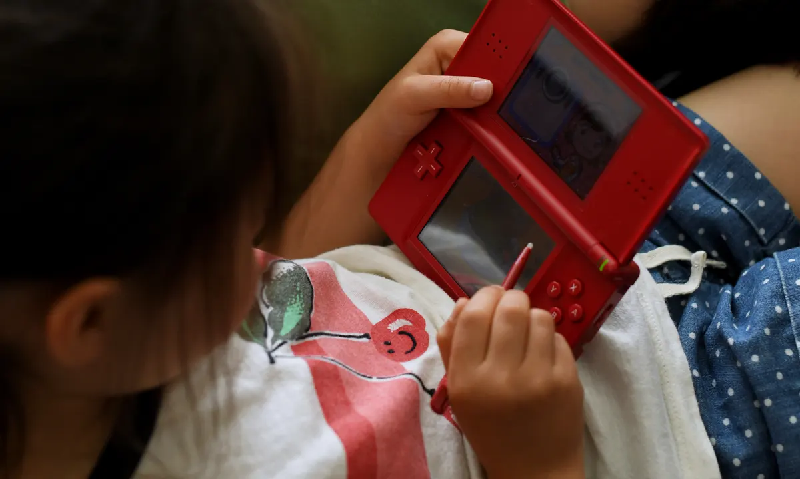
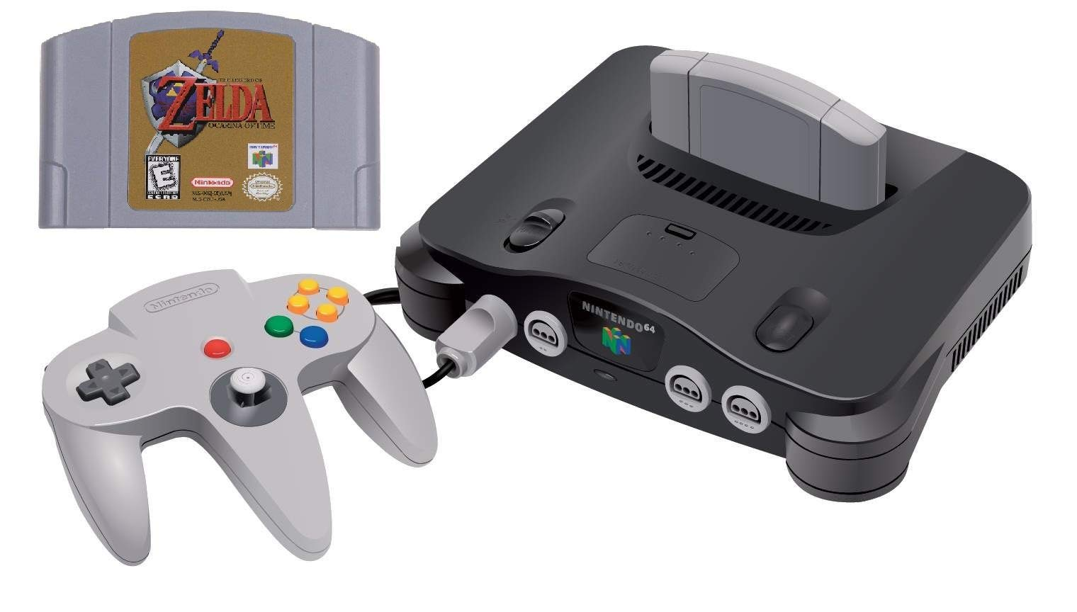
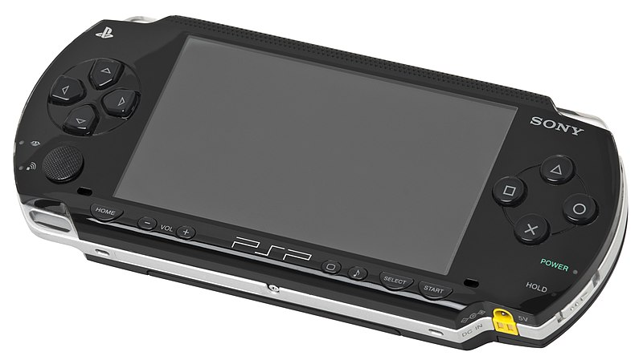

Slide 3
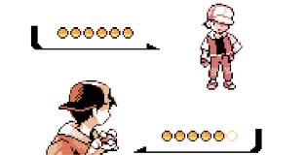
Bringing back nostalgic memories…

Slide 4


Finished Accomplishments
Hosted Frontend/Backend using AWS
Finished design of main gameplay loop
Audio/Visuals work as intended
Point System works as intended
Created MP database

Slide 5
Milestones (updated)
Milestone 2, 2/26 (completed): Complete basic CRUD database operations, Home page UI, and begin single player functionality
Milestone 3, 3/12 (completed): Continue working on single player functionality, and finalize frontend design.
Milestone 4, 4/16 (In Progress): Finish single player and host backend, Begin multiplayer functionality
Milestone 6, 4/23 (Completed): Optimize singleplayer, improve documentation instructions and continue multiplayer development
Milestone 7, 5/7 (Completed): Full deployment(including multiplayer functionality)

Slide 6
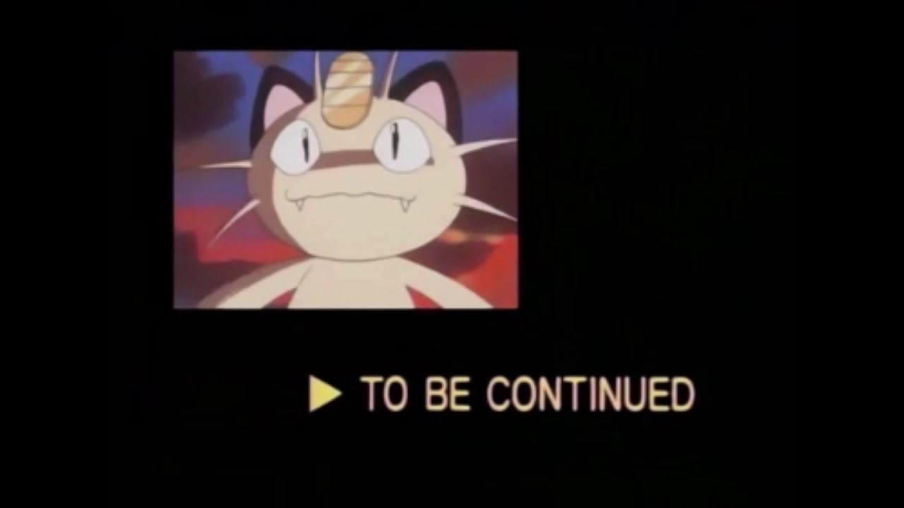

Slide 7
What We Want to Improve:
- Login or Sign Up feature in order to save previous scores
- Leaderboard of players
- Ability to replay audio
- Finishing MP functionality- framework already set.
- General UI touch up and page responsiveness

Slide 8
Challenges
Hosting the frontend took a lot longer than anticipated
Encountered a lot of technical debt
Figuring out the DB for implementing MP functionality
Learning curve with React
Bugs, Bugs, Bugs

Slide 9
Demo

