Slide 1
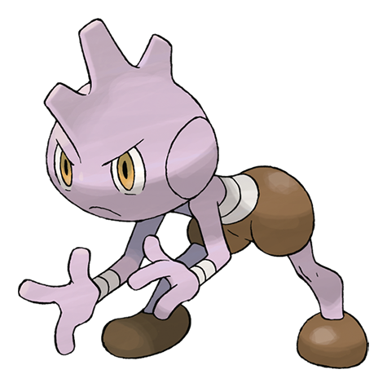
Who’s That Pokemon
Team Treehouse:
Ken Ho, Abhinav Selvaraj, Breanna Chi (lead), Prabhleen Bagri

Slide 2


Accomplishments
Able to fill flashcards dynamically from database
Partial completion of the front end based on mockup
Able to merge flashcards with frontend

Slide 3
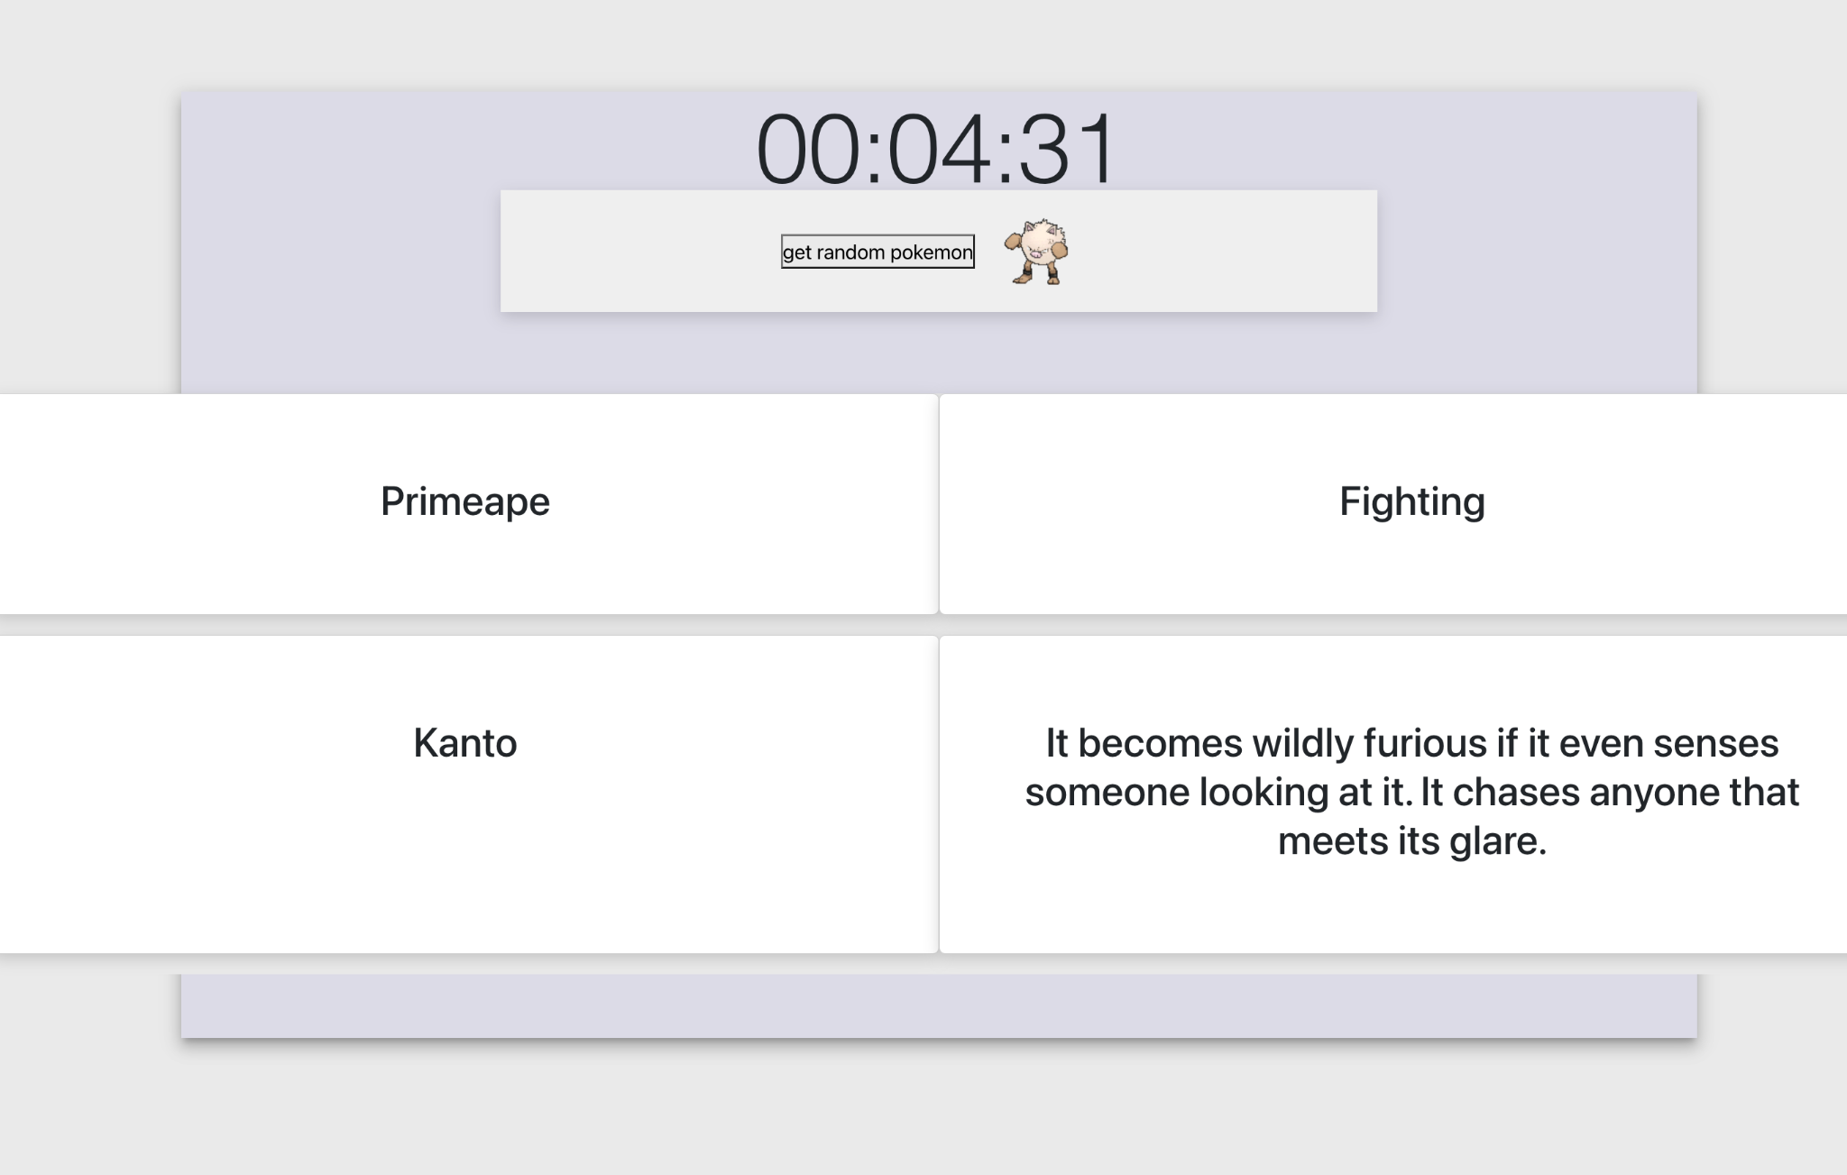

Slide 4

Milestones (updated)
Milestone 2, 2/26 (completed): Complete basic CRUD database operations, Home page UI, and begin single player functionality
Milestone 3, 3/12 (completed): Continue working on single player functionality, and finalize frontend design.
Milestone 4, 4/16 (In Progress): Finish all screens UI and connectivity,
Milestone 5, 4/9 (Tentative): Start working on multiplayer functionality and continue developing frontend and game logic
Milestone 6, 4/23 (Tentative): Completed working prototype
Milestone 7, 5/7 (Tentative): Full deployment(including multiplayer functionality)

Slide 5

Job assignments
Current Job Assignments (3/10-3/16)
Abhinav: Working on Front-end, started designing based on our mockup.
Breanna: Continue working on game over screen
Ken: Continue page routing, frontend code, and game logic
Prabhleen: Continue working on Start game screen

Slide 6

Blockers
Material UI provided a streamlined styling experience for React components, but also require some learning curve
Differentiating javascript code and react syntax

Slide 7

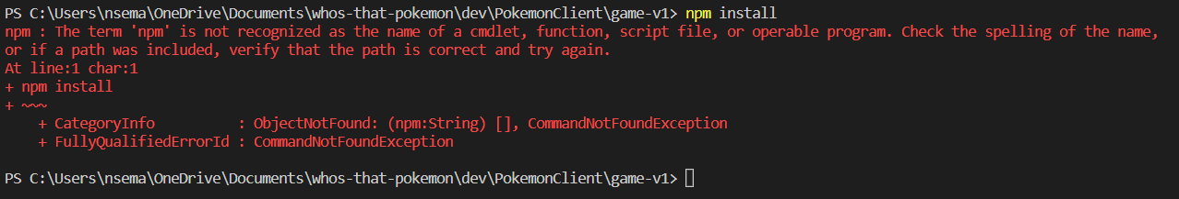
Feedback from TheLibrarians
Expert users doc easy to read/follow
Works on Mac
Doesn’t work on Windows
Can’t run frontend on VSCode
Node.js pathing issues

Slide 8

Our Response
Website is clean, looking forward to the routing and user authentication
Guidance or tips/tricks as pop up for first time creators would be nice since its a very new idea and people may need pointers.

