Slide 1

Who’s That Pokemon
Team Treehouse:
Ken Ho(Lead), Abhinav Selvaraj, Breanna Chi, Prabhleen Bagri

Slide 2

Updated Tech Stack
Front End:
HTML, CSS, React
Back End:
Java, MongoDB, Spring Boot
Hosting Service :
Itch.io
free, easy download, supports larger files and more builds, commercial use
Also considered Github pages and AWS

Slide 3

This Weeks Accomplishments
Finalized tech stack
Set up development environment
Populated MongoDB database
Started back-end development
Produced Initial Wireframe for front-end UI

Slide 4
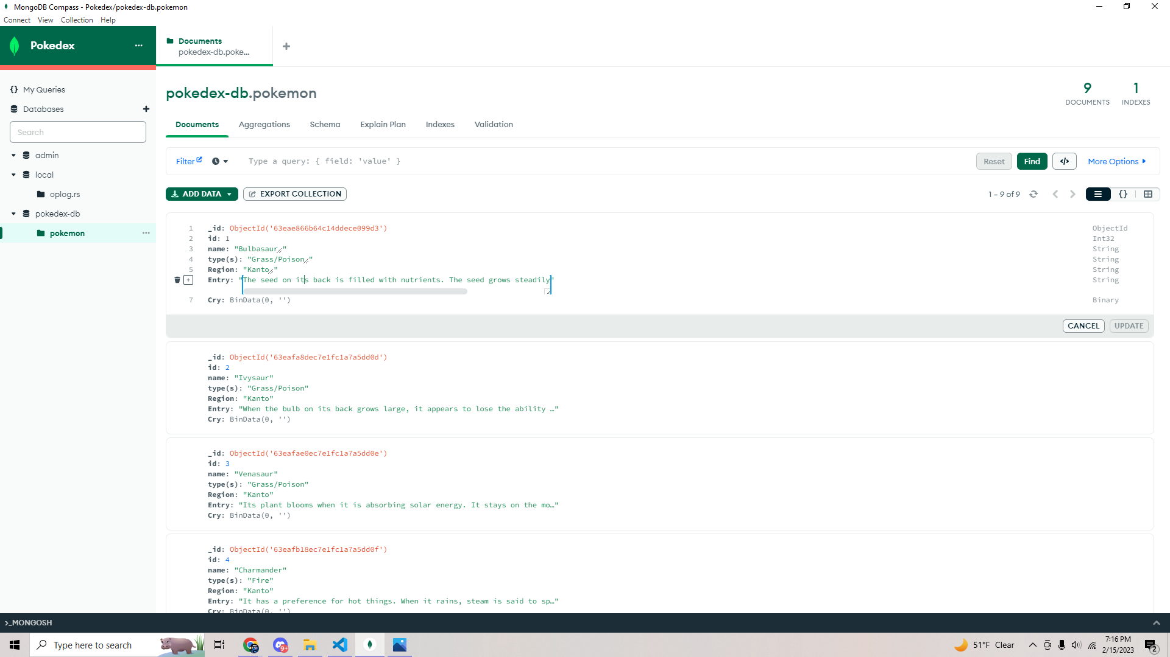

Slide 5
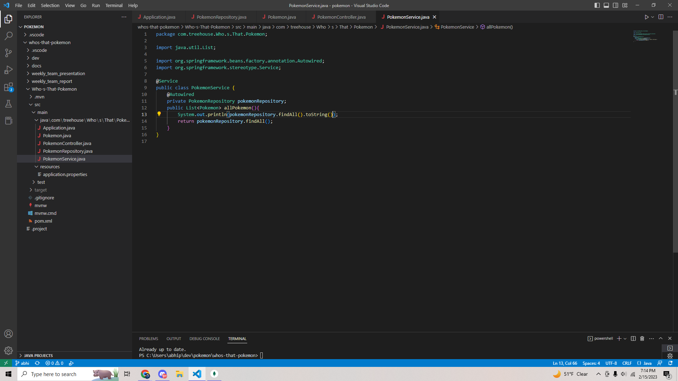

Slide 6
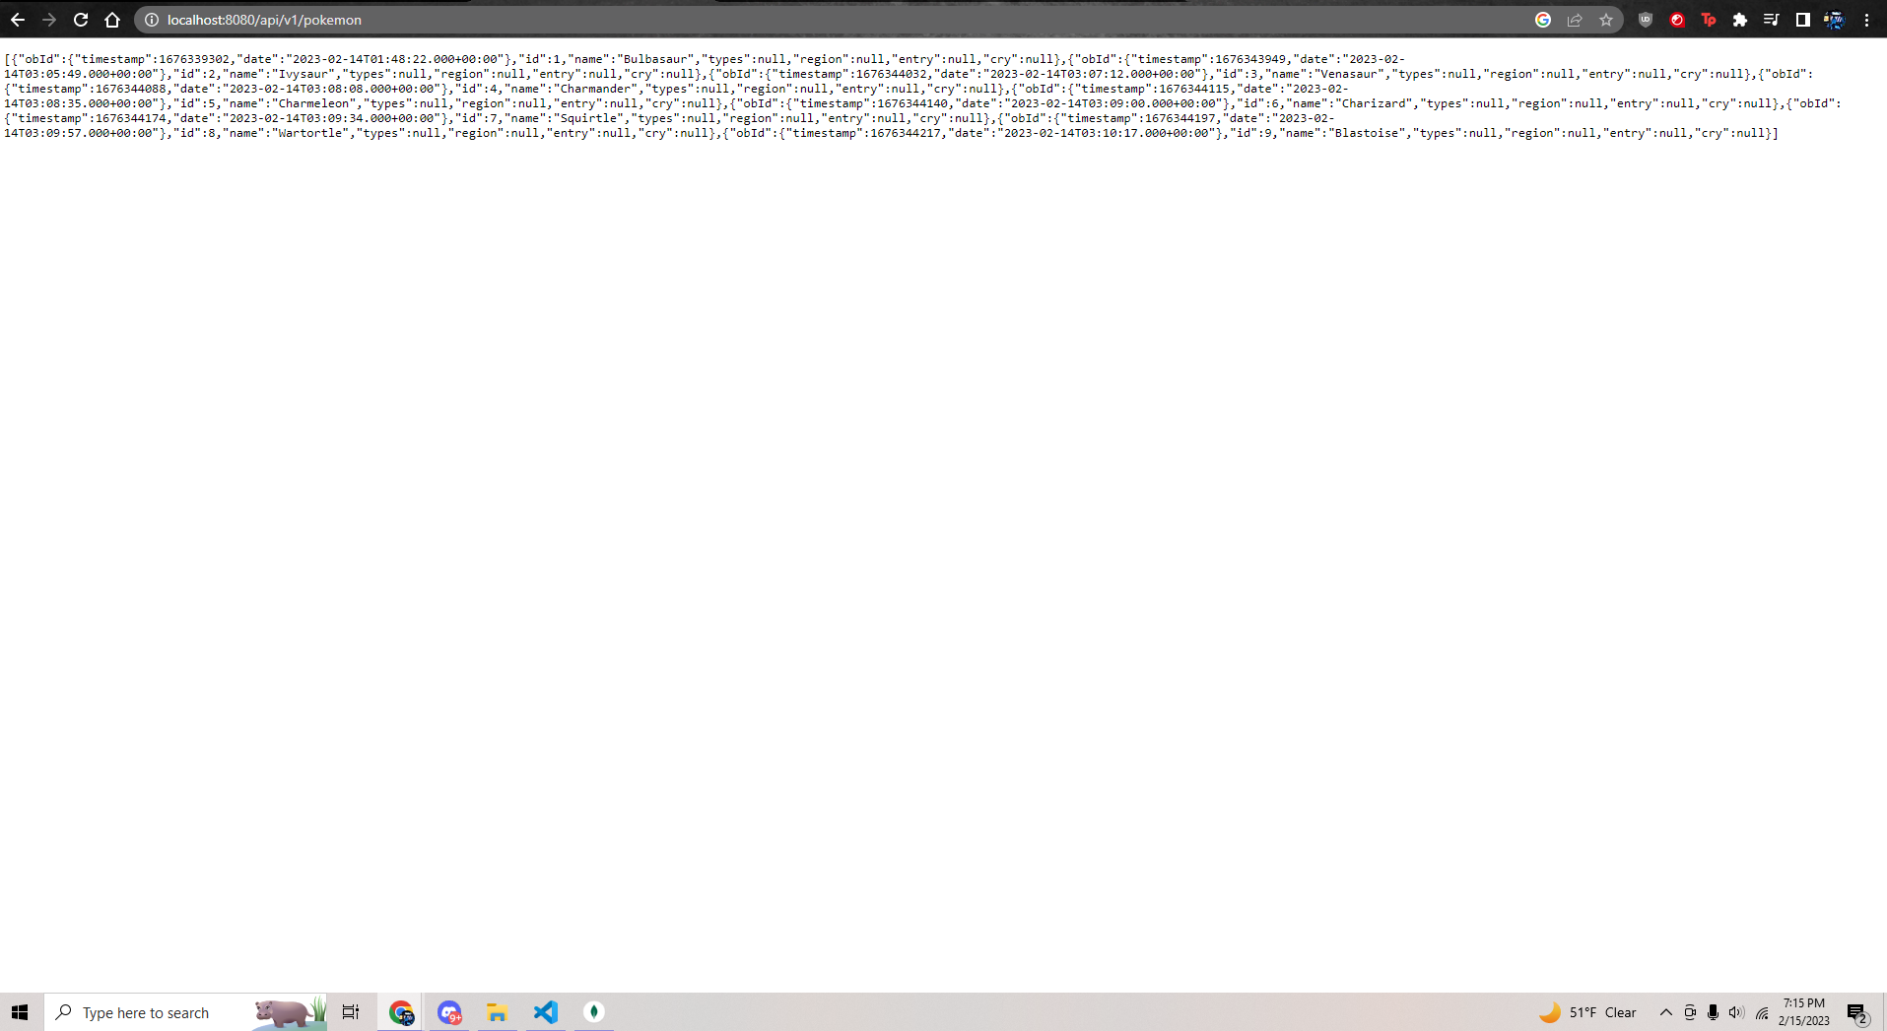

Slide 7
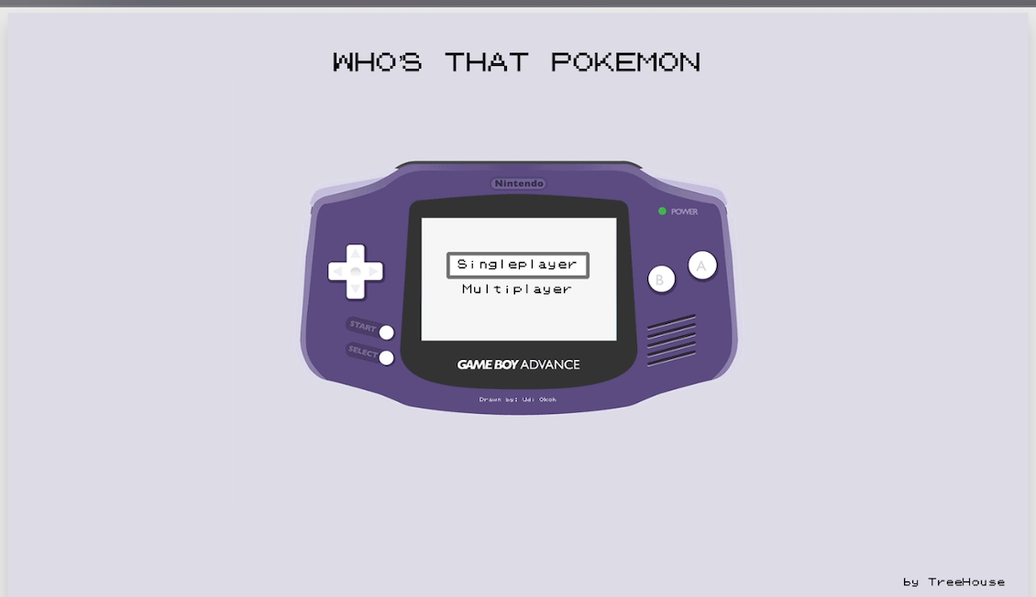
Wireframe (updated UI)

Slide 8
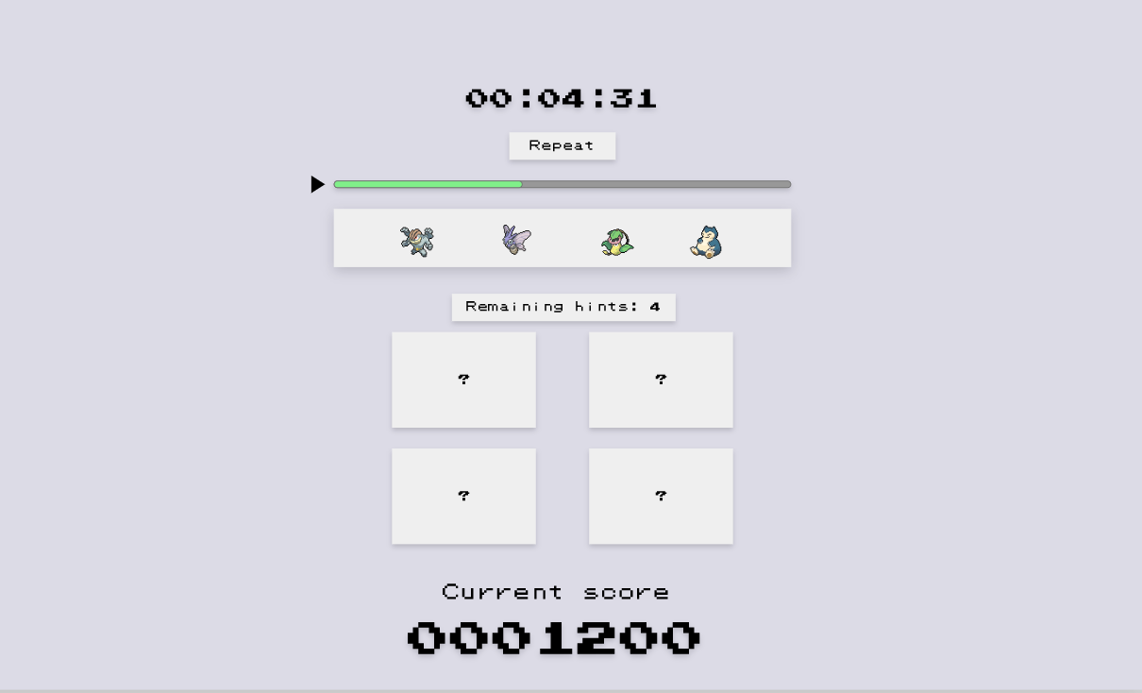

Slide 9
Milestones updated
Milestone 2, 2/26 (In Progress): Complete basic CRUD database operations, Home page UI, and begin single player functionality
Milestone 3, 3/12 (Tentative): Continue working on single player functionality, and finalize frontend design.
Milestone 4, 3/26 (Tentative): Finish single player functionality, start multiplayer functionality
Milestone 5, 4/9 (Tentative): Continue working on multiplayer functionality and continue developing frontend
Milestone 6, 4/23 (Tentative): Completed working prototype
Milestone 7, 5/7 (Tentative): Full deployment(including multiplayer functionality)

Slide 10
Job assignments
Current Job Assignments (2/13 - 2/17)
Abhinav: Setup boilerplate code for MongoDB database and prepare slides for weekly presentation
Breanna: Familiarize with GitHub’s branching processes, working on the Mobile UI, and work with Prabhleen to host to itch.io and eventually integrate multiplayer functionality into the project
Ken: Finalize project wireframe and develop UI for front end
Prabhleen: Research best platform to host by assessing each limitations and pros. Understand the integration process with AWS services as a potential hosting platform. Familiarize with itch.io to host as well as GitHub’s branching processes

Slide 11
Blockers
Need to use special way to store .wav files in MongoDB
GitHub repo has directory and branch issues that need to be fixed

