Slide 1

Who’s That Pokemon
Team Treehouse:
Ken Ho, Abhinav Selvaraj, Breanna Chi (lead), Prabhleen Bagri

Slide 2


Accomplishments
Completed responsive feature of the canvas
Able to randomly generate four pokemons per question
Separation of code components (modularization)
Game logic updated (removed time-constrained setup with a question-pool setup)

Slide 3
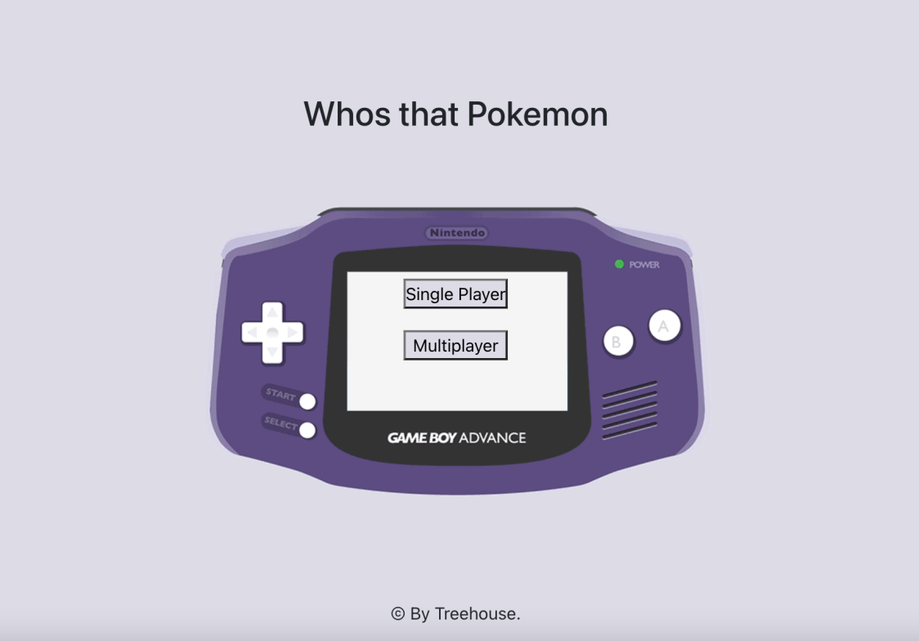

Slide 4
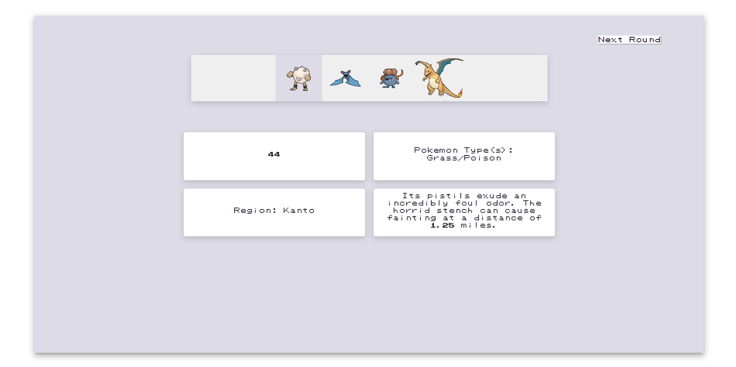

Slide 5

Milestones (updated)
Milestone 2, 2/26 (completed): Complete basic CRUD database operations, Home page UI, and begin single player functionality
Milestone 3, 3/12 (completed): Continue working on single player functionality, and finalize frontend design.
Milestone 4, 4/16 (In Progress): Finish single player and pass testing plan
Milestone 5, 4/9 (Tentative): Start working on multiplayer functionality and continue developing frontend and game logic
Milestone 6, 4/23 (Tentative): Completed working prototype
Milestone 7, 5/7 (Tentative): Full deployment(including multiplayer functionality)

Slide 6

Job assignments
Current Job Assignments (3/17-3/26)
Abhinav: Working on Front-end, game logic
Breanna: Continue end game screen development, game logic
Ken: Continue page routing, frontend code, and game logic
Prabhleen: Implement responsive behavior with the Start screen

Slide 7

Blockers
Increase in code size, caused some confusion and friction when developing the front end code
Merge conflicts due to frequent code changes

Slide 8
Test Plan
React Testing Library to test the flow of a singleplayer match
List ins
Generation of pokemon for each round should be random
No repeated pokemon in answer key
Responsive on mobile and desktop screen size

Slide 9

Feedback from DeepCourse
Clean and simple user interface
Like how the theme of the site matches the games
Some suggestions: clean up spacing around certain elements, ensure text/font is easily readable

Slide 10

Our Response
Upon basic gameplay completion, we will get more feedback in order to see how to improve UI
Font style
Spacing of components
Coloring

