Slide 1
American Express Campus Analyze This 2015
Submission by Team – Unreal_Mavericks

Slide 2
Team Details
Team Name :Unreal_Mavericks
Name | Campus | Roll No. | Mobile No. | Email Id
Abhijeet Panda | IIT Kharagpur | 11EC35011 | 8653411536 | abhijeet.panda201@gmail.com
Rishabh Kandhway | IIT Kharagpur | 11IM30015 | 7501682969 | rishabhkandhway@gmail.com

Slide 3
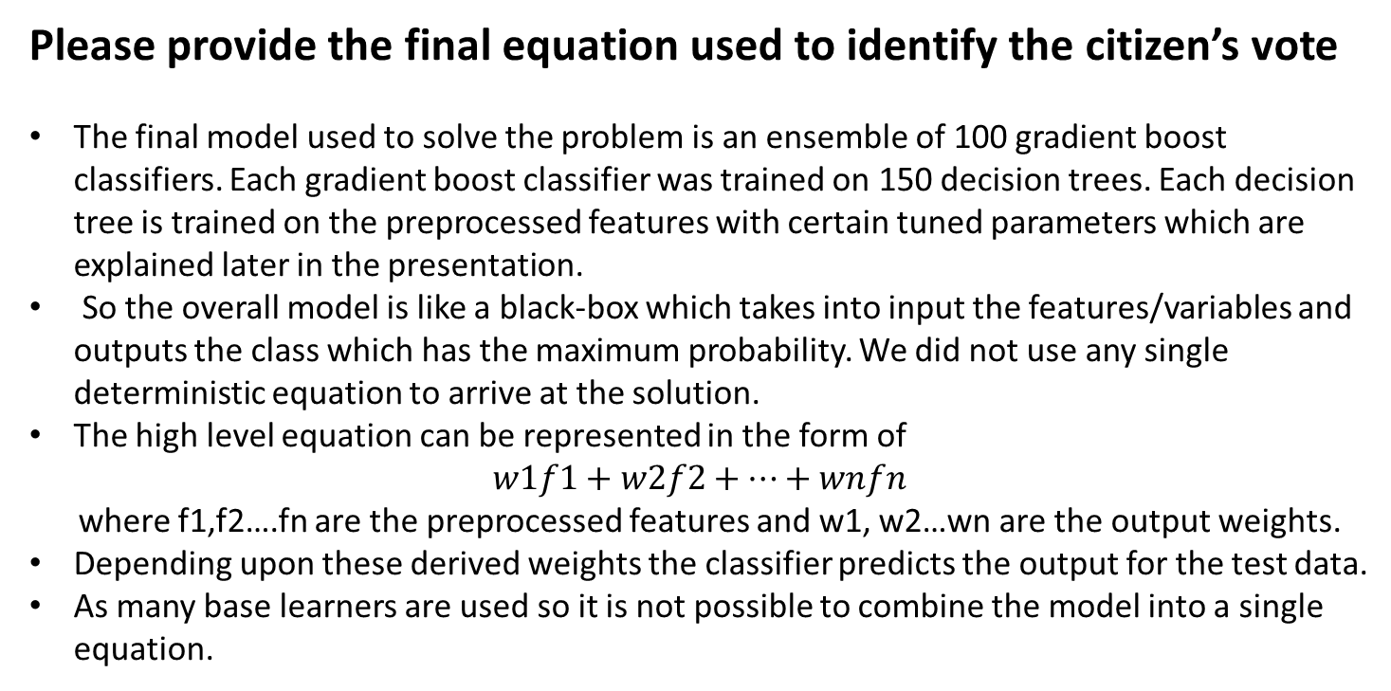
Equation to Identify Citizen’s Vote
Please provide the final equation used to identify the citizen’s vote
The final model used to solve the problem is an ensemble of 100 gradient boost classifiers. Each gradient boost classifier was trained on 150 decision trees. Each decision tree is trained on the preprocessed features with certain tuned parameters which are explained later in the presentation.
So the overall model is like a black-box which takes into input the features/variables and outputs the class which has the maximum probability. We did not use any single deterministic equation to arrive at the solution.
The high level equation can be represented in the form of
$$w1f1+w2f2+…+wnfn$$
where f1,f2….fn are the preprocessed features and w1, w2…wn are the output weights.
Depending upon these derived weights the classifier predicts the output for the test data.
As many base learners are used so it is not possible to combine the model into a single equation.

Slide 4
Details of each Variable used in the Equation
Please provide details of each variable used in the equation to identify citizen’s vote
Mvar_1: This categorical variable signifying past vote by citizen was converted into 5 binary dummy variables, one for each party.
Mvar_2 to Mvar_11: Currency sign form variable 2 to 7 was deleted and the variables were treated as continuous.
Mvar_12 and Mvar_13: Occupation of citizens was also covered to binary variables by introducing dummy variable for each occupation and variables having zero variance were discarded.
Mvar_14 and Mvar_21: These variables were used as they were provided.
Mvar_22: Dummy binary variables were introduced for each kind of educational background and variables with zero variance were discarded.
Mvar_23 to Mvar_28: These variables were used as provided.
Mvar_29 and Mvar_30: These variables were discarded as more than 50% od data was missing.

Slide 5
Estimation Technique Used
Please provide the estimation/modeling technique(s) used to arrive at the solution/equation
Plotting Predictors: Frequency plot was plotted for all the predictors to check for skewness after replacing blank space and NA’s with 0 and creating dummy variables for all the categorical vectors.
Data Transformation: Centering and scaling was done for all the predictors. Box-Cox transform was also tried but since accuracy decreased it was not used for prediction.
Multiple Model Fitting: Several models such as Artificial Neural Network, Logistic Regression, Random Forest, Naïve Bayes Classifier, Gradient Boosting, Polynomial Discriminant Analysis, Bagged Decision Trees and Ada Boost were fitted on the dataset.
Parameter Tuning: For all the fitted models parameter tuning was done based on accuracy and kappa values obtained from 10 fold cross validation test with 3 repetitions.
Selection of Best Model: Stochastic Gradient Boosting was selected as the best model based accuracy and kappa values obtained from cross validation tests.
Meta-Ensemble of Selected Model: Since a single ensemble model was not that accurate for Leader Board dataset, a meta-ensemble model with 150 gradient boosted trees, each boosted tree ensemble containing 150 decision tree was trained and final prediction was done by averaging the probabilities obtained from each gradient boosted trees.

Slide 6
Reasons for Technique(s) Used
Why do you think this is the best technique(s) for this particular problem?
Ensemble methods build larger models by combining many elementary models, that are quick to build and are known as base learners. In a multi-class classification problem with imbalanced datasets, ensemble classifiers turn out to be the best performers because they capture more behavior than each base learner captures by itself and so collectively it better models the population and accurately predicts class labels .
Classical ensemble methods that use decision trees as base learners, such as bagging and boosting are good predictors, but do not offer much insight into the structure of a dataset. But a much better classifier can be built if we can build an ensemble classifier based on other ensemble classifiers. So we used bagging of numerous gradient boost classifiers to solve this problem.
We chose bagging as our meta-ensemble classifier because it decreases the variance of the predictions of the gradient boost classifiers by generating additional data (bootstrapping), thus tuning the prediction to expected outcome.
For the final dataset we used the same model, and wherever the class output was ‘ODYSSEY’ , there we used the class with the second highest probability.

Slide 7
Final Submission File
Please embed your final submission file (.csv) here.

