Slide 1

User Authentication using Facial Recognition
SWE-681 Secure Software Design and Programming
Professor Name: Dr. Lisa Luo
Group 9:
Abhinav Sai Tummapudi (G01448222)
Siri Meghana Annamdevula (G01439296)
Anushka lytha (G01454268)

Slide 2



Introduction
Face Recognition Technology: Used to identify people in photos, videos or in real time. It is a category of biometric security.
Project Scope: The project utilizes a Siamese neural network for one- shot image recognition to enhance accuracy and efficiency in identifying faces.
Technological stack: Leveraging Tensorflow’s functional API and the LFW dataset to develop a robust capable of handling complex face recognition tasks.

Slide 3

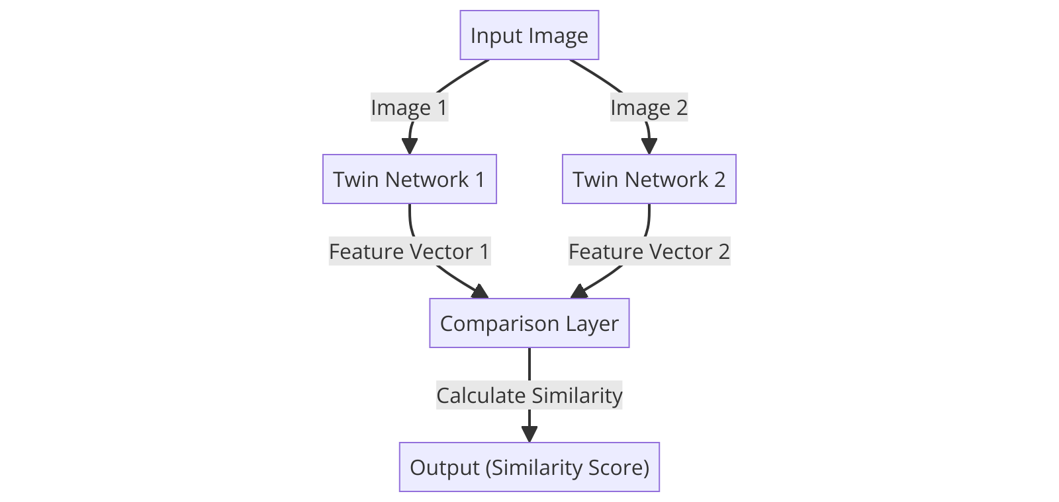
Siamese Neural Networks
Definition: Siamese Neural network consist of two or more identical subnetworks joined at their outputs. They are designed to predict the similarity of inputs by comparing their feature vectors, making them ideal for one-shot learning applications.
Advantages for Face recognition: The architecture excels in scenarios with limited data, such as one-shot learning by effectively learning from few examples to recognize faces not seen during training.
Role in project: This neural network architecture is crucial for achieving high accuracy in face recognition tasks within the project, demonstrating superior performance over traditional methods.

Slide 4
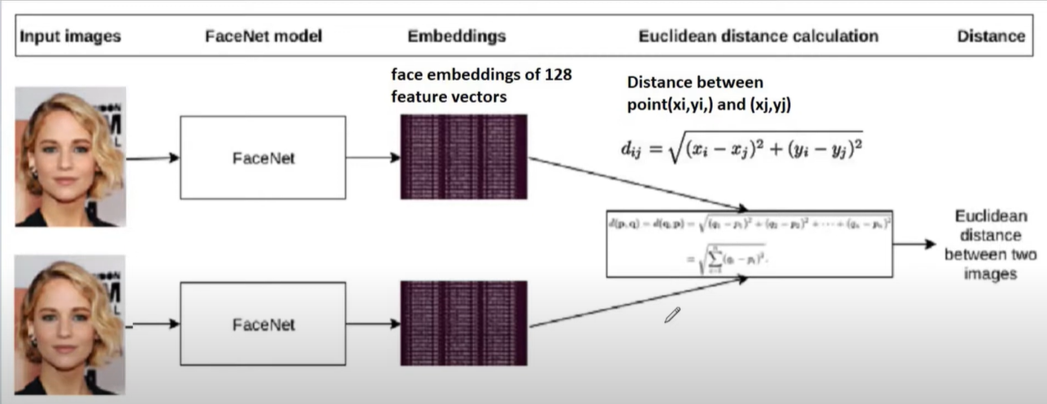
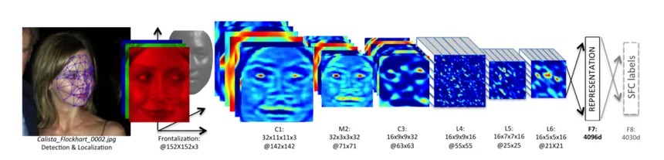
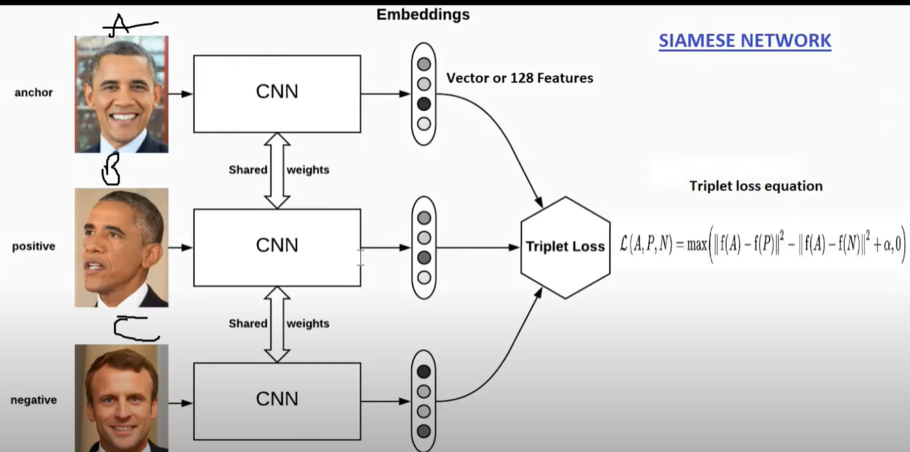

Slide 5

TensorFlow Functional API:
Functional vs Sequential API: Unlike the Sequential API that is limited to linear stacks of layers, the functional API allows more flexibility by enabling models to have multiple inputs, outputs, and complex connectivity patterns.
Benefits in the project: this approach has been crucial for tailoring the Siamese network architecture, facilitating feature extraction and comparison in ways that a sequential model could not achieve.
Practical Applications: the use of functional API has streamlined development and experimentation, leading to more efficient iterations and robust face recognition capabilities.

Slide 6
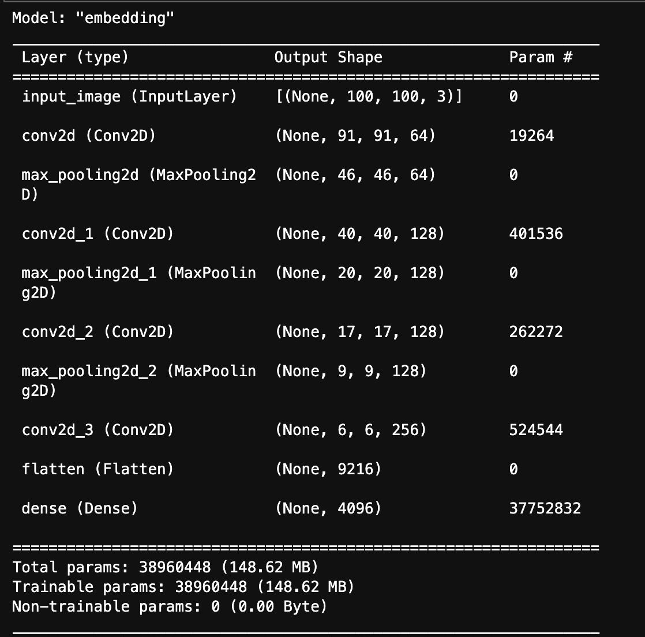
DCNN Network Architecture:

Slide 7

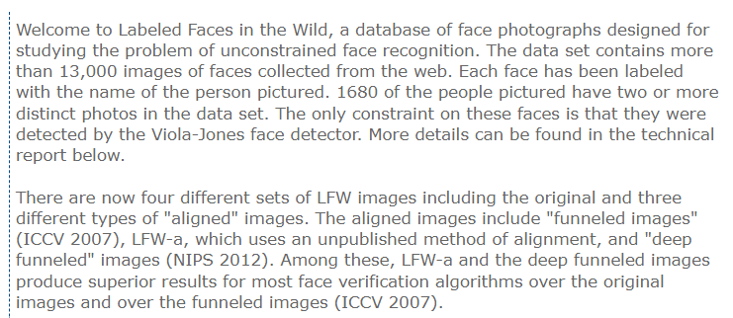
LFW Dataset
Importance: LFW has been widely used as benchmark for evaluating face recognition technologies in real-world scenarios. It offers a diverse set of images that challenge the robustness and accuracy of models.
Application in the project: In this project, the LFW dataset provides critical training and validation data, helping to fine-tune the Siamese network’s ability to recognize and differentiate faces accurately.

Slide 8
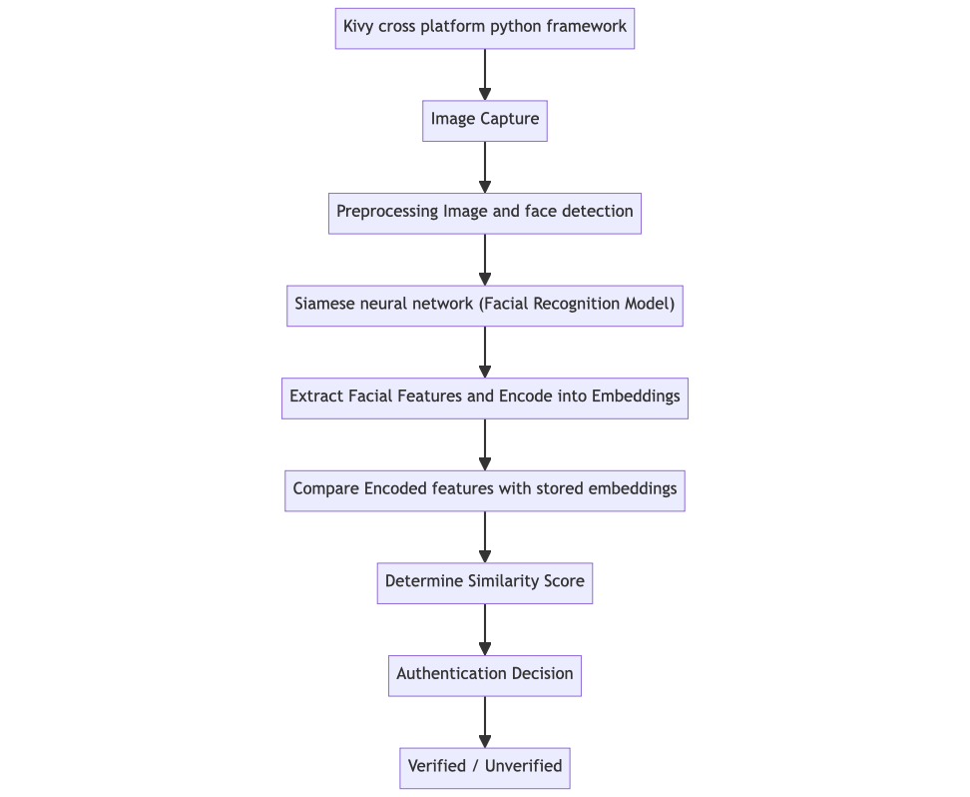
Project Flow

Slide 9

Project Demo

Slide 10

Any Question ?

Slide 11
Thank you

