Slide 1


CAPSTONE PROJECT
Airport Flight Board and Scheduler
Team :
Names : K Vinay - 2620040050
Y Abhinav – 2620030232 SECTION-2

Slide 2


Abstract
The Airport Flight Board and Scheduler is a comprehensive system designed to manage and organize flight information efficiently. It displays critical flight details including flight number, airline name, source and destination airports, departure and arrival times, and real-time flight status. The system enables users to search for flights quickly and easily by flight number, airline, or airport. By organizing all flight information in a clear and structured manner, it ensures passengers and staff have instant access to accurate, up-to-date flight data whenever needed.

Slide 3


FLIGHT DATA
AIRPORT SYSTEMS
Flight Information Details
Each flight record stores the following key data fields:
Flight Number
Airline Name
Unique identifier for each flight in the system
The operating airline for the scheduled route
Source & Destination
Times
Departure and arrival airport codes and names
Scheduled departure and arrival timestamps
Flight Status
Current state: Scheduled, Boarding, Delayed, or Cancelled

Slide 4
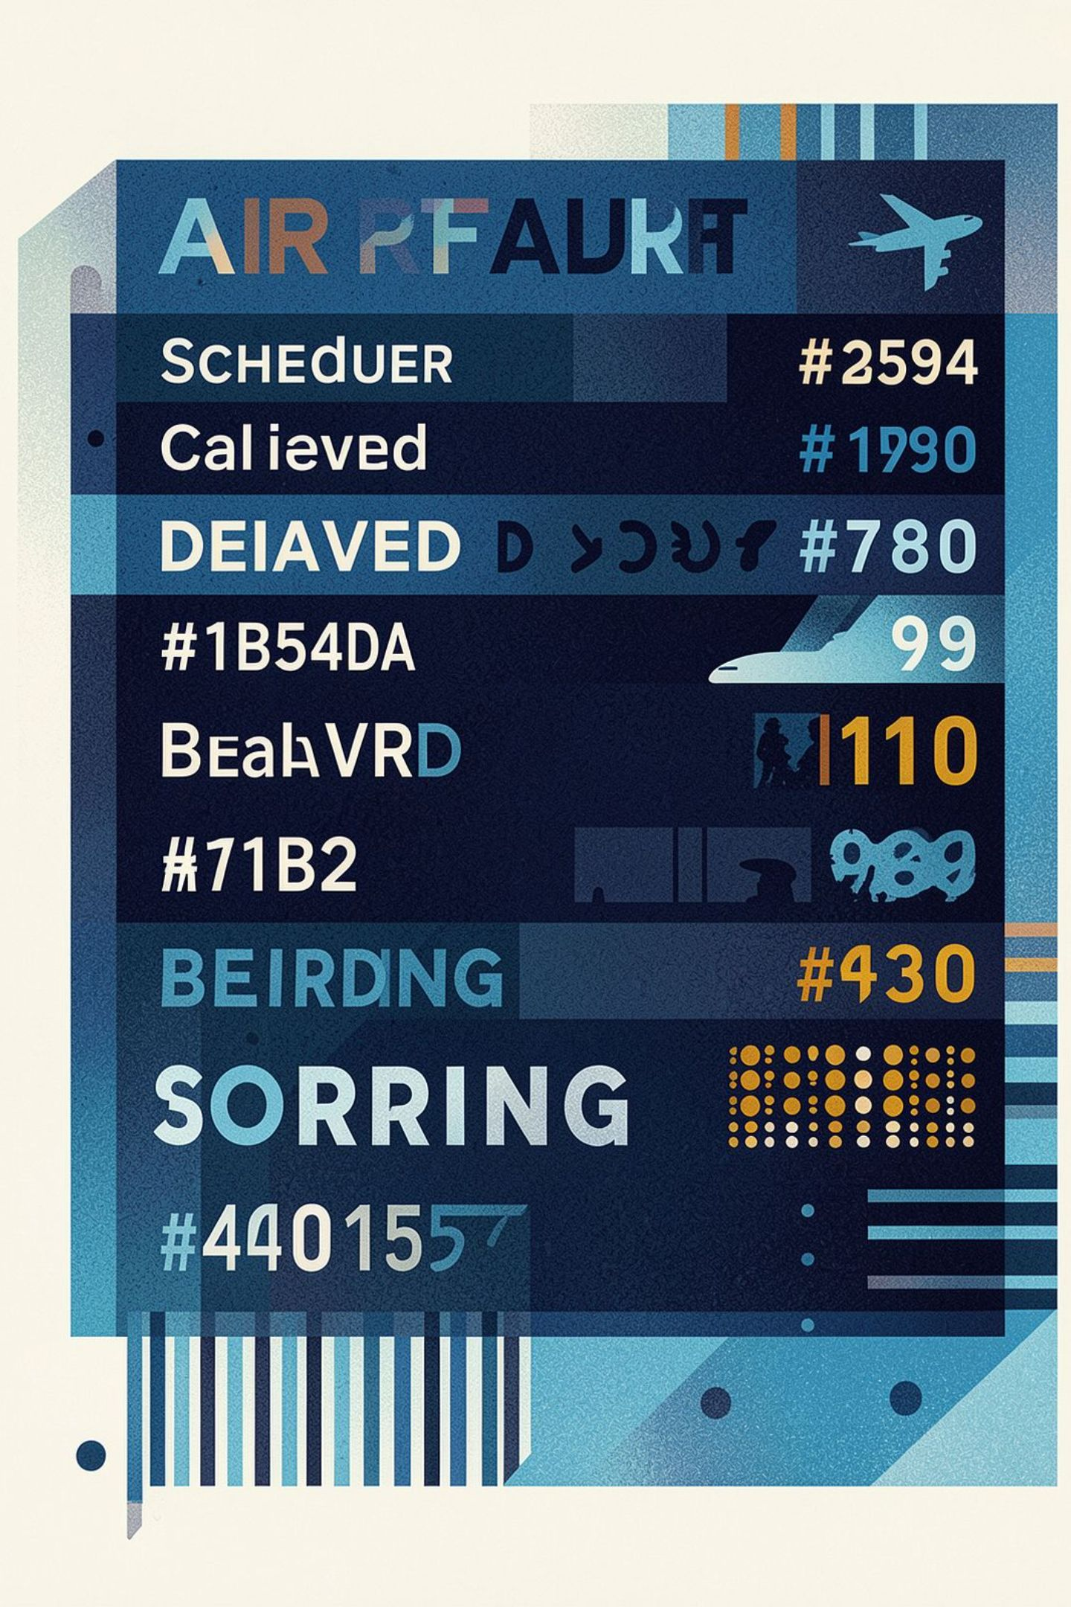

AIRPORT OPERATIONS
LIVE STATUS
Flight Board Display
Unified flight information for departures, arrivals, routes, and real-time updates.
📤 Departures & Arrivals
📍 Airport Info
Shows all upcoming departures and incoming arrivals in a unified view
Clearly shows origin and destination airports for every listed flight
⏰ Timings & Routes
🔄 Live Status Updates
Displays flight timings alongside source and destination airports
Reflects real-time changes — Scheduled, Boarding, Delayed, or Cancelled

Slide 5

AIRPORT OPERATIONS
WORKFLOW
Flight Scheduler Functions
Core actions for creating, managing, and updating flight schedules in real time.
01
➕ Add a New Flight
Register a new flight with all required details into the system
02
⏱️ Set Departure & Arrival Times
Assign precise scheduled times for each flight leg
Add Flight
Set Times
Update Schedule
Remove Flight
Change Status
03
🔄 Update Flight Schedules
Modify existing flight data as plans change
04
❌ Remove a Flight
Delete cancelled or completed flights from the active schedule
05
🔔 Change Status in Real-Time
Push live status updates instantly to the flight board

Slide 6
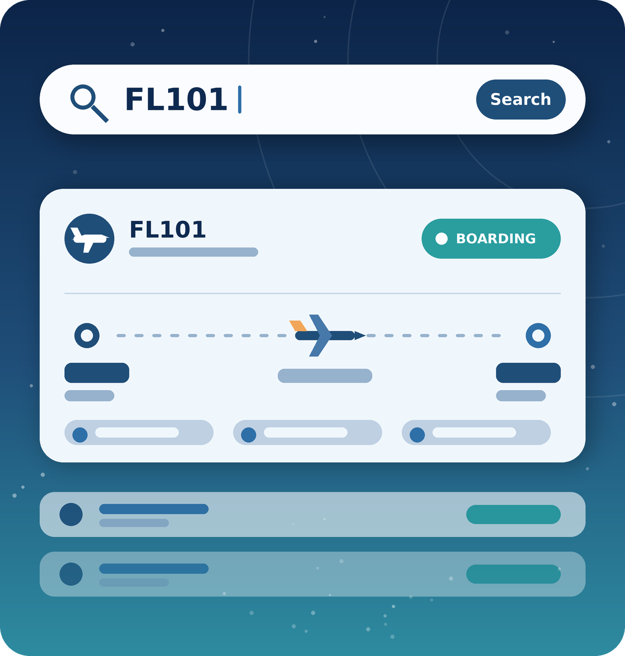

FLIGHT SEARCH
REAL-TIME
AIRPORT UI
Flight Search Feature
Find flights quickly with one simple search field that keeps results clear, fast, and easy to scan.
Multi-Field Search
Instant Results
Example in Action
Matching flight details are displayed immediately, with no delays
Search by flight number, airline name, or airport — all from a single input
Search "FL101" → instantly shows airline, route, times, and current status for that flight

Slide 7












JAVA CONCEPTS
Java Concepts Used in the Airport Flight Scheduler
Class & main() Method
if Statements
Two-Dimensional Arrays
Variables & Data Types
switch-case
String Handling (.equals())
Methods & Method Calling
for Loop
Random Number Generation
Scanner & User Input
One-Dimensional Arrays
Menu-Driven Programming

Slide 8


Benefits & Conclusion
✅ Easy Access
⚡ Fast Search
Passengers get instant access to all flight information in one organized system
Quick and efficient flight searching saves time for both staff and travelers
📋 Organized Schedules
🎯 Simple Management
All flight schedules are neatly structured and easy to manage at scale
Add, update, remove, and track flights with straightforward operations
👥 Informed Passengers
Real-time status updates keep every traveler aware of current flight conditions

Slide 9

Future Scope
💾 Database Integration
💻 Graphical Interface
Store flight data permanently in files or a database such as MySQL
Replace the console menu with a user-friendly GUI or web dashboard
🔔 Passenger Alerts
🌐 Live Data Feeds
Send SMS or email alerts for delays, gate changes and cancellations
Connect to real flight APIs and support multiple airports at once
🎫 Booking & Gates
Add ticket booking, gate assignment and baggage tracking

Slide 10

Thank You

