Slide 1
Social media conversation analysis report
Till November 2020
Team BOLT
-Animesh Maheshwari(team lead),Abhinav Choudhary,Sahil Agarwal

Slide 2

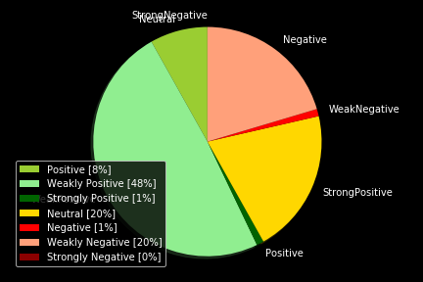
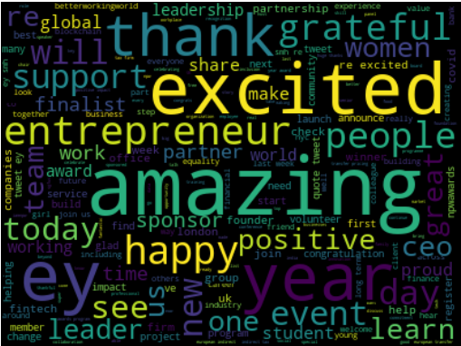
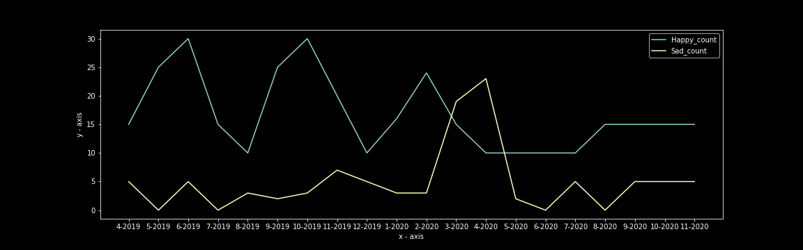
Introduction
Social media listening forms a crucial front for analysis on various fronts and helps gauge the sentiment of the major stakeholders- the users.
Team Bolt has performed extensive analysis on the social media conversations about EY and would like to present a report.

Slide 3

Social Media conversation analysis
Fields of Analysis -
Most prominent mentions on social media
Services offered by EY
EY and analysis during COVID-19
Geographical locations
Comparison with the Big 4 across different domains
Mention of EY in leading news sources that cater financial news.
Mention of technology
Handles most commonly mentioned: @EY_UKI, @Eynews, @EY_US, @EY_India, @EY
Hashtags most mentioned: #automotive, #strategy, #BetterWorkingWorld, #EY, #COVID19
Maximum tagged EY page for “amazing” @EYnews
Engagement is Maximum on “Tuesdays” followed by “Friday”
Tweets posted early evening(5pm-8pm) has the maximum reach followed by mornings(9am-12pm).
London and Paris are the cities where EY social media handles are most engaging.

Slide 4
Overall Insights The overall analysis suggests, EY performs well across the 4 major services, with a scope for improvement on the consulting segment
Ernest &Young comes out as a strong and positive market leader among the big fours. The sentiment analysis suggests, Assurance and Tax are the 2 domains of stronghold for EY.
During the pandemic, EY saw a peak engagement in the month of April, with a decrease thereafter, except an increase in September.
EY witnessed a good score of 61.9% positive(only a little less than the competitors) and 30.5% neutral conversations during the pandemic.
A geographical analysis suggests conversations about EY show the most engagement in the United States of America and India in that order. The Australian engagement for the same is drastically less, hence suggesting the organization should focus on building a stronghold in the Australian financial ecosystem in the domain of its services.
Deloitte comes out as a strong competitor to Ernest and Young. The sentiment analysis suggests, Strategy & transactions and Tax are the 2 domains of stronghold for Deloitte.
During the pandemic, Deloitte saw a peak engagement in the month of June, a little more than EY, with a comparatively lower average engagement than EY.
Deloitte witnessed a good score of 62.% positive and 29.7% neutral conversations during the pandemic.
A geographical analysis suggests conversations about Deloitte show the most engagement in the United Kingdom and India in that order.
Insights for competitor 1
Insights for competitor 2
KPMG comes out as another strong and positive market leader among the big fours. The sentiment analysis suggests, Assurance and Strategy and Transaction are the 2 domains of stronghold for KPMG.
During the pandemic, EY saw a peak engagement in the month of April, with a decrease thereafter, except an increase in September.
EY witnessed a good score of 61.9% positive(only a little less than the competitors) and 30.5% neutral conversations during the pandemic.
A geographical analysis suggests conversations about Deloitte show the most engagement in the United Kingdom and Canada in that order.
Insights for competitor 3

Slide 5
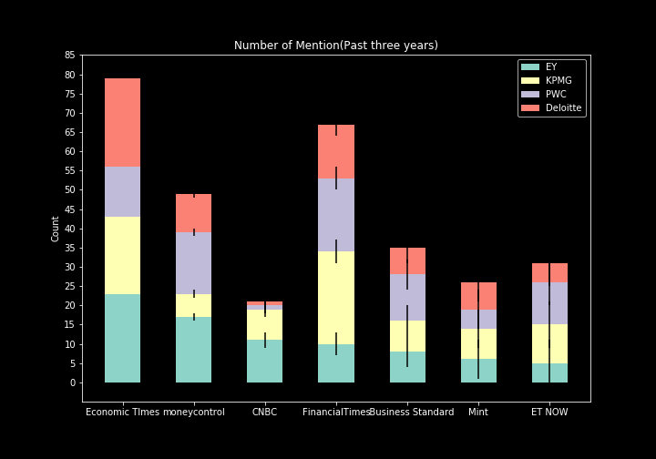
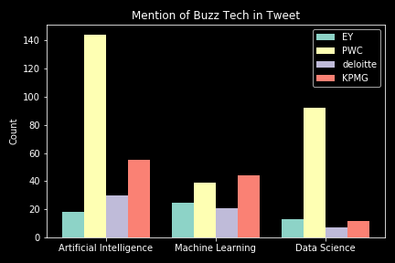
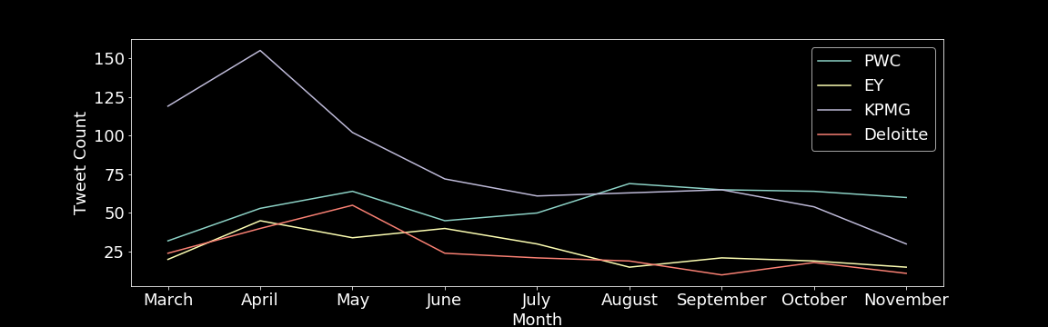
Statistics/Graphs comparing EY with other BIG4
Graph on Left shows number of times Big news channels like CNBC,Economic Times have covered these companies stories.
Graph on right shows the number of times companies have used trending technology like Artificial Intelligence ,Data Science,etc in their tweets.
Graph on left show number of times in the tweets BIG4 company name is mentioned which is related with COVID19 in this year.

Slide 6
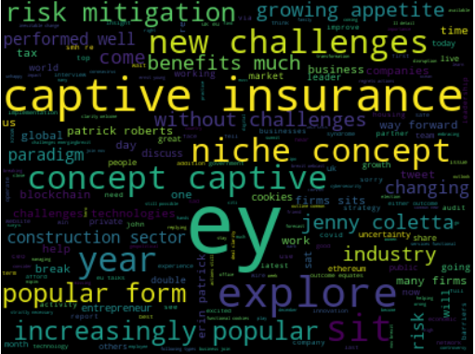
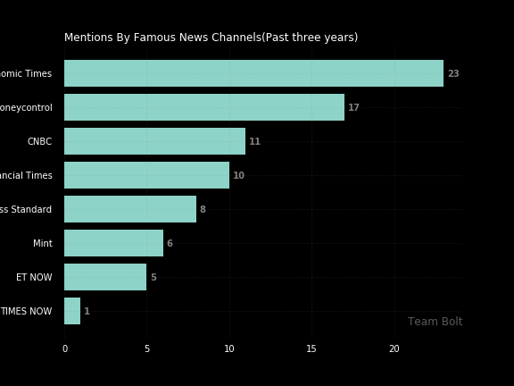
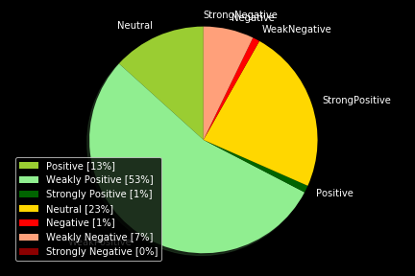
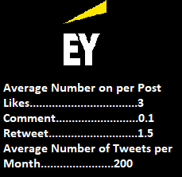
Observations on Services related consumer conversations on social media
Customer pain points
Brand responses
Success stories
Twitter Key Findings and Facts
Insurance and Consultancy are some words and services which are used with negative posts.
EY failed to mention trending technologies like AI,Data Science giving customers to cope up trend.
There were 19 incidents where KPMG was mentioned in major financial News Channels while the count is 17,14 and 12 for EY,Deloitte and PWC.
Computex and Huawei being the most tagged companies in the posts related to EY.
Tax and Assurance being the most satisfied services amongst customers.
Amongst all BIG4 EY managed to beat KPMG and PWC in social media engagement with more likes,retweets,etc
7% of the twitter accounts mentioning EY have more than 10k followers while 34% have more than 1k.
Photos/Videos in tweets have almost 10 times more engagement than simple Link and texts.

Slide 7
LinkedIn observations
LinkedIn is kept Out of Scope as its against the platform policy to scrap Linkedin data and this is clearly stated on the website.

Slide 8


Observations and
Recommendations

Slide 9
Observations and Recommendations
Geographical recommendation
The organization should focus on expanding reach in the Australian financial ecosystem
Sentiment for the company has seen a decline in India and Canada. The focus should be on improving this.
EY is doing better in USA than other countries but still it is not best BIG4 company in USA among twitter.
Services recommendation
EY should focus on the consulting segment
The organization has been doing fairly good with respect to the competitors on the Strategy & Transaction segment and this can be improved further.
Social media recommendation
Content being posted needs to be more visual in format, as the analysis suggests, this would bring more reach to the content.
The individual handles for EY services have been getting lesser reach. These should be leveraged to convey information about the work done.
Use of more trending technology like AI,ML,Data science and more information on work regarding these technologies will increase reach for EY across social media.
As the analysis suggests, it is recommended that that tweets be put early evening for maximum engagement.
Social media recommendation
@EYNews and @EYUS are the twitter account with most of the engagement and mentions.Other EY accounts need to be regularly updated. @EYnews handle is one of the most popular sources for engagement, it should be leveraged to promote the work of the services handles for more reach.
EY should use term “BIG 4” more often in there posts in order to increase its engagement and reach.(Most of the time BIG 4 term is searched on social media)
Use of trendy hashtags like #Data #cybersecurity #innovation will help to reach more people.

Slide 10








Technology Stack

Slide 11
FUTURE WORK
Getting Automatic Weekly analysis report with proper comparison with past data and other BIG 4.
More detailed analysis of competitors for better comparisons and Insightful results.
Create Interactive plots and choropleth maps for various countries.
Completely automating the entire pipeline along with real-time data analysis.

