Slide 1
Recommendation Likelihood Machine Learning Model
January 2024
Presented By:
Abhinav Sinha
+91 7351928565
abhinavsinha845@gmail.com
LinkedIn

Slide 2
CONTENTS
Introduction to the Project – Objective
Features of the Data
Exploratory Data Analysis
Model Methodology Overview
Feature Selection Process
Model Development
Model Performance & Validation

Slide 3
Introduction to the Project – Objective
LTR is a customer loyalty metric and is a management tool that can be used to gauge the loyalty of a firm's customer relationships.
The business team would like to find out the Likelihood to recommend for each customer. With the given data, you are required to build a predictive model to predict the “Likelihood to recommend”.

Slide 4
Features of the Data
Top features selected for the model
Feature | # Non-Null Records | # Total Records | # Coverage
MYSITE_Rank | 5,896 | 8,460 | 69.7%
Overall_Satisfaction_taking_everything_into_account | 6,252 | 8,460 | 73.9%
Customer_service_issue_resolution | 6,638 | 8,460 | 78.5%
Customer_service_Overall_satisfaction | 6,579 | 8,460 | 77.8%
Ease_of_business_overall_satisfaction | 6,815 | 8,460 | 80.6%
Future_proportion_of_purchase_made_at_MY_SITE | 6,109 | 8,460 | 72.2%
Customer_service_Responsiveness | 6,636 | 8,460 | 78.4%
Ease_of_business_invoicing | 6,873 | 8,460 | 81.2%
Delivery_on_time_schedules | 6,665 | 8,460 | 78.8%
No_of_Online_Sites_used | 6,681 | 8,460 | 79.0%
Delivery_on_time_accuracy_transit_time | 6,688 | 8,460 | 79.1%
Delivery_on_time_availability_of_products | 6,672 | 8,460 | 78.9%
Customer_service_general_attitude | 6,626 | 8,460 | 78.3%
Customer_service_keeping_customers_informed | 6,634 | 8,460 | 78.4%
Sales_reps_quotation | 6,693 | 8,460 | 79.1%

Slide 5
Exploratory Data Analysis
Basic checks on the target feature
Likely_to_recommend_Online_Site_MY_SITE | # Records | % Records
10 | 1462 | 17.3%
9 | 841 | 9.9%
8 | 1191 | 14.1%
7 | 1124 | 13.3%
6 | 741 | 8.8%
5 | 1053 | 12.4%
4 | 389 | 4.6%
3 | 441 | 5.2%
2 | 311 | 3.7%
1 | 306 | 3.6%
0 | 601 | 7.1%
The distributions of target variable is inclined towards the positive range of the score, with ~55% of records getting score in range of 7-10.
To model on a balanced dataset, we have converted the target variable to binary class, with score 6 to 10 in class = 1, and score <6 in class = 0.

Slide 6
Exploratory Data Analysis
Coverage overview of independent features
Coverage Range | # Independent features | % Features
90-100% | 1 | 1.6%
70-90% | 33 | 53.2%
50-70% | 2 | 3.2%
25-50% | 10 | 16.1%
10-25% | 10 | 16.1%
<10% | 6 | 9.7%
 | 62
More than half the features rest in the 70 to 90% coverage group.

Slide 7
Model Methodology Overview
Flow of the process
Input Data
Feed Input data
Encoding variables
Encoding categorical variables
Feature Selection
missing values
Model Development
Model Performance & validation
single unique values
Feature importance
Correlation
LightGBM Model development
Calculating Precision, Recall, F1 Score, ROC Curve, Confusion matrix
K-Fold cross validation
Baseline model development – logistic reg.

Slide 8
Feature Selection Process
Steps followed in the feature selection
Missing values
Dropping features with more than 80% missing values.
Single Unique Value
Feature Importance
Selecting features with 90% cumulative feature importance
Dropping features with single unique values
Correlation
Selecting top 15 features after checking correlation

Slide 9
Model Development
Overview of Development Process
We have divided model development into two parts:
Baseline model: Developing a baseline logistic regression model.
Advanced model: Developing an advanced ML model - here we have picked LightGBM Model.
LightGBM Modelling Method:
LightGBM, short for Light Gradient Boosting Machine, is an efficient and effective gradient boosting framework that uses tree-based learning algorithms designed for speed and performance. It's particularly well-suited for classification tasks.
LightGBM is part of the gradient boosting family, where new models are added sequentially to correct the errors made by existing models.
LightGBM uses decision trees as base learners.

Slide 10
Model Development
Overview of Development Process
Reasons for picking LightGBM modelling method:
LightGBM is designed to be efficient with large data sets.
Unlike many other algorithms, LightGBM can handle categorical features by converting them to integers.
LightGBM can deal with missing values natively, eliminating the need for imputing missing values in pre-processing steps.
LightGBM includes built-in support for L1 and L2 regularization, which can help prevent overfitting.

Slide 11
Model Performance & Validation
Precision, Recall and F1 Score - Results
Model Performance - LightGBM
Training Set Performance |  |  |  | Test Set Performance
 | precision | recall | f1-score | precision | recall | f1-score
0 | 0.88 | 0.68 | 0.76 | 0.82 | 0.64 | 0.72
1 | 0.84 | 0.95 | 0.89 | 0.81 | 0.92 | 0.86
Model Performance - Logistic Regression
Training Set Performance |  |  |  | Test Set Performance
 | precision | recall | f1-score | precision | recall | f1-score
0 | 0.74 | 0.38 | 0.51 | 0.76 | 0.38 | 0.5
1 | 0.72 | 0.92 | 0.81 | 0.71 | 0.93 | 0.8

Slide 12
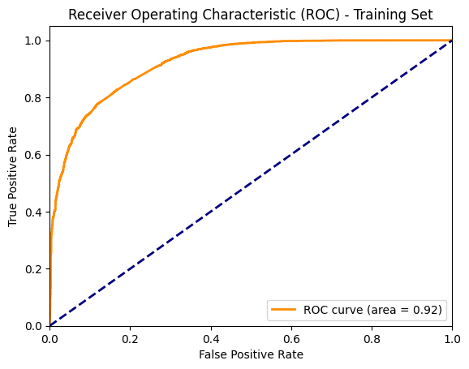
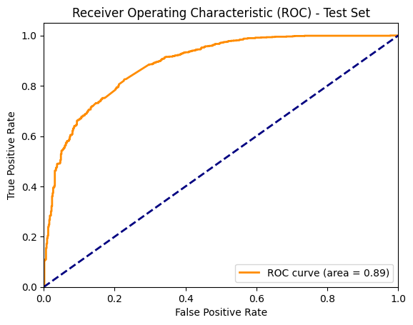
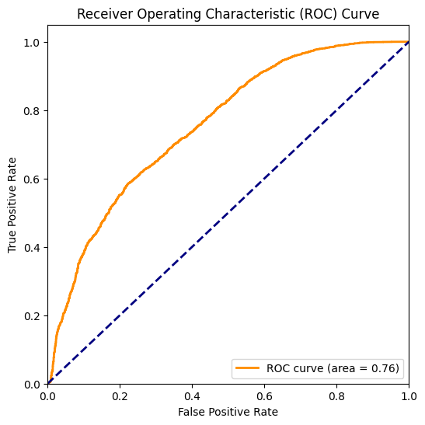
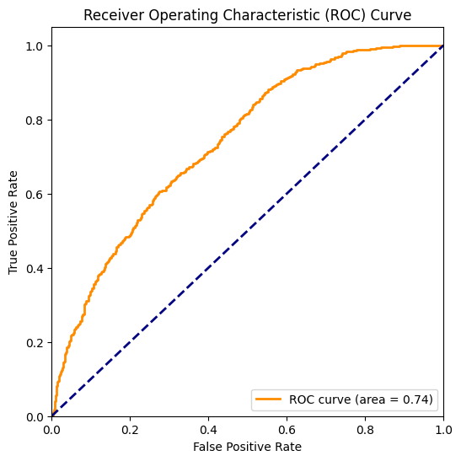
Model Performance & Validation
ROC Curve - Results
LightGBM Results
Logistic Regression Results

Slide 13
Model Performance & Validation
Precision, Recall, F1 Score and ROC curve - Definition
Precision: Indicates the accuracy of positive predictions. A low precision suggests a high number of false positives.
Recall (Sensitivity): Shows the ability of the model to find all the positive samples. Low recall indicates many false negatives.
F1-Score: Harmonic mean of precision and recall. It's a single metric that combines both precision and recall. A low F1-score suggests the model has issues with either precision or recall (or both).
The ROC curve visualizes the trade-off between the true positive rate (recall) and the false positive rate at various thresholds

Slide 14
Model Performance & Validation
Precision, Recall, F1 Score and ROC curve - Observations
In LightGBM Model Results:
High precision, recall, F1-score across both training and test sets indicate a well-performing model.
The ROC curve perfectly discriminates between the positive and negative classes, indicated by a curve that hugs the top left corner of the plot.
Training set metrics are close to test set metrics, indicating model is not overfitting.

Slide 15
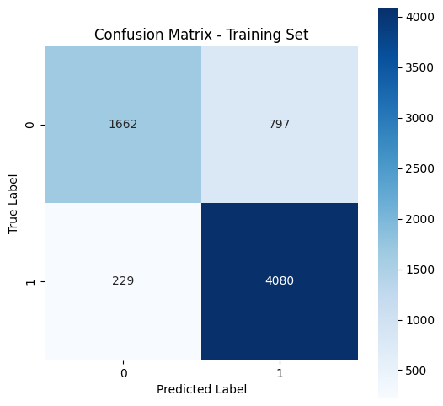
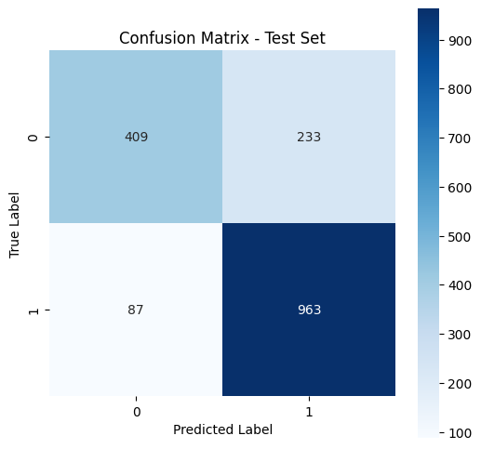
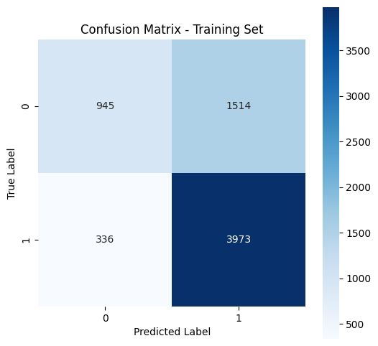
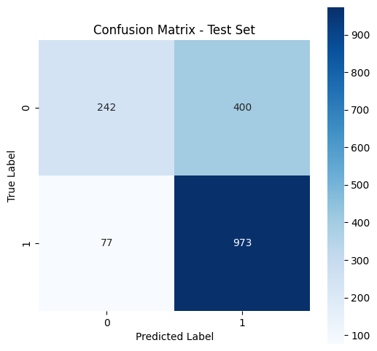
Model Performance & Validation
Confusion Matrix - Results
LightGBM Results
Logistic Regression Results

Slide 16
Model Performance & Validation
Confusion Matrix - Observations
In LightGBM Model Results:
High True positives and True Negatives: Indicates that the model is correctly identifying both positive and negative classes.
In Logistic Regression Results:
High True negative suggests that the model is too aggressive in predicting the positive class

Slide 17
Model Performance & Validation
K-Fold Cross Validation - Observations
In k-fold cross-validation we evaluate the model's performance across different subsets of data to ensure its stability and ability to generalize to unseen data.
Using LightGBM Model, we achieved k-fold cross validation score of 0.814, indicating that the model is stable and generalizes well across different subsets of the data.
Using LightGBM model, we achieved standard deviation of the accuracy across folds = 0.006, indicating model is not sensitive to the specific data it's trained on.

Slide 18
Thank You!

