Slide 1
A Novel Text Clustering Approach Using Deep-Learning Vocabulary Network
University of idaho
By
Abhinav Prabhu Adarapuram

Slide 2
Text Clustering:
Text clustering is the application of cluster analysis to text based documents.
This is done using machine learning and NLP to understand and categorize the unstructured data.
Webpages, microblogs, and social networks consists of very useful information which are collected by the text mining method.
Text clustering helps us to categorize huge amount of text documents into small meaningful clusters.

Slide 3
It is used in research fields such as text classification, sentiment analysis, text summarization, event tracking and topic detection.
Text clustering is divided into 2 parts:
Preprocessing phase
Clustering phase
The preprocessing phase is mainly to transform text documents into structured data that can be processed by clustering algorithms. It is classified into two parts:
Feature extraction
Feature selection

Slide 4
The feature extraction is divided into two categories:
Term based frequency
Semantic web method
Term frequency-based method is a method of obtaining the word count.
Semantic web is the process of building the knowledge which has words and the relation between those words.
The feature selection method is used to remove the redundant information and reduce the dimension.

Slide 5
Feature selection is categorized into 3 categories:
Corpus-based method
Latent Semantic Indexing (LSI)
Subspace-based clustering
Clustering phase:
Clustering is an unsupervised approach of machine learning where it groups similar objects into corresponding clusters.
The most representative clustering algorithm is partitional clustering such as k-means, hierarchical and ensemble.

Slide 6
Limitations in text clustering
Loss of word relations in the process of feature extraction.
Retaining the word relations in dimension reduction.

Slide 7
Proposed Methods
To overcome the issues faced due to the feature extraction and dimension reduction, deep-learning vocabulary network (DLVN) is introduced.
The vocabulary network is constructed based on related-word set, which contains the “cooccurrence” relations of words or terms.
Sparse-group deep belief network is proposed to reduce the dimensionality of feature vectors.
An improved deep learning Single-Pass (DL-SP) is used in the process of clustering.
Three major algorithms are used to implement the proposed approach. They are:
Frequent Pattern Maximal (FPMAX)
PageRank
Deep belief network (DBN)

Slide 8
FPMAX:
FPMAX is a depth-first and recursive algorithm for mining maximal frequent itemsets (MFIs) in given dataset.
Frequent pattern tree (FP-tree) is structured to store frequent itemsets, and each branch of the FP-tree is a representation of a frequent itemset.
FP tree includes a linked list head, which contains all items of the dataset.
Maximal frequent itemset tree (MFI-tree) is introduced to store all MFIs in FPMAX.

Slide 9
PageRank:
PageRank is a link-based ranking algorithm, which is used in the Google search engine.
The computation of PageRank score is a process of iteration. Given an initial value of 𝑃, the iteration ends when the score of PageRank does not change or the change is less than a threshold.
The PageRank is computed using the formula,
𝑃(𝑖) = (1−𝑑 ) + 𝑑 ∑ (𝑖,𝑗∈𝐸) 𝑃(𝑗) / 𝑂𝑗

Slide 10
Deep Belief Network:
DBN is a model of deep leaning which has multilayer restricted Boltzmann machines (RBMs).
DBN contains the input layer (visible layer), the hidden layers, and the output layer.
Each layer of the DBN is connected to each other, but the units within the layer are not connected to one another.
The training of DBN includes two steps, pretraining and fine-tuning.

Slide 11
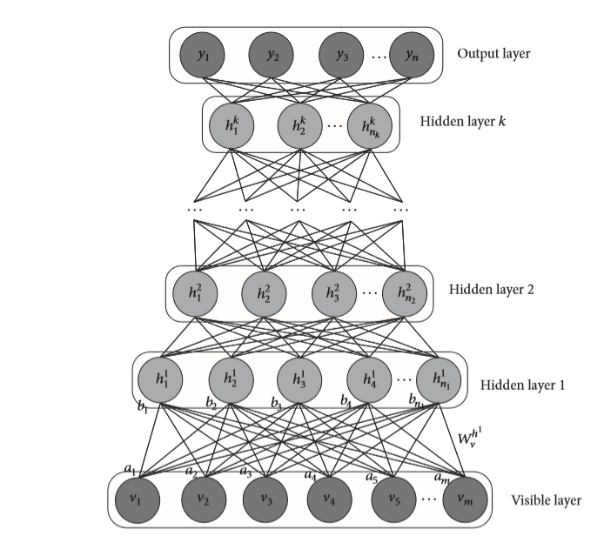
Structure of DBN

Slide 12
Deep Learning Vocabulary Network (DLVN)
The deep learning vocabulary network is an approach for text clustering.
The first step of DLVN is the construction of vocabulary network.
The nodes of the vocabulary network are used to represent the words and its edges are used to represent the relation between the words.
Two methods are used to obtain the relations of words. They are related-word set and TongYiCi CiLin.
Frequent itemset are used to discover the relations of items in database.

Slide 13
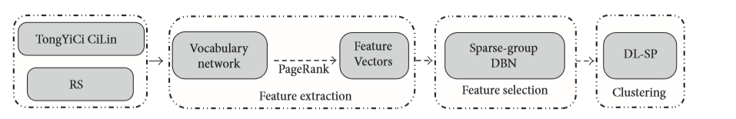
Architecture of DLVN

Slide 14
Related word-set
The relation of the words are important information in the text document.
The relations between words are important to represent the meaning of text documents.
Frequent itemsets are used to obtain cooccurrence relations between words or terms.
Natural language has the fixed collocation and corresponding contexts, which means some words or terms have a high probability of occurrence in a text document.

Slide 15
TongYiCi CiLin
It is a Chinese semantic dictionary of synonyms and related words, which organizes all words as a five-layer hierarchical tree.
It contains 77,343 words, which are divided into 12 major classes, 94 middle classes, and 1438 small classes.
The first layer and the fourth layer are capital letters, the second layer is a lowercase letter, and the third layer and the fifth layer are integers.

Slide 16
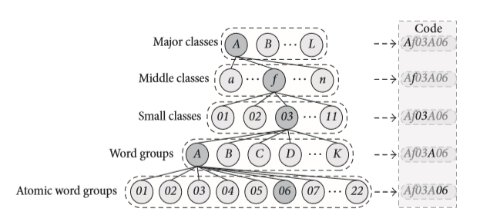
Structure of Tong YiCi CiLin

Slide 17
Vocabulary Network
Vocabulary network is constructed to represent text documents.
The vocabulary network contains the relations between words or terms.
The word groups in Tong YiCi CiLin are used as nodes instead of words in vocabulary network.
Edges of complex network are the important carrier of information, and the edges of the vocabulary network are used in calculating the “importance” of nodes.
The number and the direction of edges gives the importance of nodes, which is similar to evaluating the importance of webpages. Thus, PageRank is utilized to obtain the importance of nodes.

Slide 18
Deep Learning Single Pass (DL-SP)
Sparse group DBN is proposed for dimensionality reduction of feature vectors.
The hidden layers exhibits statistical dependencies. Therefore a regularization constant is used to reduce the relation among the layers.
Coverage rate (CoR) is used for obtaining the similarity measure among feature vectors in DL-SP.
The first document is treated as the first cluster in Single-Pass.
A similarity is computed between new document and existing clusters, which decides new document to join the existing cluster or to create a new cluster in terms of specified threshold.

Slide 19
Experiments
Three sets of experiments were conducted to validate the effectiveness of the proposed approach which are the efficiency of FPMAX-RS in related-word set mining, the comparison of feature vectors, and the comparison of DL-SP efficiency.
Efficiency of FPMAX
Running time of FPMAX and FPMAX-RS are compared in related-word set mining.
Seven categories (museum, property, education, military, car, sport, and health) of text documents were chosen from the datasets, and each category has 50 articles.
FPMAX-RS is efficient than FPMAX.

Slide 20
Comparison of Feature Vectors
Two documents from the category museum and one document in other categories including property, education, and military were chosen in random.
The aim of feature extraction is to extract the feature vectors that can represent the meaning of text documents.
K-means method is followed for clustering.
Here the number of clusters is 7 since seven categories of text documents are chosen.

Slide 21
Comparison of DL-SP Efficiency
The objective of this experiment is to compare DL-SP with LSI and Single-Pass.
DL-SP has better performance than LSI and Single-Pass in sport, military, property, education, and health.

Slide 22
Conclusion
DLVN method was proposed for text clustering.
The existing term frequency-based methods only calculated the number of words, but the relations of words are not considered in feature extraction.
Vocabulary network was built to mine the importance of words using related-word set.
The results show that DLVN method gave better results when compared to the existing method.

Slide 23
References
Yi, J., Zhang, Y., Zhao, X., & Wan, J. (2017). A Novel Text Clustering Approach Using Deep-Learning Vocabulary Network. Mathematical Problems in Engineering, 2017.

Slide 24
Thank you

