Slide 1
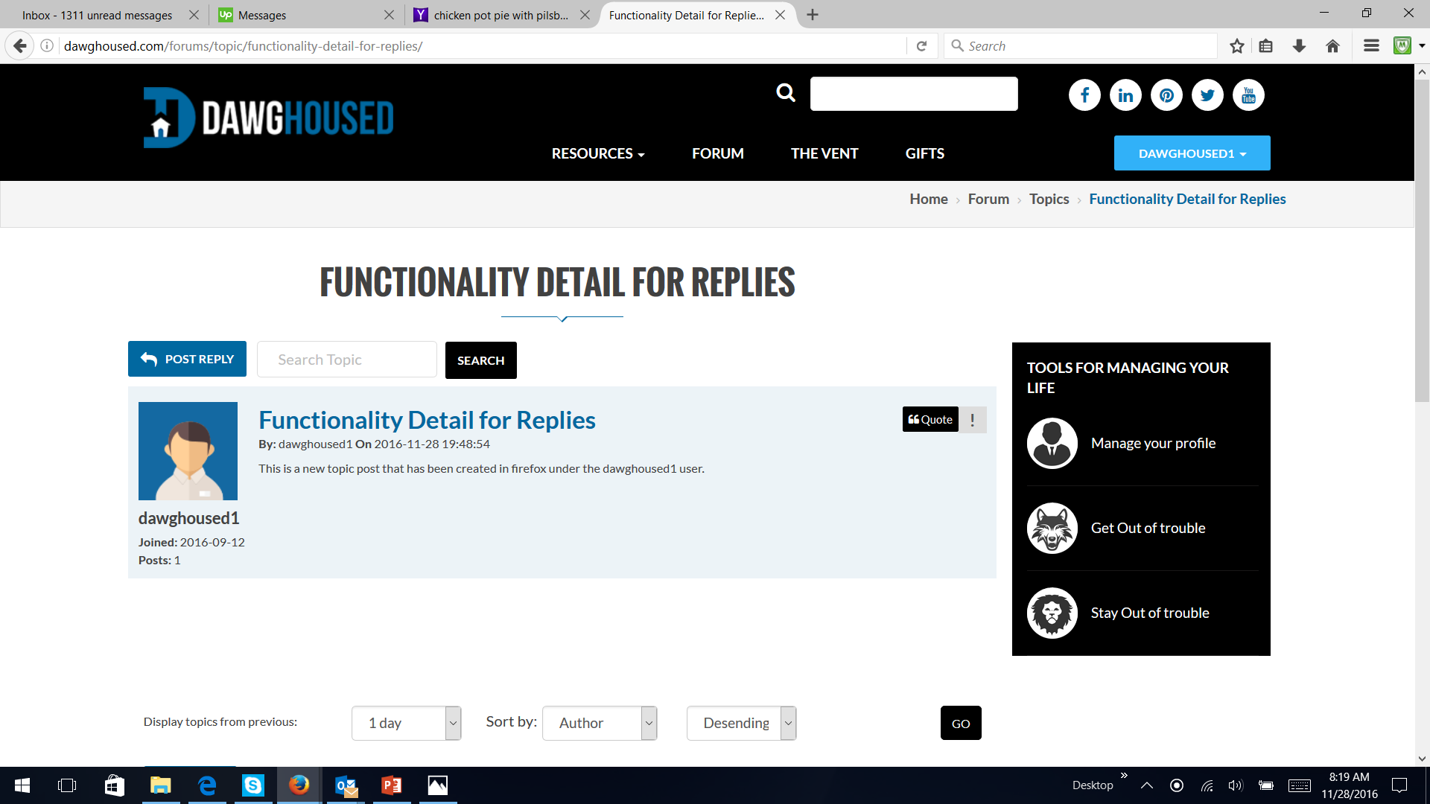
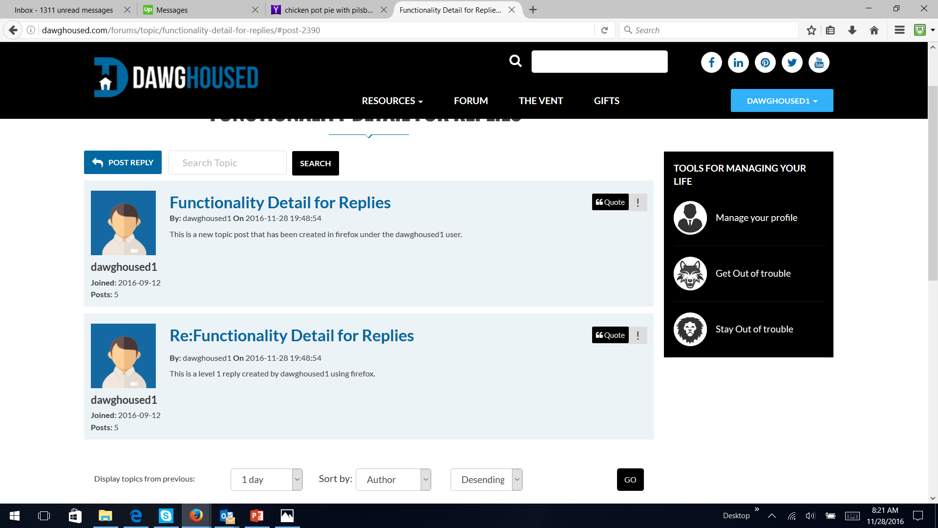
Creation of a new topic (within Red Forum category) Correct posting functionality
Creation of a reply to the topic . Correct posting functionality

Slide 2
Creation of an additional reply (now 1 original topic plus 2 replies). Correct posting functionality

Slide 3
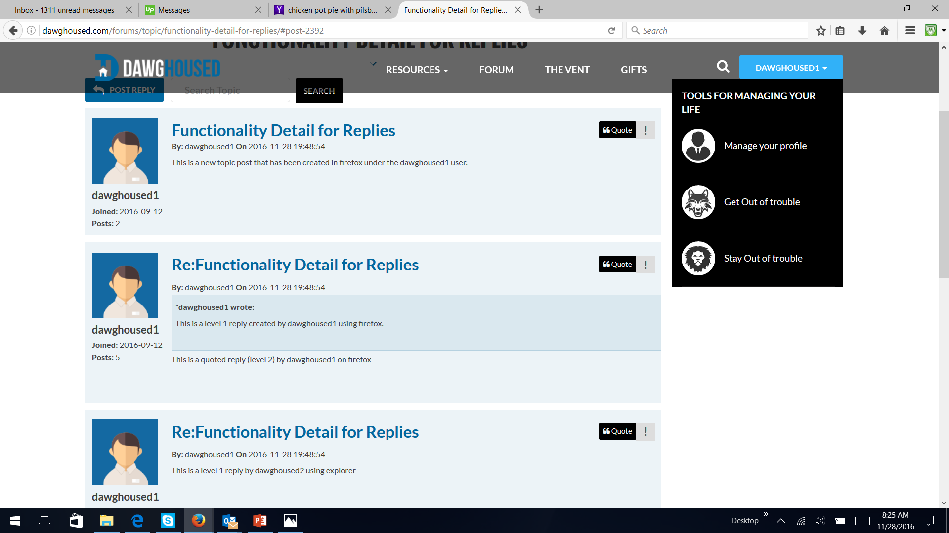
Creation of a quoted reply. Not working correctly (shown in this example). The problem is that the quoted reply “adds to” the existing reply and does not create an entirely new post.
Creation of a quoted reply (example of how it should work and look).
Note how it does not replace the original reply and that post remains unchanged
The new quoted rely is a new post and is listed at the bottom

Slide 4
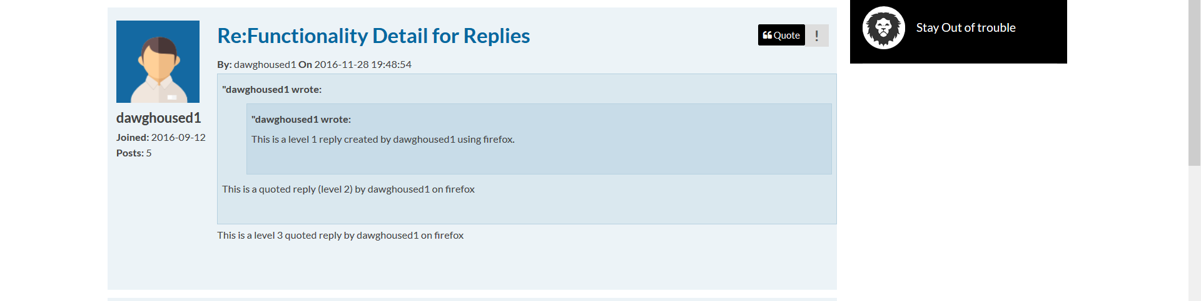
Creation of a quoted reply to a quoted reply (example of how it should work and look). Not working correctly. Note how it does not replace the original quoted reply and is listed at the bottom

Slide 5
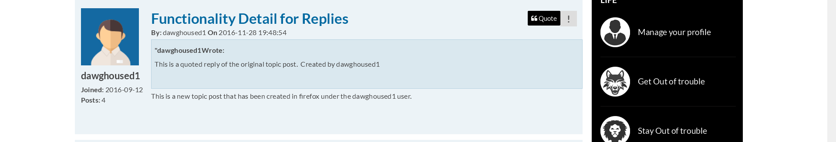
Creation of a quoted reply to the original topic post. Note how it does not replace the original quoted reply and is listed at the bottom.

Slide 6
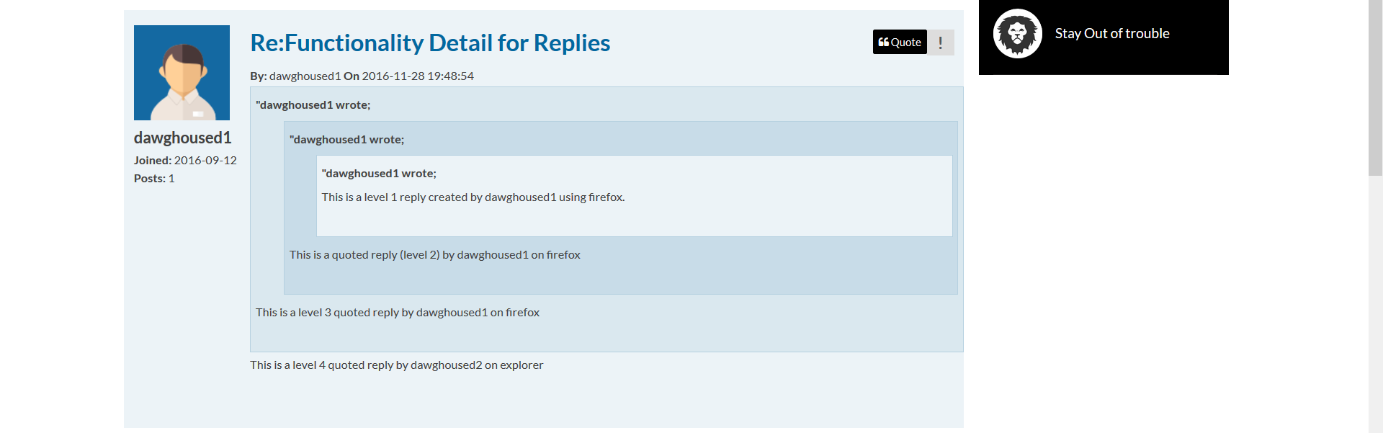
Creation of a quoted reply to a quoted reply to a quoted reply. Note how it does not replace the original quoted reply and is listed at the bottom.

Slide 7
Creation of another reply. Note how it is listed at the bottom. The newest post is always listed at the bottom regardless if it is a reply a quoted reply or a quoted reply of a quoted reply.

