Slide 1

PROJECT PHASE-2
ARTIFICIAL INTELLIGENCE
CHATBOT
For College Information

Slide 2

INTRODUCTION
What is Chatbot?
A Chabot is artificial intelligence (AI) software that can simulate a conversation (or a chat) with a user in natural language through: messaging applications, websites, mobile apps, through the telephone. This could be text based, spoken, non-verbal conversation. This Chabot will give answer to query about college related issues e.g.: (admission, branches, address, awards & achivements etc.).
Importance: A Chabot is often described as one of the most advanced and promising expressions of interaction between humans and machines.

Slide 3
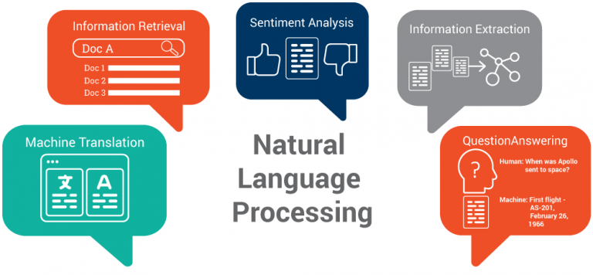

Modules of Project
The project will be concluding 2 main modules:
Using framework – Dialog Flow.
Using NLP. (deep learning)

Slide 4
Chatbot will comprise of:
Bot Chat:
User can chat with the bot , as if enquiring to the college person about college related activities.
Text to speech:
Bot will receive the commands that are spoken.

Slide 5
Working of Chatbot
User request analysis
This is the first task that a Chabot performs. It analyses the user’s request to identify the user intent and to extract relevant entities.
Returning the response
Once the user’s intent has been identified, the Chabot must provide the most appropriate response for the user’s request. The answer may be:
A generic and predefined text
A text retrieved from a knowledge base that contains different answers
A contextualized piece of information based on data the user has provided
Data stored in enterprise systems.
A disambiguating question that helps the Chabot to correctly understand the user’s request.

Slide 6
FEASIBILITY STUDY
The Chabot INDUSTRY is still in its early days but growing very fast.
Marketing motivations cannot be denied, but if Chabot meet the high expectations of the users. Many companies like:
Google, Facebook, Microsoft, IBM, and Amazon
are giving to Chabot is a strong indicator that this technology will play a key role in the future.
Clearly, Chabot is a rising TREND .
give a better experience and also save costs.
However, getting them right is not trivial.
Chatbot will IMPROVE CUSTOMER SERVICE and will also help in improving the RESPONSE rate. Catboats provide the assistance or access to information quickly and efficiently. Chatting with bots also helps to avoid loneliness, gives a chance to talk without being judged and improves conversational skills.

Slide 7
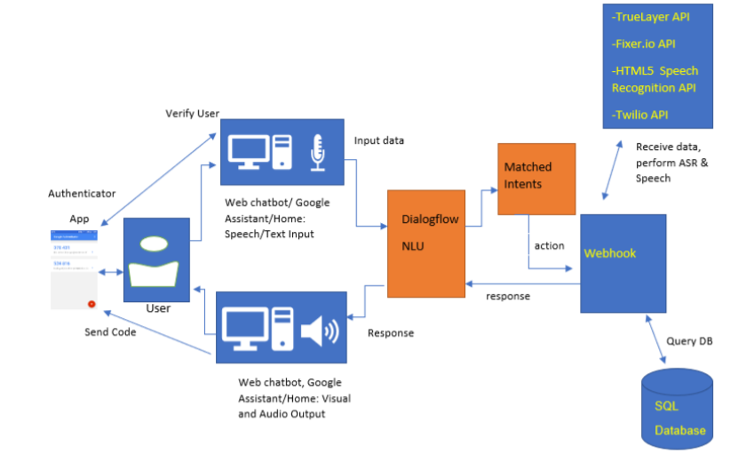
Architectural Design
Assistant : Users will interact with the chatbot from the web client and Google assistant app for Android devices.
Form of interaction : Users will carry out their interaction with the chatbot in the form natural language voice or text-based phrases.
Response : With the Google assistant integration, users will receive rich responses, such as :
images, and cards thus improving ease of use and interaction experience for users as less typing and effort ..

Slide 8

IMPLEMENTING METHODOLOGY
Dialog Flow
Strategy / Steps
Associated link to see implemented bot
Screenshots of chat with bot

Slide 9
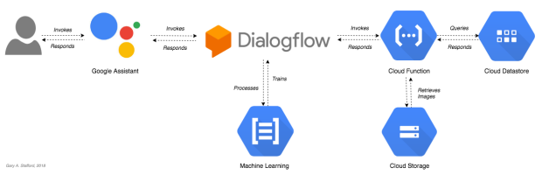
Dialog Flow
In this method following steps will be followed and they are :
1. Contexts
2. Training phases
3. Action and parameters
4. Responses

Slide 10
See the dialogue flow implementation .
https://bot.dialogflow.com/0e2b5bf5-3628-47f8-bfb4-7847ce4a35f4

Slide 11
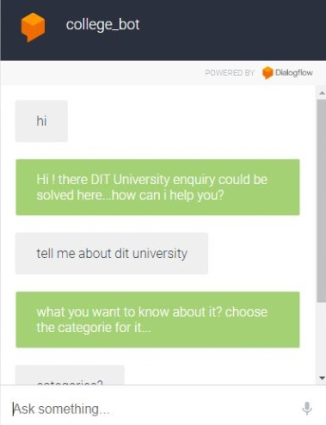
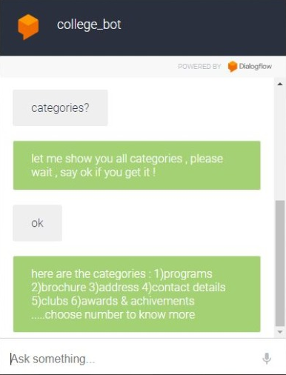
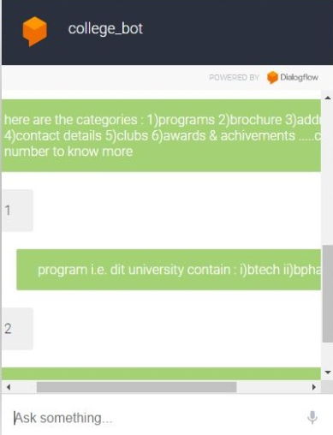
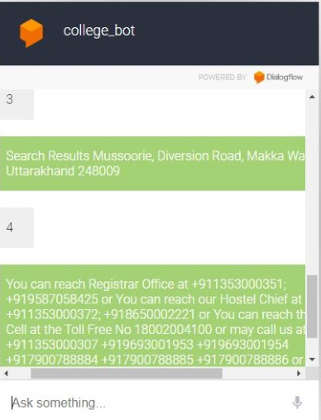
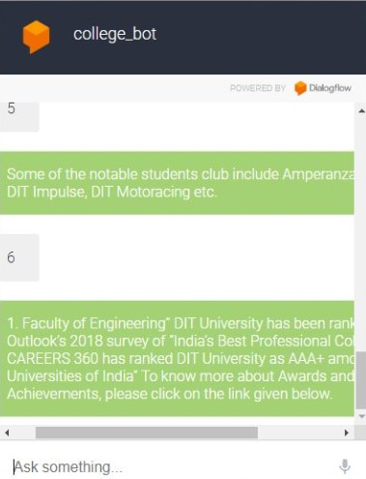
Implementation
To enquire press:
1) programs
2)brochure
3)address
4)contact details
5)clubs
6) awards and achivements
By default some task…
Entities and intents are main sub main features of framework
In this example the chatbot will extract the following information from the university:

Slide 12
IMPLEMENTING METHODOLOGY
2. NLP
Concept of NLP
Chart explaining Deep NLP

Slide 13
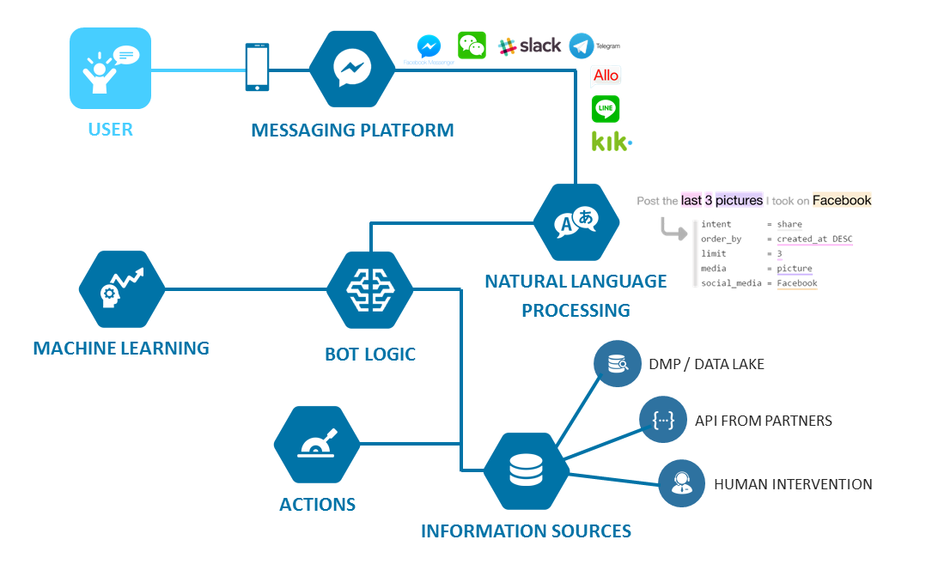
NLP (Natural Language Processing):
Natural Language Processing, usually shortened as NLP, is a branch of artificial intelligence →interaction between computers and humans using the natural language.
Objective :of NLP is to read, understand, and make sense of the human languages in a manner that is valuable.
Most NLP techniques rely on machine learning to derive meaning from human languages.

Slide 14

WORK PROGRESS
BUILDING A CHATBOT WITH NLP
PERFORMED IN 3 PHASES:
1)DATASET PREPROCESSING
2)SEQUENCE TO SEQUENCE MODEL
3)DATA TRAINING
:

Slide 15
DATA PRE-PROCESSING
STEPS INVOLVED :
Database
cleaning
integration
Data
warehouse
Flat files
ETL tools
Data
Mining
selection
transformation
For effective and accurate Chatbot data is massive.
Some screenshots are included for sample.
Resolving issues
Raw data into understandable format
Pattern finding, contain aggregated data
Data
reduction
Dividing the dataset into training data and testing data

Slide 16
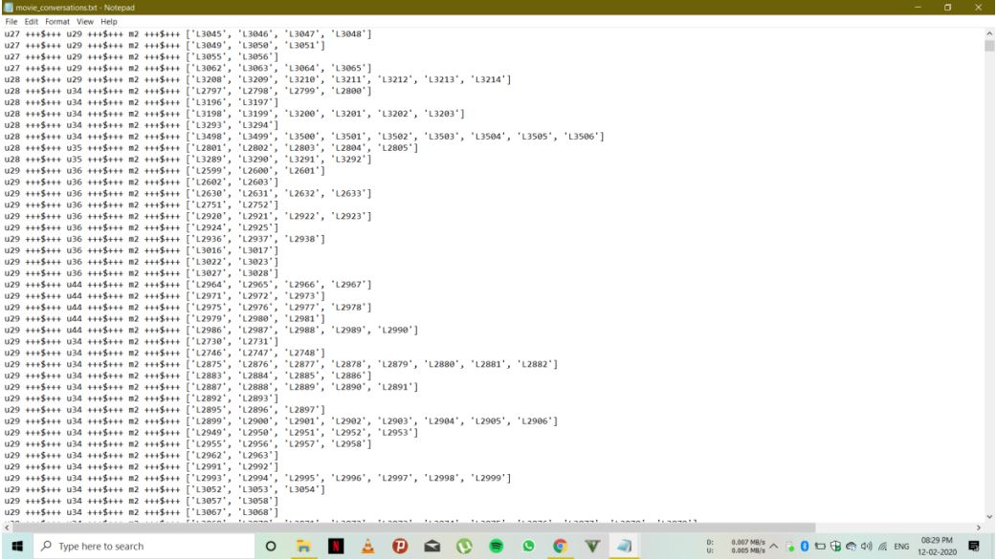
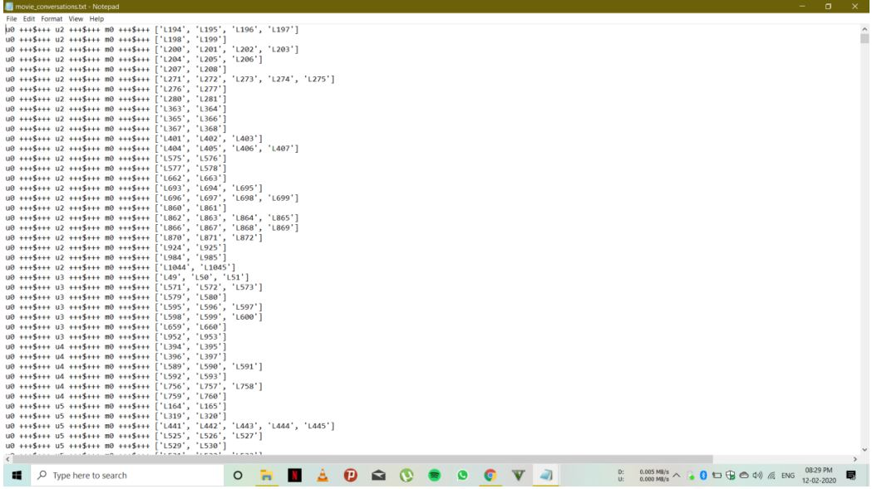

Slide 17
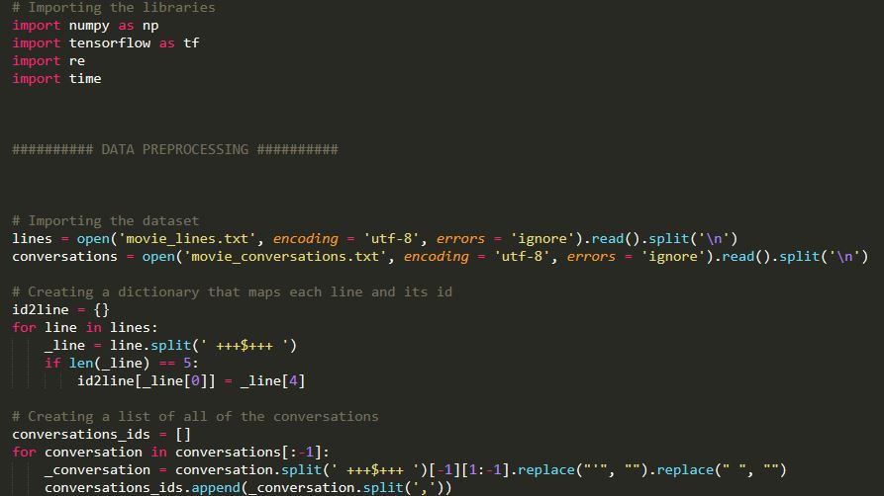
STEP 1 CODE :

Slide 18
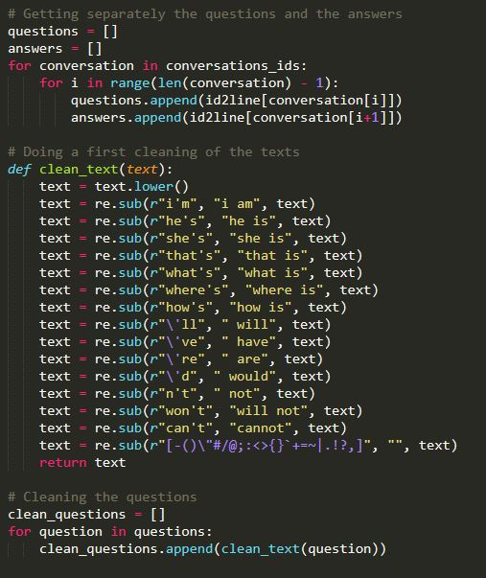
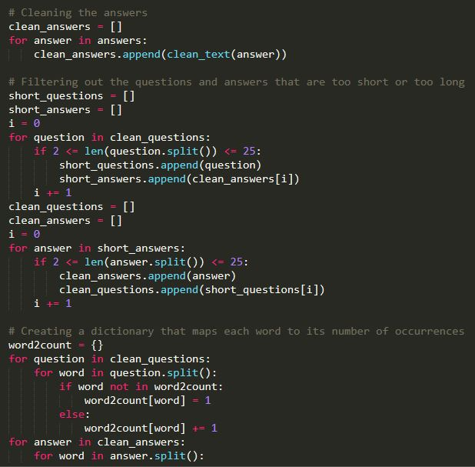

Slide 19
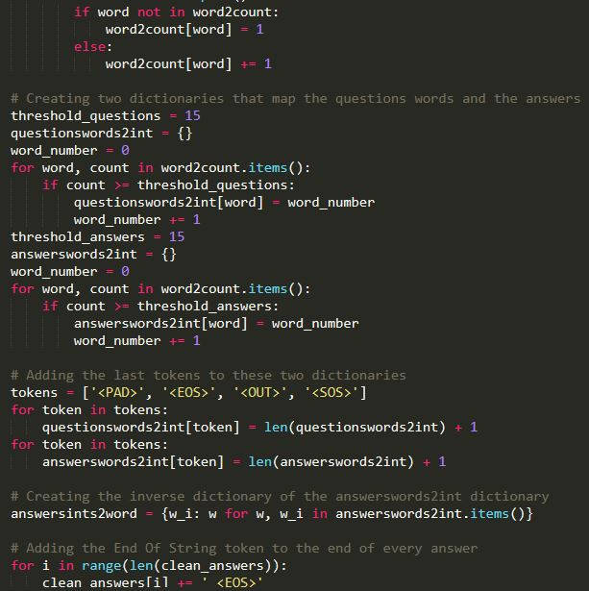
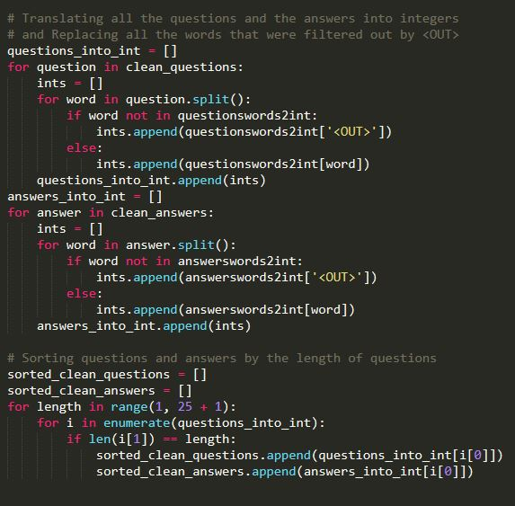

Slide 20
Sequence to Sequence Model
The current model class of choice for most dialogue and machine translation systems
Originally called “RNN Encoder – Decoder”
Seq2Seq is a method of encoder-decoder based machine translation that maps an input of sequence to an output of sequence with a tag and attention value. The idea is to use 2 RNN that will work together with a special token and trying to predict the next state sequence from the previous sequence
Consists of two recurrent neural networks (RNNs):
1) Encoder maps a variable-length source sequence (input) to a fixed-length vector.
2) Decoder maps the vector representation back to a variable-length target sequence
(output).
3) Two RNNs are trained jointly to maximize the conditional probability of the target
sequence given a source sequence.

Slide 21
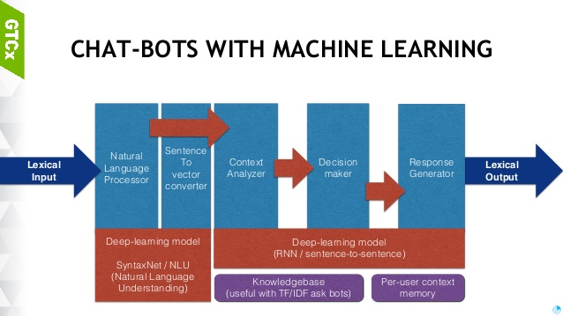
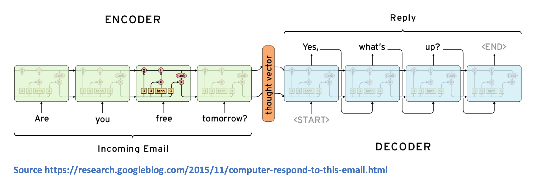

Slide 22
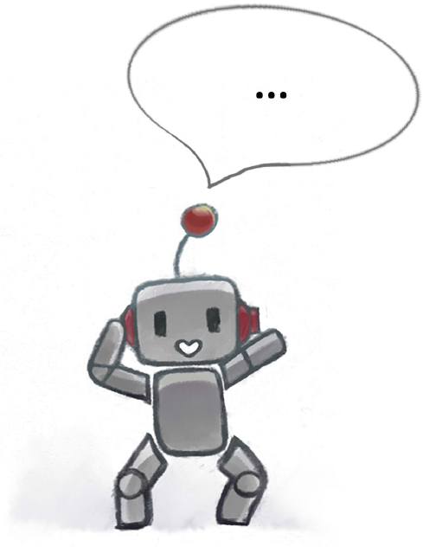
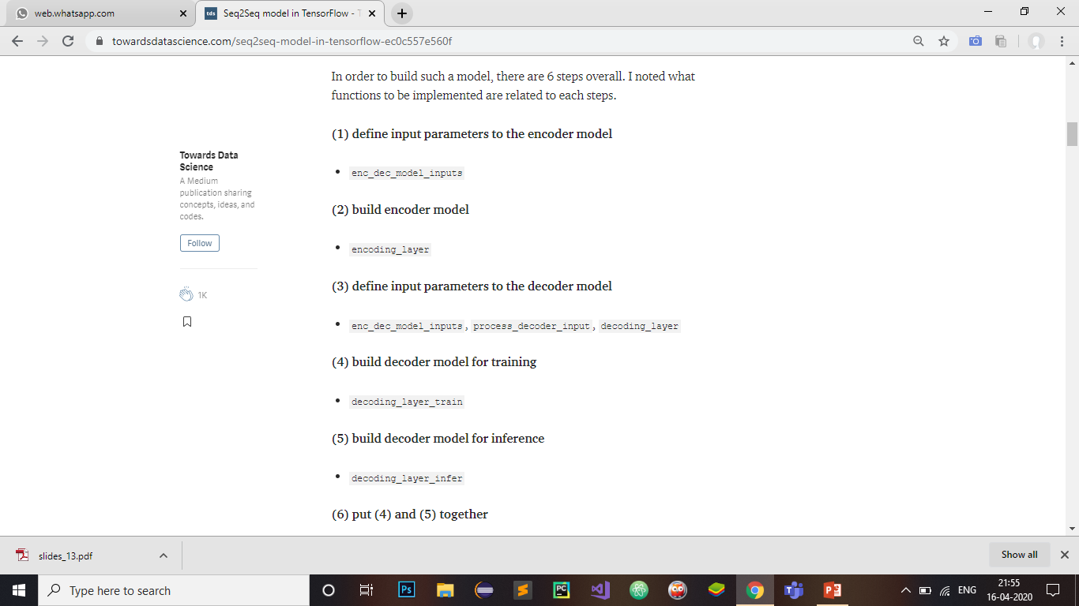

Slide 23
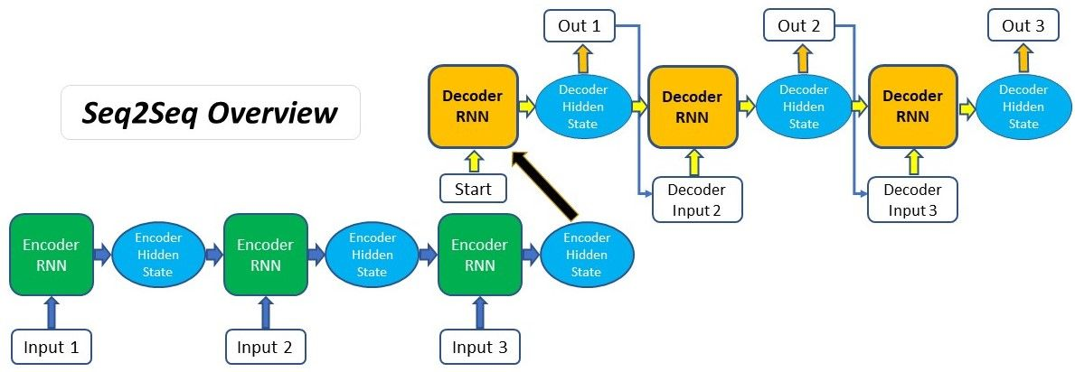
SEQUENCE TO SEQUENCE MODEL
Of Working model

Slide 24
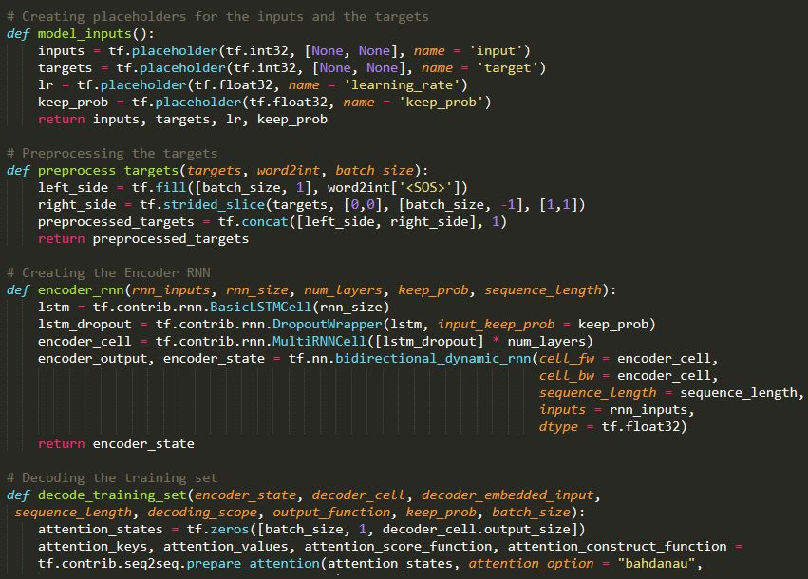
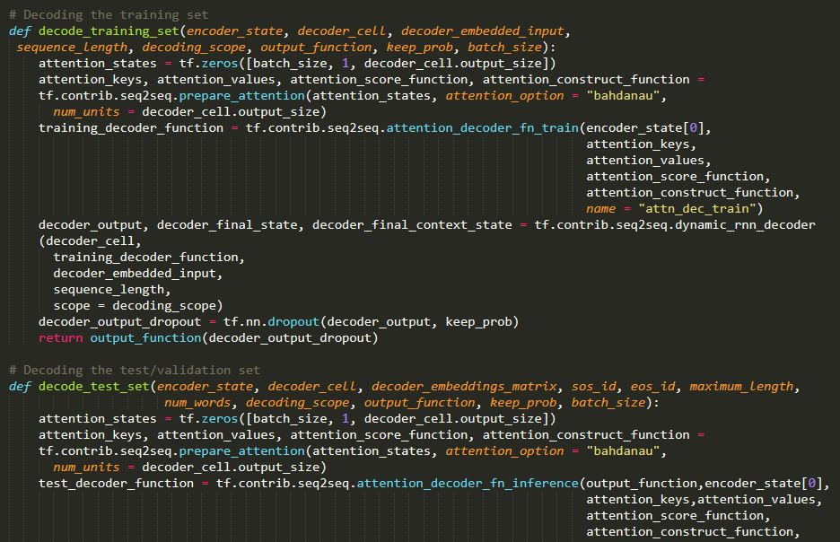

Slide 25
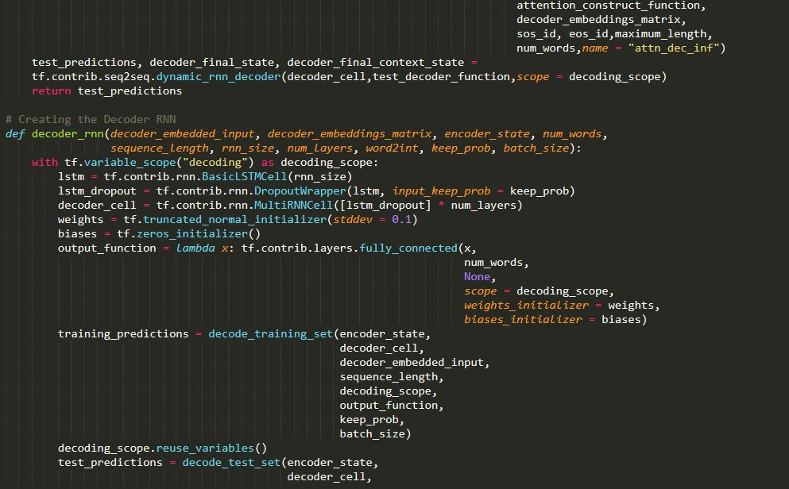
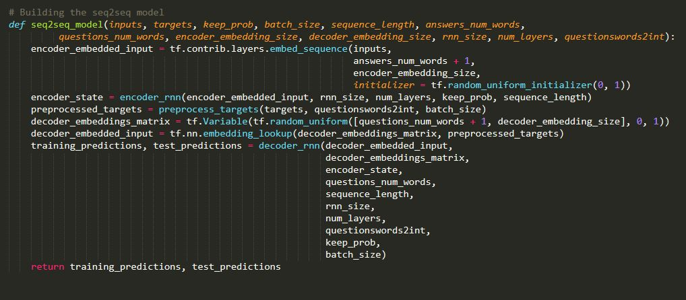

Slide 26
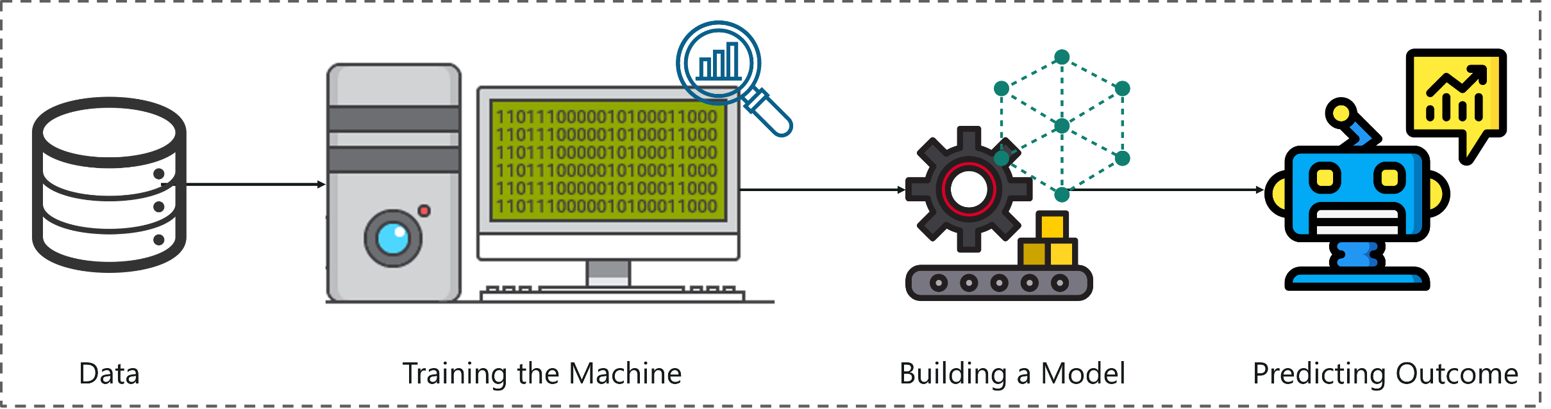
DATA TRAINING
The training data set in Machine Learning is the actual dataset used to train the model for performing various actions.
This is the actual data the ongoing development process models learn with various API and algorithm to train the machine to work automatically.
There are three types of data sets – Training, Dev and Test that are used at various stage of development. Training dataset is the largest of three of them.

Slide 27
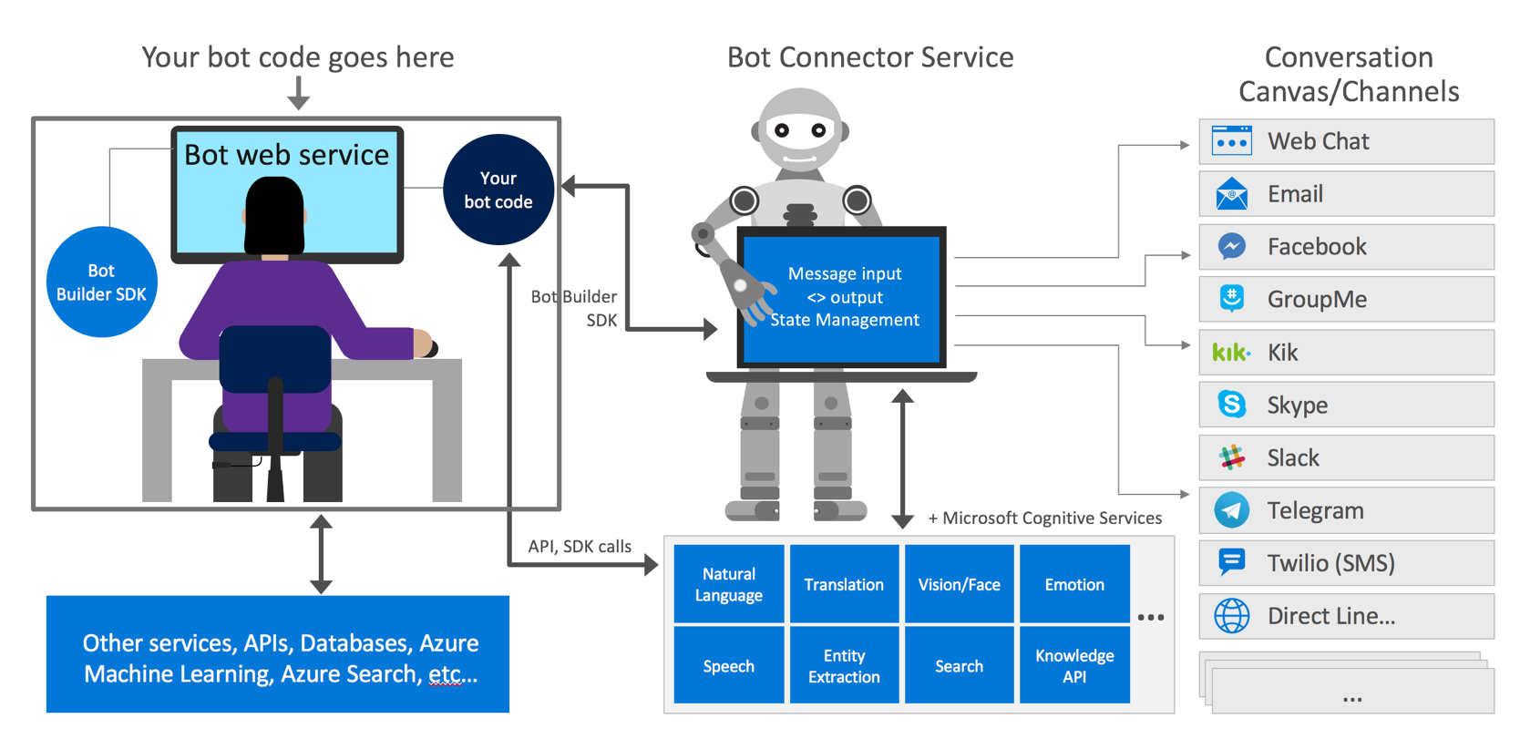

Slide 28
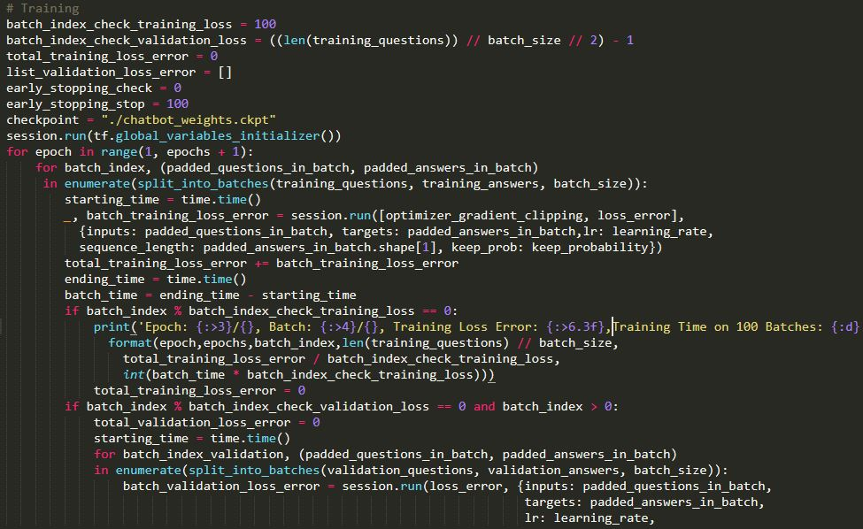
CODE FOR STEP 3:

Slide 29
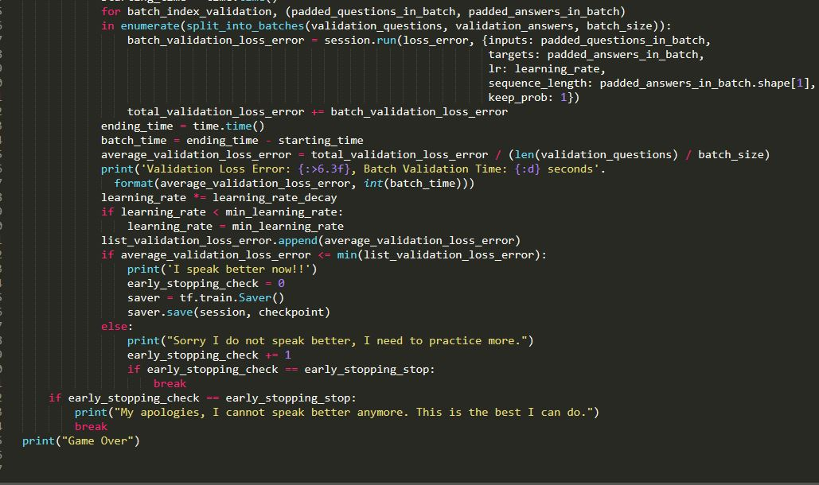

Slide 30
INNOVATIVES AND USEFULLNESS
Improve customer service
Personalize communication
Improve a response rate
Automate repetitive tasks.

Slide 31
Thankyou ! Ppt by: Yashika mittal aishwarya mishara abhinav pathak

