Slide 1
Delta Sigma Modulation-Circuit Implementation
Student: Abhinav S
Advisor: Abhishek Srivastava
May, 2022

Slide 2
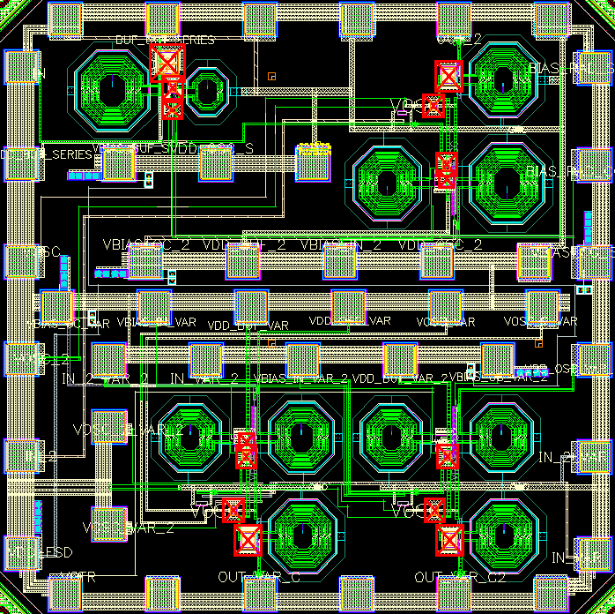
Project Summary
Project Title | IWR1843BOOST
PI | Dr. Abhishek Srivastava
Research lab | IC~WiBES Integrated Circuits inspired by Wireless and Biomedical Electronic Systems
Research center | Center for VLSI and Embedded System Technologies (CVEST)
Institute | International Institute of Information Technology Hyderabad

Slide 3
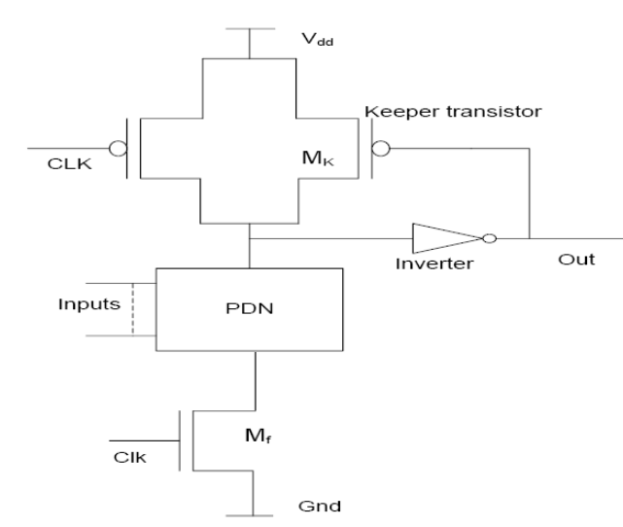
Conventional Domino Logic
Reference-Design of Manchester Carry Chain Adder using
High speed Domino Logic

Slide 4
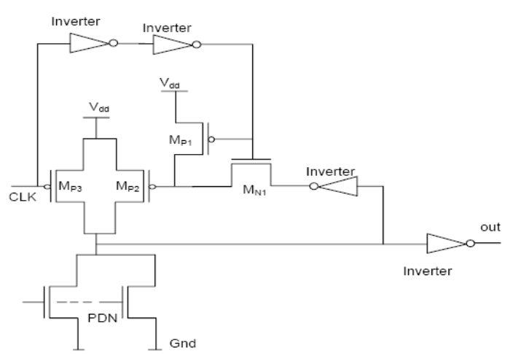
High Speed Domino Logic
Reference-Design of Manchester Carry Chain Adder using
High speed Domino Logic

Slide 5
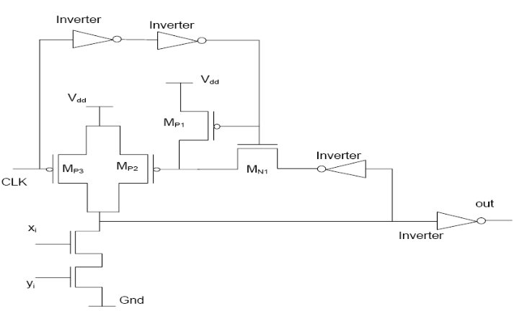
Carry Generate Circuit
Reference-Design of Manchester Carry Chain Adder using
High speed Domino Logic

Slide 6
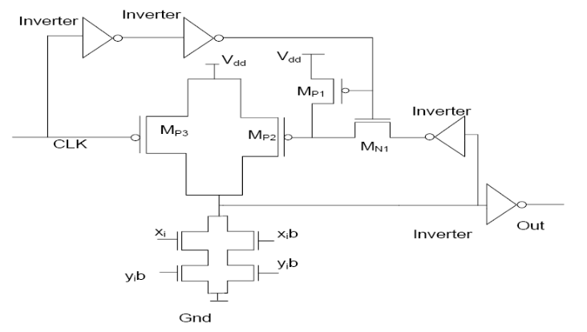
Carry Propogate Circuit
Reference-Design of Manchester Carry Chain Adder using
High speed Domino Logic

Slide 7
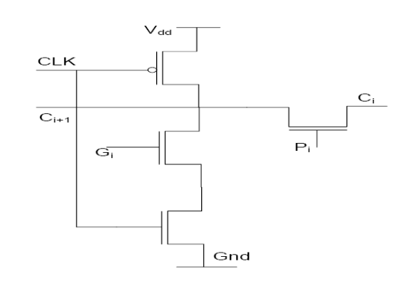
Manchester Carry Chain 1-bit Adder
Reference-Design of Manchester Carry Chain Adder using
High speed Domino Logic

Slide 8
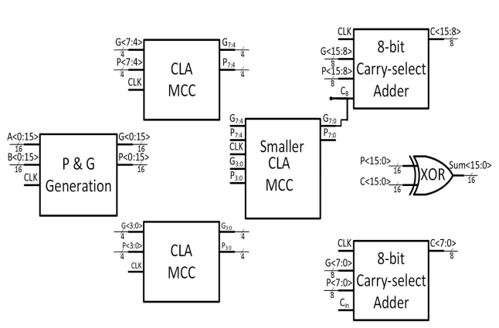
Proposed Hybrid Adder in Paper
Uses 2 CLA and smaller CLA circuit to produce C8 for second 8-bit Carry-select adder
By that time Carry select adder has already done computation and output is
selected based on C8
Reference-A 16-bit High-Speed Low-Power Hybrid Adder

Slide 9
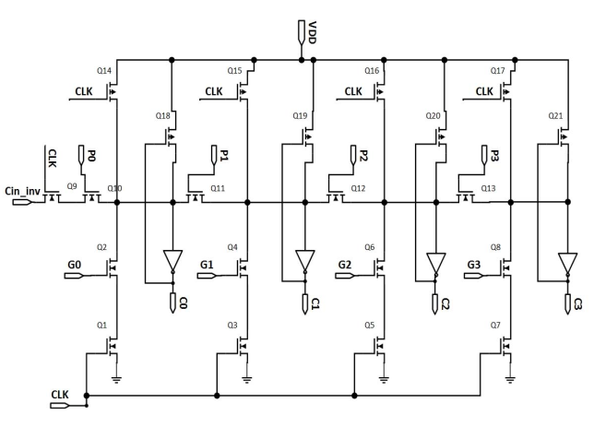
4-bit Manchester Carry Chain Adder
Used as 4-bit Carry Save Adder
Output calculated for both values of Cin and chosen with multiplexer based on
Carry provided by Carry Look-ahead Circuit
Reference-A 16-bit High-Speed Low-Power Hybrid Adder

Slide 10
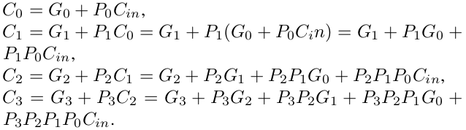

Carry Look-ahead formulas
Reference-A 16-bit High-Speed Low-Power Hybrid Adder

Slide 11
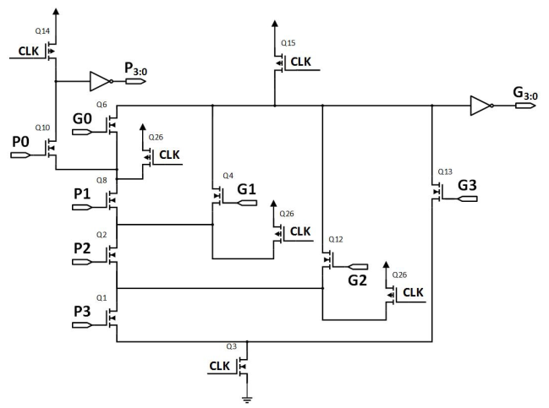
Manchester Carry Chain Carry Look-ahead Circuit
Reference-A 16-bit High-Speed Low-Power Hybrid Adder

Slide 12
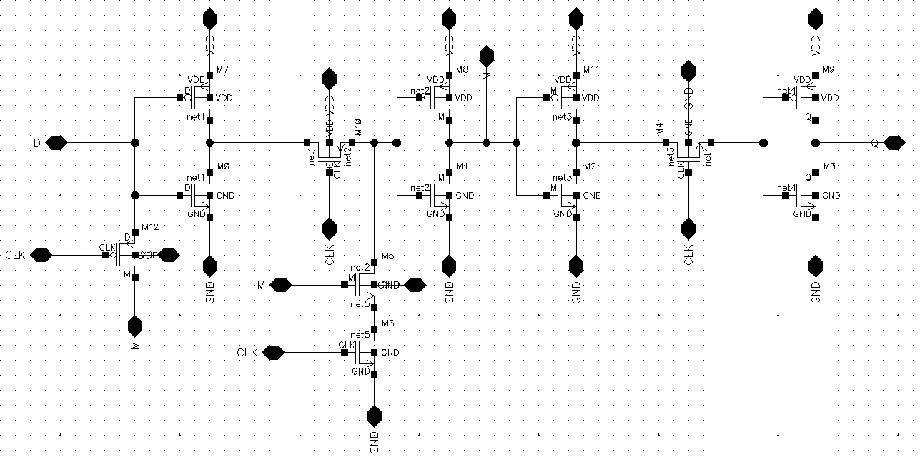
Flip-Flop-Cadence
Reference-A Partially Static High Frequency 18T Hybrid Topological Flip-Flop Design
for Low Power Application

Slide 13
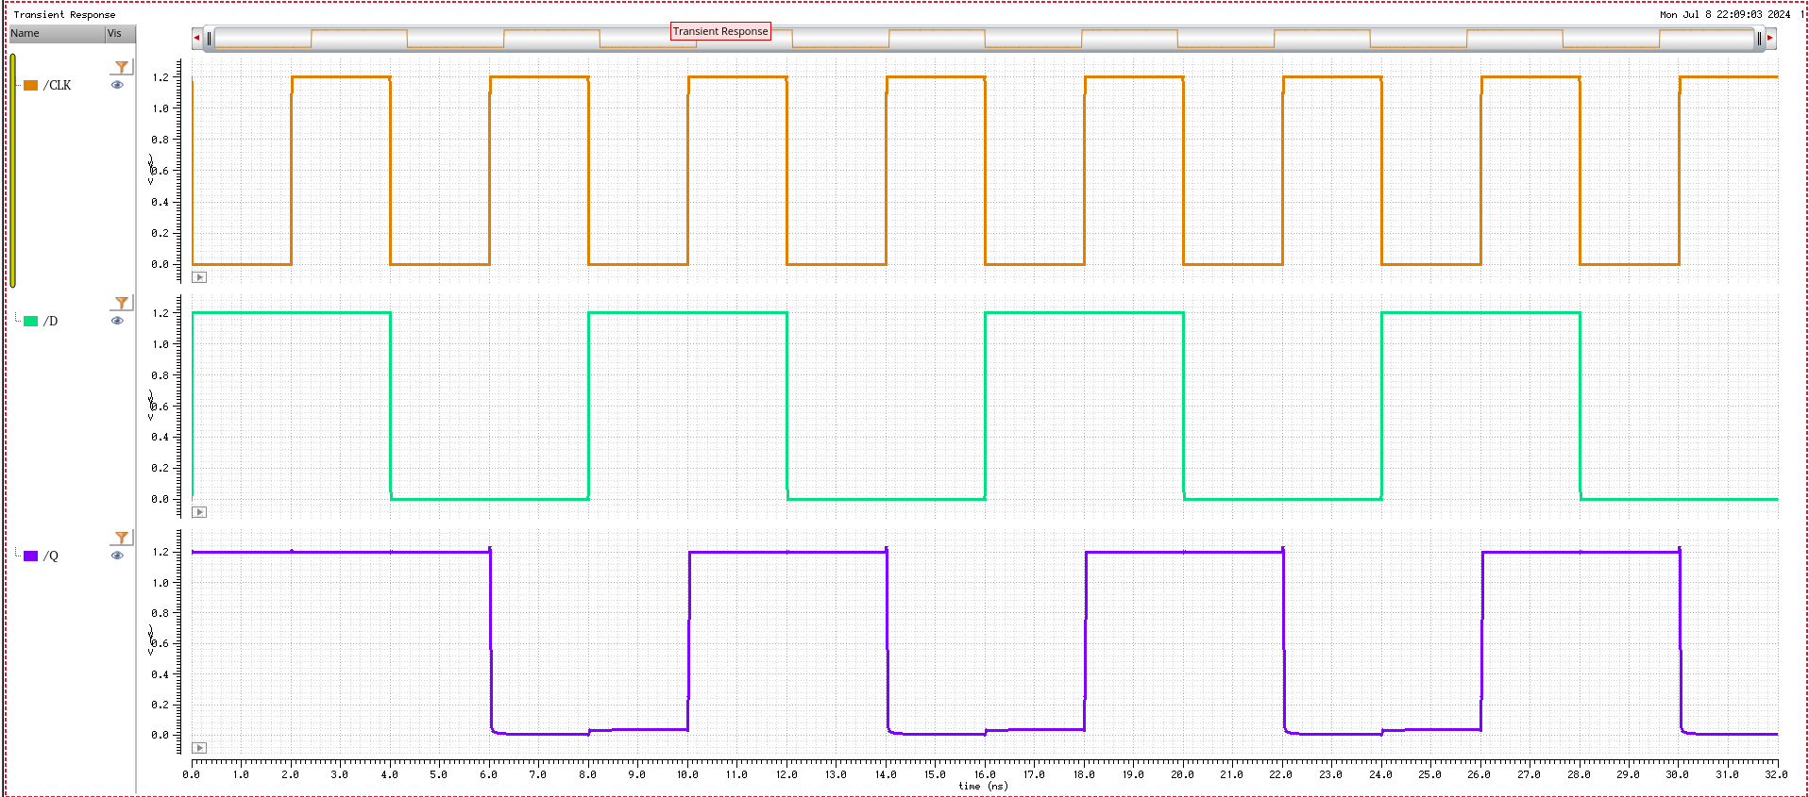
Flip Flop-Cadence
Clock Frequency=250MHz

Slide 14
Thanks

Slide 15
Backup Slides

