Slide 1
Delta Sigma Modulation-FPGA Implementation
Student: Abhinav S
Advisor: Abhishek Srivastava
May, 2022

Slide 2
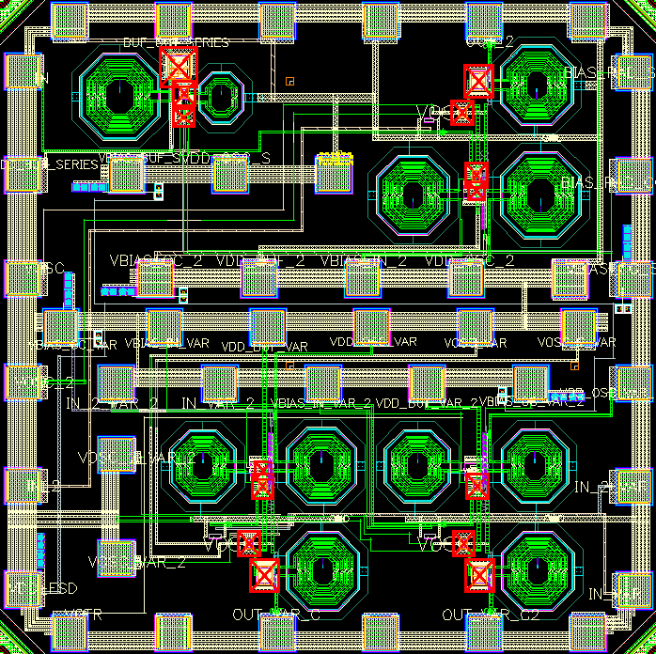
Project Summary
Project Title | IWR1843BOOST
PI | Dr. Abhishek Srivastava
Research lab | IC~WiBES Integrated Circuits inspired by Wireless and Biomedical Electronic Systems
Research center | Center for VLSI and Embedded System Technologies (CVEST)
Institute | International Institute of Information Technology Hyderabad

Slide 3
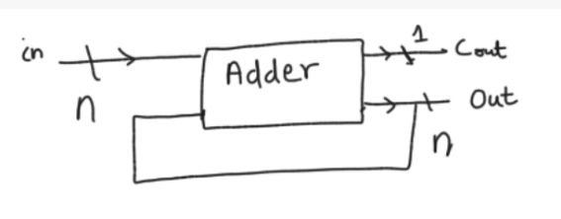
Accumulator

Slide 4
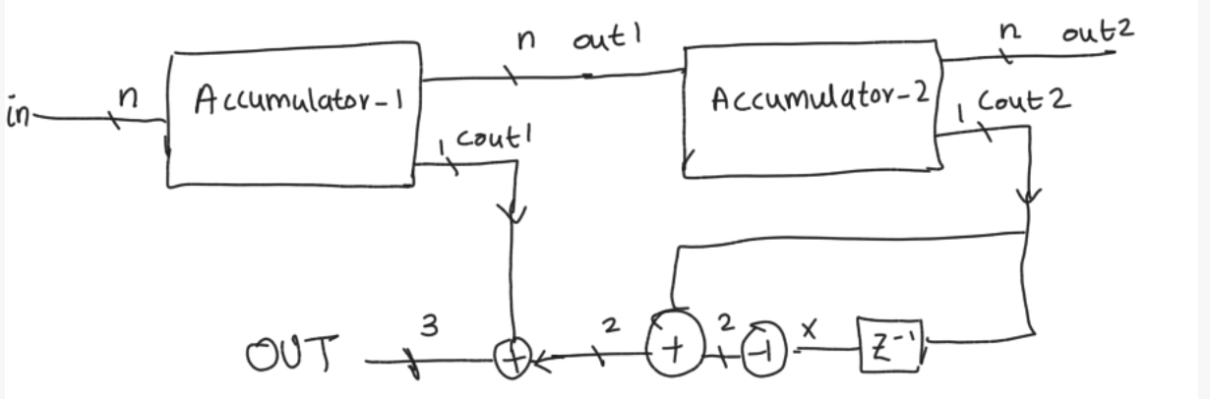
Mash 1-1 Delta Sigma Modulator
Output OUT will be produced in 2’s complement form
We want average value of OUT to be in/2^{n.}
In the experiments n=3 and average is taken over 16 clock cycles

Slide 5
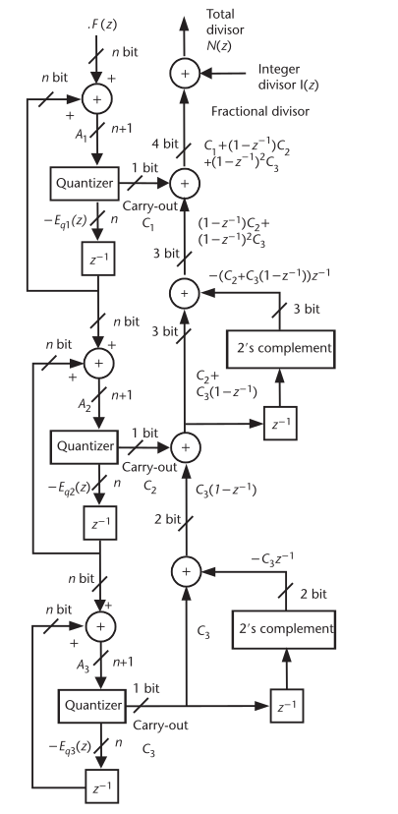
Mash 1-1-1 Delta Sigma Modulator
Reference-Integrated Circuit Design for High-Speed Frequency Systems(John Rogers)

Slide 6
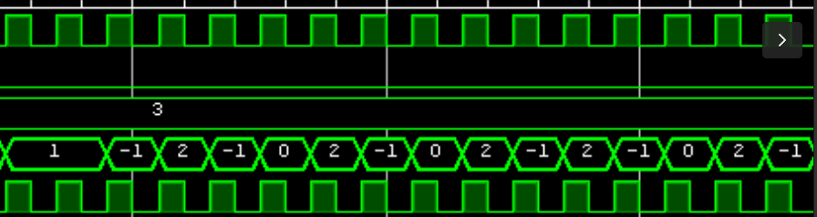
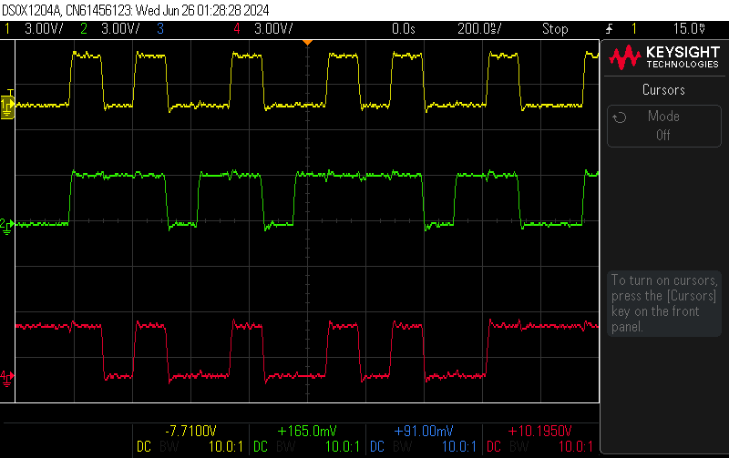
Comparison of Simulation and Experimental Results of Mash 1-1
Clk
OUT
OUT[2]
In=3,
Average=6/16
OUT[1]
OUT[0]

Slide 7
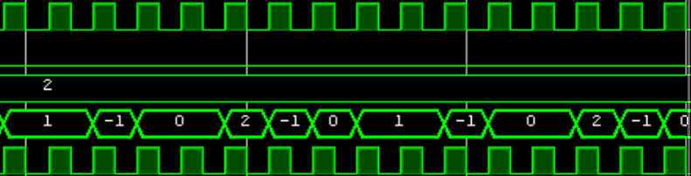
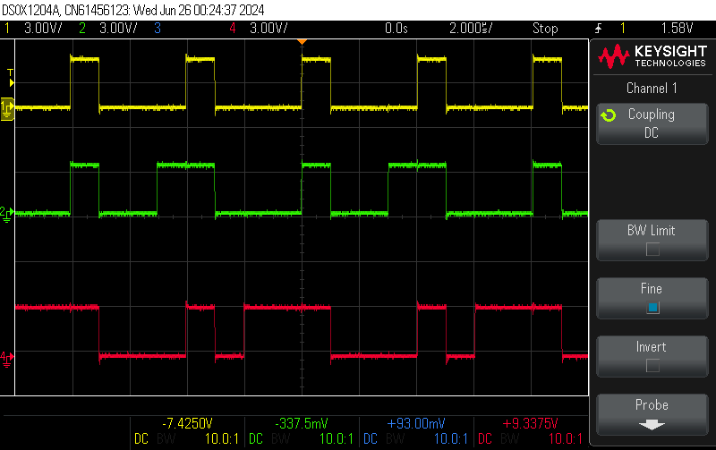
Comparison of Simulation and Experimental Results of Mash 1-1
Clk
OUT
OUT[2]
In=2,
Average=2/8
OUT[1]
OUT[0]

Slide 8
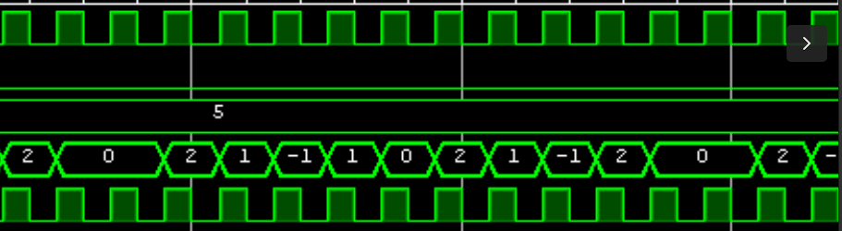
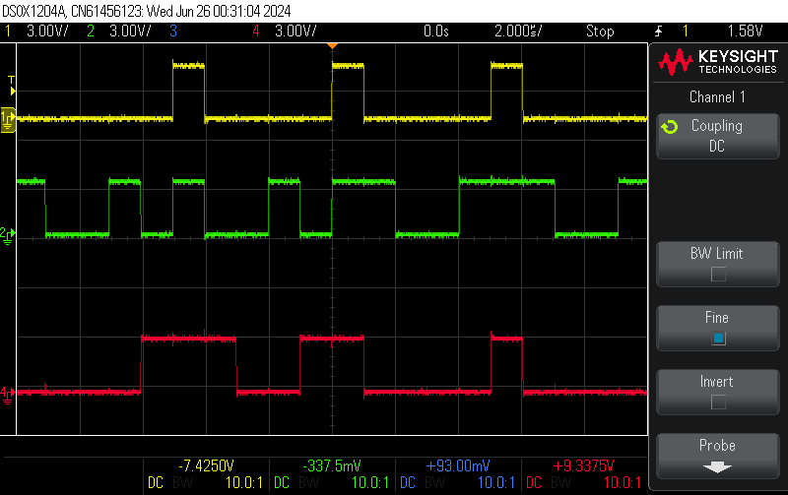
Comparison of Simulation and Experimental Results of Mash 1-1
Clk
OUT
OUT[2]
In=5,
Average=10/16
OUT[1]
Similarly Average Value for other input values has been verified
OUT[0]

Slide 9
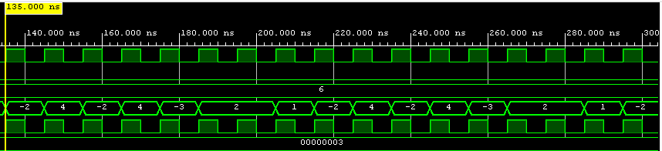
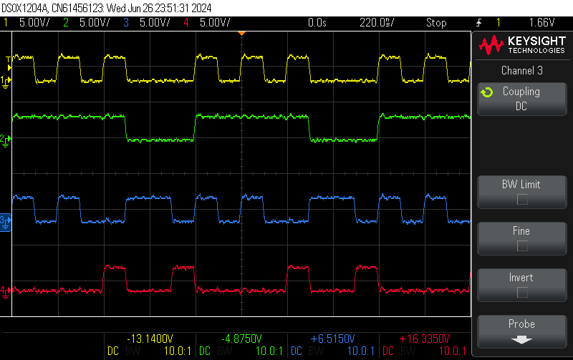
Comparison of Simulation and Experimental Results of Mash 1-1-1
Clk
Out
Out[3]
Out[2]
In=6
Average=12/16
Out[1]
Out[0]

Slide 10
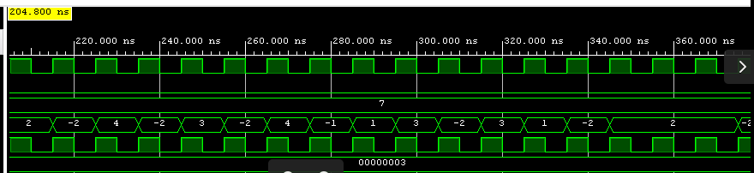
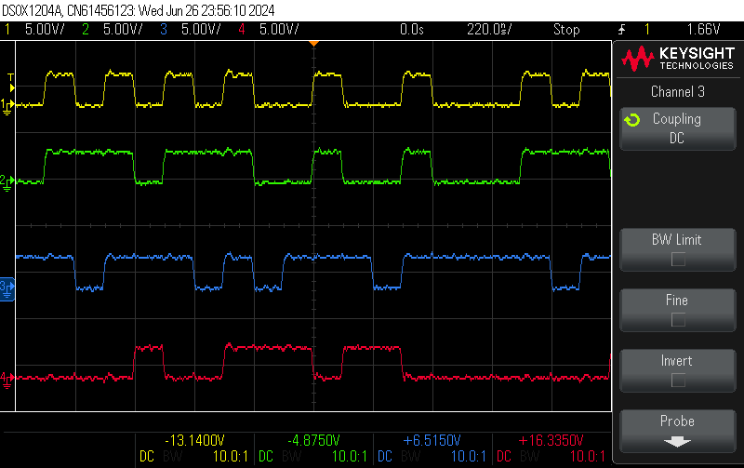
Comparison of Simulation and Experimental Results of Mash 1-1-1
Clk
Out
Out[3]
Out[2]
In=7
Average=14/16
Out[1]
Out[0]

Slide 11
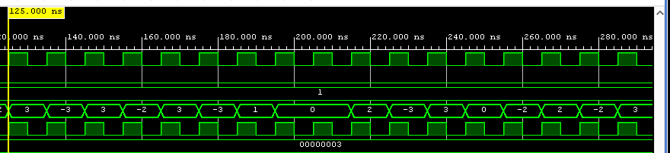
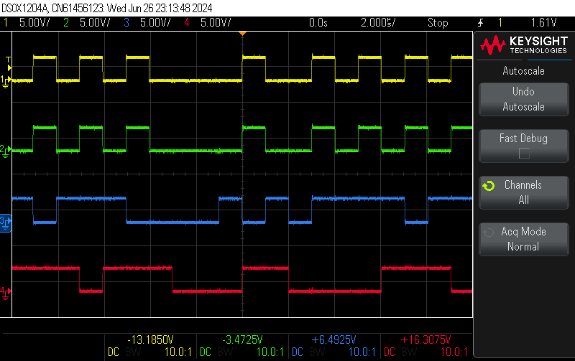
Comparison of Simulation and Experimental Results of Mash 1-1-1
Clk
Out
Out[3]
In=1
Average=2/16
Out[2]
Out[1]
Similarly Average Value for other input values has been verified
Out[0]

Slide 12
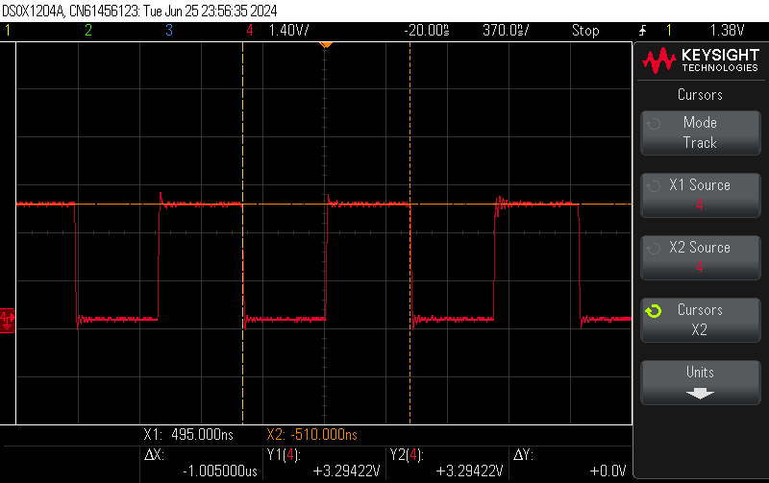
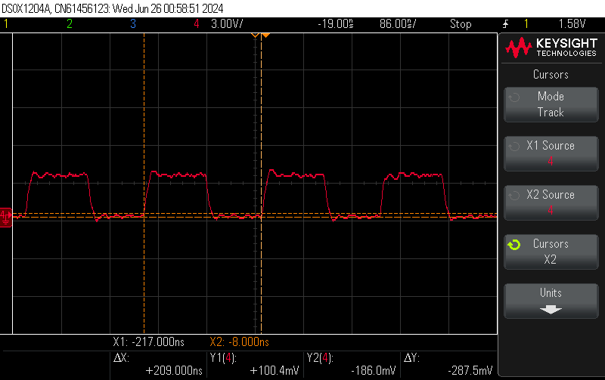
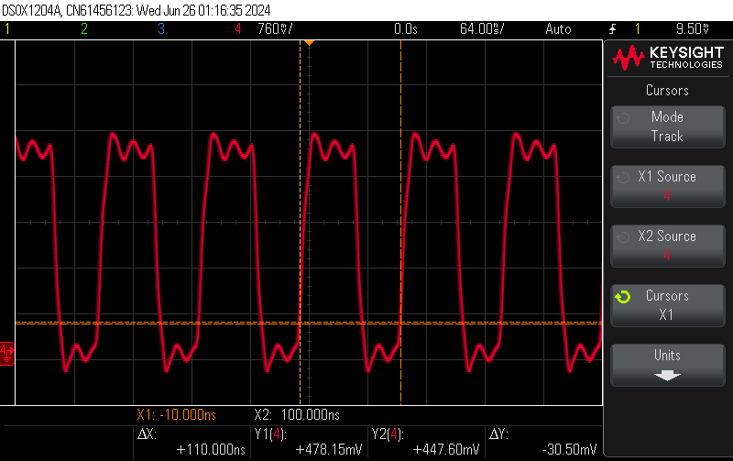
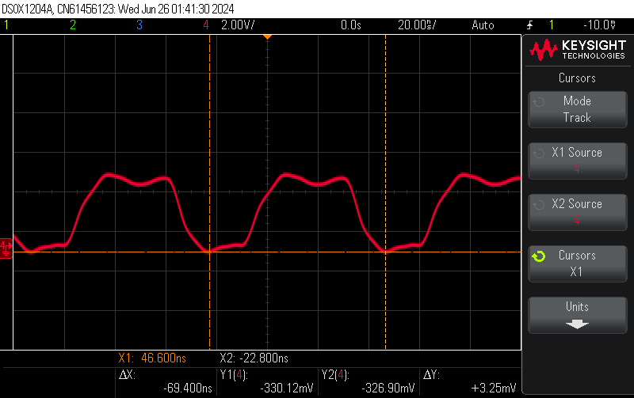
Clock at Different Frequencies without Buffer
Clk=1Mhz
Clk=5Mhz
Clk=10Mhz
Clk=16.66Mhz

Slide 13
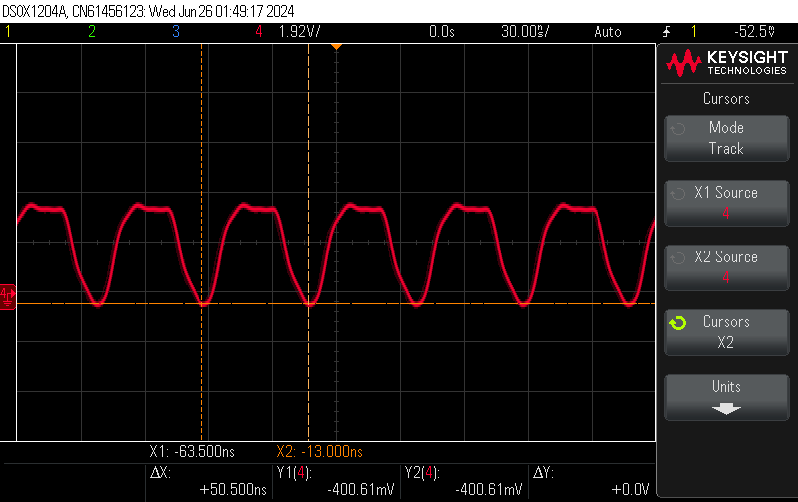
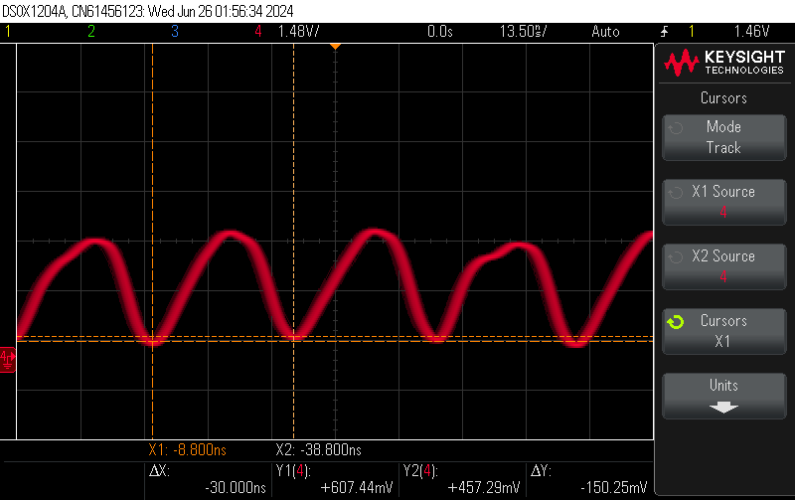
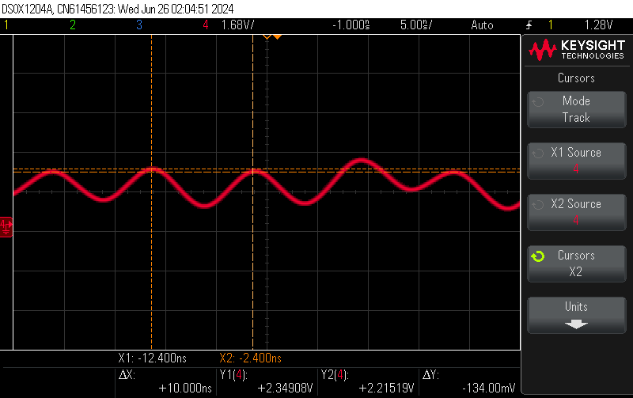
Clock at Different Frequencies without Buffer
Clk=25Mhz
Clk=50Mhz
Clk=100Mhz

Slide 14
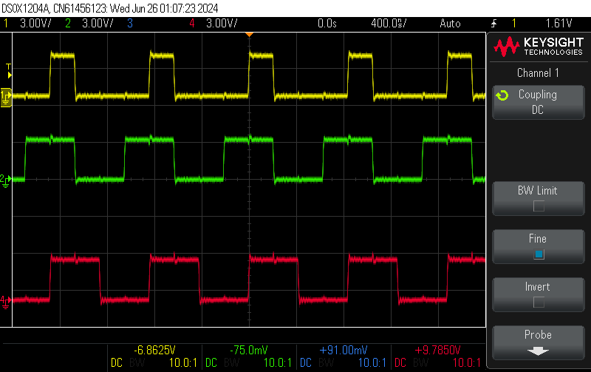
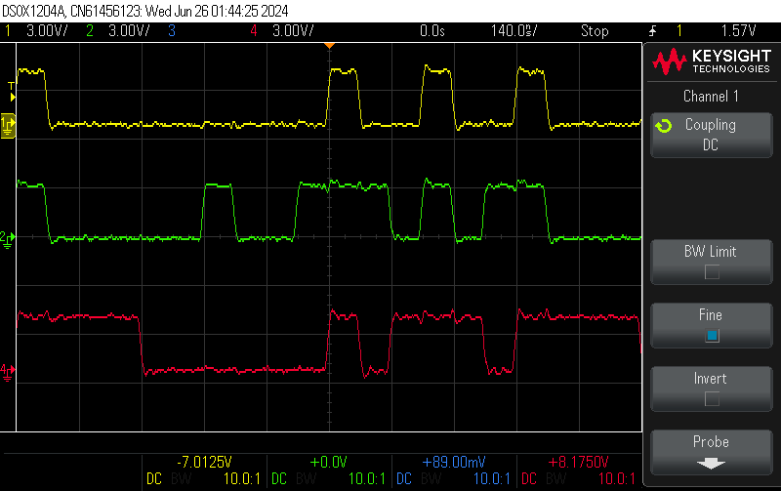
Output at Different Frequencies without Buffer
Clk=1Mhz
Clk=5Mhz
Clk=10Mhz
Clk=16.66Mhz

Slide 15
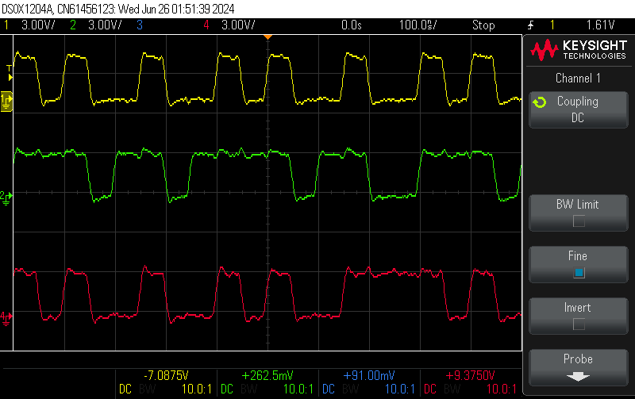
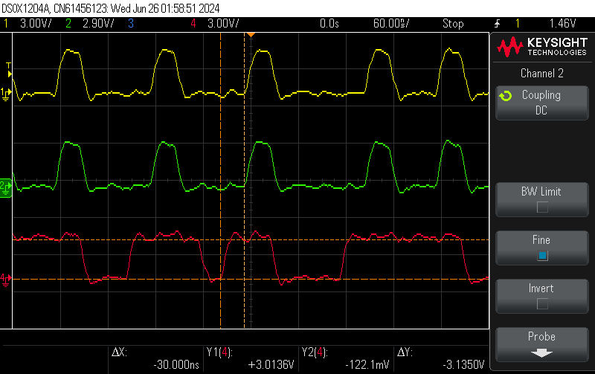
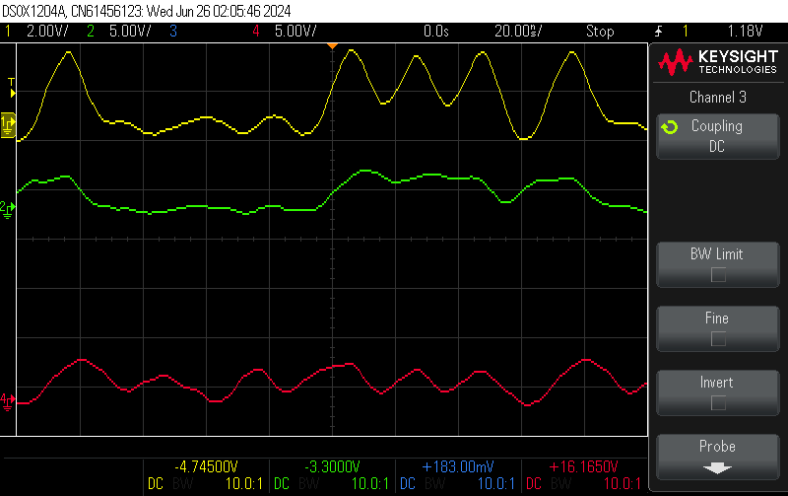
Output at Different Frequencies without Buffer
Clk=25Mhz
Clk=50Mhz
Clk=100Mhz

Slide 16
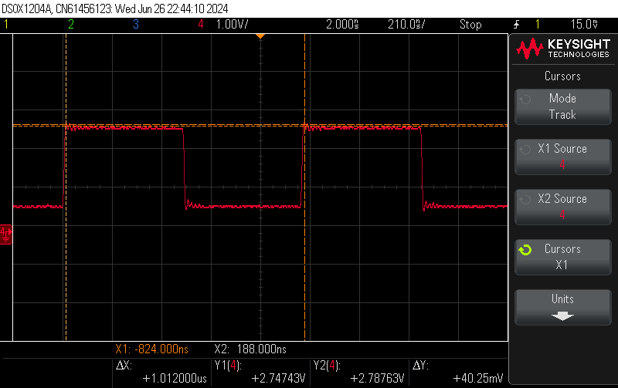
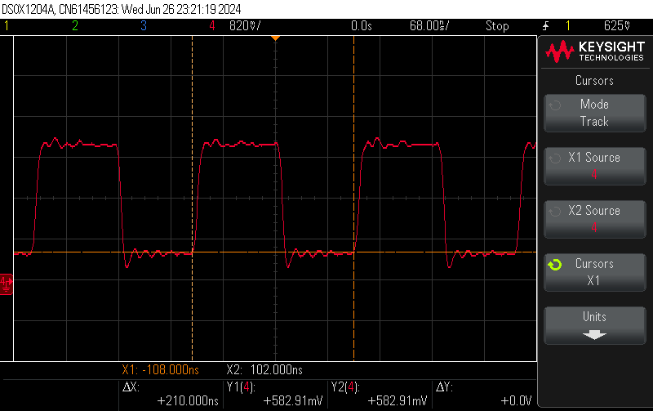
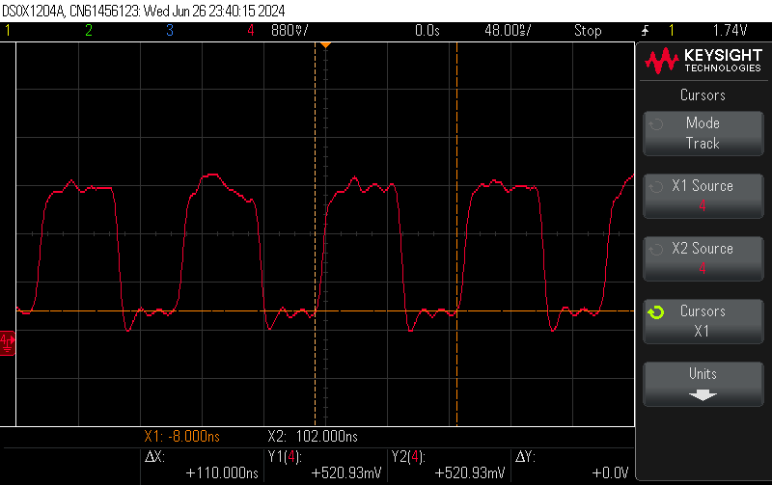
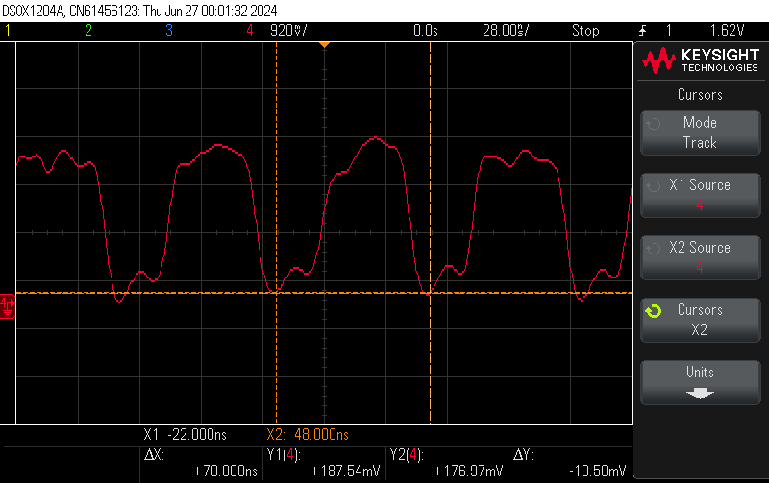
Clock at Different Frequencies with Buffer
Clk=1Mhz
Clk=5Mhz
Clk=10Mhz
Clk=16.66Mhz

Slide 17
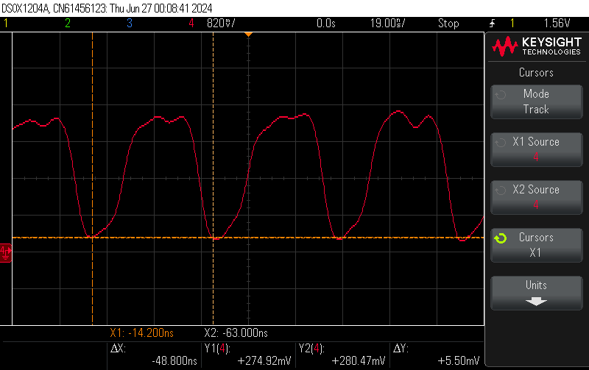
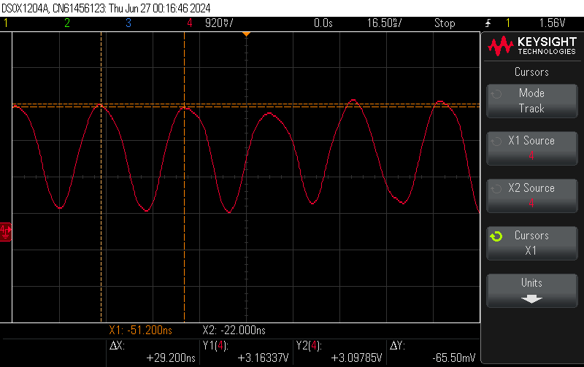
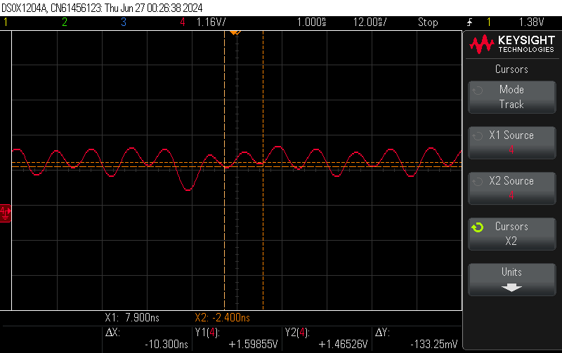
Clock at Different Frequencies with Buffer
Clk=25Mhz
Clk=50Mhz
Clk=100Mhz

Slide 18
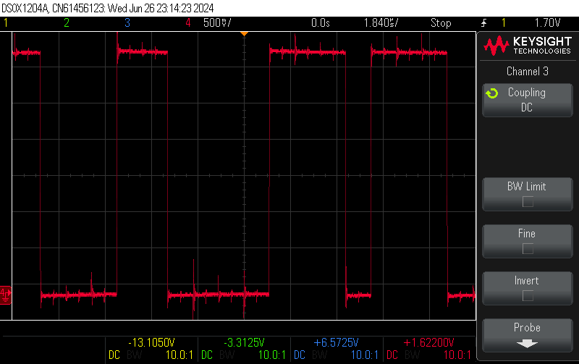
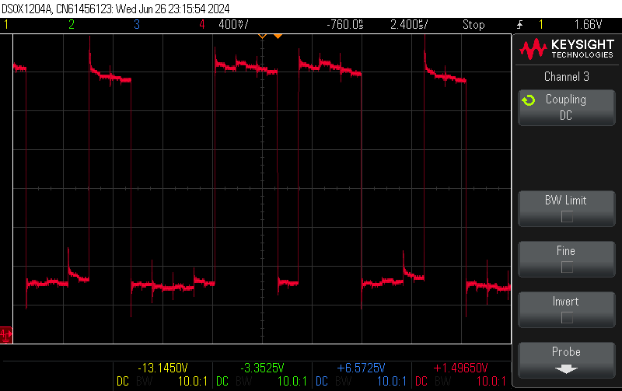
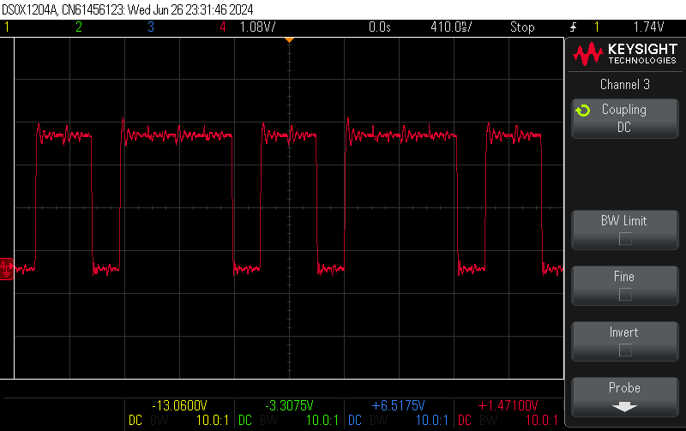
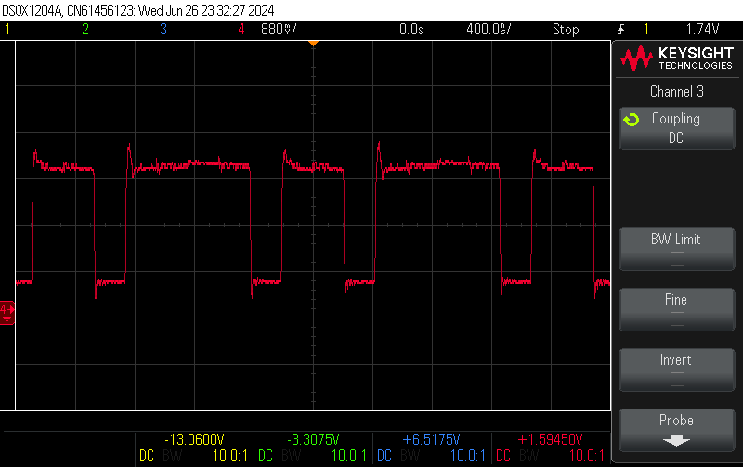
Comparison of Output without and with Buffer
Clk=1MHz
Clk=5MHz

Slide 19
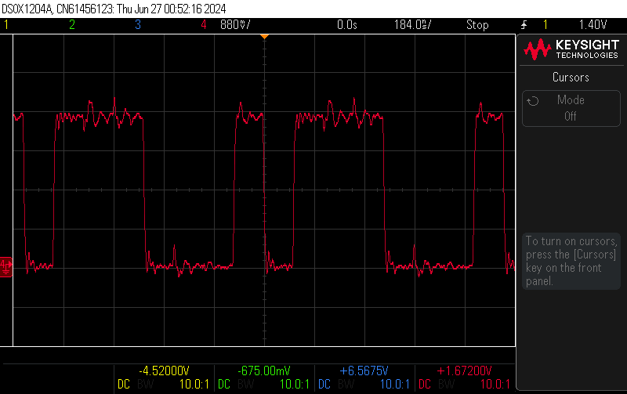
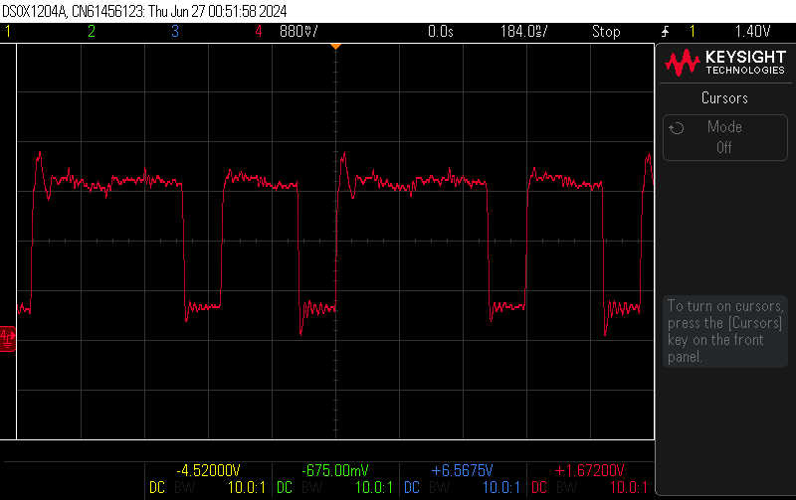
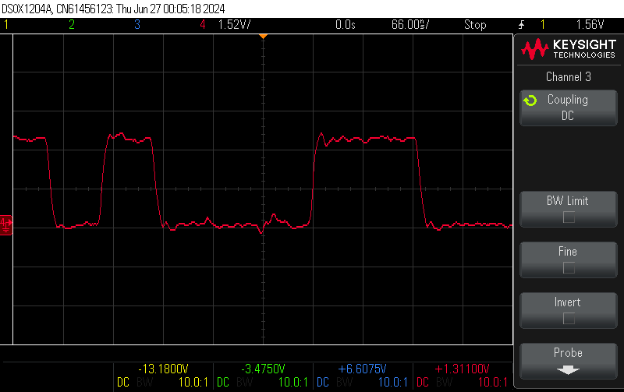
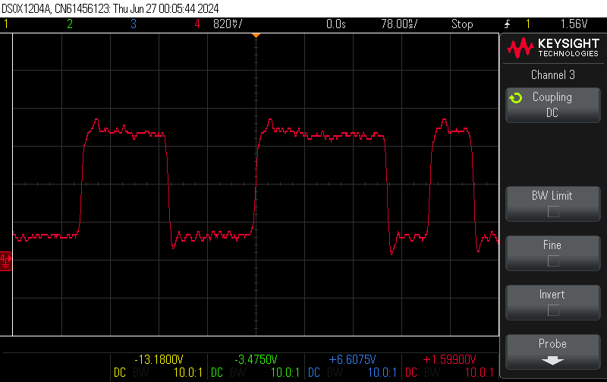
Comparison of Output without and with Buffer
Clk=10MHz
Clk=16.66MHz

Slide 20
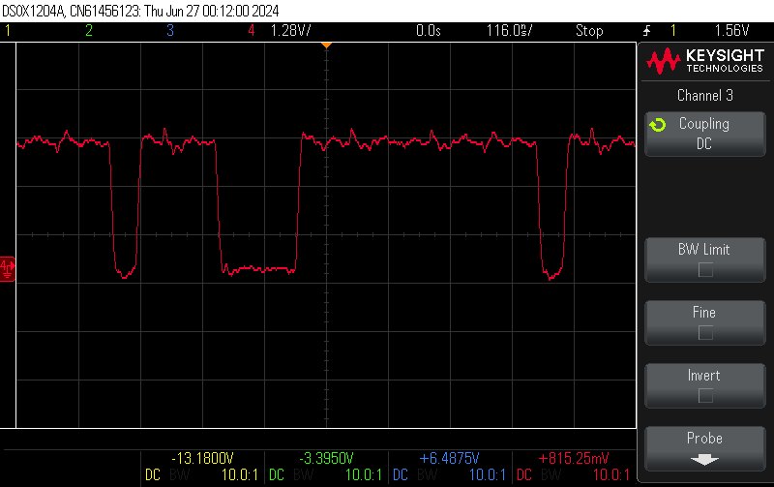
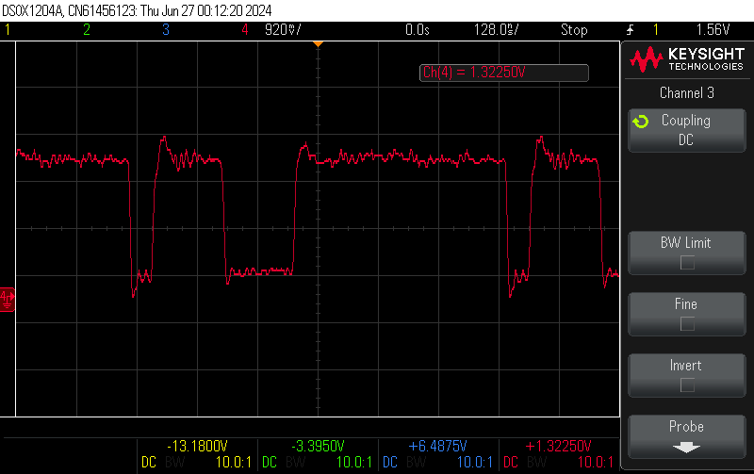
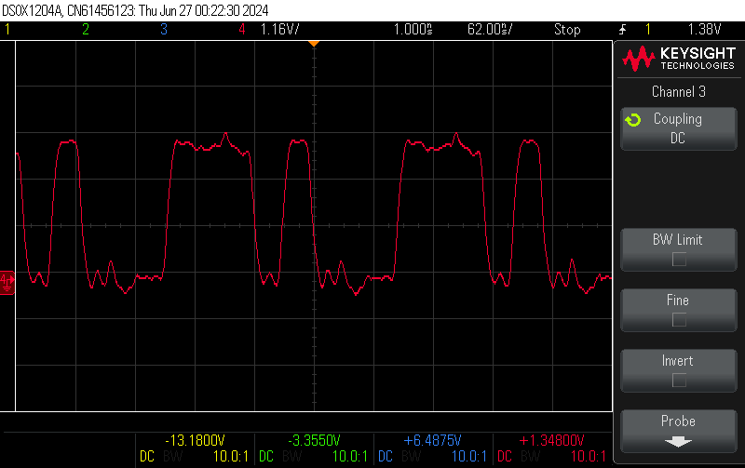
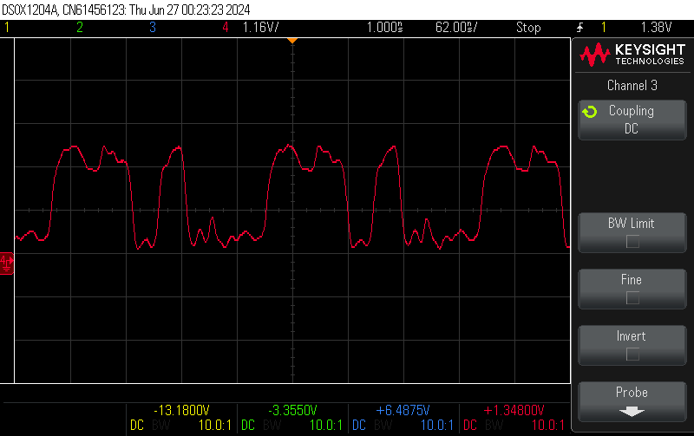
Comparison of Output without and with Buffer
Clk=25MHz
Clk=50MHz

Slide 21
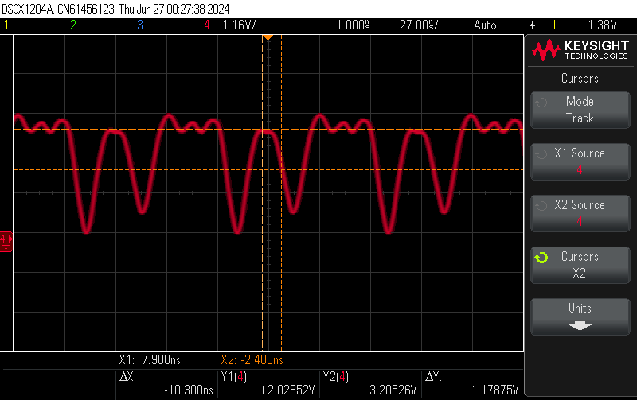
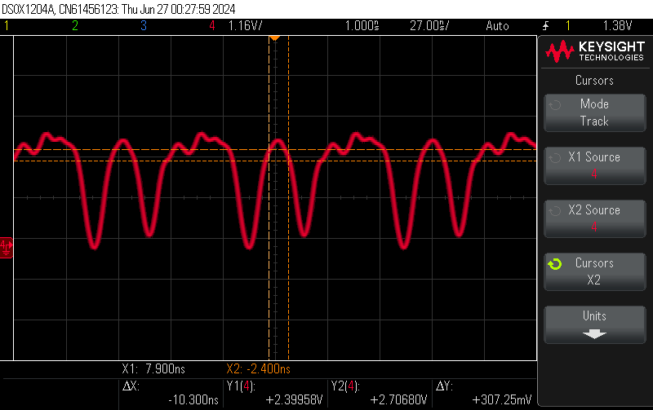
Comparison of Output without and with Buffer
Clk=100MHz
Use of Buffer did not improve the result
Till 25MHz,Output is good without Buffer

Slide 22
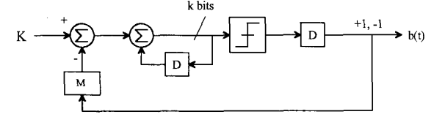

First and Second Order Delta-Sigma Modulator
First order DSM
Second order DSM
b=1→n ,b=0→n+1 Frequency Division=n+0.5+(K/2M)

Slide 23


Simulation Results
K=1(13’b0000000000001)
K-M=-4(13’b1111111111100)
K+M=6(13’b0000000000110)
Specification:-
Needed Accuracy=0.1
Number of bits of Accumulator,k=13
Number of Cycles of (b=0)=3000
Total Number of Cycles=5000
Frequency Division Ratio=n+0.6
M=5(13’b0000000000101)
First order
Second order

Slide 24


Simulation Results
K=2(13’b0000000000010)
K-M=-3(13’b1111111111101)
K+M=7(13’b0000000000111)
Specification:-
Needed Accuracy=0.1
Number of bits of Accumulator,k=13
Number of Cycles of (b=0)=3500
Total Number of Cycles=5000
Frequency Division Ratio=n+0.7
M=5(13’b0000000000101)
First order
Second order

Slide 25


Simulation Results
K=3(13’b0000000000011)
K-M=-2(13’b1111111111110)
K+M=8(13’b0000000001000)
Specification:-
Needed Accuracy=0.1
Number of bits of Accumulator,k=13
Number of Cycles of (b=0)=4000
Total Number of Cycles=5000
Frequency Division Ratio=n+0.8
M=5(13’b0000000000101)
First order
Second order

Slide 26


Simulation Results
K=4(13’b0000000000100)
K-M=-1(13’b1111111111111)
K+M=9(13’b0000000001001)
Specification:-
Needed Accuracy=0.1
Number of bits of Accumulator,k=13
Number of Cycles of (b=0)=4500
Total Number of Cycles=5000
Frequency Division Ratio=n+0.9
M=5(13’b0000000000101)
First order
Second order

Slide 27


Simulation Results
K=0(13’b0000000000000)
K-M=-5(13’b1111111111011)
K+M=5(13’b0000000000101)
Specification:-
Needed Accuracy=0.1
Number of bits of Accumulator,k=13
Number of Cycles of (b=0)=2500
Total Number of Cycles=5000
Frequency Division Ratio=n+0.5
M=5(13’b0000000000101)
First order
Second order

Slide 28


Simulation Results
K=-1(13’b1111111111111)
K-M=-6(13’b1111111111010)
K+M=4(13’b0000000000100)
Specification:-
Needed Accuracy=0.1
Number of bits of Accumulator,k=13
Number of Cycles of (b=0)=2000
Total Number of Cycles=5000
Frequency Division Ratio=n+0.4
M=5(13’b0000000000101)
First order
Second order

Slide 29


Simulation Results
K=-2(13’b1111111111110)
K-M=-7(13’b1111111111001)
K+M=3(13’b0000000000011)
Specification:-
Needed Accuracy=0.1
Number of bits of Accumulator,k=13
Number of Cycles of (b=0)=1500
Total Number of Cycles=5000
Frequency Division Ratio=n+0.3
M=5(13’b0000000000101)
First order
Second order

Slide 30


Simulation Results
K=-3(13’b1111111111101)
K-M=-8(13’b1111111111000)
K+M=2(13’b0000000000010)
Specification:-
Needed Accuracy=0.1
Number of bits of Accumulator,k=13
Number of Cycles of (b=0)=1000
Total Number of Cycles=5000
Frequency Division Ratio=n+0.2
M=5(13’b0000000000101)
First order
Second order

Slide 31


Simulation Results
K=-4(13’b1111111111100)
K-M=-9(13’b1111111110111)
K+M=1(13’b0000000000001)
Specification:-
Needed Accuracy=0.1
Number of bits of Accumulator,k=13
Number of Cycles of (b=0)=500
Total Number of Cycles=5000
Frequency Division Ratio=n+0.1
M=5(13’b0000000000101)
First order
Second order

Slide 32



Oscilloscope results using Active Probe
Setup-1
In=4
In=5

Slide 33



Oscilloscope results using Active Probe
Setup-2
In=5 @1
In=5 @2

Slide 34




Oscilloscope results using Active Probe
Setup-3
In=3 @1
In=3 @2
In=3 @3

Slide 35
Backup Slides

