Slide 1
Delta Sigma Modulator-Cadence Implementation
Student: Abhinav S
Advisor: Abhishek Srivastava
July 2024

Slide 2
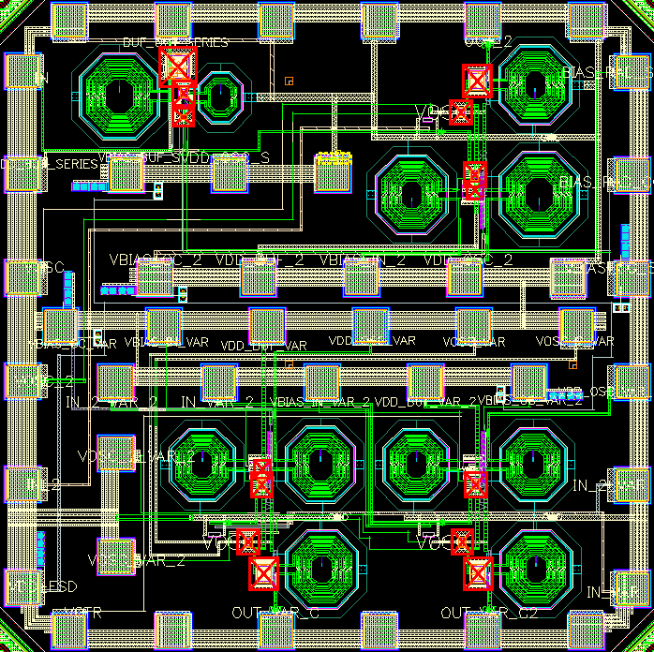
Project Summary
Project Title | IWR1843BOOST
PI | Dr. Abhishek Srivastava
Research lab | IC~WiBES Integrated Circuits inspired by Wireless and Biomedical Electronic Systems
Research center | Center for VLSI and Embedded System Technologies (CVEST)
Institute | International Institute of Information Technology Hyderabad

Slide 3
Inverter Delays for different Widths
Width | Rise Time | Fall Time
800n | 3.776p | 3.959p
900n | 3.667p | 3.841p
1u | 3.573p | 3.745p
1.2u | 3.415p | 3.595p
1.4u | 3.302 | 3.473p
2u | 3.096p | 3.259p
2.2u | 3.042p | 3.195p
3u | 2.92p | 3.029p
3.2u | 2.898p | 3.001p
4u | 2.84p | 2.917p
5u | 2.792p | 2.851p
Width of PMOS is mentioned.Ratio is 2:1

Slide 4
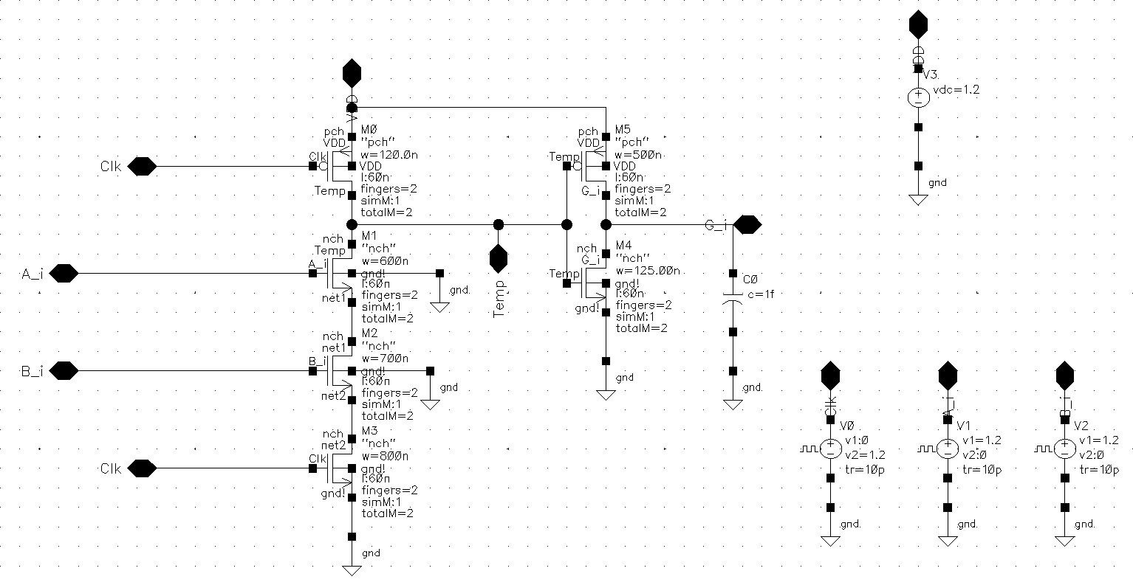
Generate(Level-1) Circuit

Slide 5
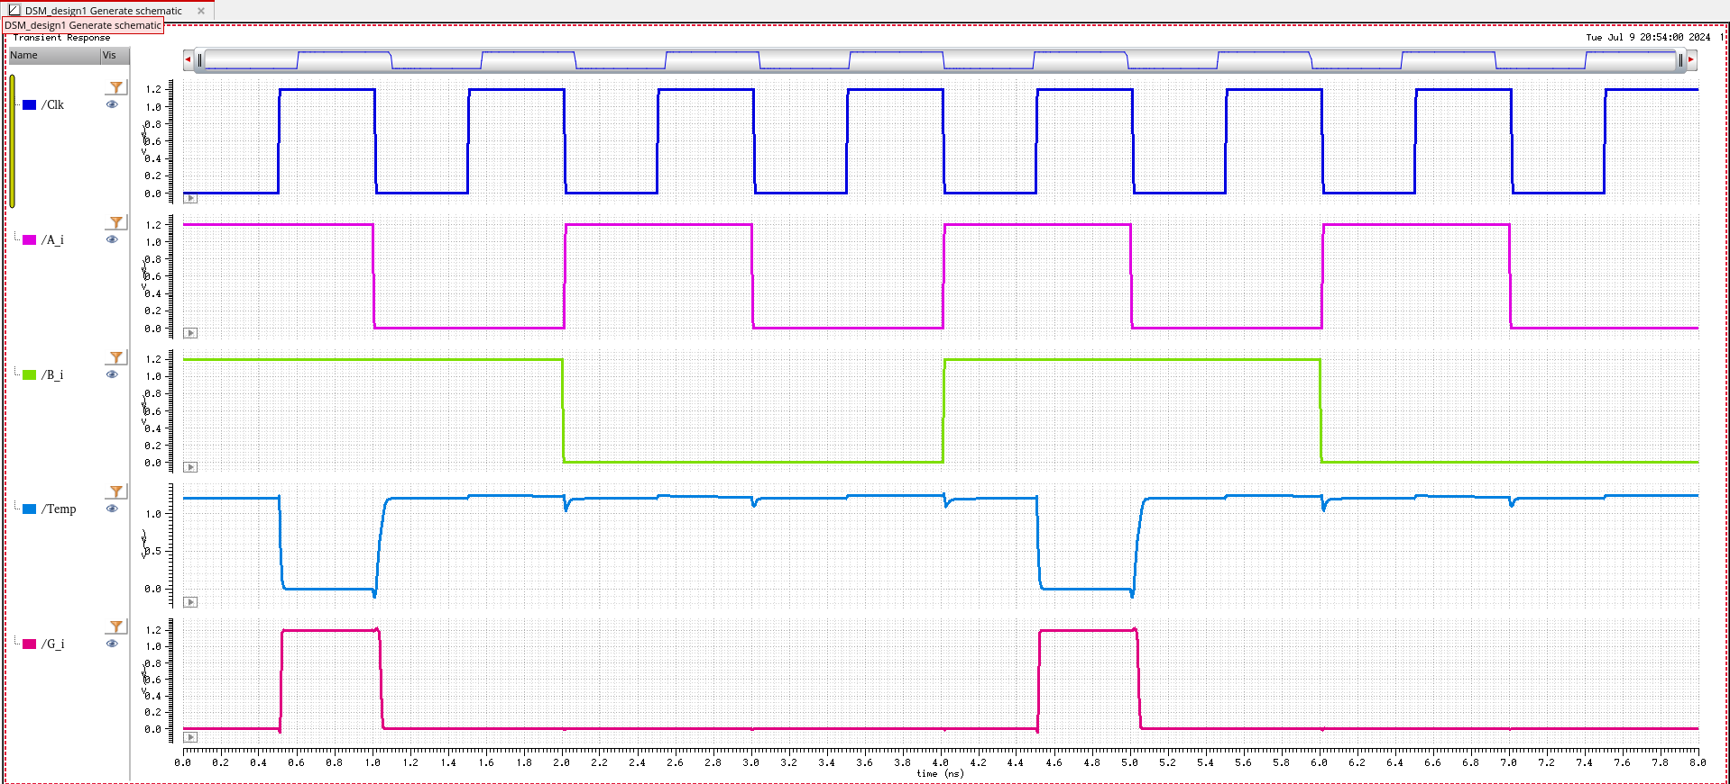
Generate(Level-1) Output

Slide 6
Generate(Level-1) Delays
Pin1/Edge | Pin2/Edge | Delay
Clk/Falling | Temp/Rising | 11.85p
Clk/Rising-5th edge | Temp/Falling | 6.044p
Clk/Rising | G_i/Rising | 10.2p
Clk/Falling | G_i/Falling | 20.47p

Slide 7
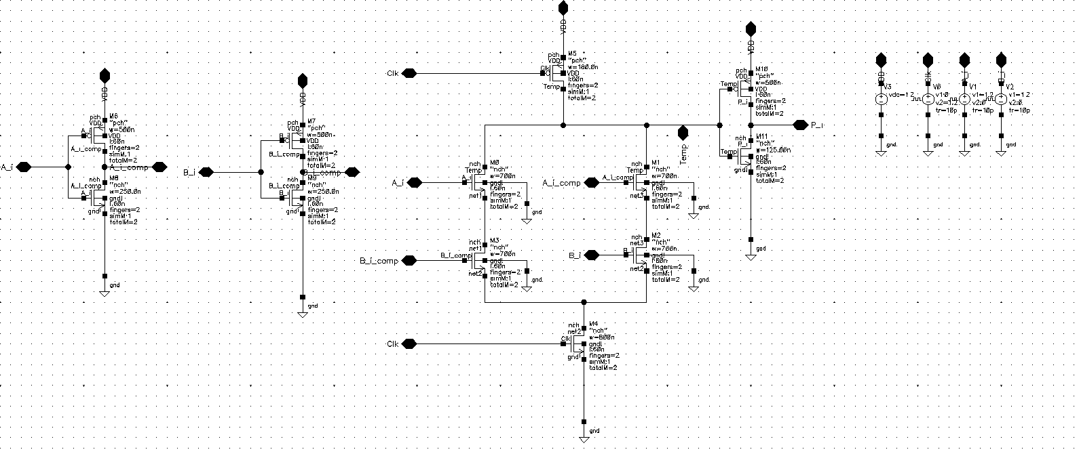
Propogate(Level-1) Circuit

Slide 8
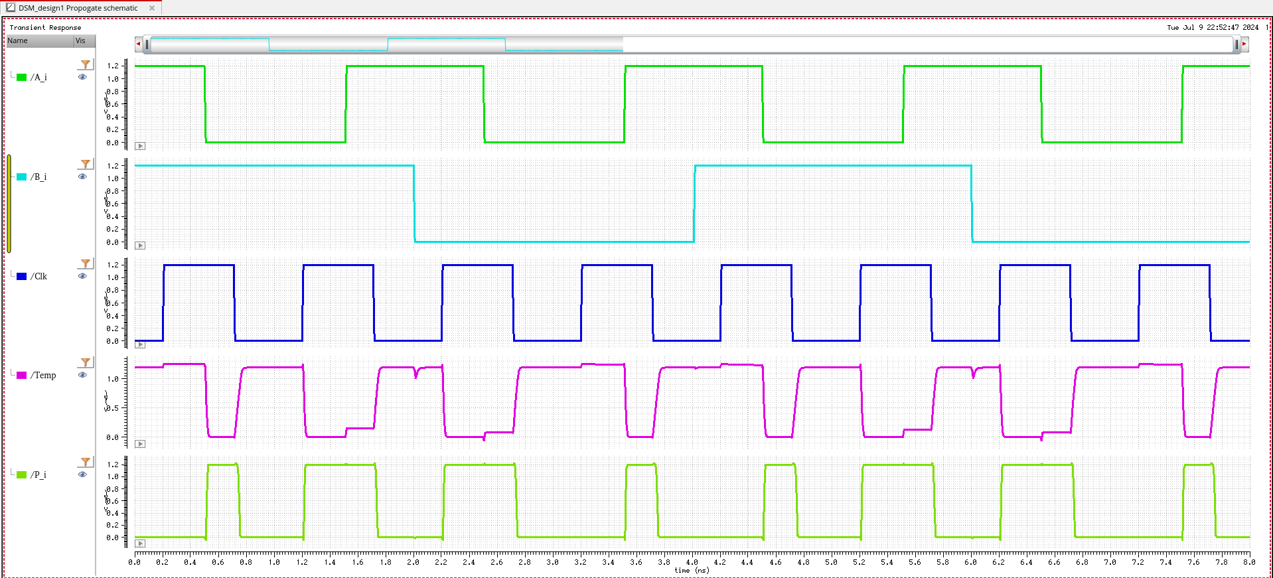
Propogate(Level-1) Output

Slide 9
Propogate(Level-1) Delay
Pin1/Edge | Pin2/Edge | Delay
A_i/Falling | P_i/Rising | 9.789p
Clk/Falling | P_i/Falling | 36.28p

Slide 10
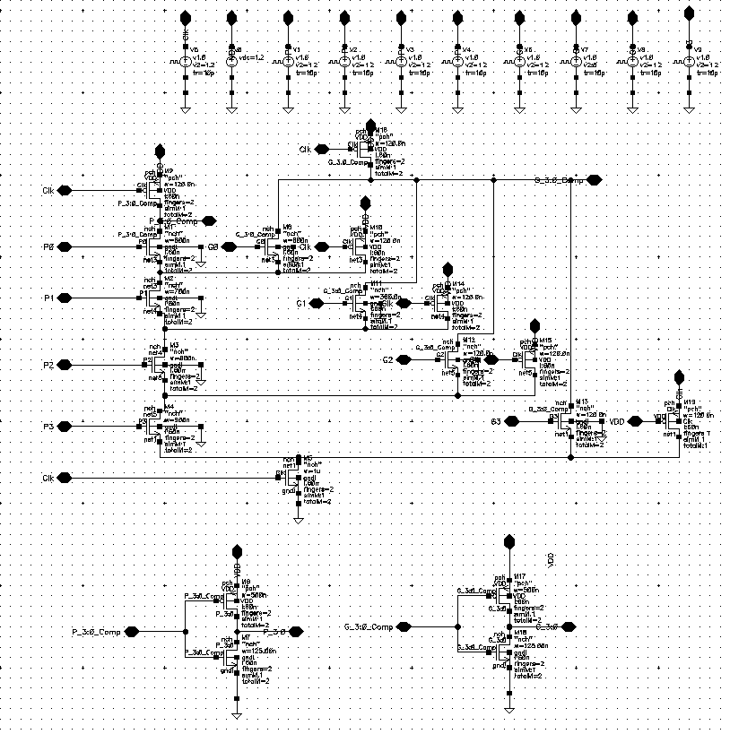
Carry Look-Ahead(Level-2) Circuit

Slide 11
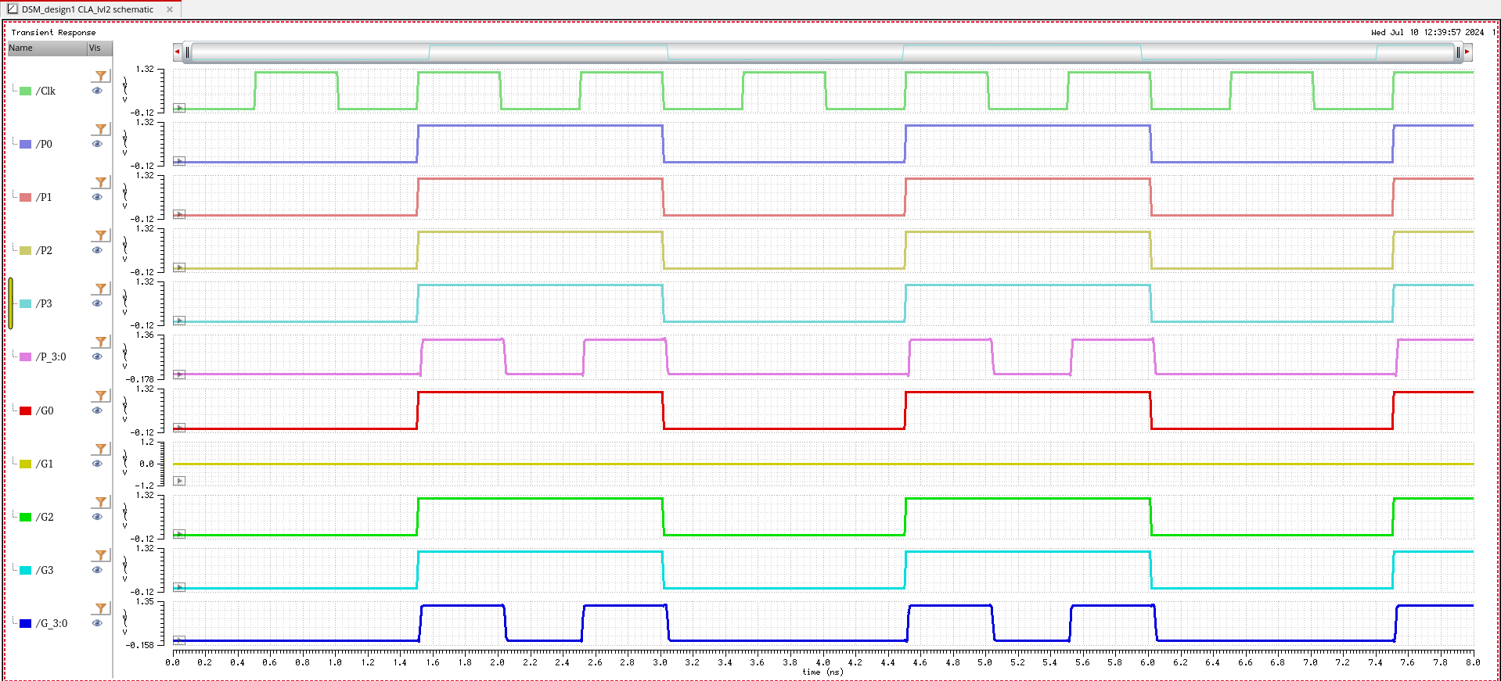
Carry Look-Ahead Circuit(Level-2) Waveform-1

Slide 12
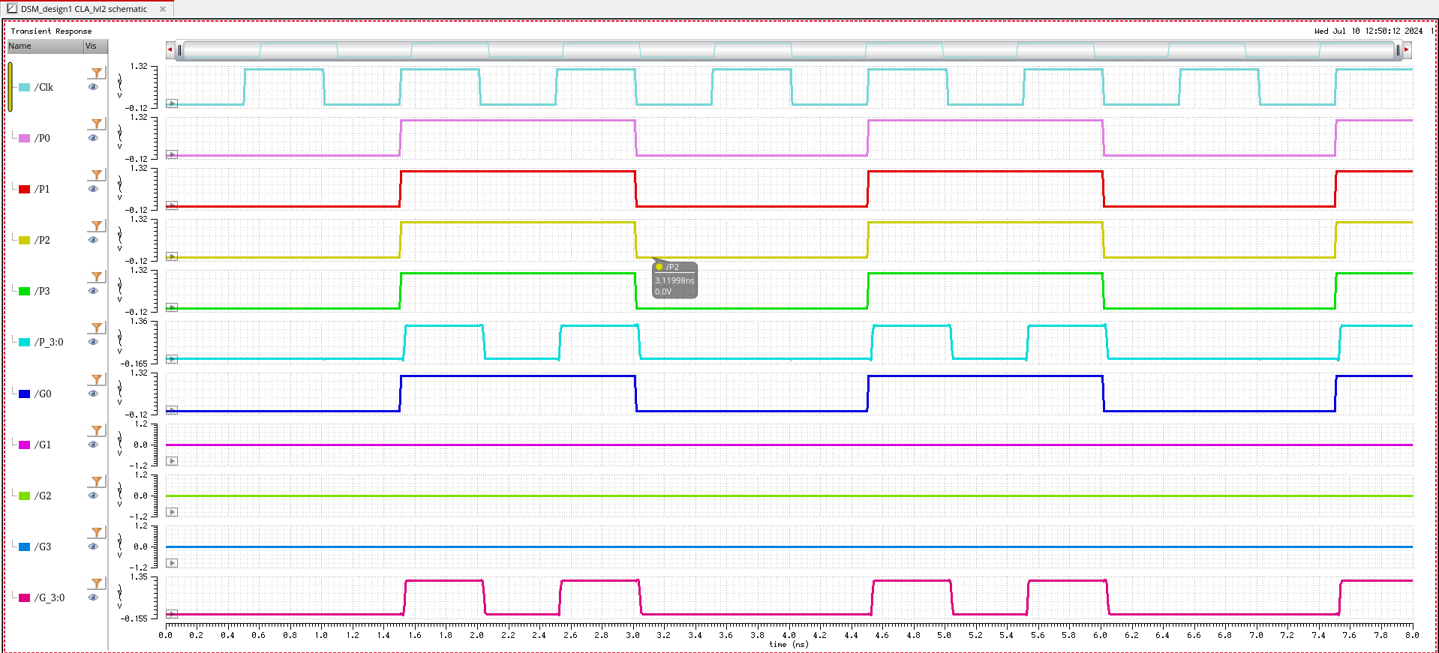
Carry Look-Ahead Circuit(Level-2) Waveform-2

Slide 13
Carry Look-Ahead(2nd Level) Delay
Pin1/Edge | Pin2/Edge | Delay/Waveform No.
Clk/Falling | P_3:0/Falling | 27.08p/1
Clk/Rising | P_3:0/Rising | 26.52p/1
Clk/Falling | G_3:0/Falling | 29.68p/1
Clk/Rising | G_3:0/Rising | 27.53p/2

Slide 14
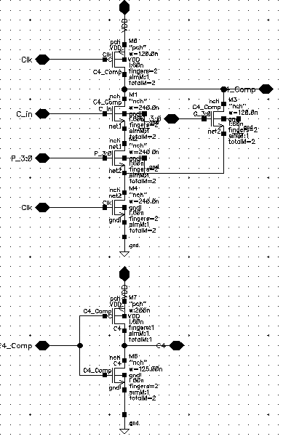
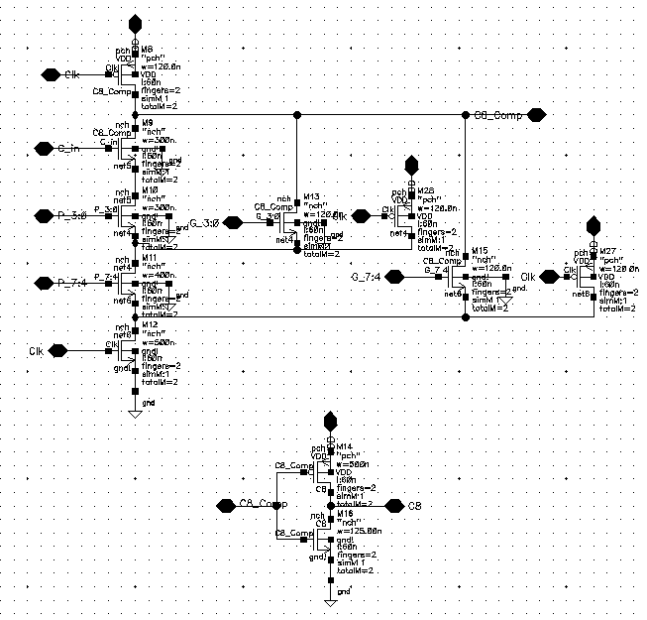
Carry Look-Ahead(Level-3) Circuit

Slide 15
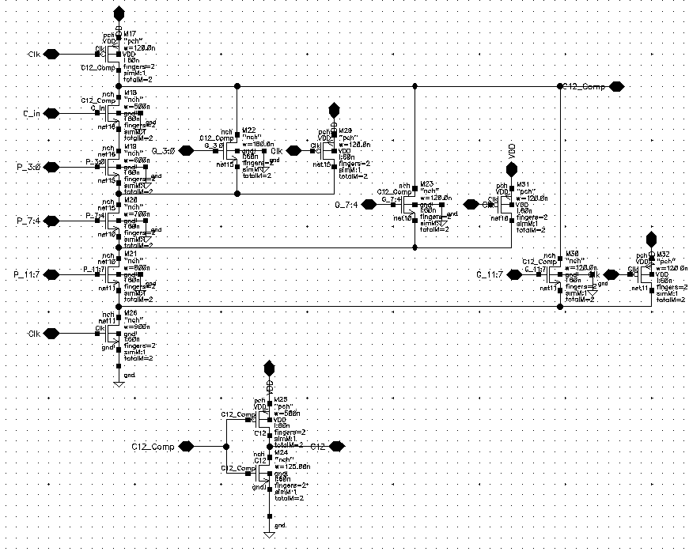
Carry Look-Ahead(Level-3) Circuit

Slide 16
Carry Look-Ahead(3rd Level) Delay
Pin1/Edge | Pin2/Edge | Delay
Clk/Falling | C12/Falling | 23.7p
Clk/Rising | C12/Rising | 18.3p
Clk/Falling | C8/Falling | 18.6p
Clk/Rising | C8/Rising | 16.5p
Clk/Falling | C4/Falling | 16.5p
Clk/Rising | C4/Rising | 12.1p

Slide 17
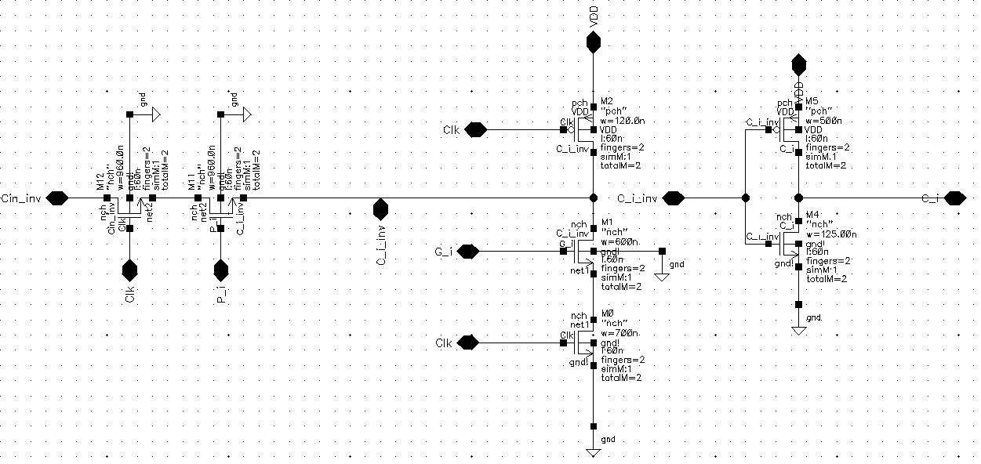
Carry Select Adder Circuit

Slide 18
Carry Select Adder Delay
Pin1/Edge | Pin2/Edge | Delay
Clk/Falling | C_i/Falling | 59.13p
Clk/Rising | C_i/Rising | 8.898p
Clk/Falling | C_i+1/Falling | 48.33p
Clk/Rising | C_i+1/Rising | 19.85p
Clk/Falling | C_i+2/Falling | 42.35p
Clk/Rising | C_i+2/Rising | 35.09p
Clk/Falling | C_i+3/Falling | 33.65p
Clk/Rising | C_i+3/Rising | 50.41p

Slide 19
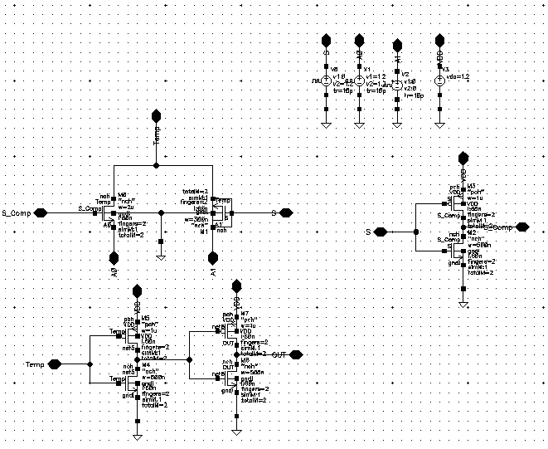
Multiplexer Circuit

Slide 20
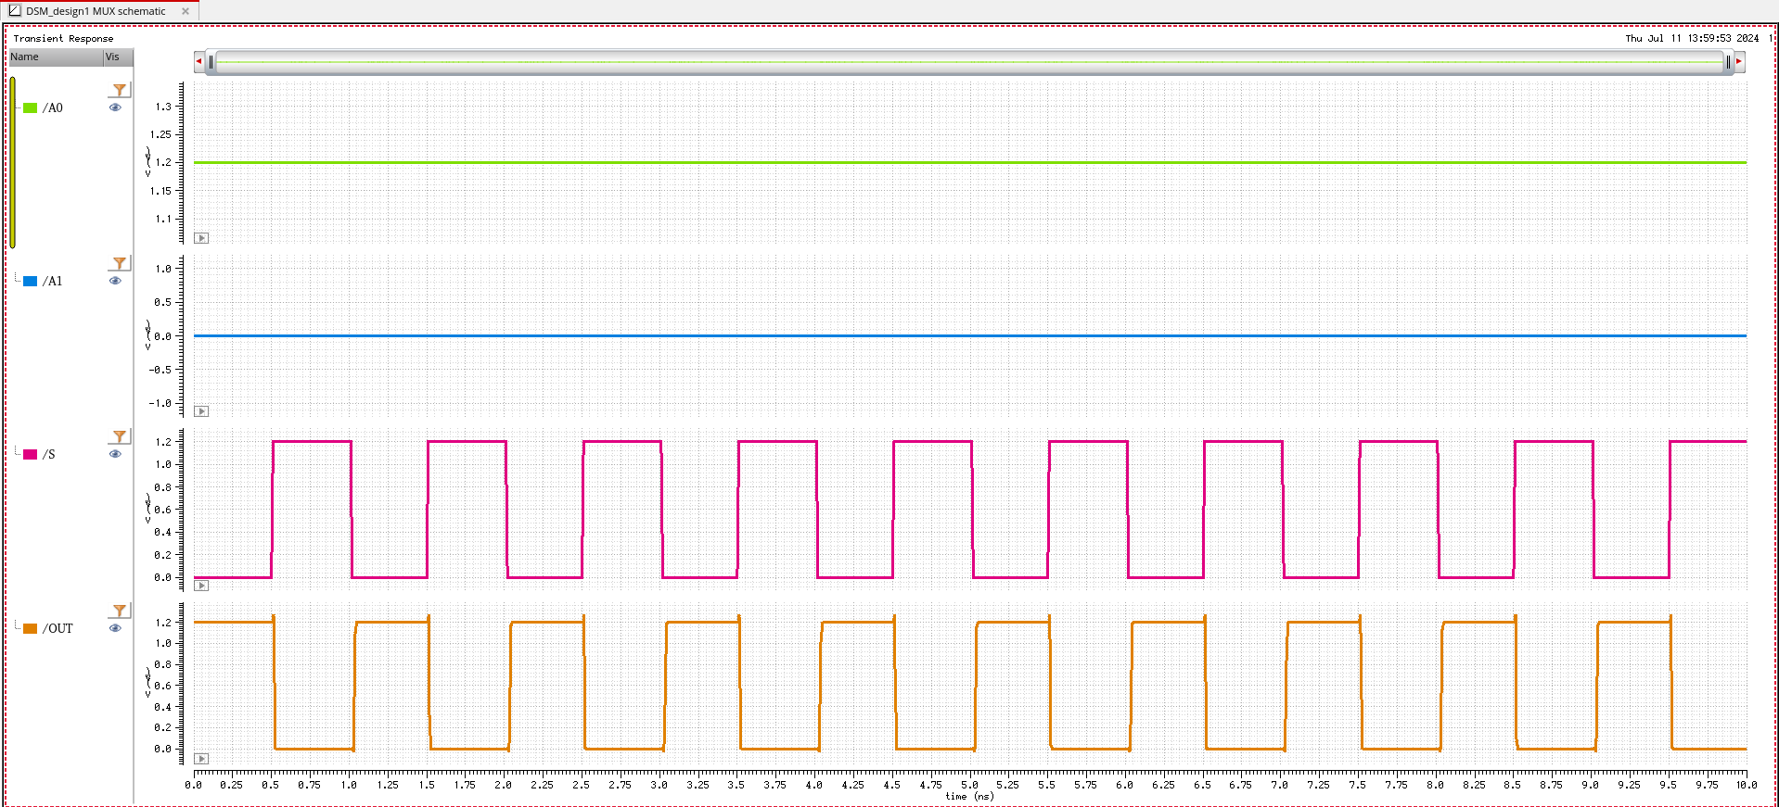
Multiplexer Waveform-1

Slide 21
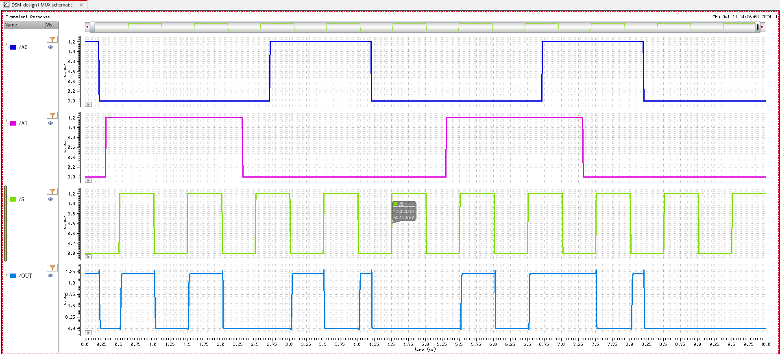
Multiplexer Waveform-2

Slide 22
Multiplexer Delay
Pin1/Edge | Pin2/Edge | Delay/Waveform No.
S/Falling | OUT/Rising | 20.7p/1
S/Rising | OUT/Falling | 12.3p/1
S/Rising | OUT/Rising | 21.5p/2
S/Falling/4th | OUT/Rising/4th | 21.9p/2

Slide 23
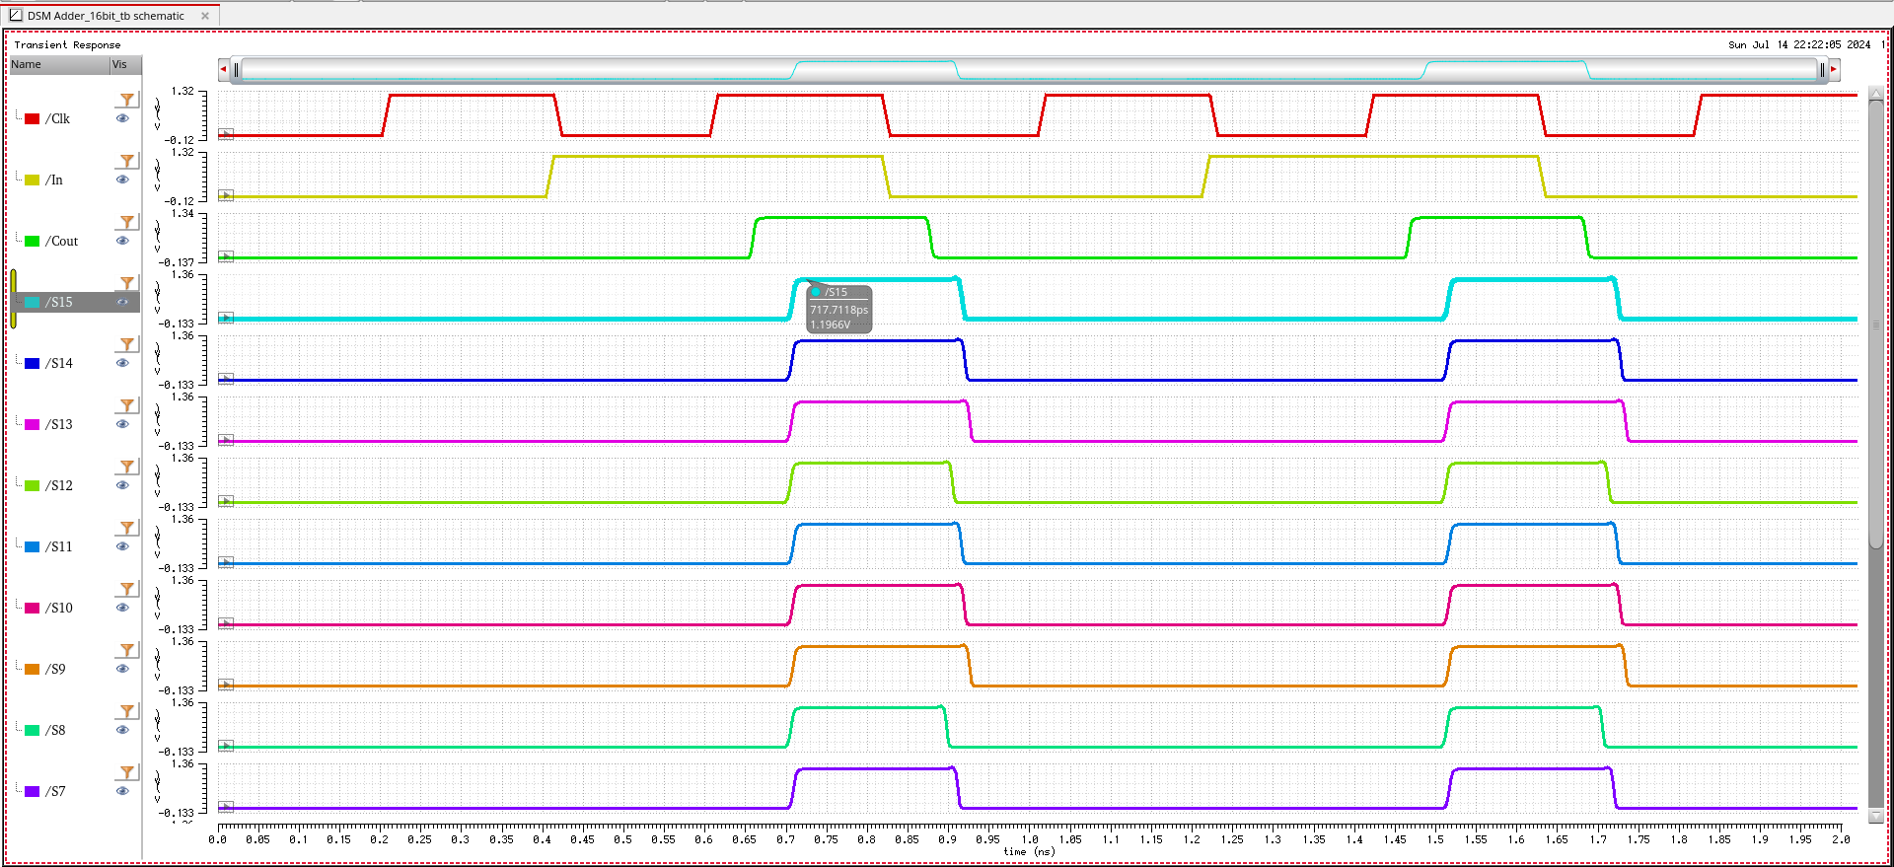
16-bit Adder Waveform-1
All inputs to adder are In.

Slide 24
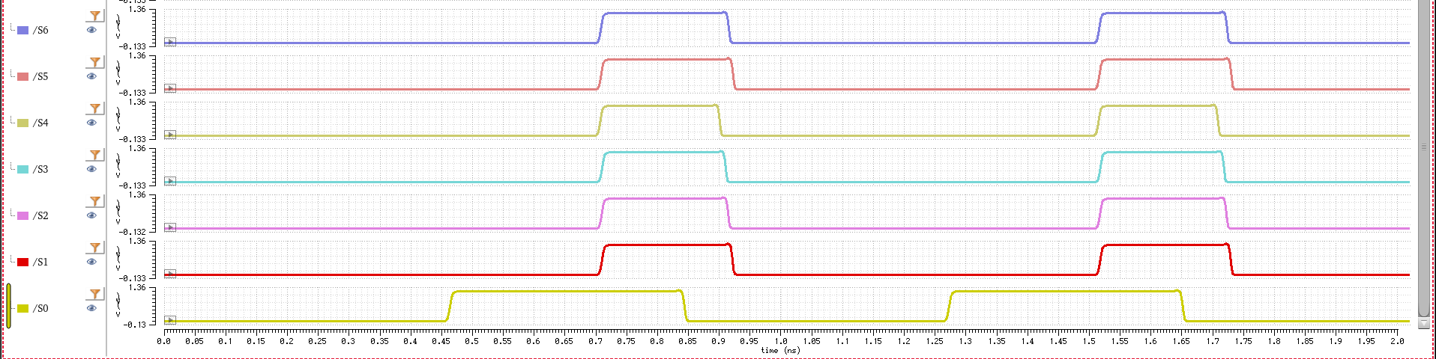
16-bit Adder Waveform-1
Clock Frequency-2.5GHz
Worst case delay-In to S15-90.25p

Slide 25
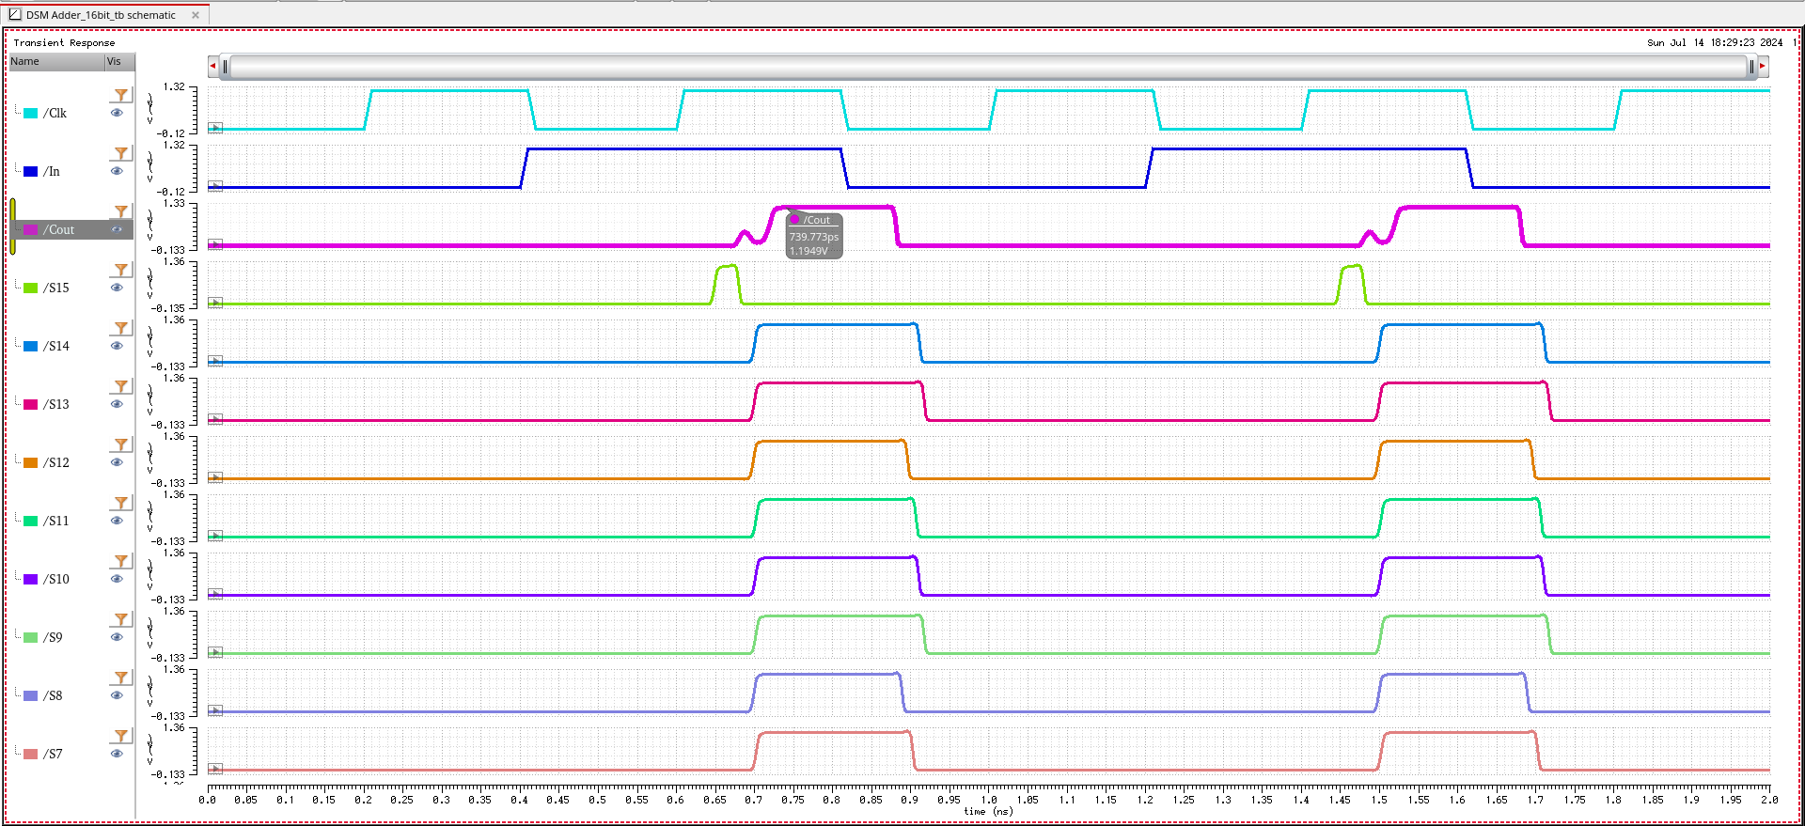
16-bit Adder Waveform-2
All inputs are In except A15 which is 0.

Slide 26
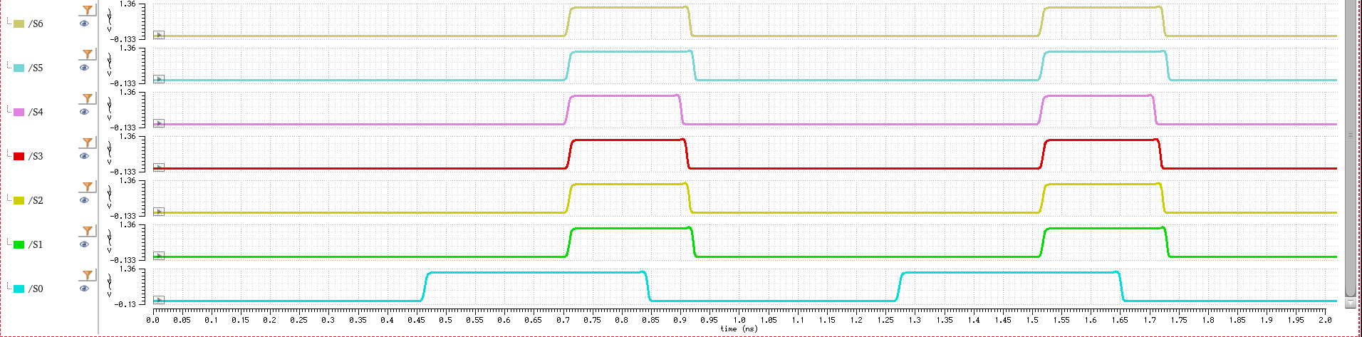
16-bit Adder Waveform-2
Clock Frequency-2.5GHz
Worst case delay-In to Cout-113.5p

Slide 27
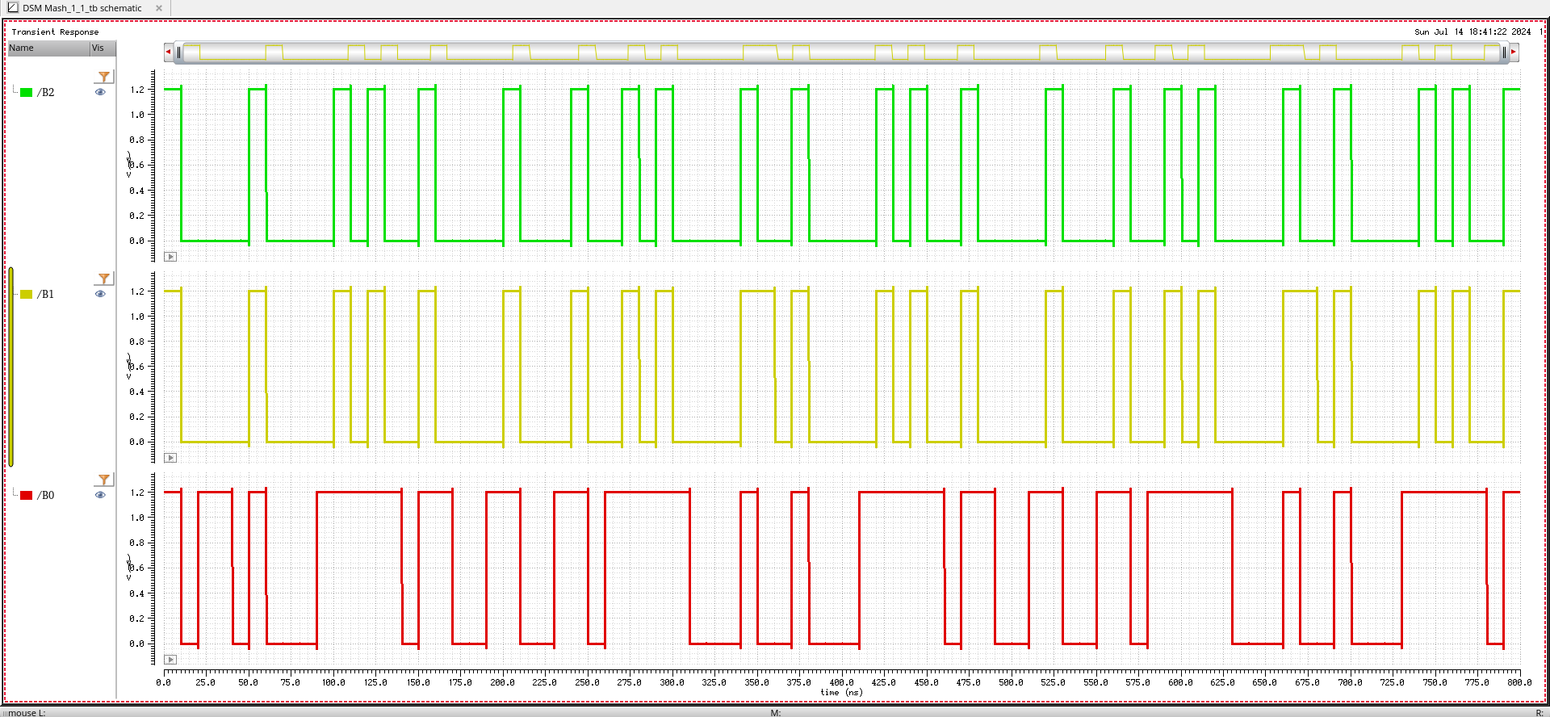
Mash 1-1 Waveform
Average-1/16
Input=16’b0001000000000000

Slide 28
Mash 1-1 Output
111 | 001 | 111 | 001 | 000 | 111 | 001 | 000
000 | 001 | 111 | 000 | 000 | 001 | 111 | 000
001 | 111 | 001 | 111 | 001 | 000 | 000 | 000
111 | 010 | 000 | 111 | 000 | 000 | 000 | 001
Number of Cycles=32
Sum=2
Average=2/32
Settling Time-4 Cycles

Slide 29
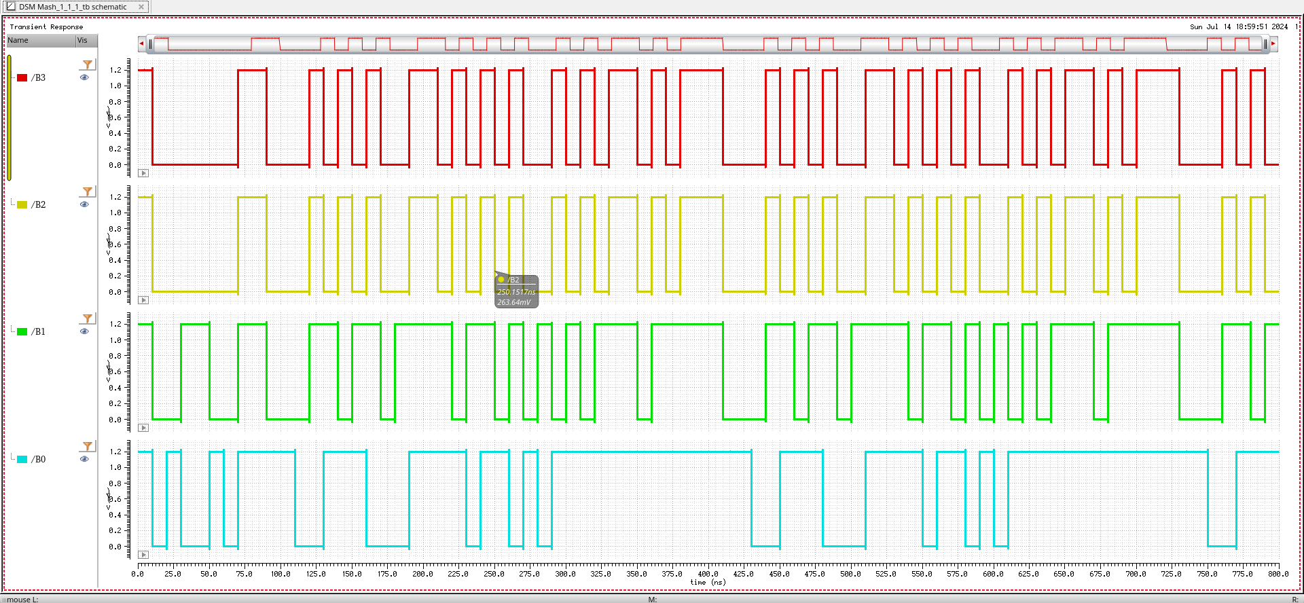
Mash 1-1-1 Waveform
Average=1/16
Input=16’b0001000000000000

Slide 30
Mash 1-1-1 Output
0001 | 0000 | 1110 | 0011 | 1101 | 0011 | 1110 | 0000
0010 | 1111 | 1111 | 0011 | 1101 | 0010 | 1111 | 0001
1110 | 0001 | 0010 | 1101 | 0011 | 1101 | 0011 | 1111
1111 | 0001 | 1111 | 0011 | 1111 | 1111 | 1111 | 0001
Number of Cycles=32
Sum=2
Average=2/32
Settling Time-7 Cycles

Slide 31
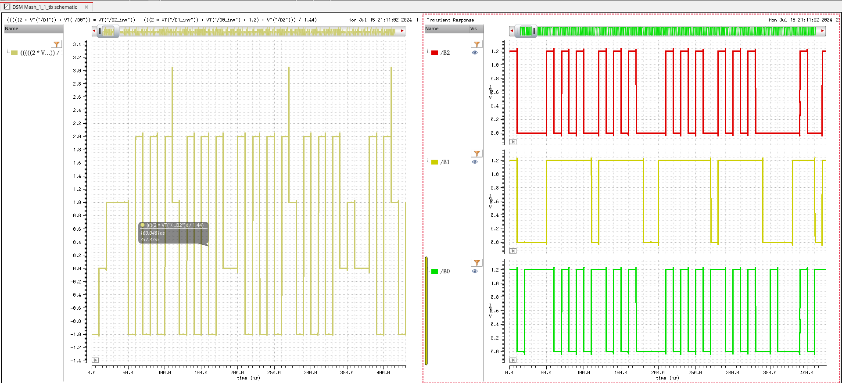
Mash 1-1 Waveform
(((2*VT("/B1")+VT("/B0"))*VT("/B2_inv"))-((2*VT("/B1_inv")+VT("/B0_inv")+1.2)*VT("/B2")))/1.44
In=1001000010000000=36864
Average expected=0.5625
Number of cycles=1024

Slide 32
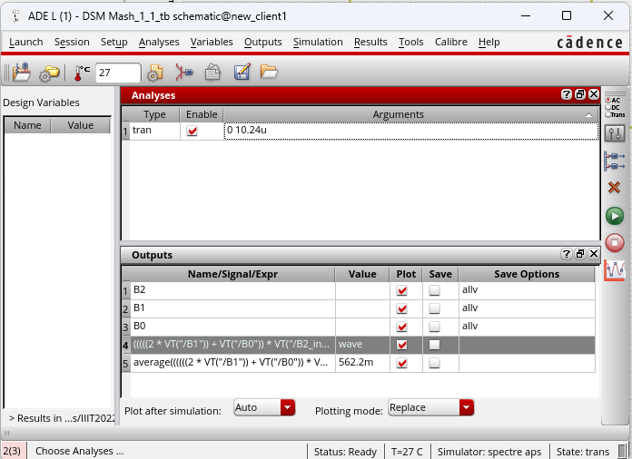
Mash 1-1 Waveform
Average Received=0.5622

Slide 33
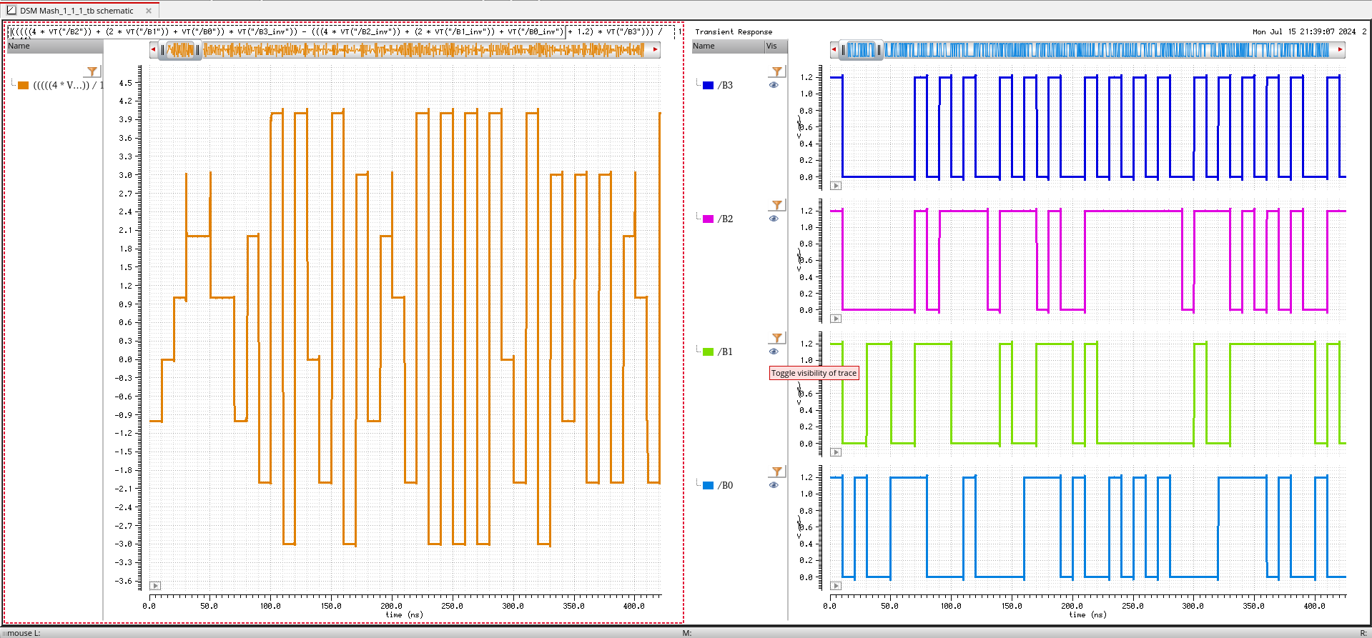
Mash 1-1-1 Waveform
(((4*VT("/B2")+2*VT("/B1")+VT("/B0"))*VT("/B3_inv"))-((4*VT("/B2_inv")+2*VT("/B1_inv")+VT("/B0_inv")+1.2)*VT("/B3")))/1.44
In=1001000010000000=36864
Average expected=0.5625
Number of cycles=1024

Slide 34
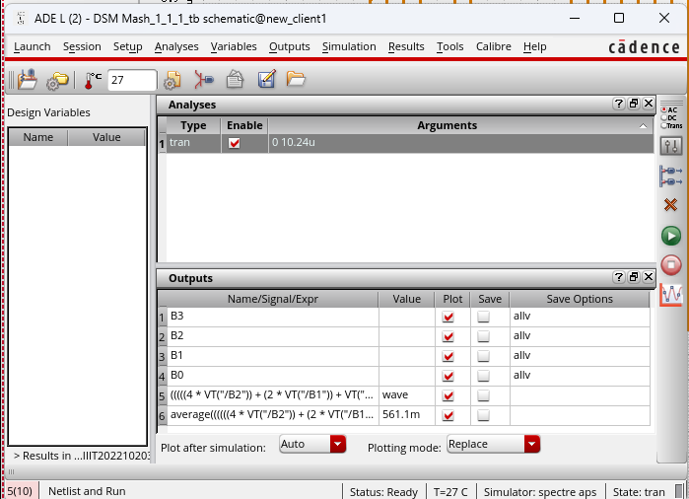
Mash 1-1-1 Waveform
Average Received=0.5611

Slide 35
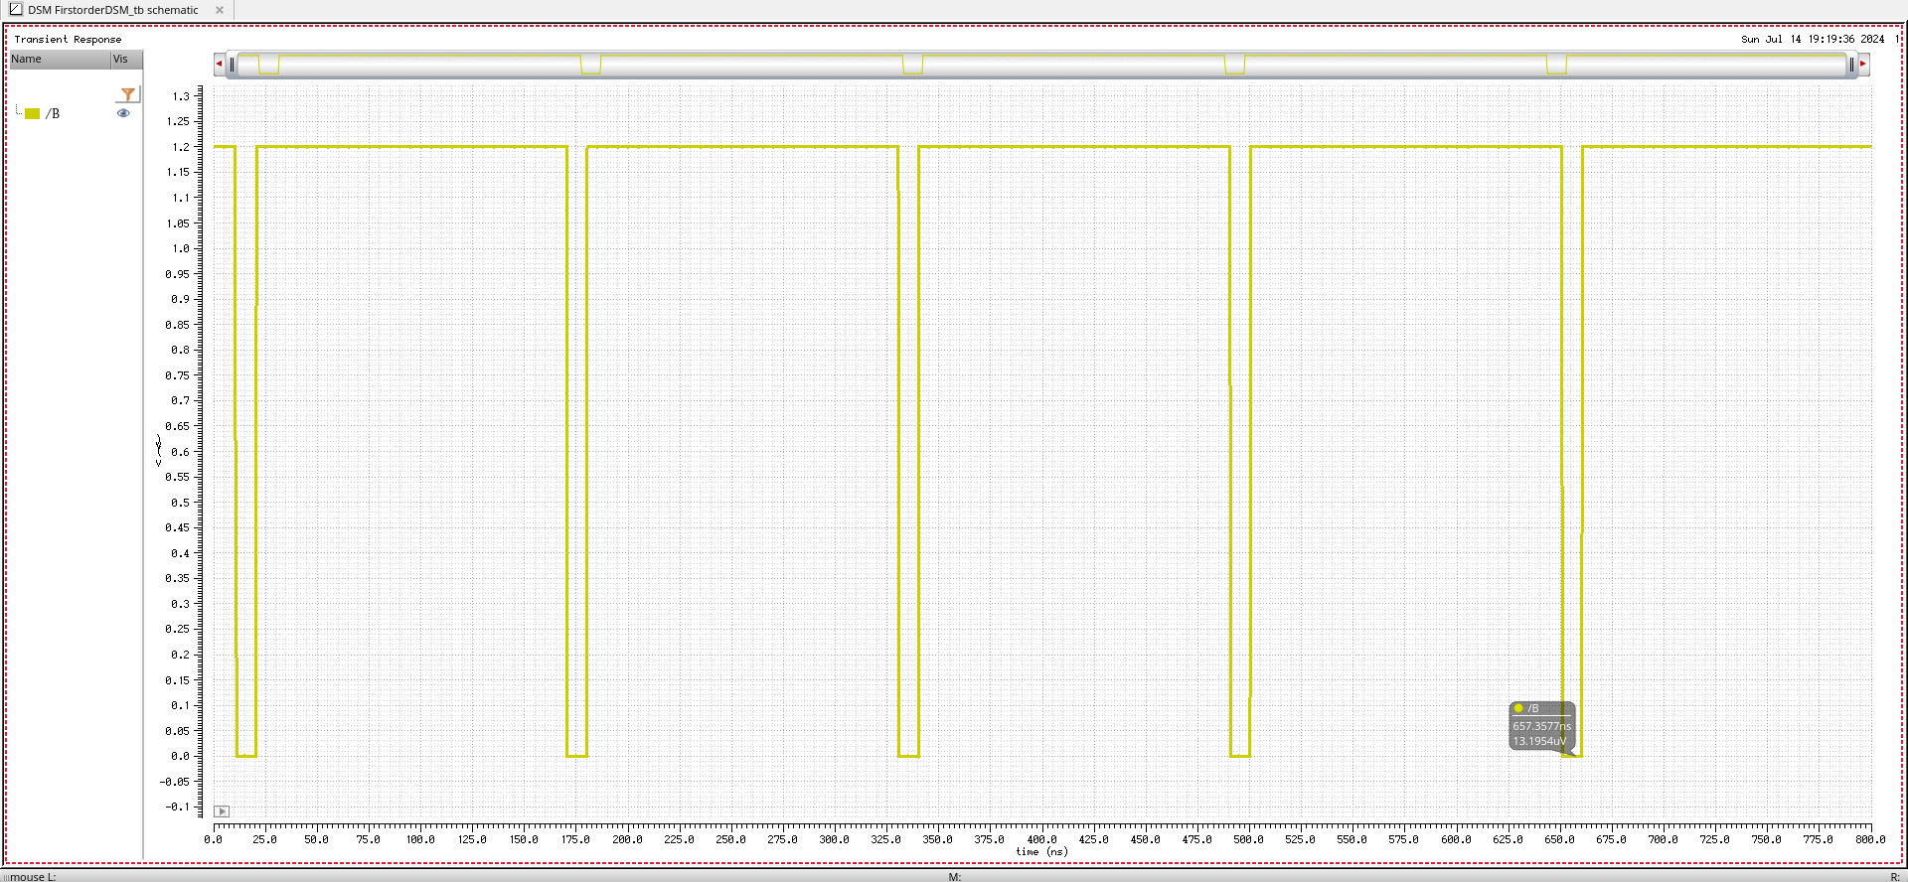
First Order Waveform
Average=1/16
K=-7(1111111111111001)
M=8(16’b0000000000001000)
Number of Cycles=16
Number of 1’s=15
1→n 0→n+1
K-M=-15(1111111111110001)
K+M=1(16’0000000000000001)

Slide 36
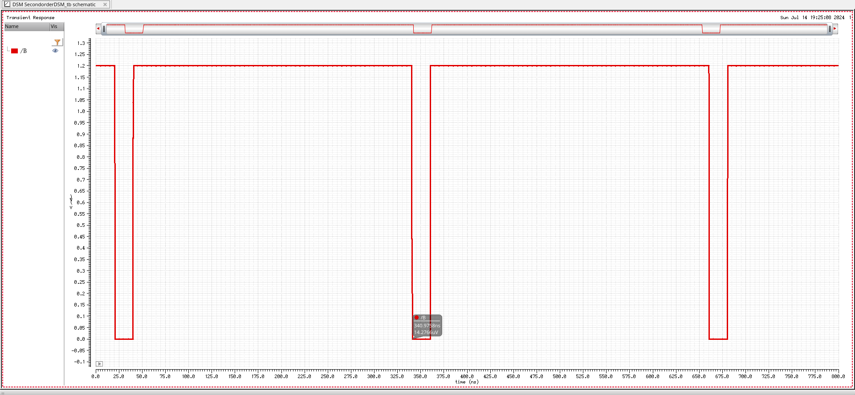
Second Order Waveform
Average=1/16
K=-7(1111111111111001)
M=8(16’b0000000000001000)
Number of Cycles=32
Number of 1’s=30
1→n 0→n+1
K-M=-15(1111111111110001)
K+M=1(16’0000000000000001)

Slide 37
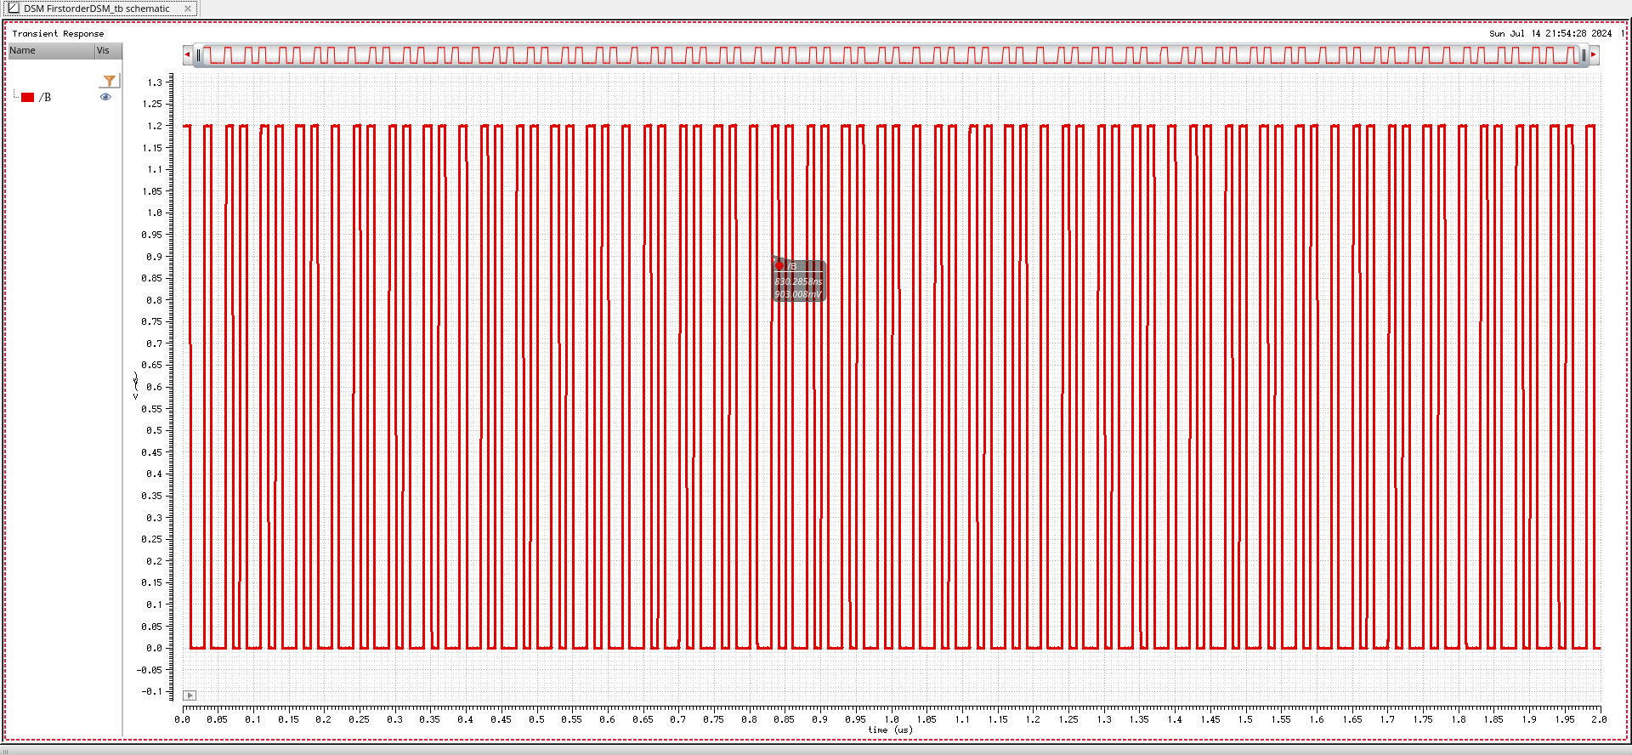
First Order Waveform
Average=0.61
K=11(1111111111111011)
M=50(16’b0000000000110010)
Average(B)=479.1m
Number of Cycles=200
Normalized Average(B)=.39925
Number of 1’s=79.85~80 cycles(Count=78)
1→n 0→n+1
Average achieved=0.6(Based on Count 0.61)
K-M=-39(1111111111011001)
K+M=61(16’0000000000111101)

Slide 38
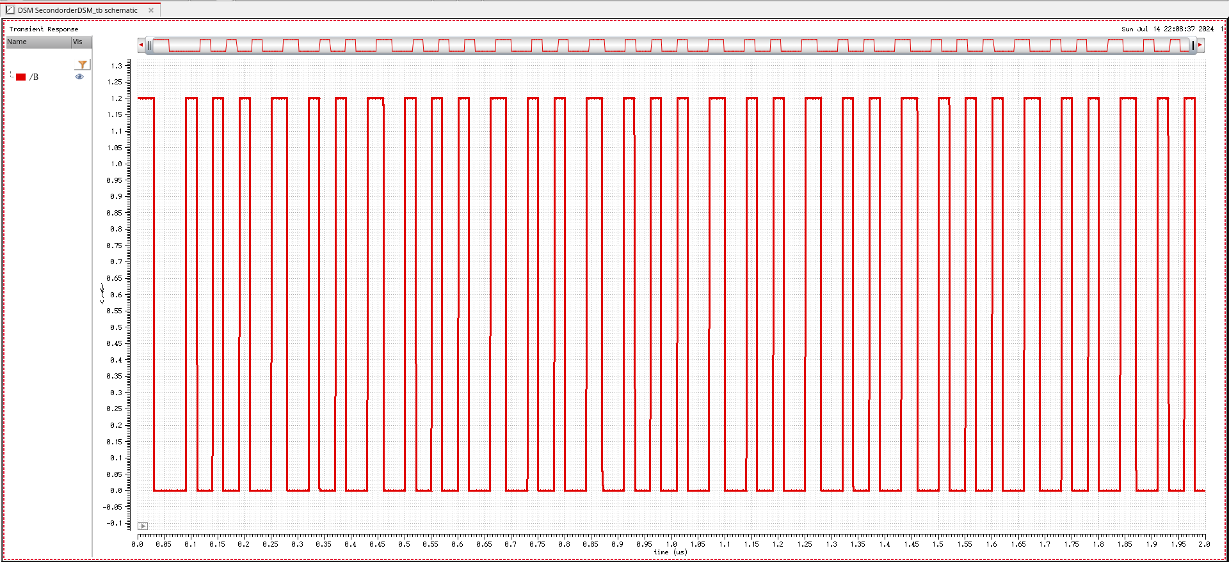
Second Order Waveform
Average=0.61
K=11(1111111111111011)
M=50(16’b0000000000110010)
Average(B)=472.5m
Number of Cycles=200
Normalized Average(B)=.39375
Number of 1’s=78.75~79 cycles(Count=78)
1→n 0→n+1
Average achieved=0.605(Based on Count 0.61)
K-M=-39(1111111111011001)
K+M=61(16’0000000000111101)

Slide 39
Thanks

Slide 40
Backup Slides

