Slide 1
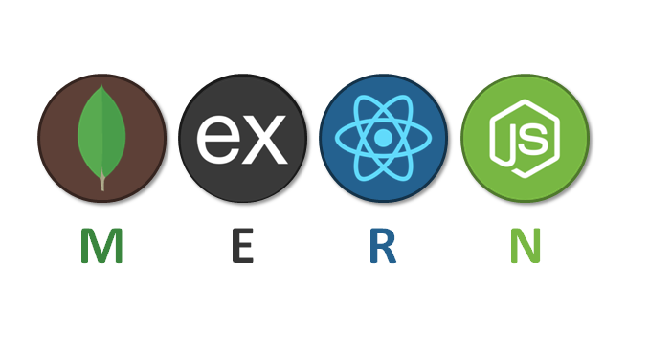
MERN Stack Development
Ritik Dwivedi

Slide 2

Javascript

Slide 3
BASIC
Types Of Programming Languages
Introduction
Features
Why JavaScript for web development
Scope
Variables
Data Types
Operators
Conditional Statement
Loops

Slide 4
Types Of Programming Languages
Procedural Language
Static Language
Dynamic Language
Interpreted Language
Low Level Language
High Level Language
Middle Level Language

Slide 5
Intro
JavaScript is a high-level, dynamic, and versatile programming language that is primarily used for building interactive and dynamic web pages. It is used for both client side and server side scripting.

Slide 6
Features
Scripting Language: Lightweight and interpreted, allowing for quick iteration and rapid development.
Interpreter-Based: Code runs directly within the browser, facilitating dynamic web experiences.
Event Handling: Responds to user interactions and browser events (clicks, scrolls, etc.) for interactive UI.

Slide 7
Light Weight: Small footprint, ideal for embedding in web pages without significant performance overhead.
Client-side Validation: Validates user input within the browser for improved data accuracy.
Event Handling: Responds to user interactions and browser events (clicks, scrolls, etc.) for interactive UI.
Async Processing: Handles multiple tasks concurrently without blocking the UI, enhancing responsiveness.
DOM Manipulation: Modifies the Document Object Model directly, controlling web page elements and their behaviour.

Slide 8
Why javascript for web development
Client-Side Interactivity: Enables dynamic and interactive user experiences.
Cross-Platform Compatibility: Runs on all major browsers and platforms.
Rich Ecosystem and Libraries: Includes frameworks like React, Angular, and Vue.js.

Slide 9
Server-Side Development: Supports server-side scripting with Node.js.
Community Support and Updates: Large, active community and frequent updates.
Integration with APIs and Services: Easy integration with third-party APIs and services.

Slide 10
Scope
Global Scope: Variables declared outside any function or block. Accessible anywhere in the code.
Function Scope: Variables declared within a function using var. Accessible only within that function.
Block Scope: Variables declared within a block (e.g., inside {}) using let or const. Accessible only within that block.

Slide 11
Variables
In JavaScript, variables are used to store data values.
There are 3 types, we can declare variables – Var, Let and Const

Slide 12
Var
Variables declared with `var` are function-scoped, meaning they are only accessible within the function where they are declared.
`var` variables are hoisted to the top of their scope. This means you can use a `var` variable before it's declared in the code.
`var` allows variable redeclaration within the same scope.

Slide 13
function example() {
if (true) {
var x = 10;
console.log(x); // Outputs 10
}
console.log(x); // Outputs 10
}

Slide 14
let
Variables declared with `let` are block-scoped, meaning they are only accessible within the block (enclosed by curly braces) where they are declared.
Unlike `var`, variables declared with `let` are not hoisted to the top of their scope. They are hoisted but not initialized, so you cannot use them before the declaration.
`let` allows you to reassign the variable, but you cannot redeclare it in the same scope.

Slide 15
function example() {
if (true) {
let x = 10;
console.log(x); // Outputs 10
}
// console.log(x); // Error: x is not defined
}

Slide 16
Const
Variables declared with `const` are also block-scoped.
`const` is used for constants, and once a value is assigned to a `const` variable, it cannot be reassigned.
Like `let`, `const` is not hoisted to the top of its scope.

Slide 17
function example() {
if (true) {
const x = 10;
console.log(x); // Outputs 10
}
// console.log(x); // Error: x is not defined
}

Slide 18
Data Types
Primitive Data Types
Immutable (values cannot be changed).
Compared by value.
Stored directly in the variable.
Non-Primitive (Reference) Data Types
Mutable (contents can be changed).
Compared by reference.
Variables hold a reference (address) to the memory location.

Slide 19
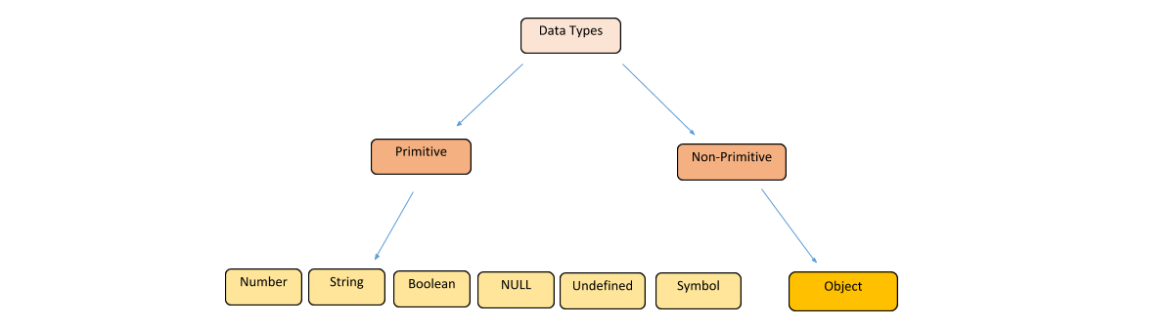

Slide 20
Operators
Operators are symbols that perform operations on variables and values.
Arithmetic Operators: Used to perform basic mathematical operations.
Assignment Operators: Used to assign values to variables.
Comparison Operators: Used to compare two values.
Logical Operators: Used to combine or invert boolean values.
Bitwise Operators: Used to perform bit-level operations.
String Operators: Used to concatenate strings.
Type Operators: Used to determine the type of a variable or object.

Slide 21
Conditional Statement
Conditional statements in JavaScript are used to execute different blocks of code based on certain conditions.
If Statement
If…Else Statement
If…Else IF…Else Statement
Switch case
Ternary Operator

Slide 22
If Statement
Syntax: if (condition) {
// code to execute if condition is true
}
Ex: let age = 18;
if (age >= 18) {
console.log("You are an adult.");
}

Slide 23
If…Else Statement
Syntax: if (condition) {
// code to execute if condition is true
} else {
// code to execute if condition is false
}

Slide 24
If…Else If…else Statement
Syntax: if (condition1) {
// code to execute if condition1 is true
} else if (condition2) {
// code to execute if condition2 is true
} else {
// code to execute if none of the conditions are true
}

Slide 25
Switch Statement
Evaluates an expression and executes code based on matching cases. Useful for multiple conditions based on the same variable.
Syntax: switch (expression) {
case value1:
// code to execute if expression === value1
break;
case value2:
// code to execute if expression === value2
break;
// more cases
default:
// code to execute if no case matches
}

Slide 26
Ex: let day = 3;
switch (day) {
case 1:
console.log("Monday");
break;
case 2:
console.log("Tuesday");
break;
case 3:
console.log("Wednesday");
break;
default:
console.log("Other day");
}

Slide 27
Ternary operator
A shorthand for if...else that evaluates a condition and returns one of two values.
Syntax: let result = (condition) ? value1 : value2;

Slide 28
Ex: let age = 20;
let canVote = (age >= 18) ? "Yes" : "No";
console.log(canVote); // "Yes"

Slide 29
Loops
Loops in JavaScript are used to execute a block of code repeatedly based on a condition. Here are the primary types of loops:
for Loop
while Loop
for each Loop

Slide 30
while loops
Syntax: while (condition) {
// code to execute
}
Eg: let i = 0;
while (i < 5) {
console.log(i); // Prints 0 to 4
i++;
}

Slide 31
For loops
Syntax: for (initialization; condition; increment) {
// code to execute
}
Eg: for (let i = 0; i < 5; i++) {
console.log(i); // Prints 0 to 4
}

Slide 32
Select Elements from dom
document.getElementById(id)
document.getElementsByClassName(className)
document.getElementsByTagName(tagName)
document.querySelector(selector)
document.querySelectorAll(selector)

Slide 33
getElementById(id)
Selects a single element with the specified ID. Since IDs are unique within a document, this method returns a single DOM element.
let element = document.getElementById('myId');
element.style.color = 'blue';

Slide 34
getElementByClassName(class)
Selects all elements with the specified class name. It returns a live HTMLCollection of elements.
let elements = document.getElementsByClassName('myClass');
for (let i = 0; i < elements.length; i++) {
elements[i].style.color = 'green';
}

Slide 35
getElementByTagName(Tag)
Selects all elements with the specified tag name. It returns a live HTMLCollection of elements.
let elements = document.getElementsByTagName('p');
for (let i = 0; i < elements.length; i++) {
elements[i].style.color = 'red';
}

Slide 36
querySelector(selector)
Selects the first element that matches the specified CSS selector. It returns a single DOM element or null if no matches are found.
// Select the first element with the class 'myClass'
let element = document.querySelector('.myClass');
if (element) {
element.style.color = 'blue';
}

Slide 37
querySelectorAll(selector)
Selects all elements that match the specified CSS selector. It returns a static NodeList of elements.
let elements = document.querySelectorAll('.myClass');
elements.forEach(function(element) {
element.style.color = 'blue';
});

Slide 38
Event Listener
You can add multiple event listeners to an element. Each event listener can handle a different event type or multiple event listeners can handle the same event type.

Slide 39
const button = document.querySelector('button');
// Handling click event
button.addEventListener('click', () => {
console.log('Button clicked!');
});
// Handling mouseover event
button.addEventListener('mouseover', () => {
console.log('Mouse over button!');
});
// Handling multiple click events
button.addEventListener('click', () => {
console.log('Another click handler!');
});

Slide 40
some examples of different types of events
click
dblclick
mouseover
mouseout
mousemove
mousedown
mouseup
keydown
keypress
keyup

Slide 41
Click Event
This event is triggered when an element is clicked.
‘
<button id="clickButton">Click Me</button>
<script>
document.getElementById('clickButton').addEventListener('click', function() {
alert('Button was clicked!');
});
</script>

Slide 42
Mouseover Event
This event is triggered when the mouse pointer is moved onto an element.
<div id="hoverDiv" style="width: 100px; height: 100px; background-color: lightblue;">Hover over me</div>
<script>
document.getElementById('hoverDiv').addEventListener('mouseover', function() {
this.style.backgroundColor = 'yellow';
});
</script>

Slide 43
Mouseout Event
This event is triggered when the mouse pointer is moved out of an element.
<div onmouseover="this.style.backgroundColor='yellow'" style="width: 100px;
height: 100px; background-color: lightblue;">Hover over me</div>

Slide 44
Keydown Event
Triggered when a key is pressed down.
<input type="text" onkeydown="console.log('Key pressed: ' + event.key)" placeholder="Type something">

Slide 45
Form Submit Event
Triggered when a form is submitted.
<form onsubmit="alert('Form submitted!’)”>
<input type="text" name="name" placeholder="Enter your name">
<button type="submit">Submit</button>
</form>

Slide 46
Change Event
Triggered when the value of an input element changes.
<select onchange="alert('Selected: ' + this.value)">
<option value="option1">Option 1</option>
<option value="option2">Option 2</option>
</select>

Slide 47
Input Event
Triggered when the value of an input element is changed (similar to change, but reacts immediately).
<input type="text" oninput="console.log('Input value changed: ' + this.value)" placeholder="Type something">

Slide 48
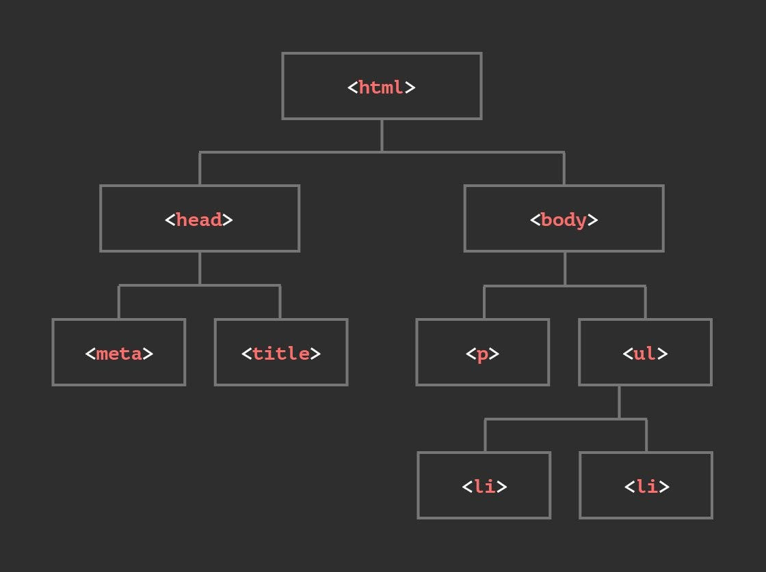
DOM tree

Slide 49
Array
In JavaScript, an array is a special type of object used to store ordered collections of items. Each item in an array can be of any type, including numbers, strings, objects, or even other arrays. Arrays are useful for organizing and manipulating lists of data.

Slide 50
Array Creation

Slide 51
Syntax: Let array_name = [item1, item2, ...];
Let fruits = ['apple', 'banana', 'cherry'];
console.log(fruits[0]); // 'apple'
console.log(fruits[1]); // 'banana'
console.log(fruits.length); // 3

Slide 52
const cars = [];
cars[0]= "Saab";
cars[1]= "Volvo";
cars[2]= "BMW";

Slide 53
const cars = new Array("Saab", "Volvo", "BMW");

Slide 54
Access/Iteration of element

Slide 55
const cars = ["Saab", "Volvo", "BMW"];
cars[0] = "Opel";

Slide 56
For Loop: The for loop is a traditional method for iterating over arrays in JavaScript.
let numbers = [1, 2, 3, 4];
for (let i = 0; i < numbers.length; i++) {
console.log(numbers[i]); // Logs each number in the array
}

Slide 57
For Each: Use this when you need to perform operations on each element without altering or creating a new array.
const fruits = ["apple", "orange", "papaya"];
fruits.forEach((num) => {
console.log(num + 2);
})

Slide 58
Map: Creates a new array with the results of calling a provided function on every element in the original array. It is used when you want to transform the elements of the array and produce a new array with the transformed values.
const fruits = ["apple", "orange", "papaya"];
const newArr = fruits.map((value) => {
console.log(value);
return value;
})
console.log(newArr);

Slide 59
METHODS

Slide 60
toString(): The toString() method in JavaScript is used to convert an array into a string representation. When applied to an array, toString() joins all the elements of the array into a single string, separated by commas.
let fruits = ['apple', 'banana', 'cherry'];
let fruitString = fruits.toString();
console.log(fruitString); // "apple,banana,cherry"

Slide 61
Push(): Add an element to the end of the array.
Const arr = [1, 2, 3, 4]
arr.push(5) // [1, 2, 3, 4, 5]
Pop(): Remove an element from end of the array.
Const arr = [1, 2, 3, 4]
arr.pop()

Slide 62
Slice(): The `slice` method is used to extract a portion of an array and returns a new array containing the selected elements.
Syntax: array.slice(startIndex, endIndex);
const fruits = ['apple', 'banana', 'orange', 'grape', 'kiwi'];
const selectedFruits = fruits.slice(1, 4);
console.log(selectedFruits); // Output: ['banana', 'orange', 'grape']
console.log(fruits); // Output: ['apple', 'banana', 'orange', 'grape', 'kiwi']

Slide 63
Splice(): The splice() method in JavaScript is a versatile array method used to change the contents of an array by removing, replacing, or adding elements. It modifies the original array and can perform multiple operations in a single call.
Syntax: array.splice(startIndex, deleteCount, item1, item2, ...);
const numbers = [1, 2, 3, 4, 5];
numbers.splice(2, 1, 6, 7);
console.log(numbers); // Output: [1, 2, 6, 7, 4, 5]

Slide 64
Filter(): The filter() method takes each element in an array and it applies a conditional statement against it. If this conditional returns true, the element gets pushed to the output array. If the condition returns false, the element does not get pushed to the output array.
const numbers = [1, 2, 3, 4, 5];
const newArr = numbers.filter((num) => {
return num % 2 === 0;
})
console.log(newArr); // [2, 4]

Slide 65
Reduce(): The reduce() method reduces an array of values down to just one value. To get the output value, it runs a reducer function on each element of the array.
Syntax: array.reduce(callback(accumulator, currentValue[, initialValue]));

Slide 66
callback: A function that is executed on each element of the array.
accumulator: The accumulated value returned by the last execution of the callback or the initialValue if provided.
currentValue: The current element being processed in the array.

Slide 67
let numbers = [1, 2, 3, 4];
let sum = numbers.reduce((acc, curr) => {
return acc + curr;
}, 0);
console.log(sum); // Outputs: 10

Slide 68
All Together:
let numbers = [1, 2, 3, 4, 5, 6];
const newArr = numbers.filter((num) => num % 2 == 0)
.map((num) => num + 3)
.reduce((acc, num) => acc + num);
console.log(newArr);

Slide 69
Objects
In JavaScript, objects are fundamental data structures that store collections of key-value pairs. These key-value pairs can consist of properties and methods.
{firstName:"John", lastName:"Doe", age:50, eyeColor:"blue"}

Slide 70
Object creATION

Slide 71
let obj = {
name : "john",
class: "BTECH",
Subject: [
"Mathematics",
"Science",
"English"
],
}
console.log(obj.Subject)

Slide 72
let student = {};
student.name = "John Doe";
student.age = 20;
student.email = "example@example.com";
console.log(student);

Slide 73
let student = new Object();
student.name = "John Doe";
student.age = 20;
student.email = "example@example.com";
console.log(student);

Slide 74
Access

Slide 75
Through DOT
let student = new Object();
student.name = "John Doe";
student.age = 20;
student.email = "example@example.com";
console.log(student.name);

Slide 76
Bracket Notation
let student = new Object();
student.name = "John Doe";
student.age = 20;
student.email = "example@example.com";
console.log(student[“name”]);

Slide 77
Methods

Slide 78
Using Object.keys()
Object.keys() returns an array of the object's own enumerable property names. You can then loop over this array to access the values.
let person = {
name: 'John',
age: 30,
occupation: 'Developer'
};
Object.keys(person).forEach(key => {
console.log(person[key]); // Output: John, 30, Developer
});

Slide 79
Using Object.values()
Object.values() returns an array of the object's own enumerable property values. You can loop over this array directly.
let person = {
name: 'John',
age: 30,
occupation: 'Developer'
};
Object.values(person).forEach(value => {
console.log(value); // Output: John, 30, Developer
});

Slide 80
Using Object.entries()
Object.entries() returns an array of the object's own enumerable property [key, value] pairs. You can loop over this array and access both keys and values.
let person = {
name: 'John',
age: 30,
occupation: 'Developer'
};
Object.entries(person).forEach(([key, value]) => {
console.log(`${key}: ${value}`);
});

Slide 81
Array and Object Destructuring

Slide 82
Array Destructuring
Array destructuring allows you to extract values from an array and assign them to variables.
const numbers = [1, 2, 3];
// Destructuring assignment
const [a, b, c] = numbers;
console.log(a); // Output: 1
console.log(b); // Output: 2
console.log(c); // Output:

Slide 83
Object Destructuring
Object destructuring allows you to extract properties from an object and assign them to variables with the same name as the properties.
const person = {
name: 'John',
age: 30
};
// Destructuring assignment
const { name, age } = person;
console.log(name); // Output: John
console.log(age); // Output: 30

Slide 84
Spread Operator ( … )
The spread operator is used to expand elements of an array or object. When used with an array, it allows you to create a new array by copying the elements of an existing array.
const arr = [5, 2, 7, 10];
const newArr = [...arr, 18, 22];
console.log(newArr);

Slide 85
Rest Operator ( … )
The rest operator is used to collect the remaining elements of an array or properties of an object into a single variable.
const arr = [5, 2, 7, 10];
const [a, b, ...rest] = arr;
console.log(rest);

Slide 86
Asynchronous JavaScript

Slide 87
If there is a task waiting for resources and taking time, So asynchronous JavaScript allows other task to be completed on the given time.
JavaScript is a single-threaded language, meaning it has only one thread of execution. Asynchronous operations in JavaScript are typically handled using callbacks, promises, and more recently, async/await.

Slide 88
Callbacks:
Callbacks are functions that are passed as arguments to other functions. The receiving function will then, at some later point, "call back" the passed function and execute it.
function myFunction(callback) {
// Function body
// You can call the callback function at some point
callback();
}

Slide 89
function getData(callback) {
console.log("getting the data...");
callback();
}
function printData(){
console.log("data printed");
}
getData(printData);

Slide 90
SetTimeout():
The setTimeout function is a commonly used JavaScript function that allows you to schedule the execution of a function after a specified delay in milliseconds.
setTimeout(() => {
console.log('This message is displayed after 2 seconds');
}, 2000);

Slide 91
function getData(callback) {
console.log("getting the data...");
setTimeout(() => {
callback();
}, 1000)
}
function printData(){
console.log("data printed");
}
getData(printData);
console.log("Processing data...");

Slide 92
SetInterval():
The setInterval function in JavaScript is used to repeatedly execute a function or a piece of code at specified intervals (in milliseconds).
setInterval(() => {
console.log('This message is displayed every 2 seconds');
}, 2000);

Slide 93
function getData(callback) {
console.log("getting the data...");
setInterval(() => {
callback();
}, 1000)
}
function printData(){
console.log("data printed");
}
getData(printData);

Slide 94
Promises

Slide 95
Promises are a JavaScript feature introduced to handle asynchronous operations more easily and in a more organized manner.
- The `Promise` constructor takes a function with `resolve` and reject` parameters.
- Inside this function, you perform an asynchronous operation (e.g., making an API request, reading a file).
- If the operation is successful, you call `resolve` with the result; otherwise, you call `reject` with an error.

Slide 96
After creating a Promise, you can use the `.then()` method to handle the successful resolution of the promise and the `.catch()` method to handle any errors.
let promise = new Promise(function(resolve, reject) {
// asynchronous operation
if (/* operation successful */) {
resolve(value); // fulfilled
} else {
reject(error); // rejected
}
});

Slide 97
Async Await

Slide 98
Async/await is a feature in JavaScript that simplifies the handling of asynchronous code. It provides a more readable and synchronous-like syntax for writing asynchronous functions. Async/await is built on top of Promises and is supported in modern JavaScript environments.
- Async/await is a combination of two keywords:
- async: Marks a function as potentially containing asynchronous operations.
- await: Used within an async function to pause execution until a promise is resolved or rejected.

Slide 99
async function fetchData() {
let response = await fetch('https://api.example.com/data');
let data = await response.json();
console.log(data);
}
fetchData();
It always return a promise.
The await keyword pauses the function execution until the promise is resolved and returns the result.

Slide 100
Event Loop

Slide 101
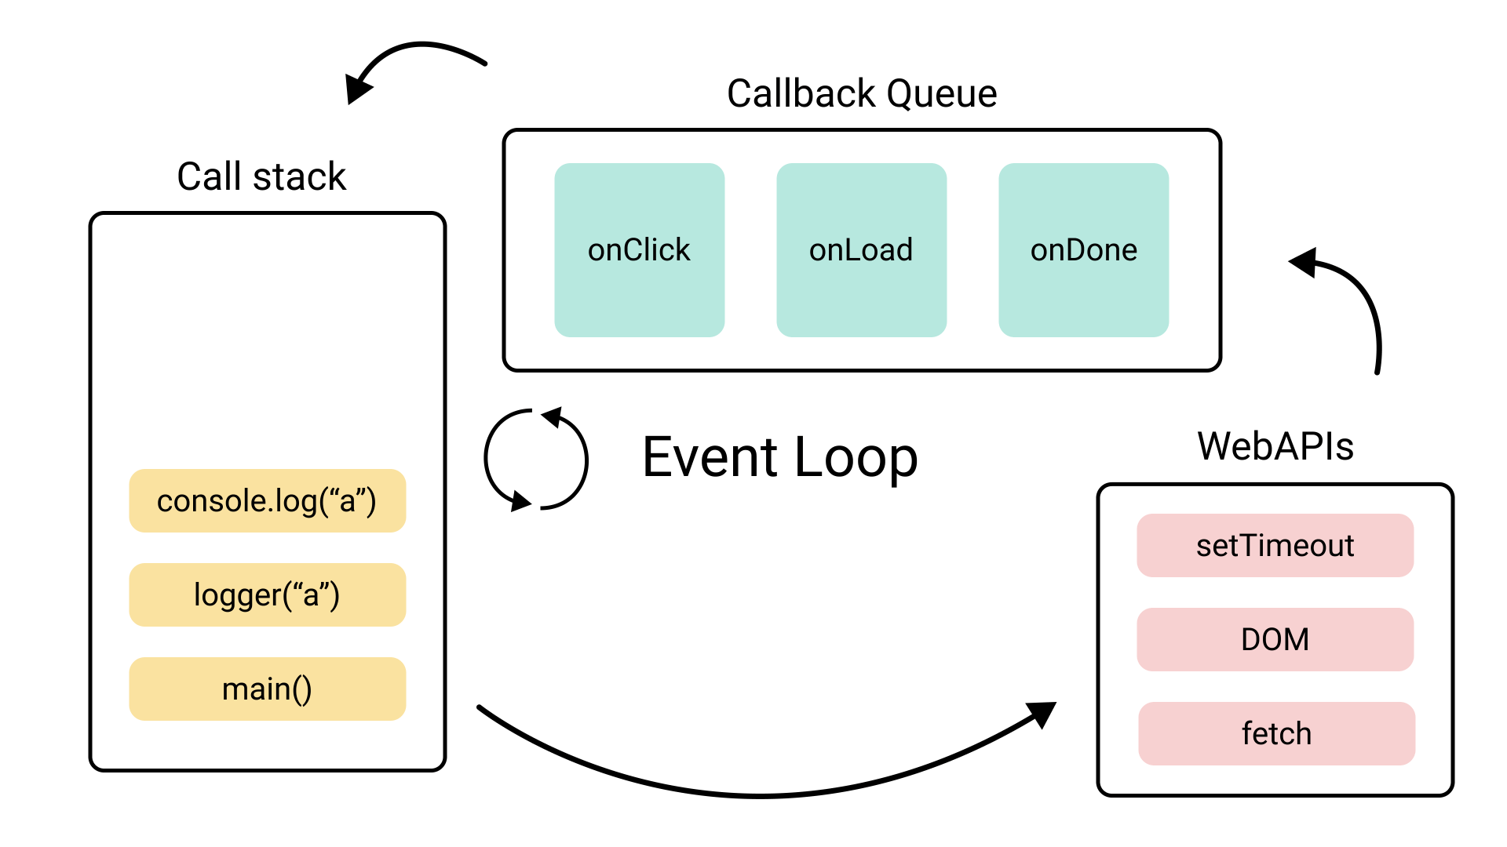

Slide 102
JavaScript is single-threaded, meaning it executes one operation at a time. However, it uses the event loop to manage asynchronous operations such as callbacks, promises, and other events.
1. Execution Context: JavaScript code runs inside an execution context.
2. Memory Allocation: Initially, memory is allocated to variables and functions.
3. Function Invocation: When a function is invoked, a new execution context is created for it.

Slide 103
4. Call Stack: Code in the call stack executes first.
5. Queues:
- Callbacks: If there are callbacks, they move to the callback queue or microtask queue and wait for call Stack to be completed.
- Microtask Queue: After the call stack is empty, the microtask queue is checked and tasks are executed. (Promises)
- Callback Queue: Once the microtask queue is clear, tasks in the callback queue are executed. (SetTimeout)
This sequence ensures that microtasks have priority over regular callbacks.

Slide 104
JSON

Slide 105
JSON, which stands for JavaScript Object Notation, is a lightweight data interchange format that is easy for humans to read and write, and easy for machines to parse and generate.
JSON supports various data types, including strings, numbers, objects, arrays, booleans, and null.
{
"name": "John",
"age": 30,
"isStudent": false
}

Slide 106
What can you do with it?
Web Development: Send data between client and server, configure applications, and store data.
APIs: Build RESTful APIs to expose data and functionality to other applications.
Data Storage: Store configuration files, user settings, and other structured data efficiently.
- Data Sharing: Easily share data between platforms and applications via JSON files.

Slide 107
JSON Methods:
`JSON.parse()`:
This method is used to parse a JSON string and convert it into a JavaScript object.
const jsonString = '{"name": "John", "age": 30}';
const jsonObj = JSON.parse(jsonString);
console.log(jsonObj.name); // Output: John

Slide 108
`JSON.stringify()`:
- This method is used to convert a JavaScript object into a JSON string.
const person = { name: "Alice", age: 25 };
const jsonString = JSON.stringify(person);
console.log(jsonString); // Output: {"name":"Alice","age":25}

Slide 109
Making HTTP requests in JavaScript

Slide 110
Fetch API:
1. Modern Approach: The Fetch API is a more modern and flexible approach to making HTTP requests in JavaScript.
2. Promise-Based: Fetch is based on Promises, which makes the code cleaner and more readable.
3. Simplicity: Fetch provides a simpler and cleaner syntax.
5. Cross-Origin Requests: Fetch is designed with cross-origin requests in mind, making it easier to handle CORS (Cross-Origin Resource Sharing).

Slide 111
Ex:

Slide 112
AXIOS:
Axios is a promise-based HTTP client for the browser and Node.js. It provides a more powerful and flexible API compared to fetch.
Installation
To use Axios in your project, you need to install it using npm or yarn:
npm install axios

Slide 113
Ex:

Slide 114
Thanks!

