Slide 1

Movie Recommender System Using Hybrid Filtering and KNN Algorithm
Capstone Project by Group 7 Team members
Abhinav Anand
Priyanka S
Deekshitha AG
Lakshmi Priya
Mahathevan S J
Mentor : Dr. Debasish Roy

Slide 2
Problem Definition
A movie recommender system, is a Machine Learning -based approach for filtering or predicting the users’ film preferences based on their historic choices and action.
It’s the latest filtration technique that predicts the possible movie choices of the particular user and their preferences towards a movie.
A movie recommender system is basically a tool that helps streaming media platforms recommend users’ favourite movies on the basis of their interests and behaviour.
OTT platforms like Netfix, Amazon Prime Video, Rakuten Viki ,Disney+Hotstar ,etc will recommend movies based on our watchlist. It creates a list of favourite movies according to each individual profile.
Web-based movie recommender systems like MovieLens , Flickmetrix, Popcornic,etc will recommend movies based on our customized answers.

Slide 3
How is Movie Recommender System helpful?
Movie Recommender System assists people by recommending what movie to watch without requiring them to go through the time consuming and complex process of selecting from a vast number of movies ranging from hundreds to millions. This decreases human effort by recommending movies based on the user's preferences.
Businesses just need to upload the data set and extract inputs from their users. After generating the recommendations out of inputs, businesses can apply preferred filters to adjust the final recommendations.

Slide 4
Dataset
Link: https://www.kaggle.com/datasets/rounakbanik/the-movies-dataset?page=2
Description:
credits: Contains Cast and Crew Information for all movies in the movies_metadata.csv file (45432 rows)
Keywords: Contains the movie plot keywords for our MovieLens movies.(46419 rows)
movies_metadata: Contains information on 45,000 movies featured in the Full MovieLens dataset.Features include posters, backdrops, budget, revenue, release dates, languages, production countries and companies.(45466 rows)
ratings: Contains ratings of movies by multiple users present in movies_metadata(2602429 rows)

Slide 5
Suggested Solution and EDA
Generating recommendation of movies based on the inputs given via the user.
The Algorithms we are aiming to use:
Content-Based Filtering/Collaborative Filtering/Hybrid Filtering
K-Nearest Neighbours Supervised Algorithm
The four datasets were cleaned thoroughly, and joined and basic visualizations were performed to get insights of the data.
We have performed outlier detection, but not treated it.
Performed feature scaling, normality tests and multicollinearity using VIF and correlation matrix

Slide 6
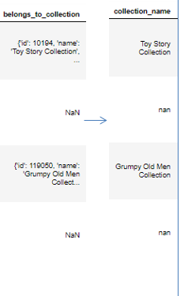
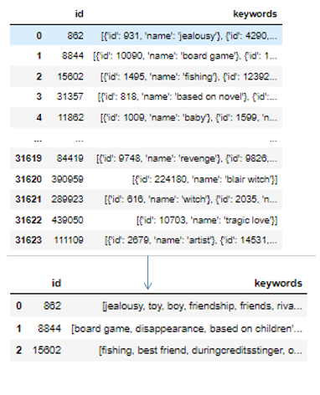
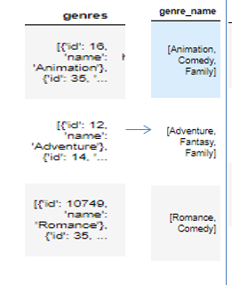
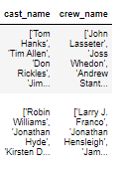

Major challenges
1. The basic data cleaning and joining of the records, most of the important features was in the form of list of dictionaries in separate files and extracting the relevant information from multiple data sources. 1.Genre: 2.Collection: 3.Keywords:
4. Credits:

Slide 7
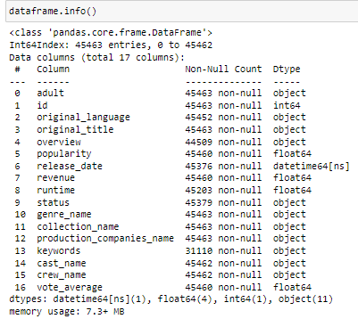
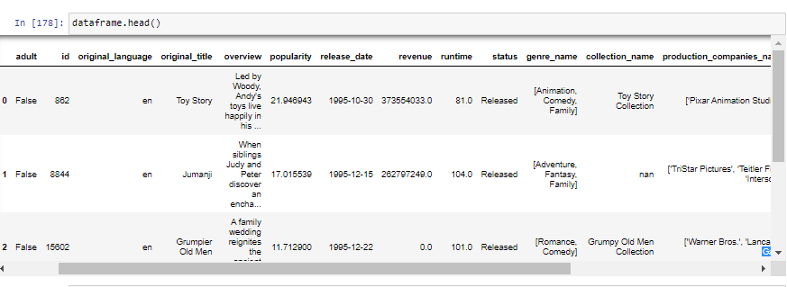
2.Joining data and establishing and relationships and bringing multiple data as one usable data source.

Slide 8
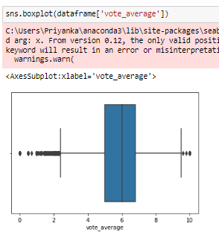
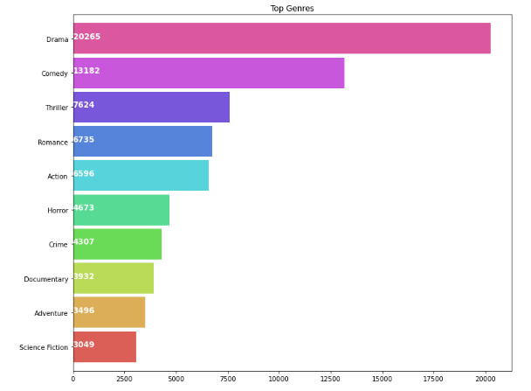
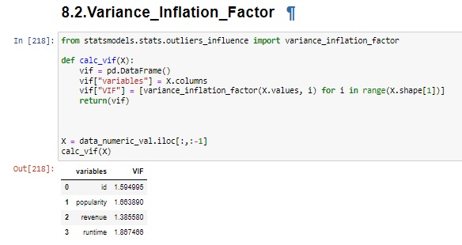
Outlier Detection
Genre Visualization
Multicollinearity

Slide 9
Movie Recommendation and Rating Prediction using K-Nearest Neighbors
KNN finds the most similar movies to a user’s past preferences that are most likely to enjoy.To implement a KNN movie recommendation system, start by gathering a dataset of movies and their features (e.g., genre, keywords, cast_name, etc.). Then use a similarity metric (e.g., cosine similarity) to compare the features of the movies in the dataset and determine the "closest" movies to a user's past preferences. Finally, Recommend the top K movies (where K is a user-defined parameter) that are most similar to the user's past preferences.
K value is arbitrary and why ?
A small value of K means that noise will have a higher influence on the result and a large value make it computationally expensive.
The optimal value of K can be determined through experimentation and testing, where different values of K are tried and the performance of the recommendation system is evaluated using RMS.
How the Similarity between movies is calculated ?
If the vectors are close to parallel, i.e. angle between the vectors is 0, then we can say that both of them are “similar”, as cos(0)=1. Whereas if the vectors are orthogonal, then we can say that they are independent or NOT “similar”, as cos(90)=0.

Slide 10
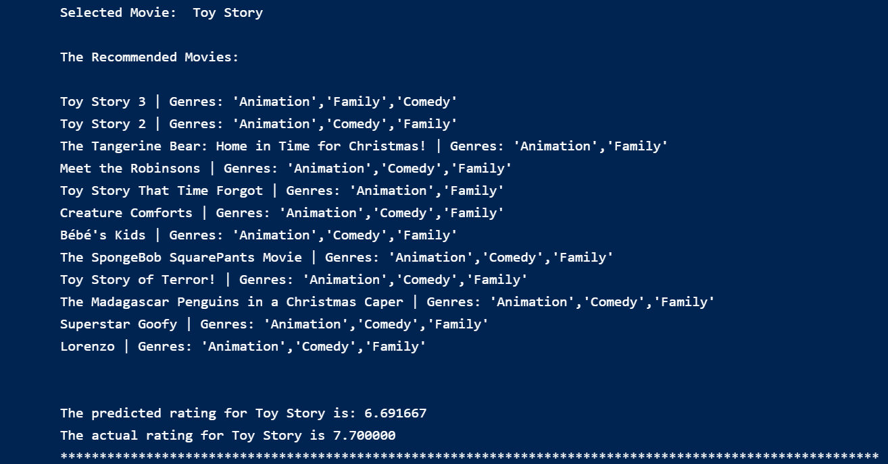
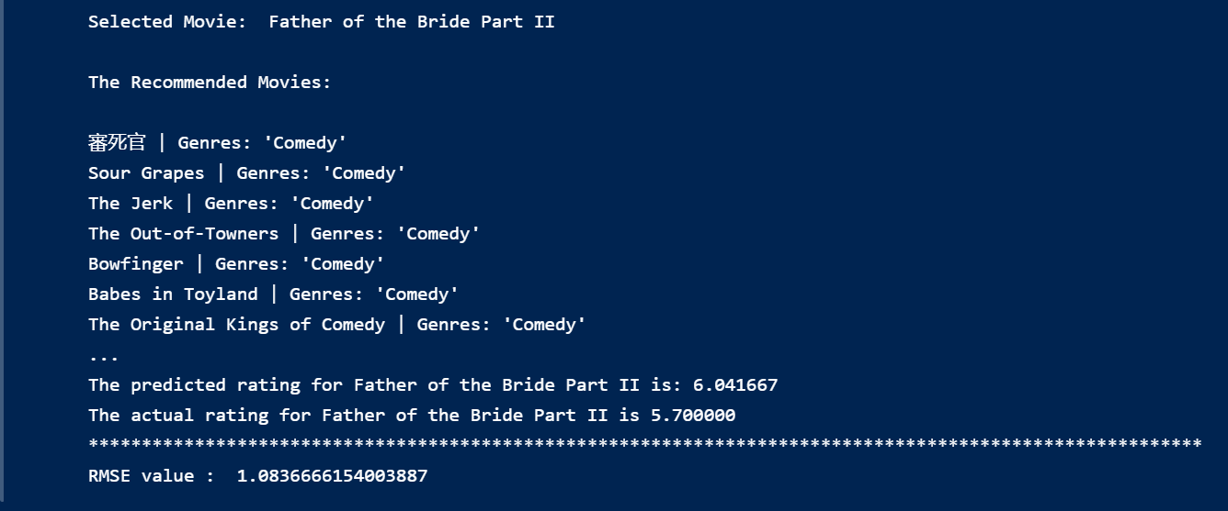

Slide 11
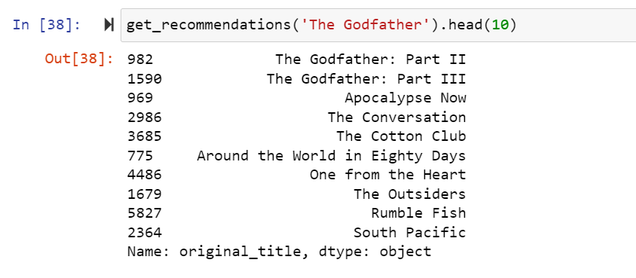
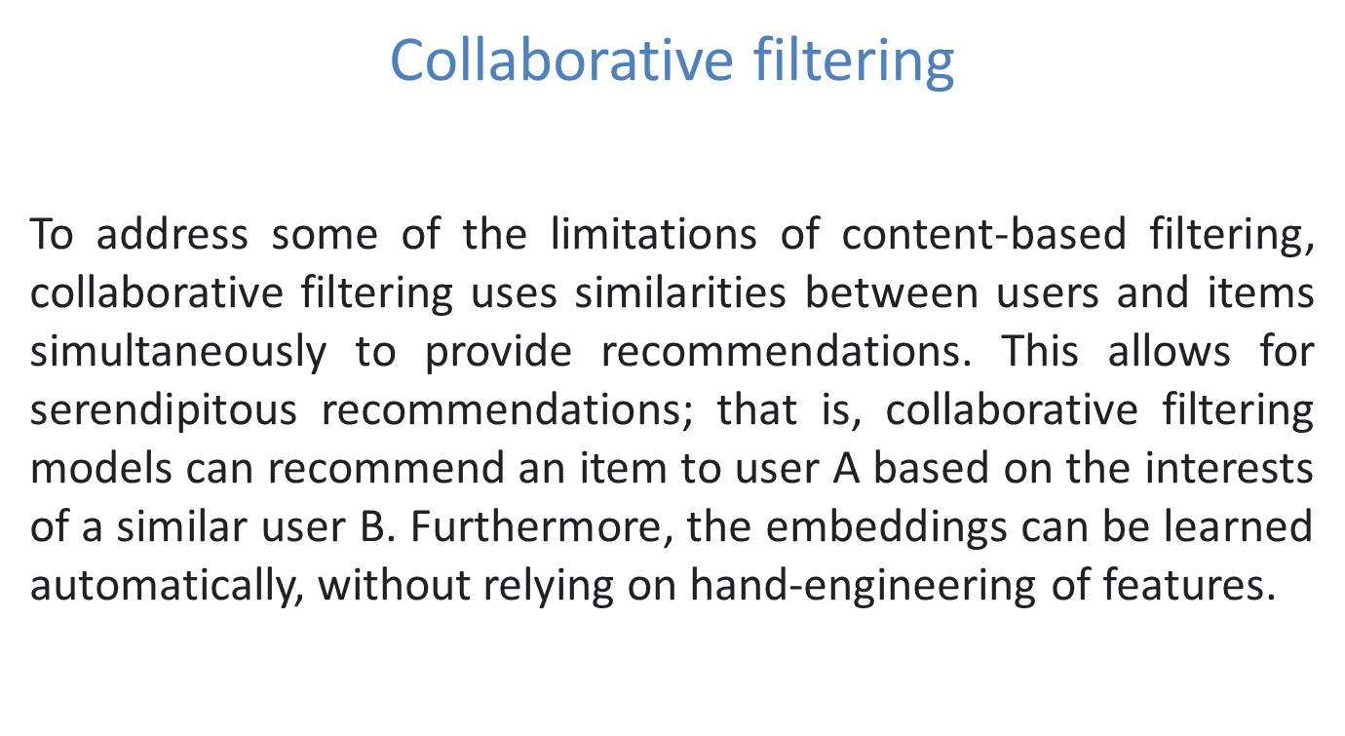
Content-Based Recommendations systems
Content-Based Recommendations systems are the systems that look for similarity before recommending something. The intuition behind this sort of recommendation system is that if a user liked a particular movie or show, he/she might like a movie or a show similar to it.
Cosine Similarity is used-This type of metric is used to compute the similarity textual data. We convert these textual data in the form of vectors and check for cosine angle between those two vectors if the angle between them is 0. It means they are similar or else they are not.

Slide 12
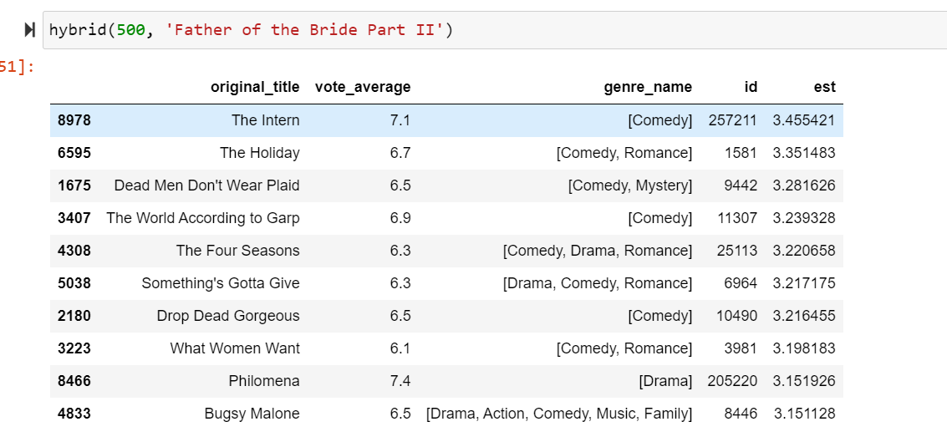
Hybrid systems
We built a simple hybrid recommender that brings together techniques we have implemented in the content based and collaborative filter based engines. This is how it will work:
Input: User ID and the Title of a Movie
Output: Similar movies sorted on the basis of expected ratings by that particular user.
The movie recommendation system is a hybrid filtering system that performs both collaborative and content-based filtering of data to provide recommendations to users regarding movies. The system conforms to a different approach where it seeks the similarity of users among others clustered around the various genres and utilizes his preference of movies based on their content in terms of genres as the deciding factor of the recommendation of the movies to them.
The system is based on the belief that a user rates movies in a similar fashion to other users that harbour the same state as the current user and is also affected by the other activities (in terms of rating) he performs with other movies.

Slide 13
Results
After apply all the algorithm got the RMSE value for all the model.
For Hybrid RMSE was 0.6 (based on rating).
For Collaborative filtering RMSE was 0.9 (based on rating)
For KNN RMSE was 1.083 (based on voting average).
After comparing all the models, We found the KNN was giving the most
accurate results based on genre of the movie.
Although RMSE for KNN does not give much information. So, we consider the recommendation provided by KNN instead of focusing on RMSE value.
Based on RSME value, Hybrid filtering performed better than other models.

Slide 14
Limitations , Problems and Conclusion
1. Sparsity Problem: The main reason behind data sparsity is that most users do not rate most of the items and the available ratings are usually sparse. Collaborative filtering suffers from this problem because it is dependent over the rating matrix in most cases.
2. Cold start problem: Cold start problem refers to the situation when a new user or item just enters the system. Three kinds of cold start problems are: new user problem, new item problem and new system problem.
3. Computation Resource and Time : For KNN Algorithms we need computation power since this algorithm requires a lot of resource to run. Without enough hardware or resources, it is very difficult to run this algorithm. Also, this algorithm requires lot of computation time to execute.
Conclusions:
Several Recommendations system have been based on Content-Based, Collaborative-Based and Hybrid-Based Filtering and so far, most of them able to solve the problems while providing better recommender system.
After generating the recommendations out of inputs, businesses like OTT (Netflix,AmazonPrime,Hotstar,etc) and Websites like MovieLens, Flickmetrix, Popcornic,etc can apply preferred filters to adjust the final recommendations.

Slide 15
THANK YOU

