Slide 1

Movie Recommender System – Hybrid/Content Filtering
ABHINAV ANAND
DEEKKSHITHA A.G
LAKSHMI PRIYA A
MAHATHEVAN S J
PRIYANKA S
Mentor: Dr. Debasish Roy

Slide 2


Understanding The Problem Statement
A movie recommender system, is a Machine Learning -based approach for filtering or predicting the users’ film preferences based on their historic choices and action.
It’s the latest filtration technique that predicts the possible movie choices of the particular user and their preferences towards a movie.

Slide 3
How is Movie Recommender System helpful?
Movie Recommender System assists people by recommending what movie to watch without requiring them to go through the time consuming and complex process of selecting from a vast number of movies ranging from hundreds to millions. This decreases human effort by recommending movies based on the user's preferences.
We are building the model using Content based filtering, Collaborative filtering, Tf-idf and also with Hybrid Filtering using mixed approach we try to find the best recommendations

Slide 4
Dataset
Link: https://www.kaggle.com/datasets/rounakbanik/the-movies-dataset?page=2
Description:
credits: Contains Cast and Crew Information for all movies in the movies_metadata.csv file (45432 rows)
Keywords: Contains the movie plot keywords for our MovieLens movies.(46419 rows)
movies_metadata: Contains information on 45,000 movies featured in the Full MovieLens dataset.Features include posters, backdrops, budget, revenue, release dates, languages, production countries and companies.(45466 rows)
ratings: Contains ratings of movies by multiple users present in movies_metadata(2602429 rows)

Slide 5
Suggested Solution and EDA
Generating recommendation of movies based on the inputs given via the user.
The Algorithms we are aiming to use:
Content-Based Filtering/Collaborative Filtering/Hybrid Filtering
TF- IDF/Bag of words
The four datasets were cleaned thoroughly, and joined and basic visualizations were performed to get insights of the data.
We have performed outlier detection, but not treated it.
Performed feature scaling, normality tests and multicollinearity using VIF and correlation matrix.
The backend was implemented by using MySql and Connected the database to Jupyter Notebook to bring in the final cleaned dataset.

Slide 6



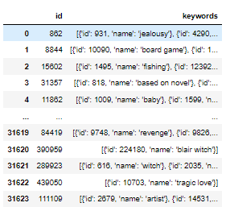
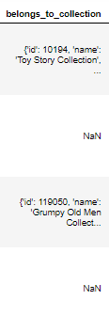
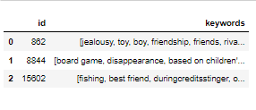
Major challenges
1. The basic data cleaning and joining of the records, most of the important features was in the form of list of dictionaries in separate files and extracting the relevant information from multiple data sources. 1.Genre: 2.Collection: 3.Keywords:

Slide 7
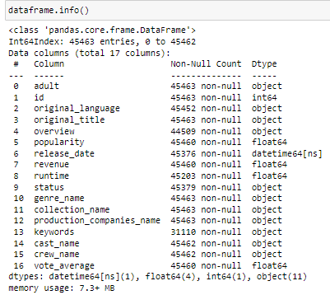
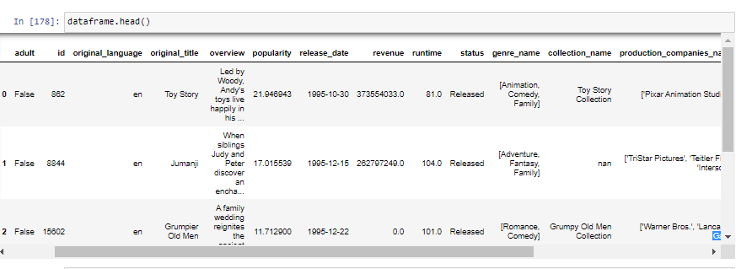
2.Joining data and establishing and relationships and bringing multiple data as one usable data source.

Slide 8
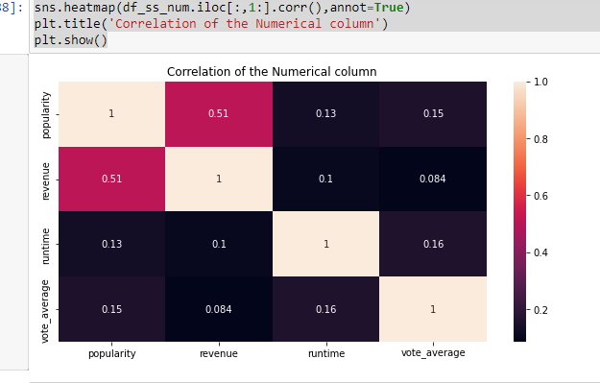
Correlation of the numerical columns

Slide 9
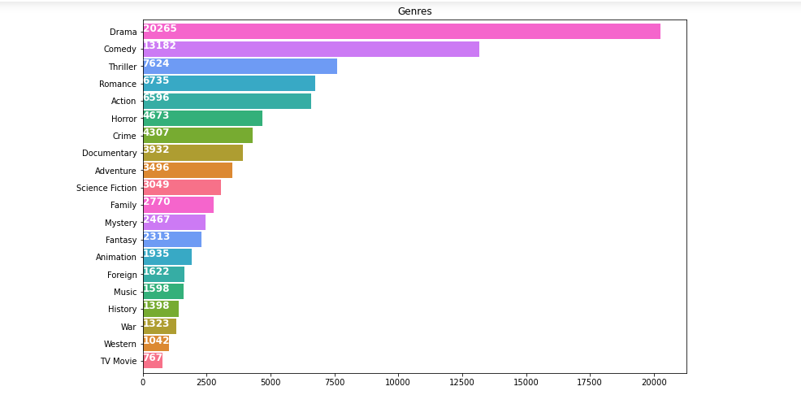
Count of genre wise movies

Slide 10
Algorithms
Collaborative filtering-based: Collaborative filtering-based recommender systems solely rely on past interactions between users and movies in order to suggest new movies. Similar users are groups, and all their interactions are considered when making recommendations to the target user.
Content-based filtering: Content-based filtering in recommender systems leverages machine learning algorithms to predict and recommend new but similar movies to the user. Recommending movies based on their characteristics is only possible if there is a clear set of features for the movies and a list of the user’s choices.
Term Frequency Inverse Document Frequency (TFIDF) : What Is TF-IDF? TF-IDF, or term frequency-inverse document frequency, is a figure that expresses the statistical importance of any given word to the document collection as a whole

Slide 11
Result
After apply all the algorithm got the RMSE value for all the model.
For Hybrid RMSE was 0.6 (based on rating).
For Collaborative filtering RMSE was 0.9 (based on rating)
For KNN RMSE was 1.083 (based on voting average).
After comparing all the models, We found the KNN was giving the most
accurate results based on genre of the movie.
Although RMSE for KNN does not give much information. So, we consider the recommendation provided by KNN instead of focusing on RMSE value.
Based on RSME value, Collaborative filtering performed better than other models.

Slide 12
Conclusions

Slide 13
THANK YOU
ABHINAV ANAND
DEEKKSHITHA A.G
LAKSHMI PRIYA A
MAHATHEVAN S J
PRIYANKA S

