Slide 1

CS465- DISTRIBUTED DATABASE SYSTEMS PROJECT TITLE: “ HOTEL MANAGEMENT SYSTEM ”
PRESENTED BY:
JAYA RAGHA CHARAN - 201CS117
V. SAI SWAROOP - 201CS264
BADAVATH AKSHITHA – 201CS213
PAMPATI ABHINAV SAI – 201CS137
BK ESWAR TEJA – 201CS211

Slide 2
INTRODUCTION
Welcome to the Hotel Management System presentation. Our system leverages cutting-edge technologies such as Spring Cloud, Eureka, Keycloak, MongoDB, MySQL, Resilience4J, Kafka, and Docker to deliver a robust and scalable solution. With a microservices architecture including Booking Service, Hotel Booking Service, Inventory Service, Authentication Service, Discovery Server, and Notification Server, we ensure seamless booking experiences, efficient inventory management, and secure authentication processes. Let's dive into the details of how our system revolutionizes hotel management.

Slide 3
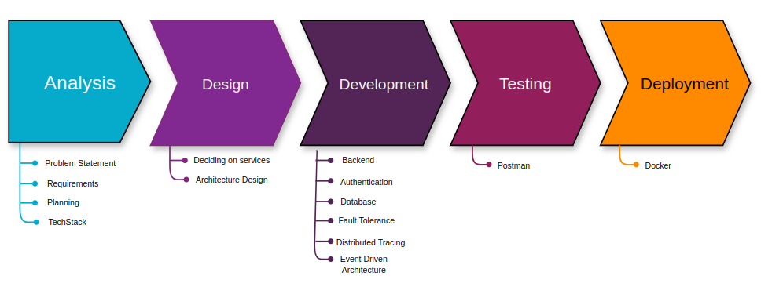
Methodology

Slide 4
Overview of Technologies used:
Spring Cloud, Eureka for backend development
Keycloak for authentication and authorization
MongoDB and MySql for data storage
Resilience4J for fault tolerance
Kafka for event driven architecture
Postman for testing
Docker for containerisation

Slide 5
SYSTEM OVERVIEW
Microservices Architecture:
The Hotel Management System adopts a modular microservices architecture, facilitating independent development and scalability of its components. This strategy increases adaptability and robustness within the system.
Microservices Roles:
Booking Service
Hotel Booking Service
Inventory Service
Authentication Service
Discovery Server
Notification Server

Slide 6
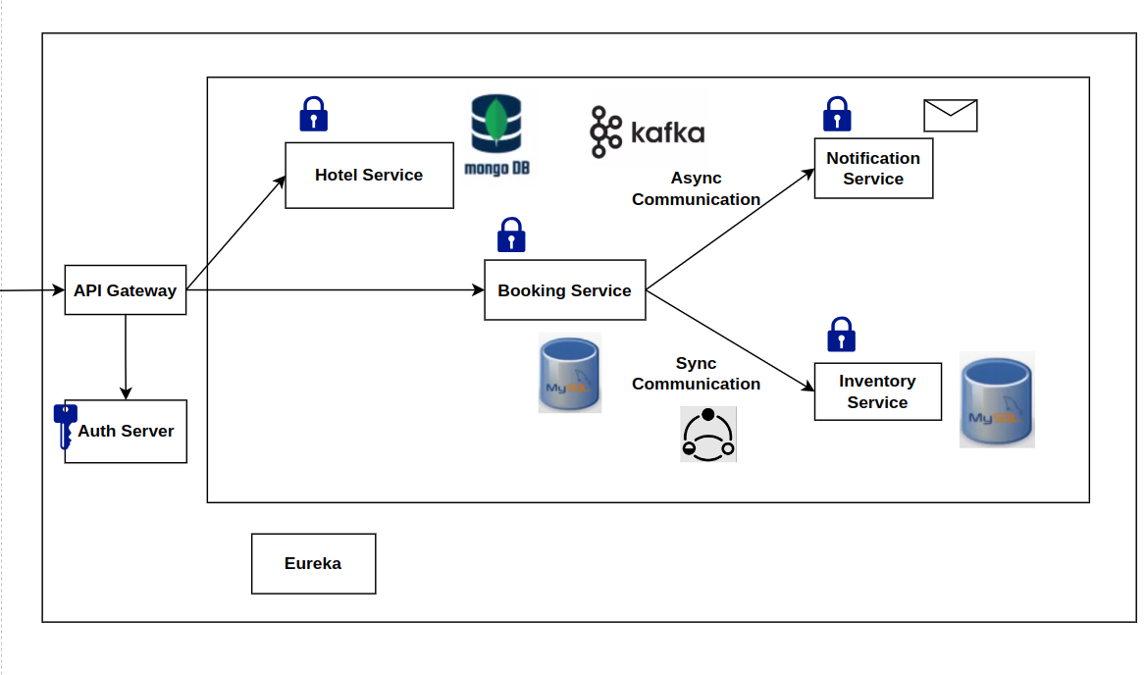
System Microservices Architecture

Slide 7
SYSTEM OVERVIEW
Hotel - Booking: Allows the addition of new hotels to the system along with their pricing and descriptions.
Bookings service: Enables users to make and view bookings, providing a seamless experience for managing hotel reservations
Inventory Management: Real-time updates to inventory and reflect available rooms.
Discovery Server: Keeps track of available inventory services in a microservices architecture.
Notification Server: Notifies users when a booking is made.

Slide 8
Hotel Booking service (localhost:8080/api/hotel)
The Hotel Booking Microservice is a crucial component of our system that handles the addition of hotels to our database along with the pricing and description.
Creates a hotel-id after adding the hotel.
POST - Adds the hotels to the MongoDB database.
GET - Lists out all the hotels in the database

Slide 9
Bookings service (localhost:8080/api/bookings)
The Bookings service Microservice in our system helps us with making the booking along with the number of rooms required.
This makes a synchronous communication between bookings-service and inventory-service to check the availability of rooms in a particular hotel.
POST : Makes a booking with rooms, price.

Slide 10
Inventory Service: ( localhost:8080/api/inventory )
In this project, an inventory service plays a crucial role in managing the availability of rooms, handling bookings, and ensuring efficient inventory management.
When a user requests to book a room, the booking service communicates with the inventory service to check the availability of rooms in the specified hotel name in the sku-code..

Slide 11
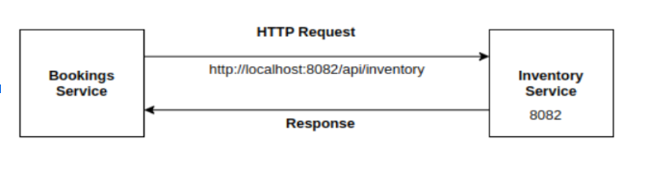
Inter Service Communication
Synchronous Communication.
Asynchronous Communication.

Slide 12
Discovery Service:
Developing a service discovery server is crucial for microservices to dynamically locate and communicate with services.
Utilizing Spring Cloud Netflix Eureka helps in avoiding hardcoded URLs and enables efficient communication between services.
This dynamic discovery allows for easier scaling, as new instances of services can be automatically registered with Eureka and discovered by other services.

Slide 13
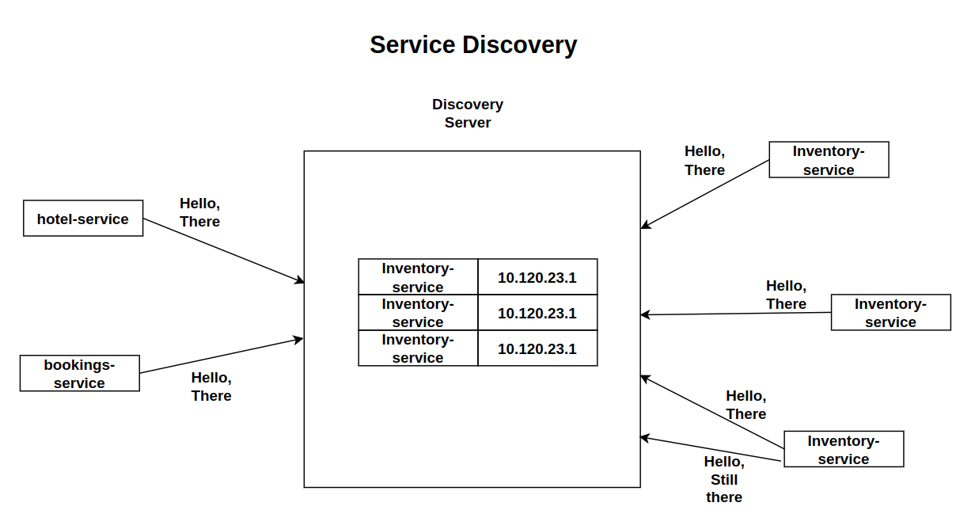
Functions of Discovery Server:
Service Registration: When a Spring Boot microservice application initializes, it contacts the Eureka server and provides information about itself, including its network location.
Load Balancing: When a service needs to communicate with another service that has multiple instances running, intercepts the request and distributes it among those instances.

Slide 14
API Gateway:
An API Gateway is a central entry point for managing, securing, and optimizing communication between clients and backend services or APIs.
It handles routing, load balancing, protocol translation, security, rate limiting, logging, and lifecycle management of APIs.
It simplifies access, enhances security, and improves performance in distributed systems.

Slide 15
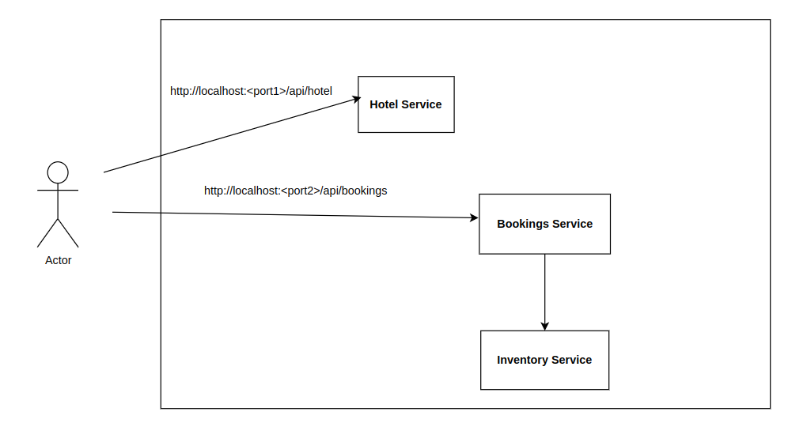
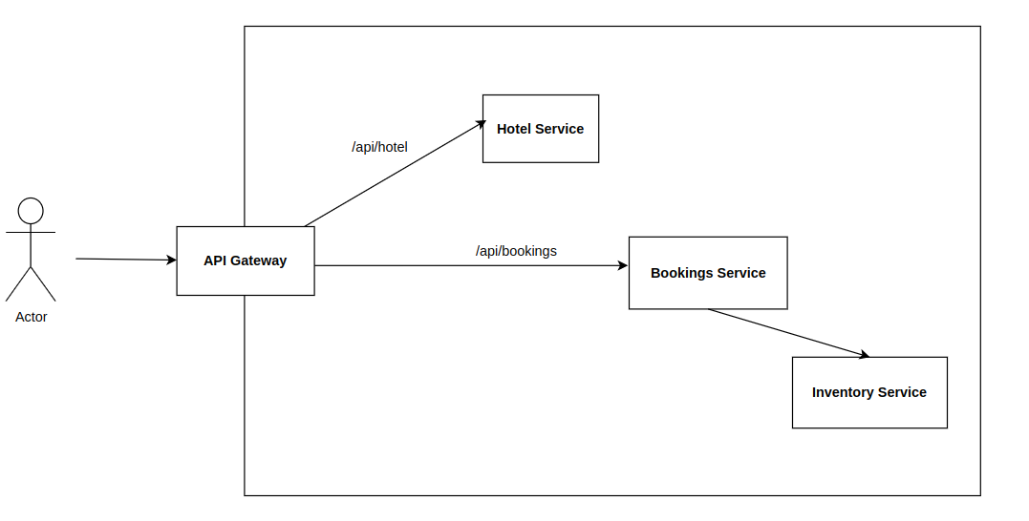
Monolithic Vs Microservice

Slide 16
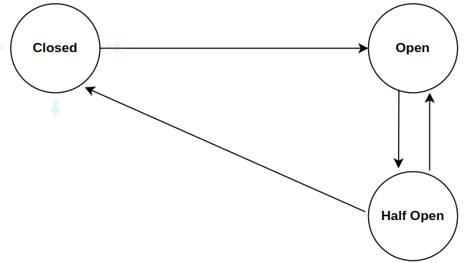
Fault Tolerance
Circuit Breaker:
States:
Closed: Allows all requests through to the microservice.
Open: Blocks requests to the microservice upon detecting failures, preventing further degradation.
Half Open: Permits a limited number of requests to test if the microservice has recovered; transitions based on success or failure.
FallBack
Timeout
Retry Property

Slide 17
Authentication
Authentication is the process of verifying the identity of users attempting to access a system, application, or service.
Authentication typically involves users providing credentials, such as usernames and passwords, which are then verified against stored credentials in a database or identity provider.
Keycloak is an open-source identity and access management solution that provides robust authentication capabilities
It offers various authentication methods, including username/password, social login (e.g., Google, Facebook), OAuth 2.0, OpenID Connect, and more.

Slide 18
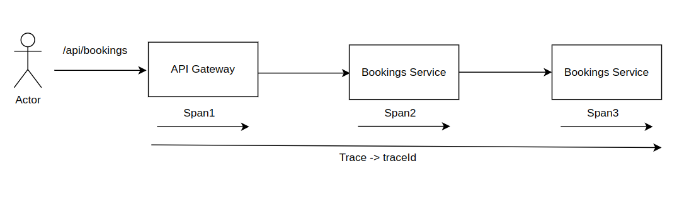
Distributed Tracing
Zipkin is an open-source distributed tracing system, it provides visibility into the latency and performance of distributed systems by tracing requests as they travel across various microservices

Slide 19
Event Driven Architecture - Notification Service
Event-driven architecture (EDA) facilitates communication between system components through events, allowing for loose coupling and asynchronous operation.
In EDA, components produce and consume events, triggering actions or processes
Kafka, a distributed streaming platform, is commonly used for asynchronous communication in EDA, enabling efficient handling of real-time data streams.
Notification service operates asynchronously, meaning it sends notifications independently without waiting for immediate responses.

