Slide 1
TAB-O-Ranger
Chrome Extension to arrange the various tabs on the basis of webpage content by using machine learning.
API used-MeaningCloud
Team-Illuminati

Slide 2
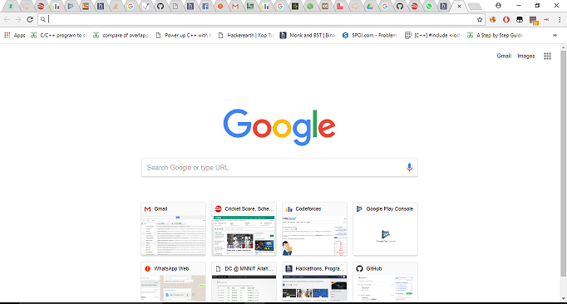
Need Of The Extension
When you have multiple tabs opened on the browser ,it becomes a headache to keep the track of the position of the webpages as shown in the image.

Slide 3

Hence, a possible solution is to group the webpages by one of the following criterias -
Sort the titles.
Sort according to URLs.
Group them according to the wepage content.
The first two are already implemented by various chrome extensions available on the chrome web store.
Now the role of Tab-0-Ranger comes if you want to order the groups by the third criteria.

Slide 4
Tasks performed by Tab-0-Ranger-
1) Classification of webpage’s content(titles) into the respective classes using standard domain respective taxonomies.
2) Preprocessing of text by removal of stop words, perform lemmatization and removal of non alphanumeric characters in order to evaluate how important is a word in a document.

Slide 5
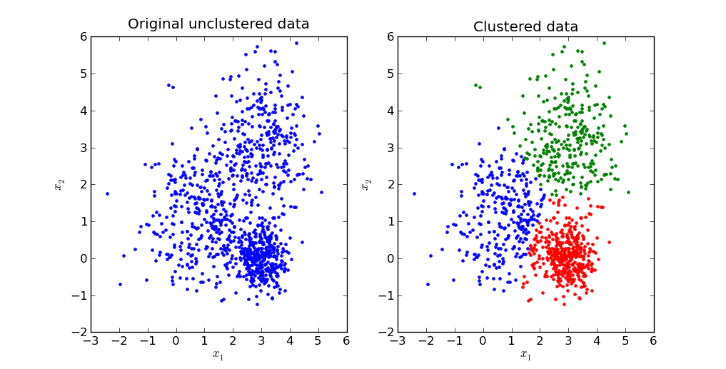
3) Clustering of keywords extracted from the webpage’s content (obtained from above 2 steps) in order to divide them in groups in decreasing order of the relevance score of the clusters.

Slide 6
Future Aspects
Right now, the groups can be done if the webpage content is in either of the 6 languages namely English ,Spanish ,French ,Italian , Portugese and Catalan . So in future , we will try to detect the webpage language and translate them into one of the above language and thus perform grouping.

Slide 7
Thank You

