Slide 1
Al-Powered Behavioral Anomaly Detection for Cybersecurity
Problem Statement ID – 3 Al-Powered Behavioral Anomaly Detection for Cybersecurity
Problem Statement Title- Al-Powered Behavioral Anomaly Detection for Cybersecurity
Theme- Aiml & Cybersecurity
PS Category- Software
Student Name: Venkata Abhinav Kumar Gupta Gunda
Student ID : 23BCE1037 gunda.abhinav26@gmail.com

Slide 2
Aegis AI — Two-Stage Behavioral Anomaly Detection & Threat Classification Architecture
1. Detailed Explanation of the Proposed Solution
Decoupled Two-Stage Machine Learning Pipeline:
  Stage 1 (Unsupervised Anomaly Detection): Combines Isolation Forest, PyTorch LSTM Autoencoder (sequence reconstruction MSE), Mahalanobis Z-Score Distance, and continuous Haversine Geo-Velocity Scaling into a unified 0-100 Risk Score without using ground-truth labels.
  Stage 2 (Supervised Threat Categorization): Uses an XGBoost Multi-Class Classifier trained on SMOTE-balanced attack vectors to categorize Stage-1 flagged anomalies into 7 distinct attack categories (Brute Force, Credential Stuffing, Lateral Movement, Low-and-Slow Exfiltration, Device Spoofing, Impossible Travel, Insider Drift).
Adaptive Baseline Management: Integrates a Cold-Start Peer Group Profiler for new entities and rolling 7d/30d baseline updates with an interactive SOC analyst feedback loop (POST /api/feedback).
2. How It Addresses the Problem
Eliminates Signature Vulnerability: Models dynamic access telemetry over time across 45 causal feature dimensions rather than relying on static IP blacklists or hash signatures.
Resilient to Extreme Class Imbalance: Keeps Stage-1 training natural on ~98% normal streams; applies SMOTE oversampling only to Stage-2 training attack vectors.
Low False Alarm Rate: Achieves a 2.45% False Positive Rate (FPR) on held-out test events, fitting comfortably within realistic SOC analyst alert budgets.
3. Innovation and Uniqueness
Continuous Physical Geo-Velocity Model : Physically bounds movement velocity using continuous Haversine distance equations.
Zero Data Leakage Architecture: Enforces 0% entity overlap between Train, Validation, and Test splits.
Explainable AI (XAI) Diagnosis Cards: Generates dynamic threat definitions, root-cause bullet points, and percentage feature attributions for SOC analysts.

Slide 3
Technical Architecture & Implementation Methodology
1. Technologies Used
Programming Languages & AI/ML Frameworks: Python 3.10+, PyTorch 2.0+ (LSTM Autoencoder), XGBoost 2.0+ (Gradient Boosted Trees), Scikit-Learn 1.4+ (IsolationForest, StandardScaler).
Data Processing & Oversampling: Imbalanced-Learn (SMOTE), Pandas, NumPy, Faker (Synthetic Telemetry Generator).
Web Application & Streaming API: Python http.server (Native REST API Server), HTML5/CSS3/Vanilla JS (SOC Analyst Dashboard).
Model Serialization & Testing: Joblib, PyTorch .pth, JSON Metadata, Pytest (8/8 Unit Tests Passed).
2. Methodology & Implementation Process
Synthetic Telemetry Generation: Built 28,257 events across 165 entities using enterprise access log schemas (entity_id, timestamp, geo_location, resource_accessed, auth_method, device_fingerprint).
Causal Feature Engineering: Extracted 45 temporal, geographic, failure burst, fingerprint shift, resource edge, exfiltration volume, and drift features.
Decoupled Two-Stage Model Fitting: Fitted scaler, IsolationForest, PyTorch LSTM, calibrated Stage-1 threshold (T = 32.0), and trained XGBoost; serialized frozen artifacts to models/.
Frozen Evaluation: Conducted pure inference on held-out test split (26 test entities, 4,481 logs, 0% entity overlap).

Slide 4
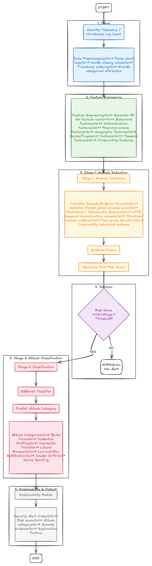
Technical Architecture & Implementation Methodology
Step 1: Read the Data (Input)
  The system receives user login data (login time, IP address, city, device type, password success/failure).
  It cleans and prepares the data.
Step 2: Calculate Key Clues (Features)
  It calculates 45 numbers, such as: how fast the user moved, how many passwords failed, if the device changed, or if a secret file was opened.
Step 3: Check for Anything Strange (Stage-1 Anomaly Detection)
  AI models (Isolation Forest + LSTM) compare this login to normal user behavior.
  It creates a Risk Score from 0 to 100.
Step 4: Is the Risk High? (Decision)
  No (Risk < 32) It is Normal. No alert is created.
  Yes (Risk > 32) It is Suspicious! Pass to Step 5.
Step 5: Identify the Attack Type (Stage-2 Classification)
  An XGBoost AI model determines which exact attack it looks like:
    Brute Force (many wrong passwords)
    Impossible Travel (login from 2 far cities in 20 minutes)
    Device Spoofing (fake device ID)
    Lateral Movement (trying to access secret admin files)
Step 6: Explain Why & Show Alert (Dashboard Output)
  The system sends an alert to the Security Analyst Dashboard.
  It tells the analyst the risk score, the attack type, and the exact reason why

Slide 5
FEASIBILITY AND VIABILITY
1. Analysis of Feasibility & Viability
High Computational Efficiency: Decoupled Stage-1/Stage-2 architecture filters ~98% of benign traffic using fast tree and matrix operations, invoking heavy XGBoost classification only on flagged anomalies (~2% of traffic).
Low Operational Overhead: 2.45% False Positive Rate prevents analyst alert fatigue.
Real-Time Integration Feasibility: Native HTTP REST API (http://localhost:5000/api/evaluate_single) enables seamless streaming integration into existing SIEM platforms (Splunk, Microsoft Sentinel).
2. Potential Challenges & Risks
Cold-Start False Positives: Brand-new users/devices lacking historical baselines triggering false alarms.
Concept Drift: Evolving employee work schedules or legitimate role changes causing false risk inflation.
Class Imbalance Bias: Rare attack categories being underrepresented during training.
3. Strategies for Overcoming Challenges
Peer Group Baseline Profiling: ColdStartEngine evaluates new entities against population peer distributions rather than penalizing missing history.
Rolling Baseline Window & Feedback Loop: Rolling 7d/30d windows and analyst feedback API (POST /api/feedback) dynamically adjust drift boundaries.
Stage-2 Targeted SMOTE: Synthetic oversampling balances rare attack categories without distorting natural Stage-1 baseline streams.

Slide 6
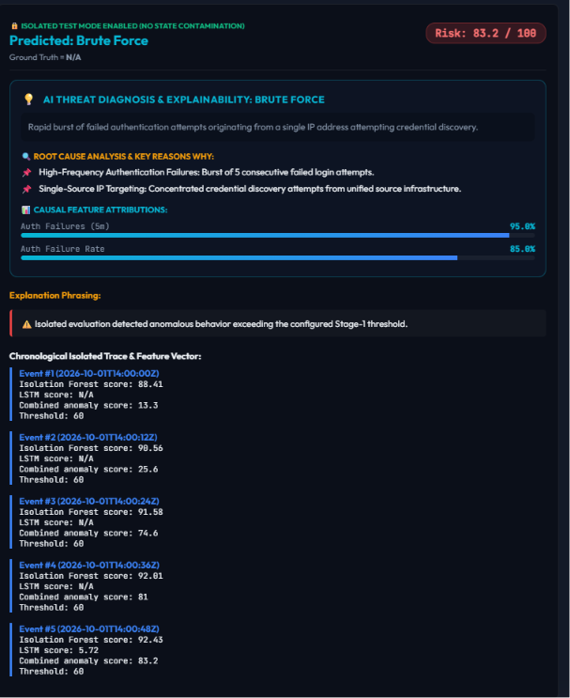
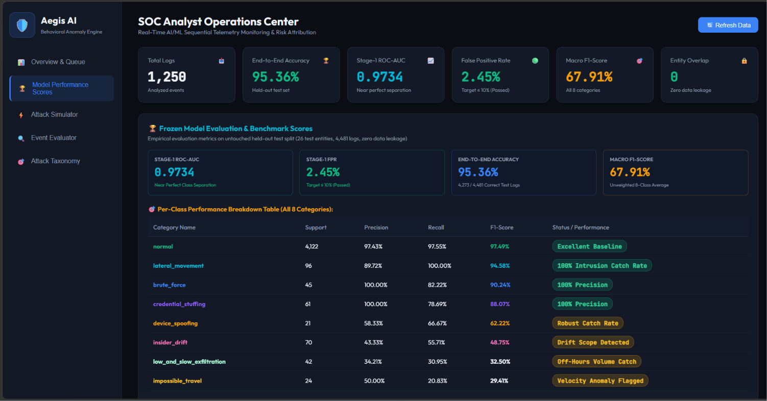
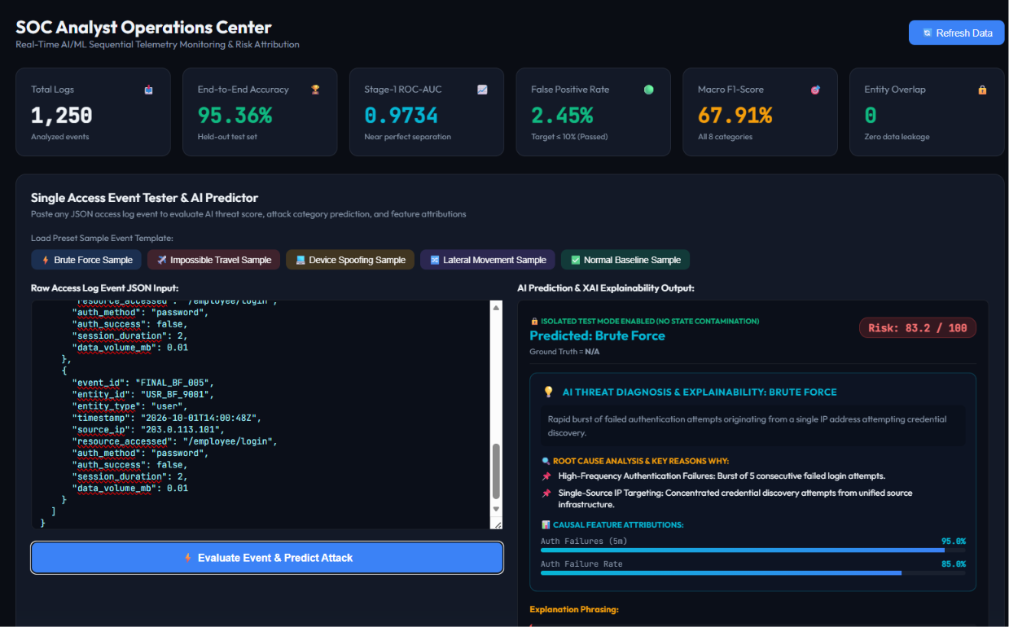
ARTIFACTS

