Slide 1

Dictionaries

Slide 2
Dictionaries
A dictionary is like a list, but more general. In a list, the index positions have to be integers; in a dictionary, the indices can be (almost) any type.
Dictionaries are like bag - no order.
purse = dict()
purse['money'] = 12
purse['candy'] = 3
purse['tissue'] = 75
print(purse)
{'money': 12, 'candy': 3, 'tissue': 75}
print(purse['candy'])
3
purse['candy'] += 2
print(purse)
{'money': 12, 'candy': 5, 'tissue': 75}
Prog44.py

Slide 3
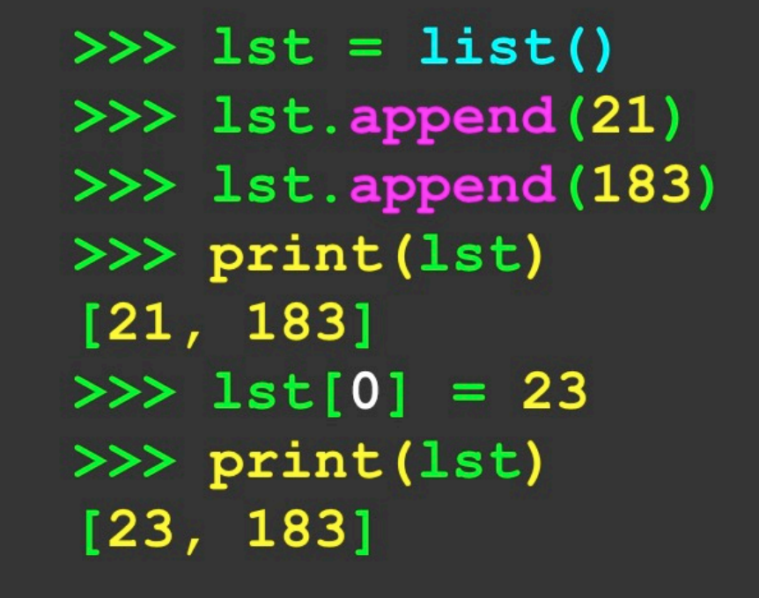
Comparing Lists and Dictionaries
Dictionaries are like lists except that they use keys instead of numbers to look up values
purse = dict()
purse['money'] = 12
purse['candy'] = 3
purse['tissue'] = 75
print(purse)
{'money': 12, 'candy': 3, 'tissue': 75}
print(purse['candy'])
3
purse['candy'] += 2
print(purse)
{'money': 12, 'candy': 5, 'tissue': 75}
Prog44.py
Type to enter a caption.

Slide 4
Dictionary Literals (Constants)
Dictionary literals use curly braces and have a list of key:value pairs.
You can make an empty dictionary using empty curly braces.
>>>d = {‘icecream’ : 5 , ‘chocolates’ : 8 , ‘chips’ : 10}
>>>print(d)
{‘icecream’ : 5 , ‘chocolates’ : 8 , ‘chips’ : 10}
>>>emp = {}
>>>print(emp)
{}

Slide 5
Counting names using Dictionaries
When we encounter a new name, we ned to add a new entry in the dictionary and if this the second or later time we have seen the name, we simply add one to the count in the dictionary under that name.
counts = dict()
names = ['Abhinav', 'Ishkirat', 'Ishan', 'Abhinav', 'Ishan',]
for name in names:
if name not in counts:
counts[name] = 1
else:
counts[name] = counts[name] + 1
print(counts)
Output:
{'Abhinav': 2, 'Ishkirat': 1, 'Ishan': 2}
Prog45.py

Slide 6
Simplified Counting with get()
We can use get() and provide a default value of zero when the key is not yet in the dictionary - and then just add one.
counts = dict()
names = ['Abhinav', 'Ishkirat', 'Ishan', 'Abhinav', 'Ishan',]
for name in names:
counts[name] = counts.get(name,0) + 1
print(counts)
Output:
{'Abhinav': 2, 'Ishkirat': 1, 'Ishan': 2}
Prog46.py

Slide 7
Counting Pattern
counts = dict()
print('Enter a line of text: ')
line = input()
words = line.split()
print('Words: ', words)
for word in words:
counts[word] = counts.get(word,0) + 1
print(‘Counts',counts)
Lets try in VS Code
Prog47.py
The general pattern to count the words in a line of text is to split the line into words, then loop through the words and use a dictionary to track the count of each word independently.

Slide 8
Definite Loops and Dictionaries
Even though dictionaries are not stored in order, we can write a for loop that goes through all the entries in a dictionary - actually it goes through all of the keys in the dictionary and looks up the values.
counts = {'to': 3, 'count': 2, 'the': 4, 'words': 2, 'in': 1}
for key in counts:
print(key,counts[key])
Output:
to 3
count 2
the 4
words 2
in 1
Prog48.py

Slide 9
Retrieving lists of Keys and Values
>>> d = {'icecream':5 ,'chocolates':8 ,'chips':10}
>>> print(list(d))
['icecream', 'chocolates', 'chips']
>>> print(d.keys())
dict_keys(['icecream', 'chocolates', 'chips'])
>>> print(d.values())
dict_values([5, 8, 10])
>>> print(d.items())
dict_items([('icecream',5),('chocolates',8),('chips',10)])
You can get a list of keys, values, or items(both) from a dictionary.
What is a tuple? Coming soon…..

Slide 10
Two Iteration Variables
We loop through the key-value pairs in a dictionary using *two* iteration variables.
Each iteration, the first variable is the key and the second variable is the corresponding value for the key.
d = {'icecream':5, 'chocolates':8, 'chips':10}
for key,value in d.items():
print(key,value)
Output:
icecream 5
chocolates 8
chips 10

Slide 11
Please Like, Share and Subscribe to my
Youtube Channel

