Slide 1

LOOPS and ITERATION

Slide 2
Indefinite Loops
While loops are called "indefinite loops" because they keep going until a logical condition becomes False
The While loop are pretty easy to examine to see if they will terminate or if they will terminate or if they will be "infinite loops".

Slide 3
Definite Loops
Quite often we have a list of items – effectively a finite set of things.
We can write a loop to iterate over each of the items in a set using the Python for construct.
These loops are called "definite loops" because they execute an exact number of times.

Slide 4
While Loop
Computers are often used to automate repetitive tasks.
Repeating identical or similar tasks without making errors is something that computers do well and people do poorly. Because iteration is so common, Python provides several language features to make it easier.
One form of iteration in Python is the while statement. Here is a simple program that counts down from five and then says “Blastoff!”.
n = 0
while n < 5:
print(n)
n = n + 1
print('Blastoff!')
Prog10.py

Slide 5

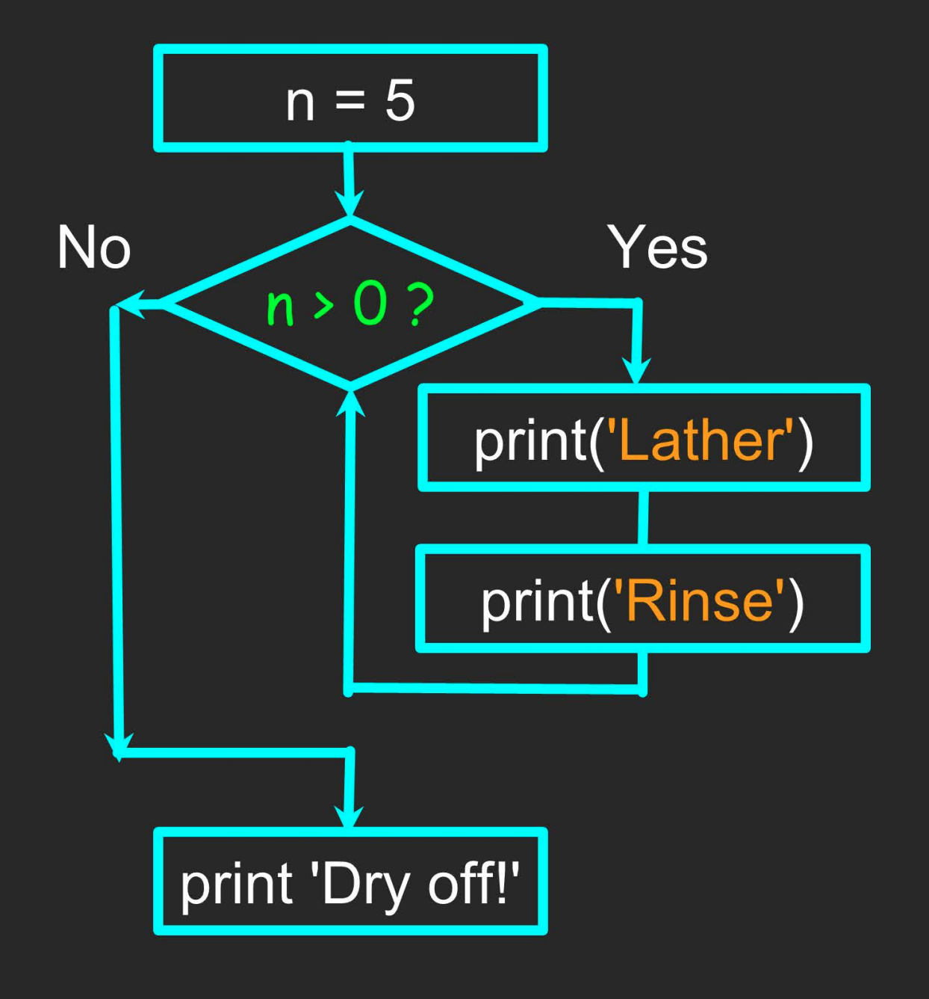
An Infinite Loop
n = 5
while n>0:
print('Lather')
print('Rinse')
print('Dry off!)
What is wrong in this. Type quickly in comment section.

Slide 6
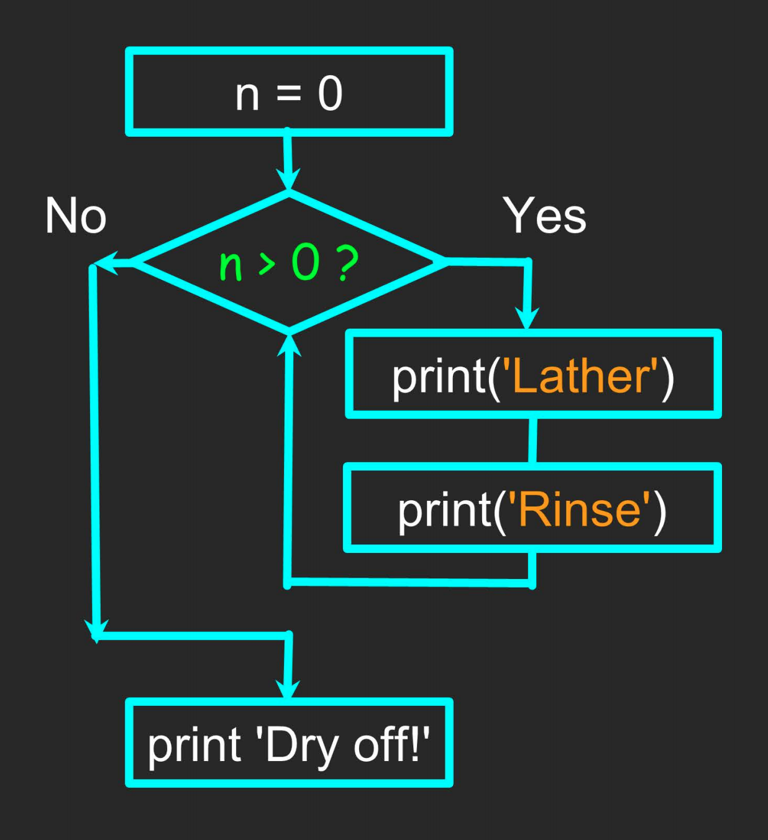
Another Loop
n = 0
while n>0:
print('Lather')
print('Rinse')
print('Dry off!)
What is wrong in this. Type quickly in comment section.

Slide 7
Breaking Out of a Loop
The break statement ends the current loop and jumps to the statement immediately following the loop.
It is like a loop test that can happen anywhere in the body of the loop.
while True:
line = input('> ')
if line == 'done':
break
print(line)
print('Done!')
Output:
> hello there
hello there
> finished
finished
> done
Done!

Slide 8
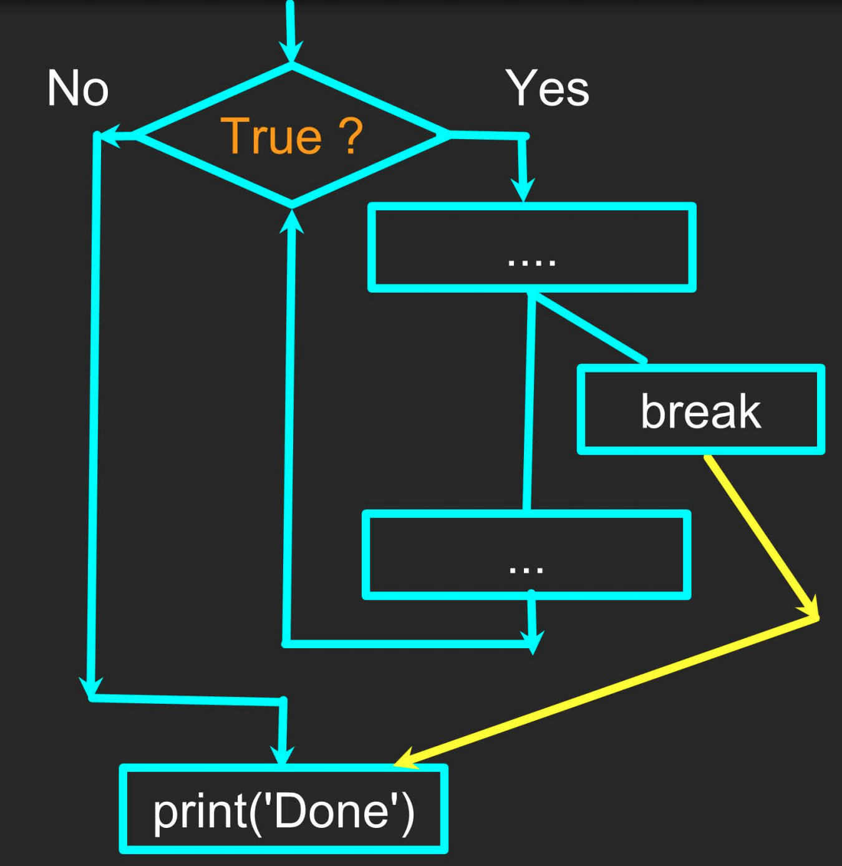

Slide 9
Finishing iterations with continue
The continue statement ends the current iteration and jumps to the top of the loop and starts the next iteration.
while True:
line = input('> ')
if line[0] == '#':
continue
if line == 'done':
break
print(line)
print('Done!')
> hello there
hello there
> # don't print this
> print this!
print this!
> done
Done!

Slide 11
Please Like, Share and Subscribe to my
Youtube Channel

