Slide 1

TRY / EXCEPT

Slide 2
The try / except Structure
You surround a dangerous section of code with try and except.
If the code in the try works-the except is skipped.
If the code in the try fails-it jumps to the except section

Slide 3
astr = 'Hello Bob'
try:
istr = int(astr)
except:
istr = -1
print('First',istr)
astr = '123'
try:
istr = int(astr)
except:
istr = -1
print('Second', istr)
Prog7

Slide 4
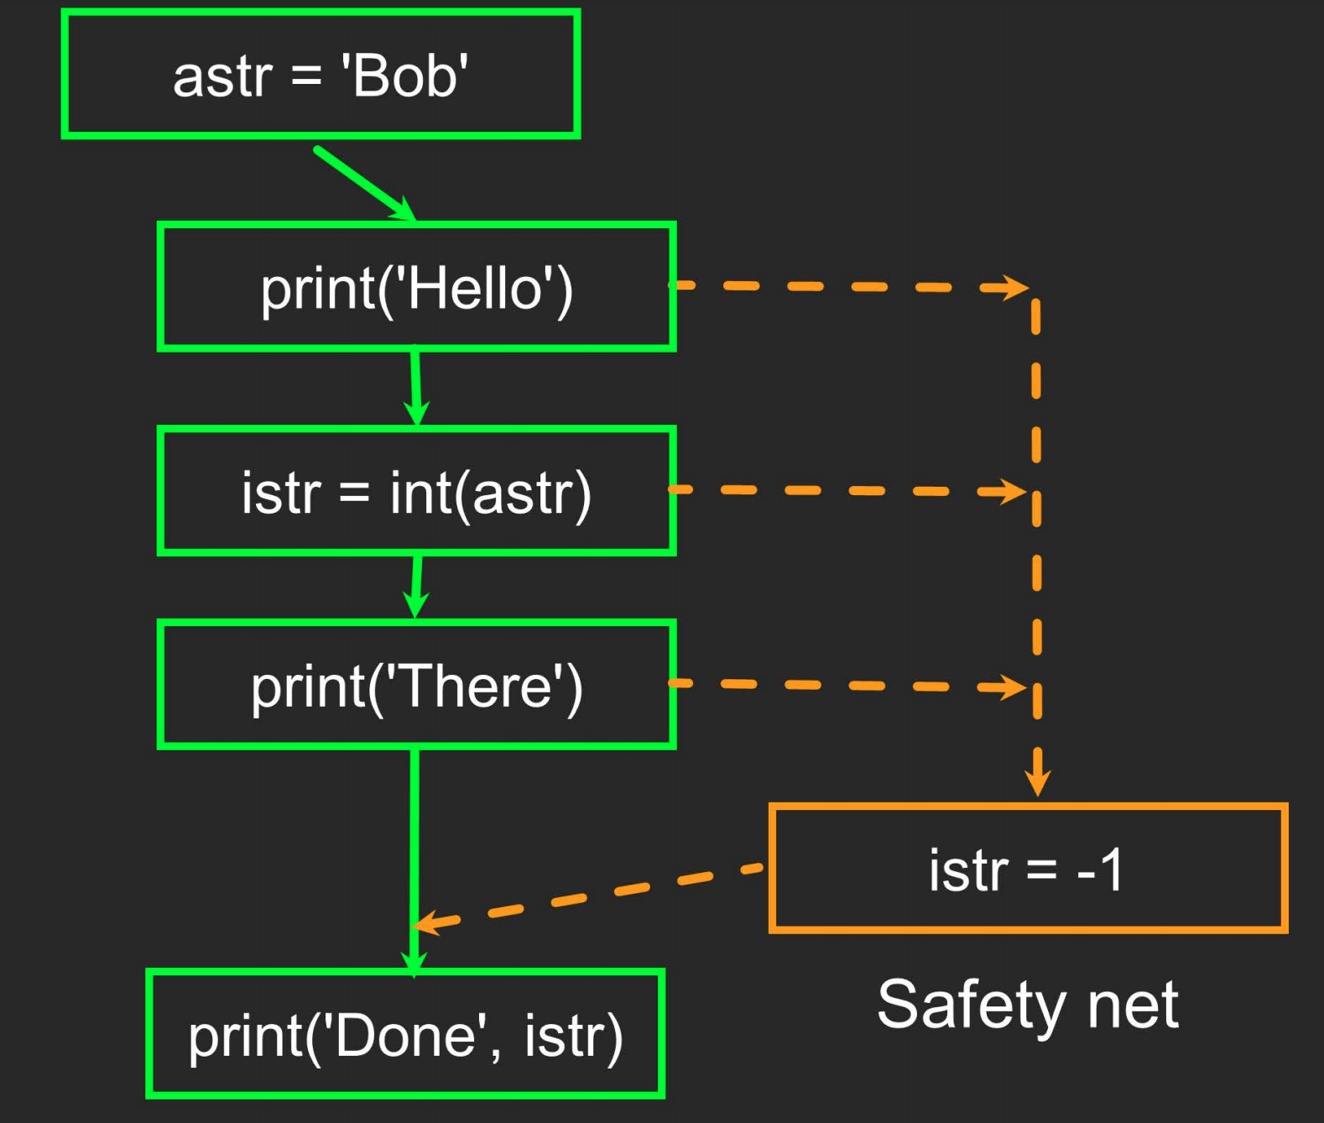
astr = 'Bob'
try:
print('Hello')
istr = int(astr)
print('There')
except:
istr = -1
print('Done', istr)

Slide 5
inp = input('Enter Fahrenheit Temperature:') try: fahr = float(inp) cel = (fahr - 32.0) * 5.0 / 9.0 print(cel) except: print('Please enter a number')

Slide 6
Please Like, Share and Subscribe to my Youtube Channel

