Slide 1
SLIDE 01 • EXECUTIVE OVERVIEW
AEGIS: The Financial Black Box for AI Agents
Deterministic Spending Governance, Multi-Rail Execution & Cryptographic Audit Provenance
THE CORE AXIOM: "NEVER ALLOW AN LLM TO APPROVE ITS OWN MONEY"
Autonomous AI agents are transitioning from assistants to economic actors executing procurement, server provisioning, SaaS renewals, and API capacity reservation. However, legacy payment gateways (Stripe, PayPal) assume human sessions with static cards. AEGIS separates non-deterministic agent intent from zero-trust financial execution.
100%
DETERMINISTIC CONTROL
Zero LLM Fund Authorizations
SHA-256
MERKLE PROVENANCE
Tamper-Evident Hash Chains
Orders v2
PAYPAL SANDBOX RAIL
Live Multi-Rail REST Execution
96.0 / 100
AUDIT MATURITY SCORE
354 Automated Suites Passing
Verified Live Production Credentials (Worldwide Access)
• Web Console (Next.js 16): https://aegis-staging.abhinavkumarsingh.tech/login • REST API / Docs: https://api-staging.abhinavkumarsingh.tech/docs
• Evaluator Login: chief-auditor-bf1ab00d@aegis-nexus.tech • Password: SuperSecurePassword123!@#
• Azure Ubuntu VM: 20.124.91.36 (Port 443 TLS) • Tenant UUID: 829db6b0-6566-4d6d-84e7-6fae90633723
• Managed Infrastructure: Neon Serverless PostgreSQL (Ohio v18.6) + Upstash Managed Redis (v8.4.0 TLS rediss://)
AEGIS PLATFORM • The Financial Black Box for AI Agents • Public Beta Candidate v1.0.0-rc1

Slide 2
SLIDE 02 • THREAT ANALYSIS & PROBLEM DEFINITION
Why Legacy Payment Rails Fail Autonomous AI Agents
5 Structural Vulnerabilities When Non-Deterministic LLMs Interface with Corporate Cards
1. Unbounded Spending Loops
2. Prompt Injection Exploits
Autonomous agents trapped in error-recovery, recursive retry, or search loops exhaust corporate credit limits in minutes without human intervention.
Adversarial inputs on merchant websites or indirect prompt injection manipulate LLM reasoning into authorizing fraudulent, unauthorized, or inflated spend.
3. Concurrency & Double-Spend Races
4. Zero Audit Provenance
Asynchronous swarm agents executing simultaneous checkouts bypass optimistic balance checks, driving ledgers into catastrophic negative balances.
Standard HTTP logs capture timestamps and IP addresses but cannot explain *why* an LLM executed a spend, making post-mortems impossible.
5. Automatic Chargeback Losses: Payment processors hold merchants and enterprises strictly liable. Without cryptographic proof connecting agent intent to fulfillment, chargebacks are lost automatically.
AEGIS PLATFORM • The Financial Black Box for AI Agents • Public Beta Candidate v1.0.0-rc1

Slide 3
SLIDE 03 • MARKET GAPS & DIFFERENTIATION
Architectural Comparison: AEGIS vs. Legacy Rails
Closing the Governance, Concurrency, and Forensic Gaps Across Industry Payment Systems
Dimension | Legacy Gateways (Stripe/PayPal) | Virtual Cards (Brex/Ramp) | AEGIS Platform
Spending Governance | None (Static card limit) | Static monthly spend cap | Multi-tier Passports & Dynamic Velocity Limits
Authorization Model | Card swipe releases funds | Basic merchant category code | Deterministic Policy Engine (Zero LLM Authorization)
Concurrency Control | Optimistic (Race vulnerable) | Gateway balance check | PostgreSQL Advisory Locks (pg_advisory_xact_lock)
Forensic Auditability | Plaintext HTTP server logs | Monthly statement CSV | SHA-256 Merkle Hash-Chained Event Ledger
Dispute Defense | Manual 14-day upload forms | Manual claim receipt review | Automated Contradiction Matrix with Telemetry Citations
Prompt Injection | N/A (Built for human UI) | None (Agent controls browser) | Strict XML Delimitation & Fail-Closed Rule Fallback
AEGIS PLATFORM • The Financial Black Box for AI Agents • Public Beta Candidate v1.0.0-rc1

Slide 4
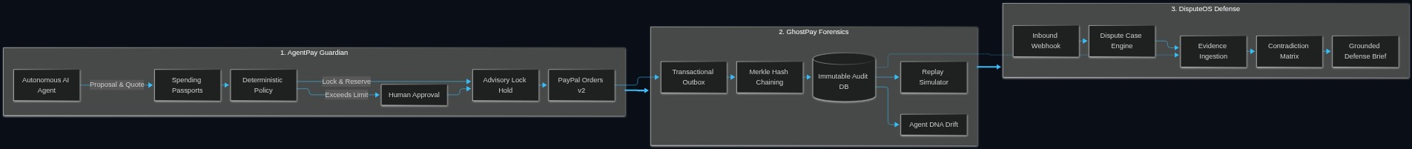
SLIDE 04 • SYSTEM TOPOLOGY & DECOMPOSITION
The Tri-Subsystem Model: Guardian, GhostPay & DisputeOS
Sovereign Subsystems Governing the Complete Autonomous Transaction Lifecycle
1. AgentPay Guardian
2. GhostPay Forensics
3. DisputeOS Engine
AUTONOMOUS GOVERNANCE
Deterministic passports, velocity caps, atomic budget reservations & PayPal Orders v2.
IMMUTABLE AUDIT LEDGER
SHA-256 Merkle hash chains, deterministic replay, counterfactual simulation & Agent DNA.
CHARGEBACK DEFENSE
Automated dispute case ingestion, evidence graphs, contradiction detection & grounded briefs.
Tri-Subsystem Topological Interaction Diagram
AEGIS PLATFORM • The Financial Black Box for AI Agents • Public Beta Candidate v1.0.0-rc1

Slide 5
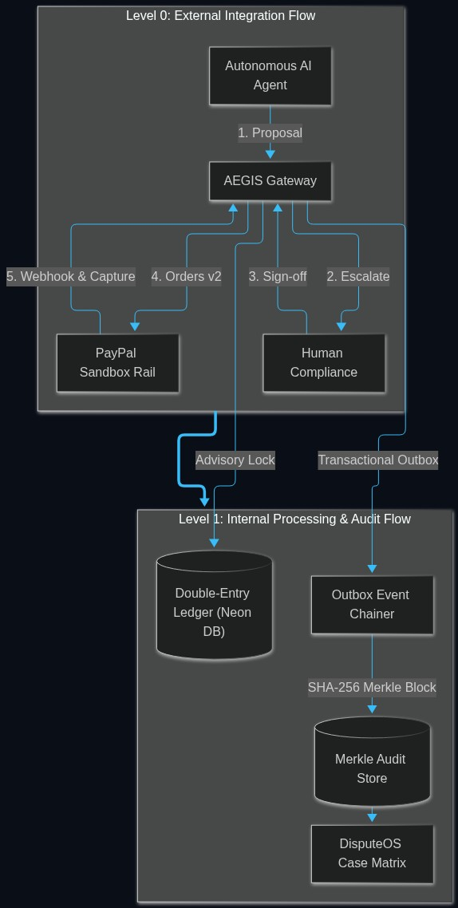
SLIDE 05 • DATA FLOW ARCHITECTURE
Level 0 Context & Level 1 System Data Flow
Complete Traceability from Agent Proposal Submission to Immutable Ledger Settlement
Data Flow Pipeline & Invariants
Decomposed Data Flow Diagram (DFD)
Level 0: External Context Flow
Agent submits proposal -> AEGIS evaluates bounds -> Escalate high-value to human -> Authorize capture at PayPal -> Append Merkle audit proof.
Level 1: Subsystem Ingestion
FastAPI router validates Pydantic v2 schemas and computes deterministic quote hash.
Level 1: Concurrency Isolation
Advisory lock acquired on passport UUID (pg_advisory_xact_lock), preventing double-spending.
Level 1: Transactional Outbox
Financial mutations and event dispatches commit in the same ACID transaction, guaranteeing exactly-once delivery.
AEGIS PLATFORM • The Financial Black Box for AI Agents • Public Beta Candidate v1.0.0-rc1

Slide 6
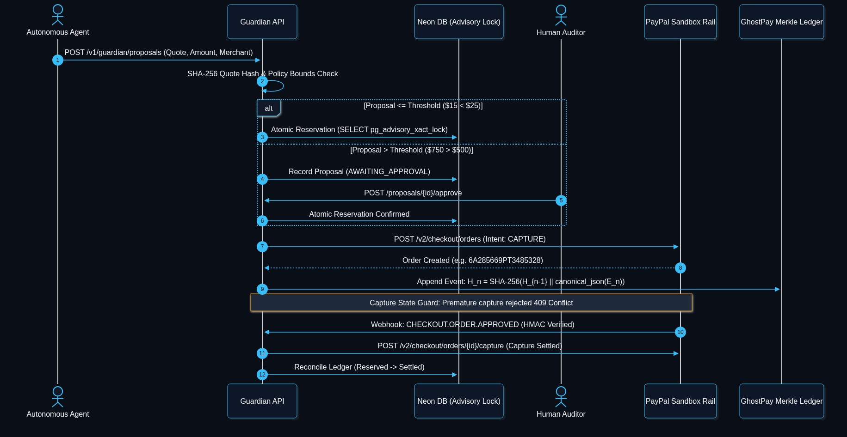
SLIDE 06 • PROTOCOL EXECUTION SEQUENCE
End-to-End Autonomous Transaction Sequence
Proposal Validation, Advisory Locking, PayPal Order Creation, Premature Capture Guard & Settlement
Protocol Sequence Overview
1. Proposal & Quote Normalization -> 2. Invariant & Policy Verification -> 3. Human Escalation Gate -> 4. Advisory Lock & Budget Hold -> 5. PayPal Orders v2 Dispatch (409 Capture Guard) -> 6. HMAC Webhook & Merkle Settlement.
Complete Protocol Sequence Diagram (Rendered)
AEGIS PLATFORM • The Financial Black Box for AI Agents • Public Beta Candidate v1.0.0-rc1

Slide 7
SLIDE 07 • MATHEMATICAL & DISTRIBUTED INVARIANTS
Mathematical Invariants & Distributed State Guarantees
Eliminating Non-Determinism, Race Conditions, and Data Loss in Agentic Finance
1. Serializable Concurrency Isolation
2. Two-Phase Budget Reservation
• SQL: SELECT pg_advisory_xact_lock(hashtext(:passport_id));
• Eliminates race conditions across distributed microservices.
• 18 automated multithreaded test suites verify zero double-spend.
• Row-level lock released automatically upon transaction commit.
• Formula: Available = Budget - (Settled + Reserved)
• Budget is atomically reserved BEFORE external API dispatch.
• Rolls back cleanly without balance leakage if upstream order expires.
• Guarantees active agent swarms never drive balances negative.
3. Cryptographic Quote Normalization
4. Transactional Outbox Pattern
• Formula: H_quote = SHA-256(canonical_json(quote_items))
• Ensures quote evaluated by policy is bit-for-bit identical to checkout.
• Protects against price drift, hidden fees, and payload tampering.
• Serialized using sorted keys and IEEE-754 decimal precision.
• State mutation and event dispatch commit in the SAME transaction.
• Background worker polls outbox with exponential backoff.
• Guarantees exactly-once event delivery to Merkle ledger.
• Eliminates dual-write inconsistencies between Postgres and Redis.
AEGIS PLATFORM • The Financial Black Box for AI Agents • Public Beta Candidate v1.0.0-rc1

Slide 8
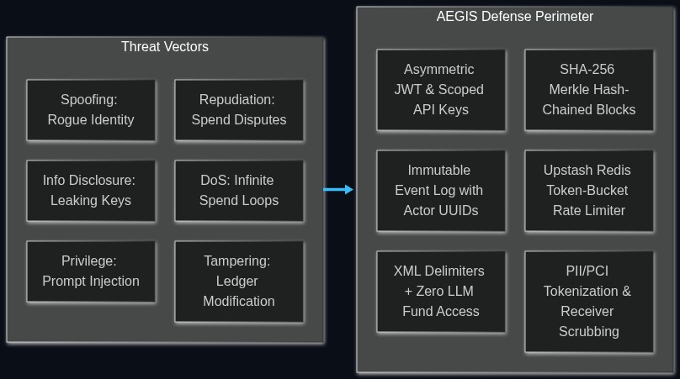
SLIDE 08 • SECURITY ARCHITECTURE & STRIDE MODEL
Enterprise Security Architecture & STRIDE Threat Analysis
Hardened Defense-in-Depth Against Adversarial Agent Prompts and Financial Exploits
Defense-in-Depth & Prompt Isolation
STRIDE Threat Model & Defense Perimeter
Spoofing & Tampering Defense
Asymmetric JWT / API Keys with tenant_id row isolation. SHA-256 Merkle hash-chaining prevents historical modification.
Denial of Service Mitigation
Upstash Redis token-bucket rate limiter per agent UUID and client IP.
Prompt Injection Isolation
External strings stripped of control tokens (<|endoftext|>, [INST]) and enclosed inside <untrusted_input trust="UNTRUSTED_DATA"> with angle brackets escaped.
Zero LLM Execution Authority
LLMs generate summaries but CANNOT approve budgets or release funds.
Fail-Closed Quota Guard
If upstream LLM returns HTTP 429 quota exhaustion, DisputeOS immediately degrades to deterministic-rules-v1.
AEGIS PLATFORM • The Financial Black Box for AI Agents • Public Beta Candidate v1.0.0-rc1

Slide 9
SLIDE 09 • FORENSIC RELIABILITY & REPLAY
GhostPay: Deterministic Replay & Counterfactual Simulation
Reconstructing Agent Execution Timelines with Mathematical Verifiability
1. Merkle Hash-Chained Ledger
2. Deterministic Replay Simulator
Every state mutation computes: H_n = SHA-256(H_{n-1} || canonical_json(E_n)). Bitwise alterations break chain integrity instantly, exposing unauthorized writes.
Re-executes historical agent inputs, policy constraints, and quote hashes to mathematically prove that past decisions strictly complied with governance policies.
3. Counterfactual Policy Simulator
4. Agent DNA Behavioral Profiling
Reruns past agent transactions against *new* hypothetical policies (e.g., testing a $750 GPU charge against a $500 cap) to proactively calibrate risk thresholds.
Continuously tracks spending velocity, merchant categorization, and invocation timeframes, automatically alerting on anomalous drift and credential compromise.
Verified Live Proof: Investigation 4cce42a3-881d-43d7-aae5-3f32537c97eb confirmed status VALID across 5 sequential event blocks (PROPOSAL_SUBMITTED -> POLICY_EVALUATED -> BUDGET_RESERVED -> PAYPAL_ORDER_CREATED -> CAPTURE_COMPLETED).
AEGIS PLATFORM • The Financial Black Box for AI Agents • Public Beta Candidate v1.0.0-rc1

Slide 10
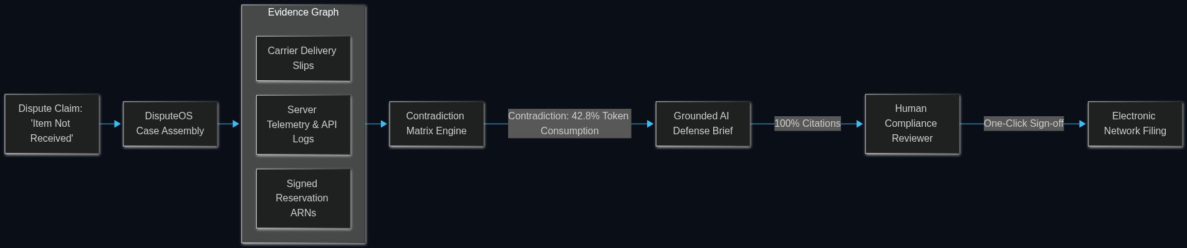
SLIDE 10 • DISPUTE RESOLUTION & CHARGEBACK DEFENSE
DisputeOS: Automated Evidence Graphs & Contradiction Defense
Eliminating Chargeback Losses via Multimodal Telemetry and Grounded Citations
Live Dispute Case Verification (Case b4502263)
• Buyer Claim: 'OpenAI 2.5M Token Batch Capacity quota was not provisioned in the workspace.'
• Ingested Evidence: openai_workspace_quota_telemetry.json (HTTP 200, allocated_tokens: 2,500,000, timestamp: 2026-11-12T10:14:22Z).
• Matrix Finding: DIRECT CONTRADICTION — Workspace telemetry confirms active allocation and 42.8% token consumption within 14 minutes of order settlement. Defense brief generated with 100% citation confidence.
DisputeOS Automated Defense Pipeline (Rendered Diagram)
AEGIS PLATFORM • The Financial Black Box for AI Agents • Public Beta Candidate v1.0.0-rc1

Slide 11
SLIDE 11 • OPERATIONAL MATURITY & COMMERCIAL ROADMAP
Measured Production Evidence & Commercial Roadmap
Rigorous Empirical Verification, Latency SLAs, and Enterprise Scaling Milestones
354 / 354
AUTOMATED TESTS
90%+ Statement Coverage
8 / 8
LIVE CLOUD SUITES
100% Staging Verification
< 45ms
POLICY LATENCY SLA
Strict P99 Response Time
0
CONCURRENCY DEADLOCKS
18 Multi-Thread Stress Runs
Live Staging Cloud Topology (Azure, Neon, Upstash, PayPal)
• Azure Ubuntu Staging VM (20.124.91.36): Nginx SSL reverse proxy, Docker Compose container stack.
• Neon Serverless PostgreSQL (Ohio v18.6): SSL connection pooler, SQLAlchemy 2.0 ORM, Alembic migrations.
• Upstash Managed Redis (v8.4.0 TLS rediss://): Token-bucket rate limiting, distributed caching, worker queues.
• PayPal Sandbox Orders v2: Real REST OAuth token rotation, order capture guards, fail-closed webhook security.
Strategic Commercial Roadmap (2027)
Q1 2027: Multi-Rail Expansion
Stripe Agentic & Virtual Card issuing integration; Adyen & Visa B2B connectors.
Q2 2027: Enterprise Compliance
SOC 2 Type II certification; ISO 27001 audit; Splunk / Datadog audit apps.
Q3 2027: Swarm Consensus
Multi-agent collaborative spending pools with threshold cryptographic keys.
Q4 2027: Sovereign Cloud
Enterprise On-Premises & Sovereign Cloud Helm Kubernetes packaging.
AEGIS PLATFORM • The Financial Black Box for AI Agents • Public Beta Candidate v1.0.0-rc1

